Slide 1
SecA2 and GroEL2 Western Blots

Slide 2
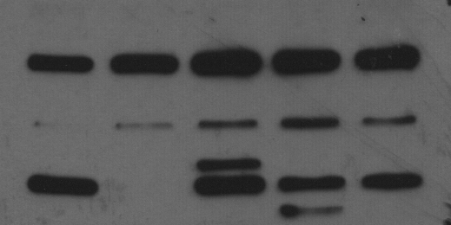
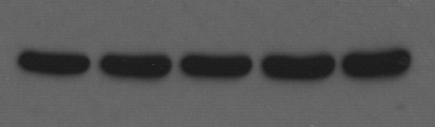
SecA2, FtsZ, and GroEL2_Rep. 1
Pellets from Feb. 2022 in vitro growth curve
250 kDa
150 kDa
α-SecA2
100 kDa
75 kDa
α-GroEL2
(Loading control)

Slide 3
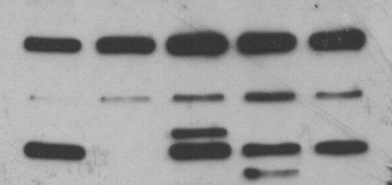
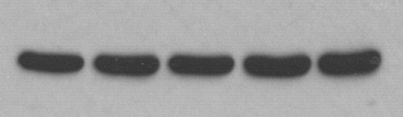
SecA2, FtsZ, and GroEL2_Rep. 1
Pellets from 23-25 Feb. 2022 in vitro growth curve
ΔsecA2/secA2_MM
ΔsecA2/secA2_MT
ΔesxBA
WT
ΔsecA2
For each, entire membrane the exposure was increased by 25% and brightness by 100%.
250 kDa
150 kDa
α-SecA2
100 kDa
75 kDa
α-GroEL2
(Loading control)
2 June 2022
From pellets 23 and 25 February 2022

Slide 4
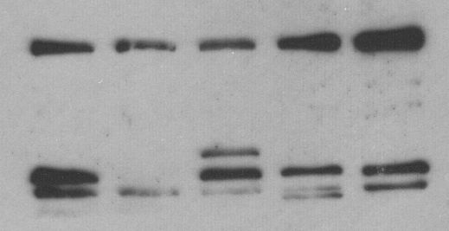
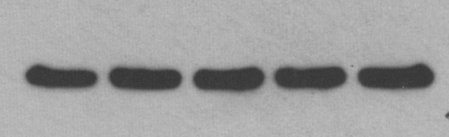
SecA2, FtsZ, and GroEL2_Rep. 2
Pellets from 16-18 March 2022 in vitro growth curve
ΔsecA2/secA2_MM
ΔsecA2/secA2_MT
ΔesxBA
WT
ΔsecA2
For each, entire membrane the exposure was increased by 25% and brightness by 100%.
250 kDa
150 kDa
α-SecA2
100 kDa
75 kDa
α-GroEL2
(Loading control)
6 June 2022
From pellets 16 and 18 March 2022

Slide 5
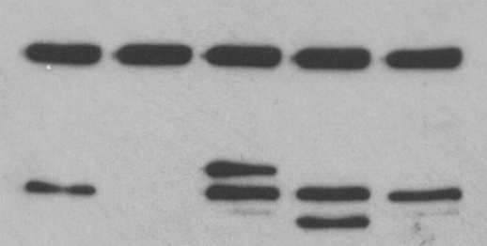
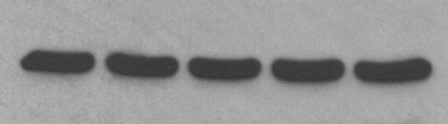
SecA2 and GroEL2 ONLY_Rep. 3
Pellets from 23-24 March 2022 in vitro growth curve
ΔsecA2/secA2_MM
ΔsecA2/secA2_MT
ΔesxBA
WT
ΔsecA2
For each, entire membrane the exposure was increased by 25% and brightness by 100%.
250 kDa
150 kDa
α-SecA2
100 kDa
75 kDa
α-GroEL2
(Loading control)
8 June 2022
From pellets 23 and 24 March 2022

Slide 6
Rig-I and MAVS Western Blots

Slide 7
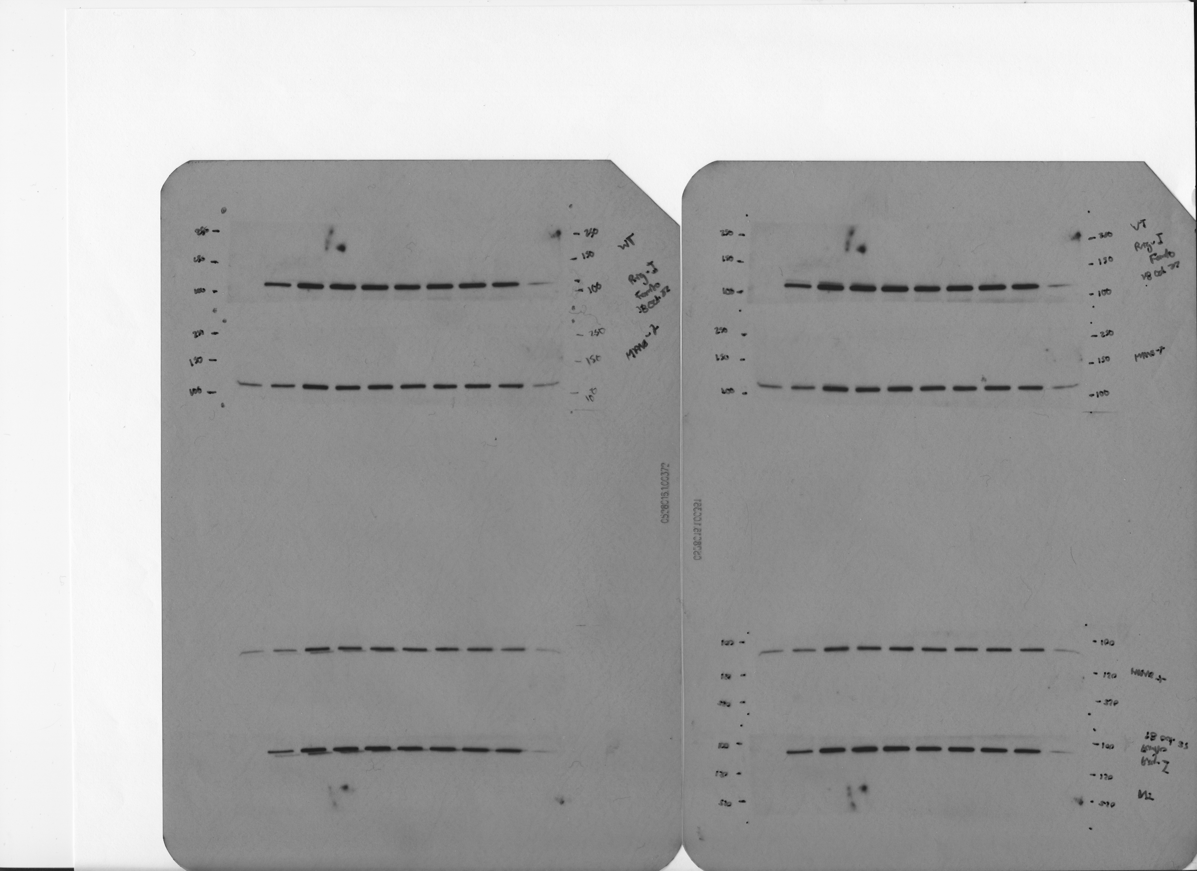
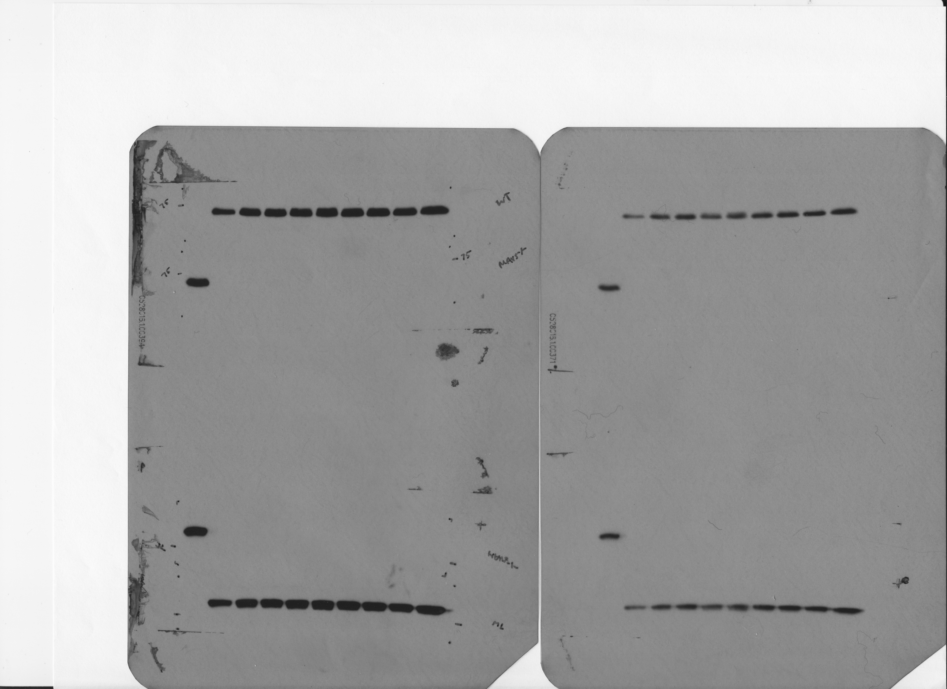
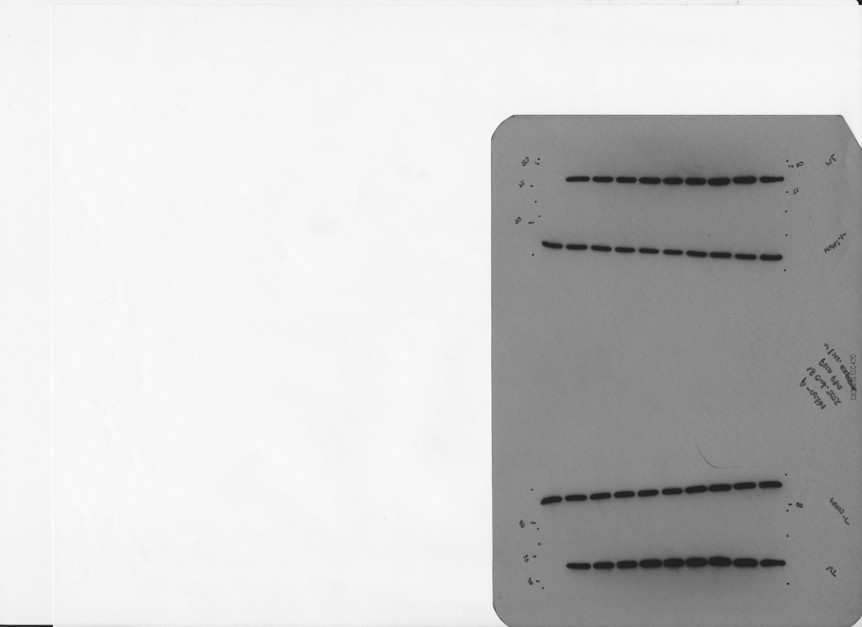
20 October 2022
WT BMDMs
WT BMDMs
MAVS^{-/-} BMDMs
Empty
Uninfected
WT
ΔsecA2_MOI1
ΔsecA2_MOI5
ΔsecA2_MOI10
ΔsecA2/psecA2MM
ΔsecA2/psecA2MT
ΔesxBA
WT-HK
Uninfected
Uninfected
WT
ΔsecA2_MOI1
ΔsecA2_MOI5
ΔsecA2_MOI10
ΔsecA2/psecA2MM
ΔsecA2/psecA2MT
ΔesxBA
WT-HK
250 kDa
α-Rig-I
250 kDa
150 kDa
150 kDa
α-Rig-I
100 kDa
100 kDa
75 kDa
α-MAVS
75 kDa
α-MAVS
50 kDa
α-β actin
50 kDa
α-β actin

Slide 8
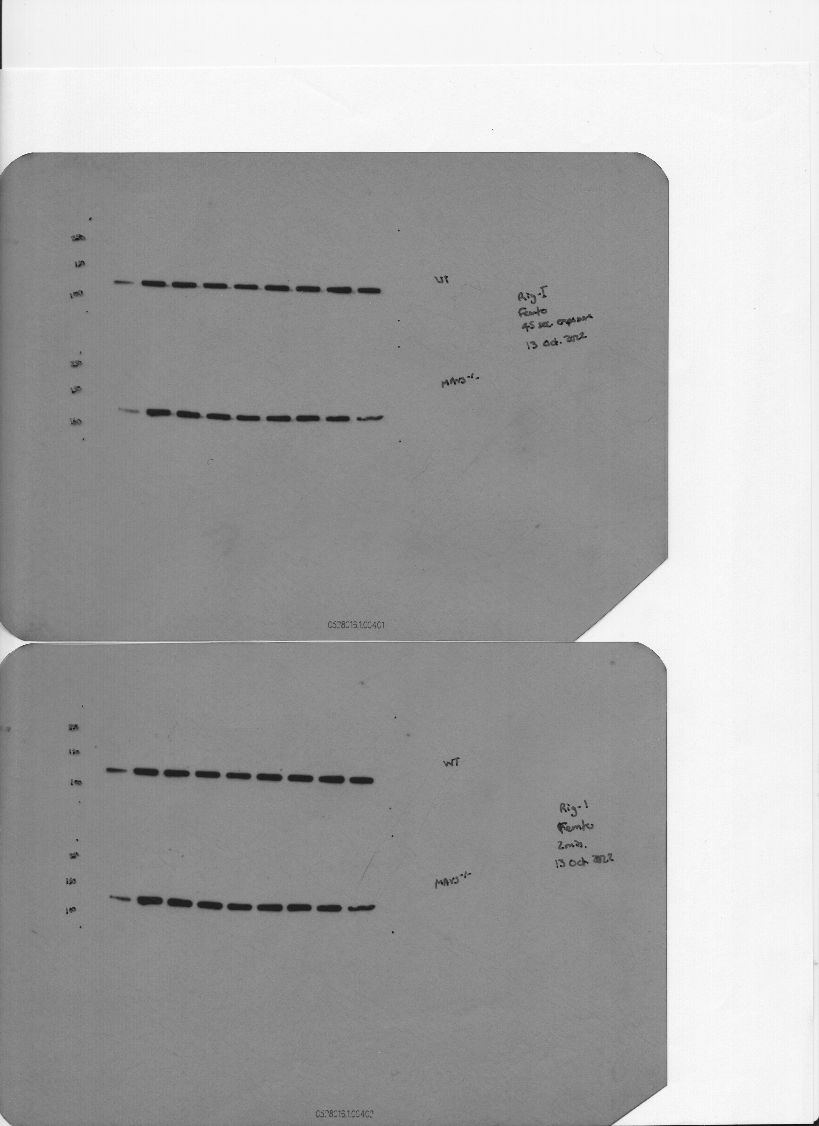
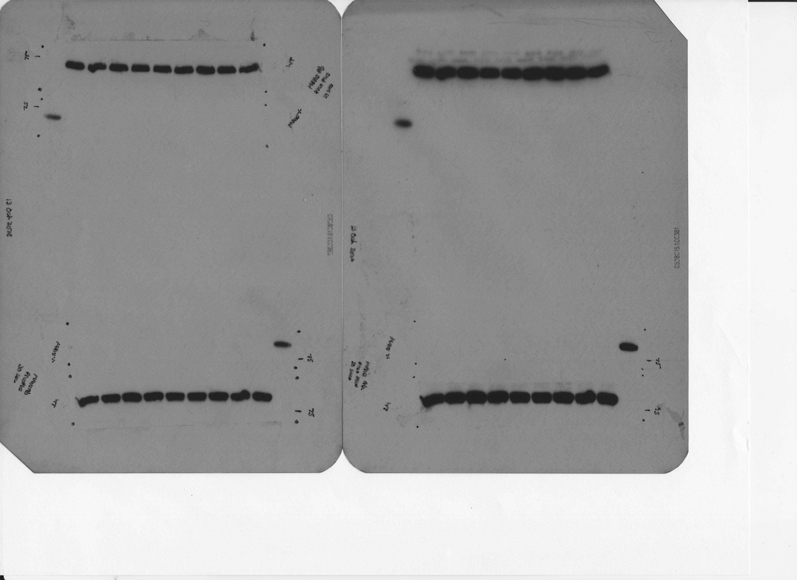
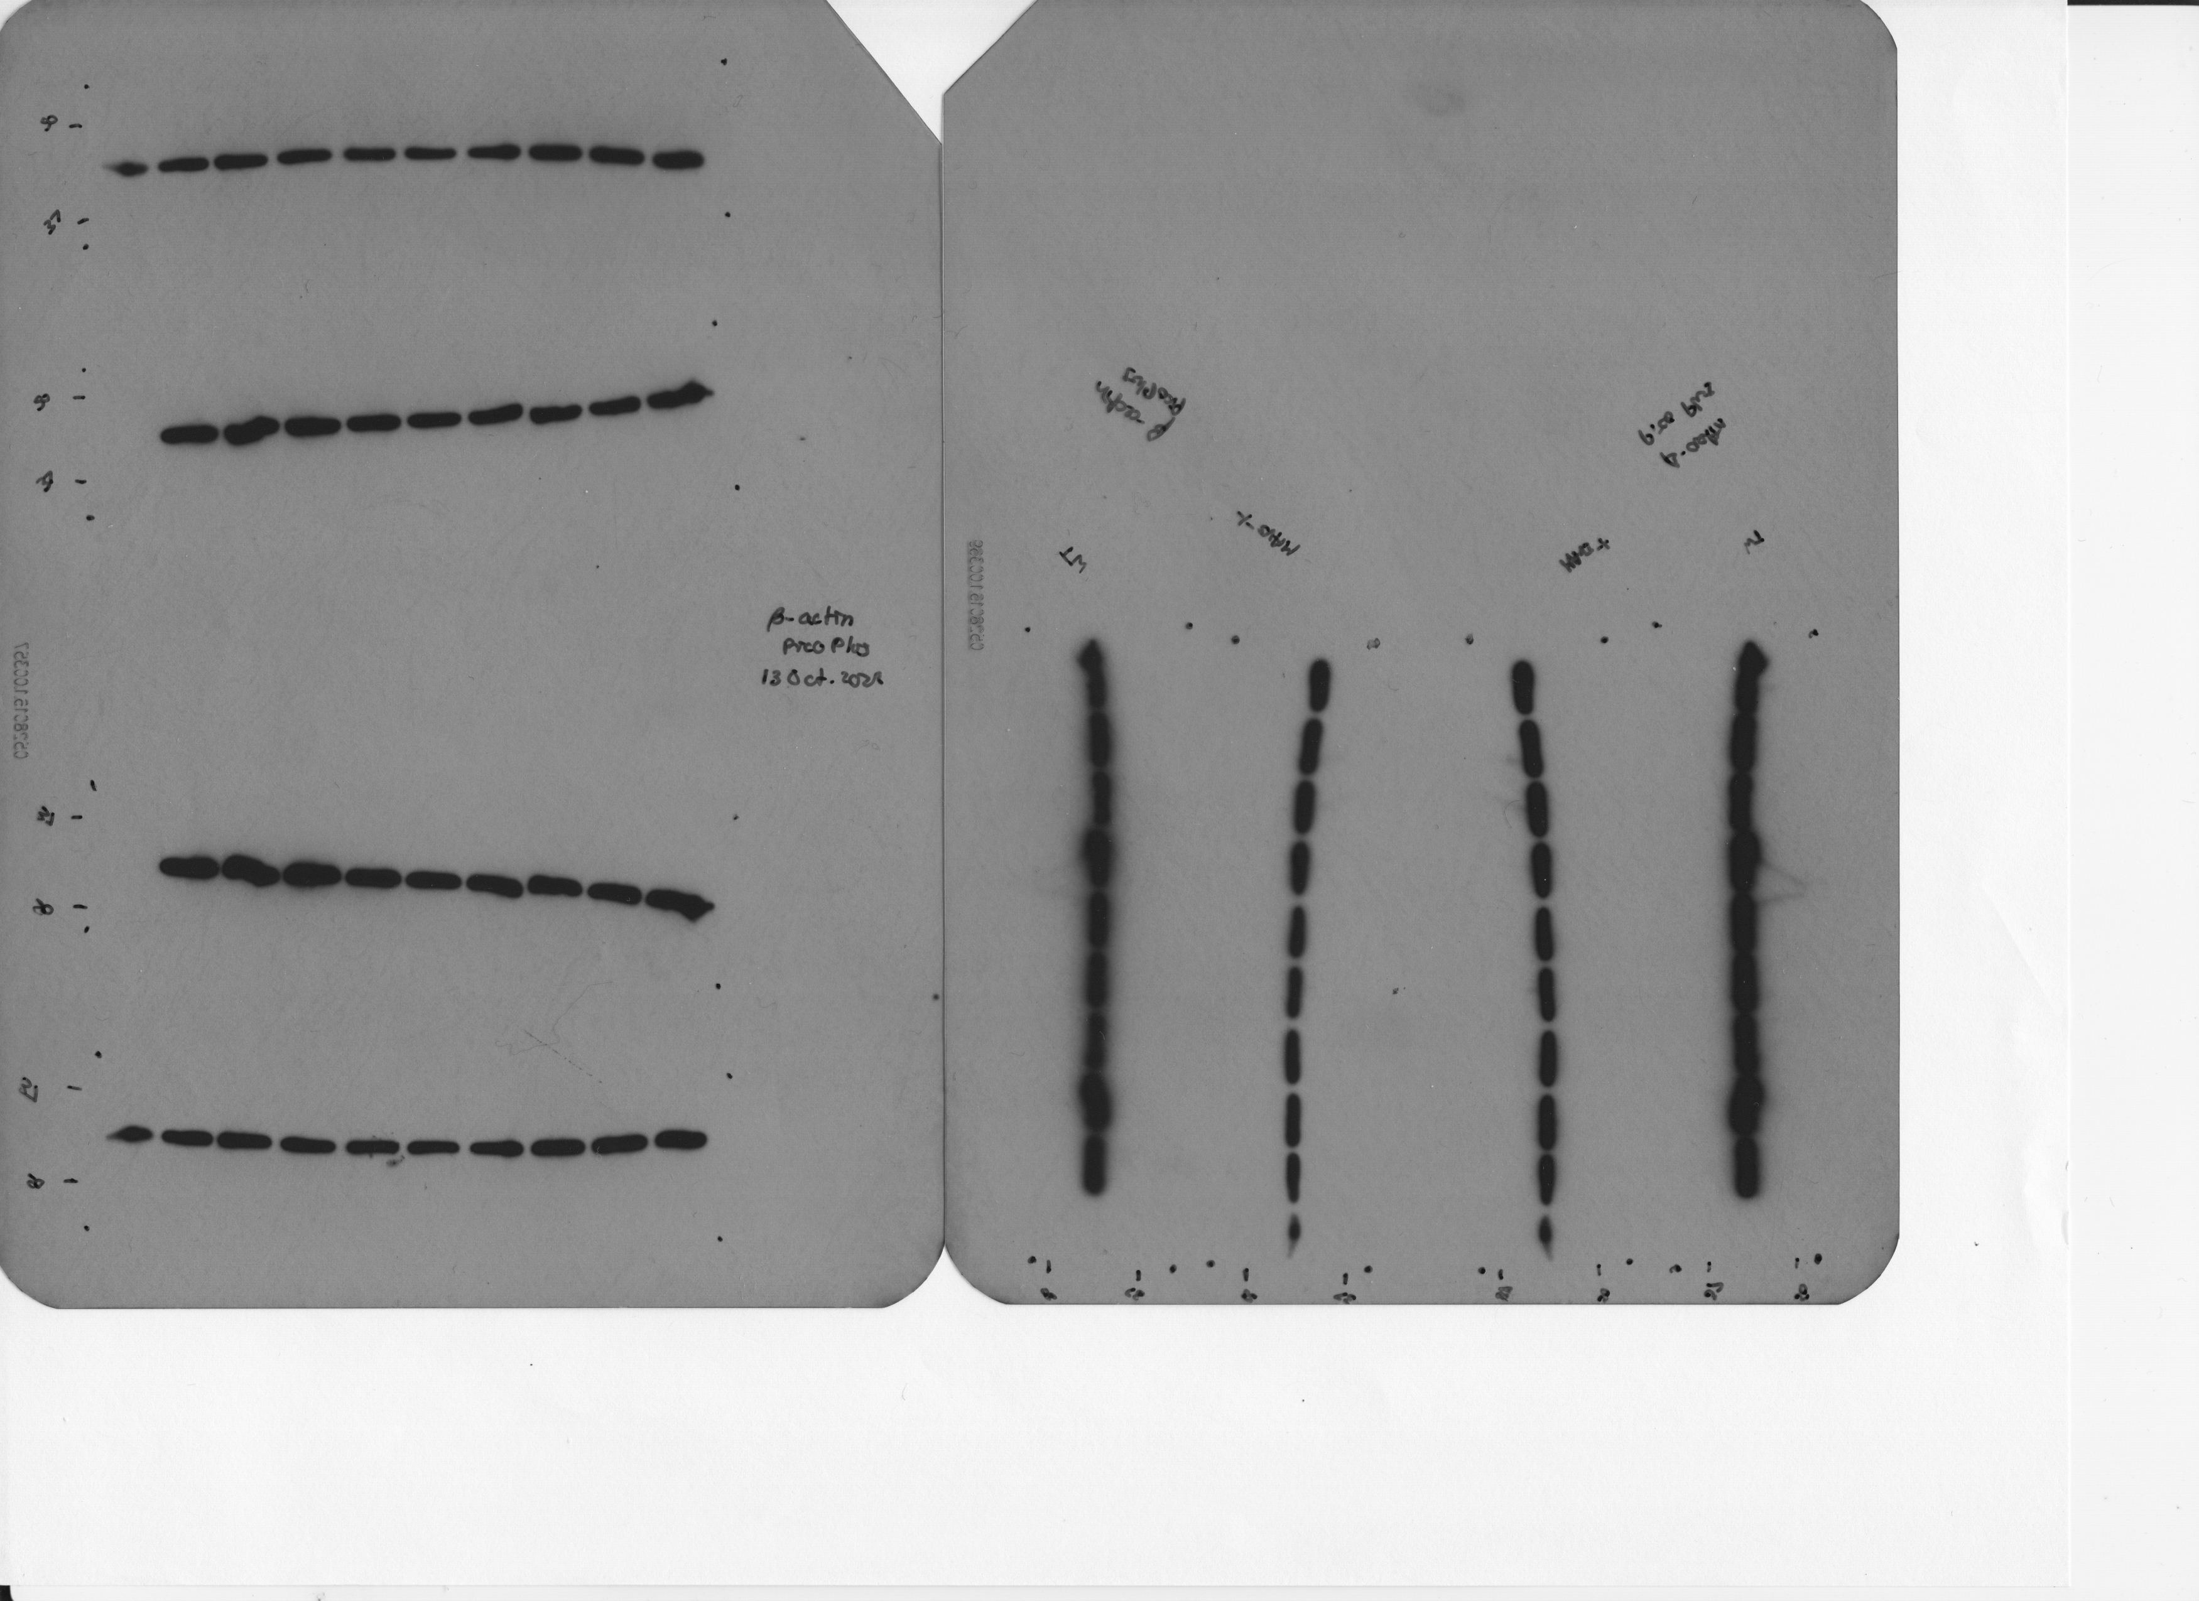
14 October 2022
WT BMDMs
WT BMDMs
MAVS^{-/-} BMDMs
Empty
Uninfected
WT
ΔsecA2_MOI1
ΔsecA2_MOI5
ΔsecA2secA2_MT
ΔsecA2//secA2_MM
ΔsecA2/secA2_MT
ΔesxBA
WT-HK
Uninfected
Uninfected
WT
ΔsecA2_MOI1
ΔsecA2_MOI5
ΔsecA2secA2_MT
ΔsecA2//secA2_MM
ΔsecA2/secA2_MT
ΔesxBA
WT-HK
250 kDa
α-Rig-I
250 kDa
150 kDa
150 kDa
α-Rig-I
100 kDa
100 kDa
75 kDa
α-MAVS
75 kDa
α-MAVS
50 kDa
α-β actin
50 kDa
α-β actin
α-β actin

Slide 9
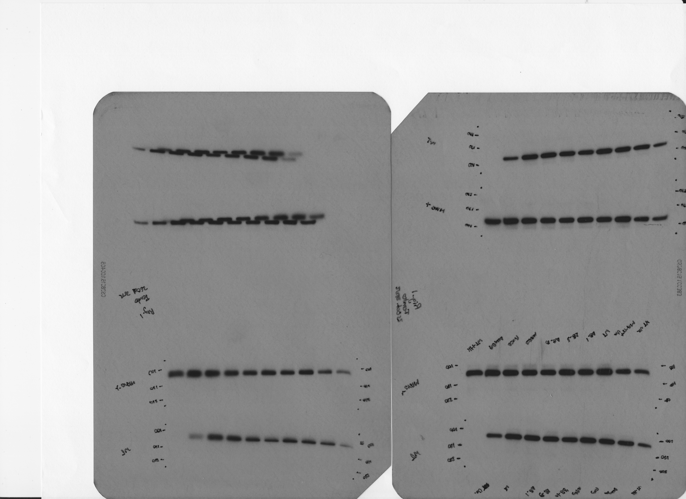
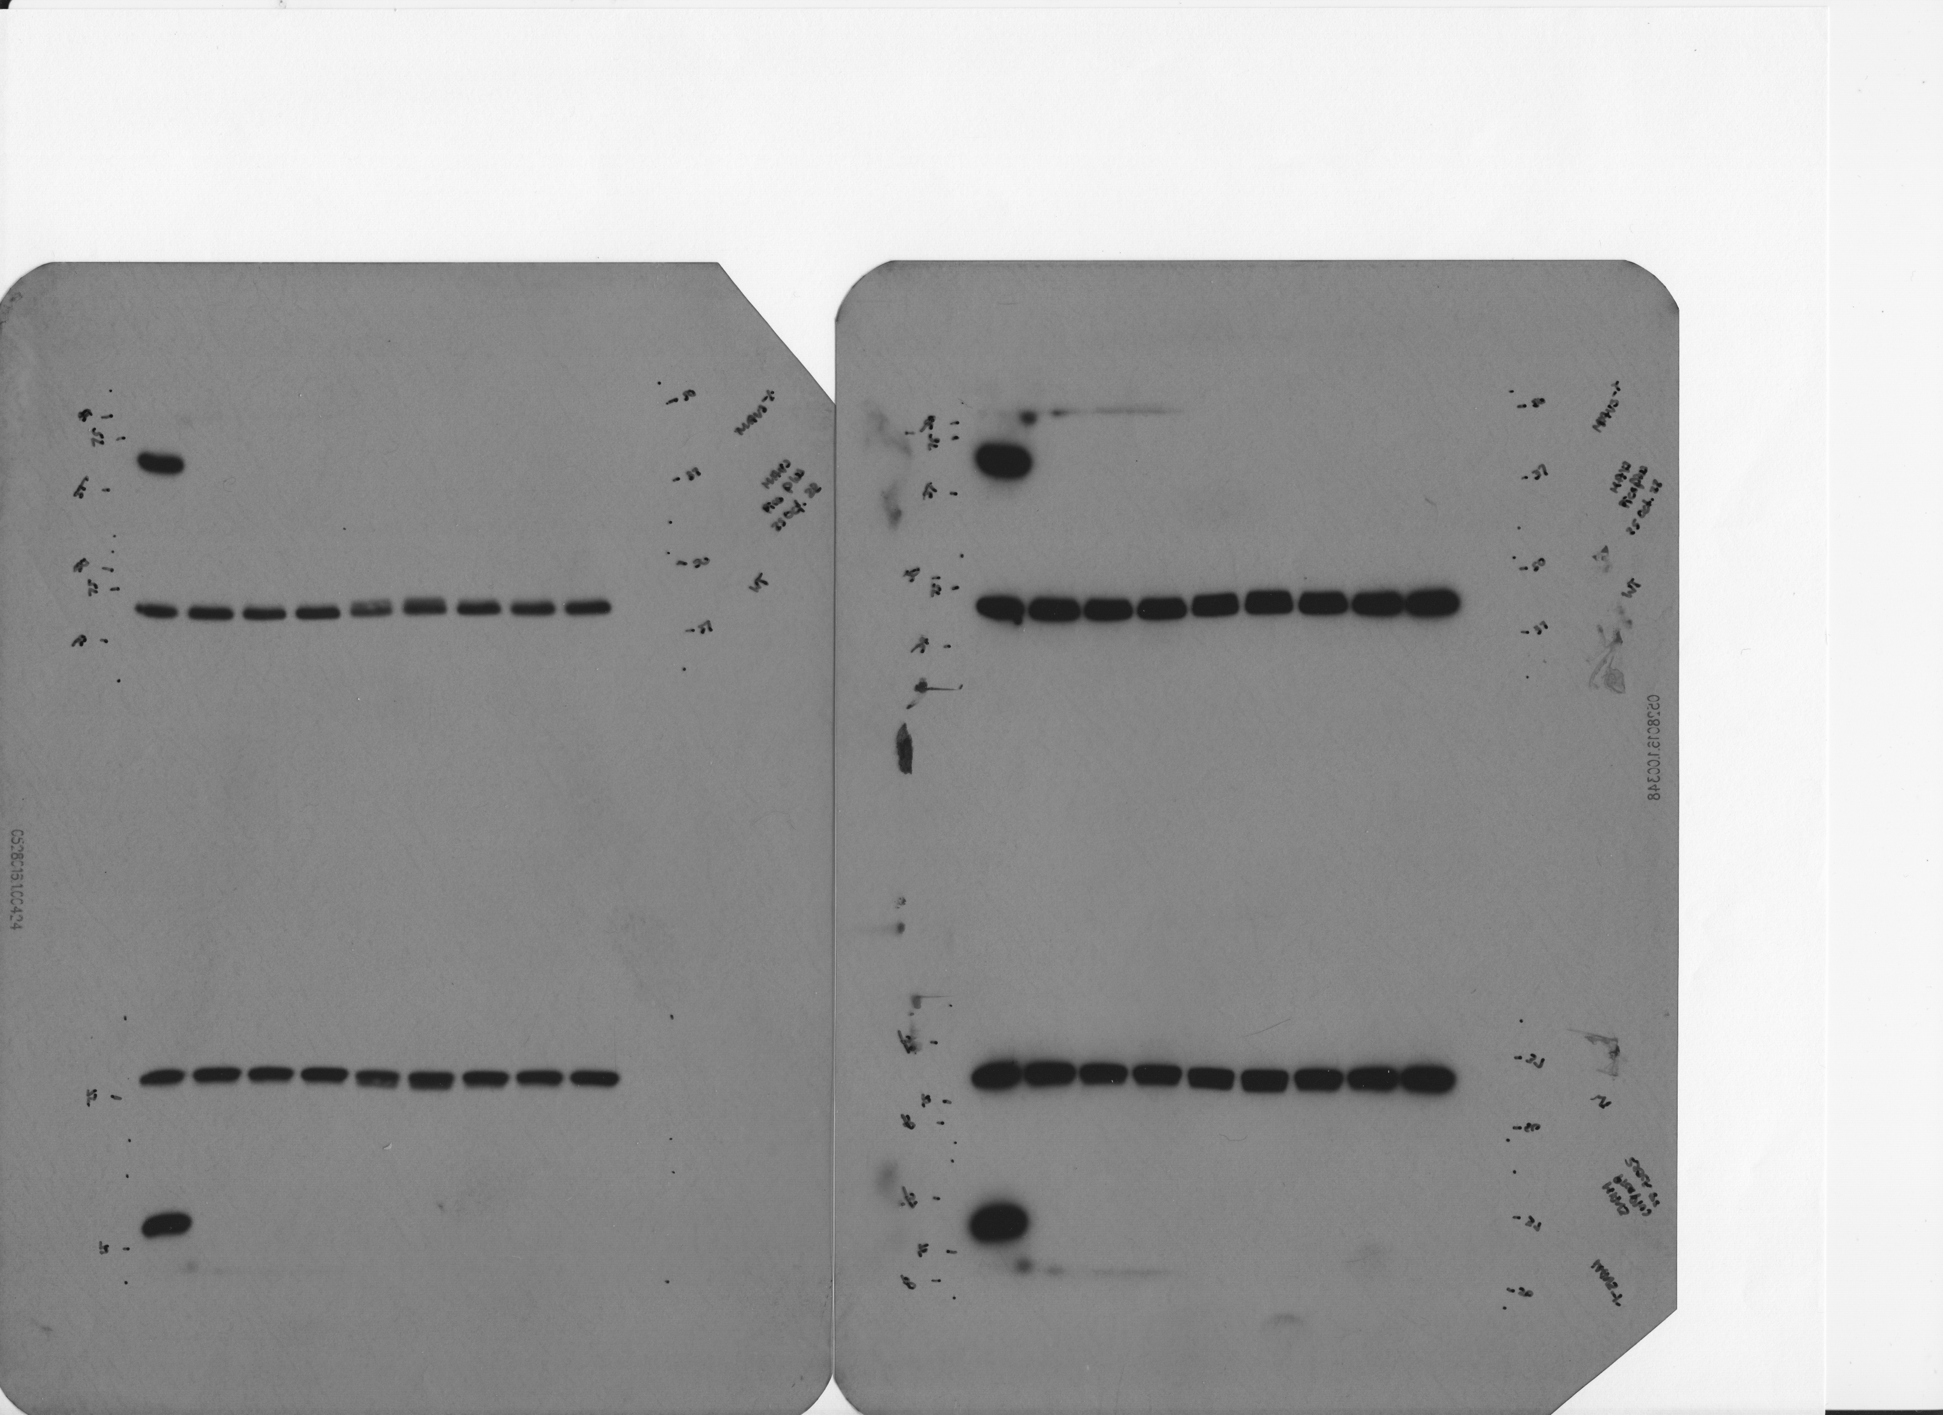
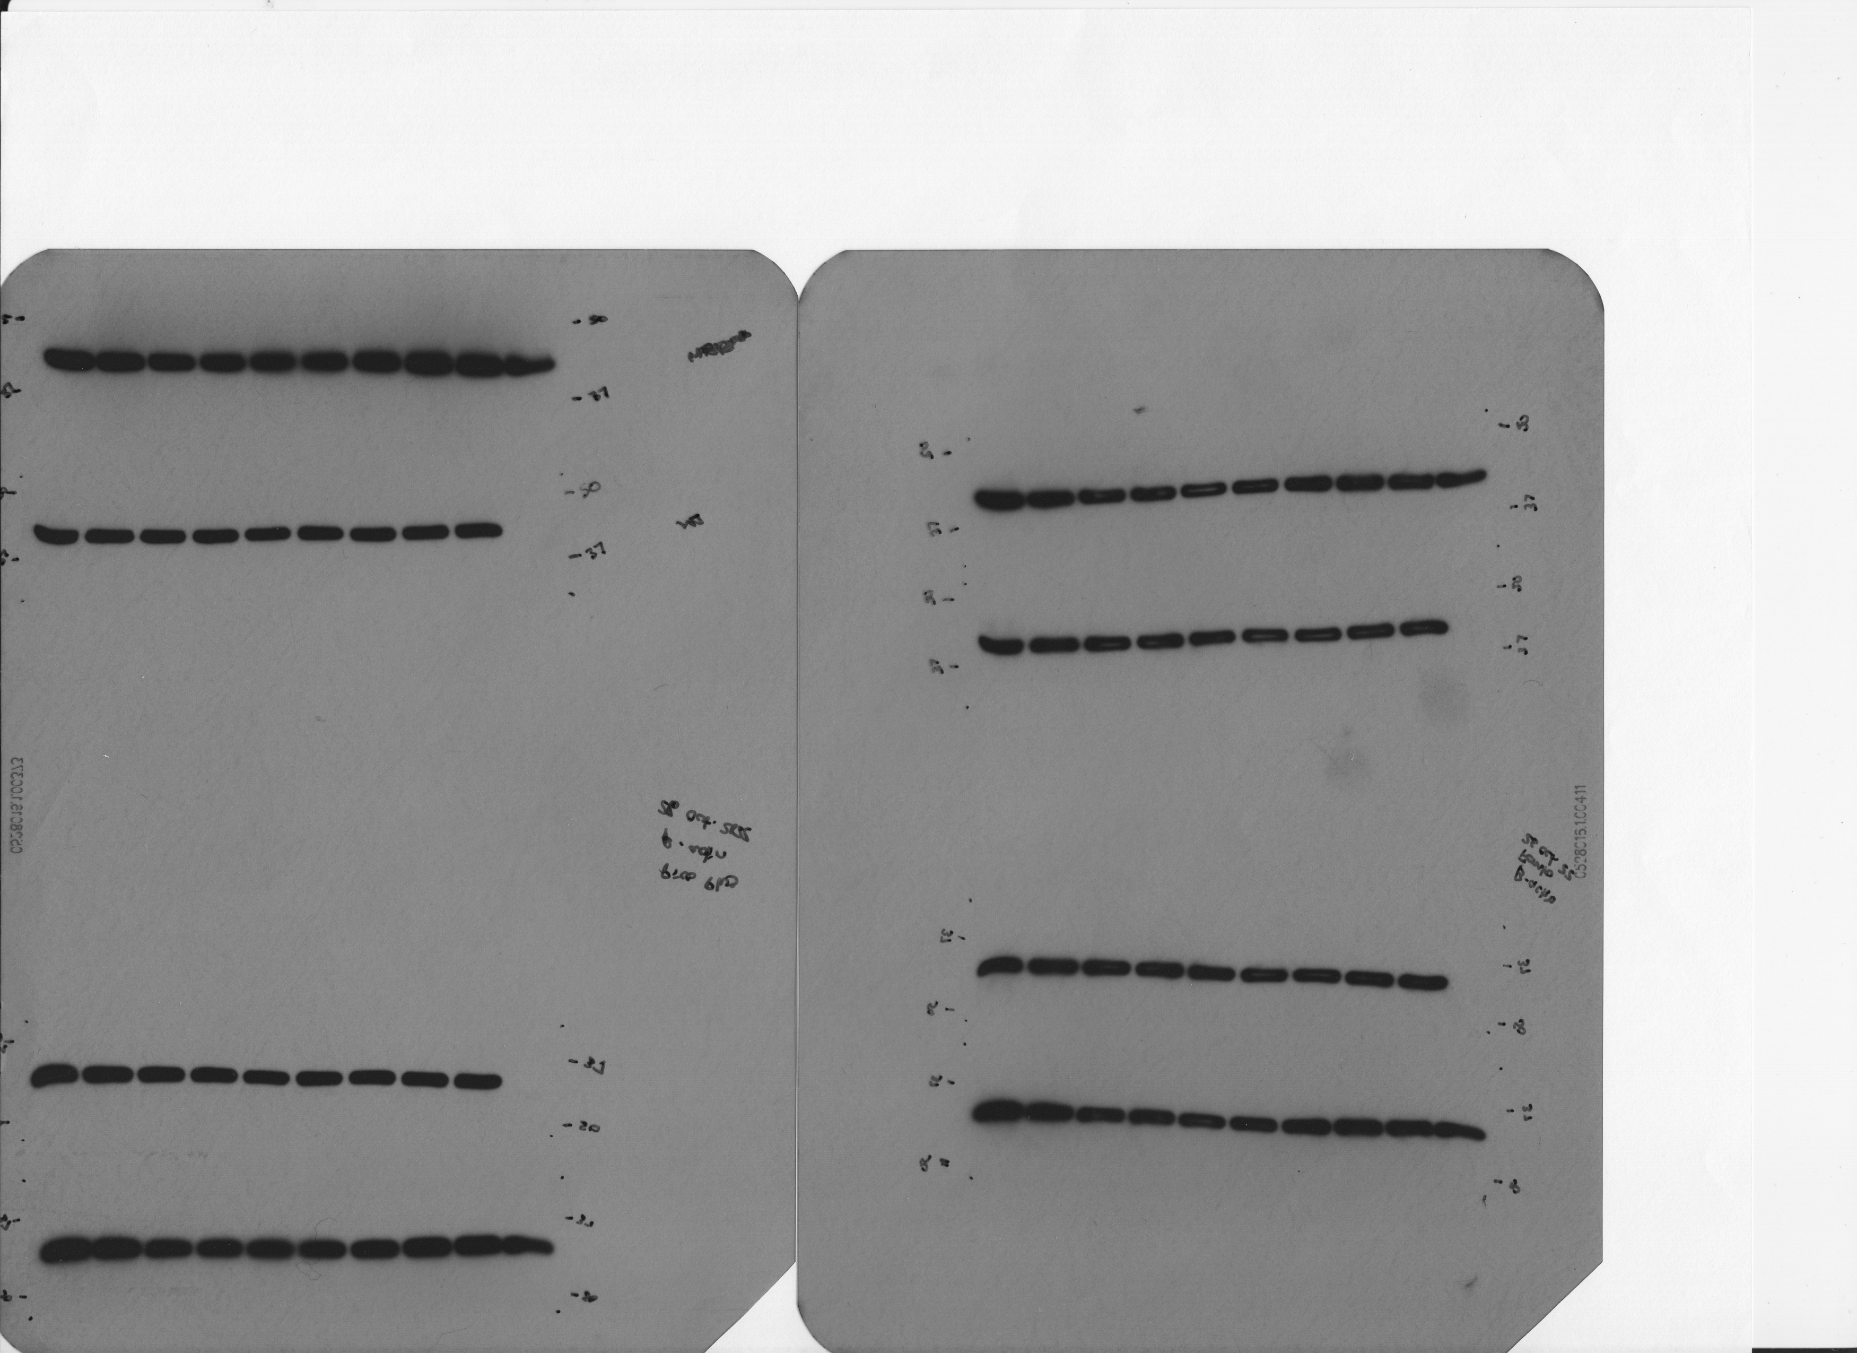
25 October 2022
WT BMDMs
WT BMDMs
MAVS^{-/-} BMDMs
Empty
Uninfected
WT
ΔsecA2_MOI1
ΔsecA2_MOI5
ΔsecA2secA2_MT
ΔsecA2//secA2_MM
ΔsecA2/secA2_MT
ΔesxBA
WT-HK
Uninfected
Uninfected
WT
ΔsecA2_MOI1
ΔsecA2_MOI5
ΔsecA2secA2_MT
ΔsecA2//secA2_MM
ΔsecA2/secA2_MT
ΔesxBA
WT-HK
250 kDa
α-Rig-I
250 kDa
150 kDa
150 kDa
α-Rig-I
100 kDa
100 kDa
75 kDa
α-MAVS
75 kDa
α-MAVS
50 kDa
α-β actin
50 kDa
α-β actin
α-β actin

