Slide 1
CSSELEC1 Project
TicTacToe Android Game using C#

Slide 2
Introduction
The program is based from a classic game of Tic-tac-toe implemented in android. The Xamarin plugin for Visual Studio 2015 was used in building the program. The game is designed for two players to play the game. The first player to place his piece horizontally, vertically or diagonally will be declared the winner of the match and will be give a point. If ever a draw is to occur no point is given to both players. After every match the players are prompted to continue their game or start a new match.

Slide 3
Features
Tracking of player’s scores
Continuing of game after every match
New game option after every match
Supports Android v4.0 or higher
Most Compatible with Android 6.0

Slide 4
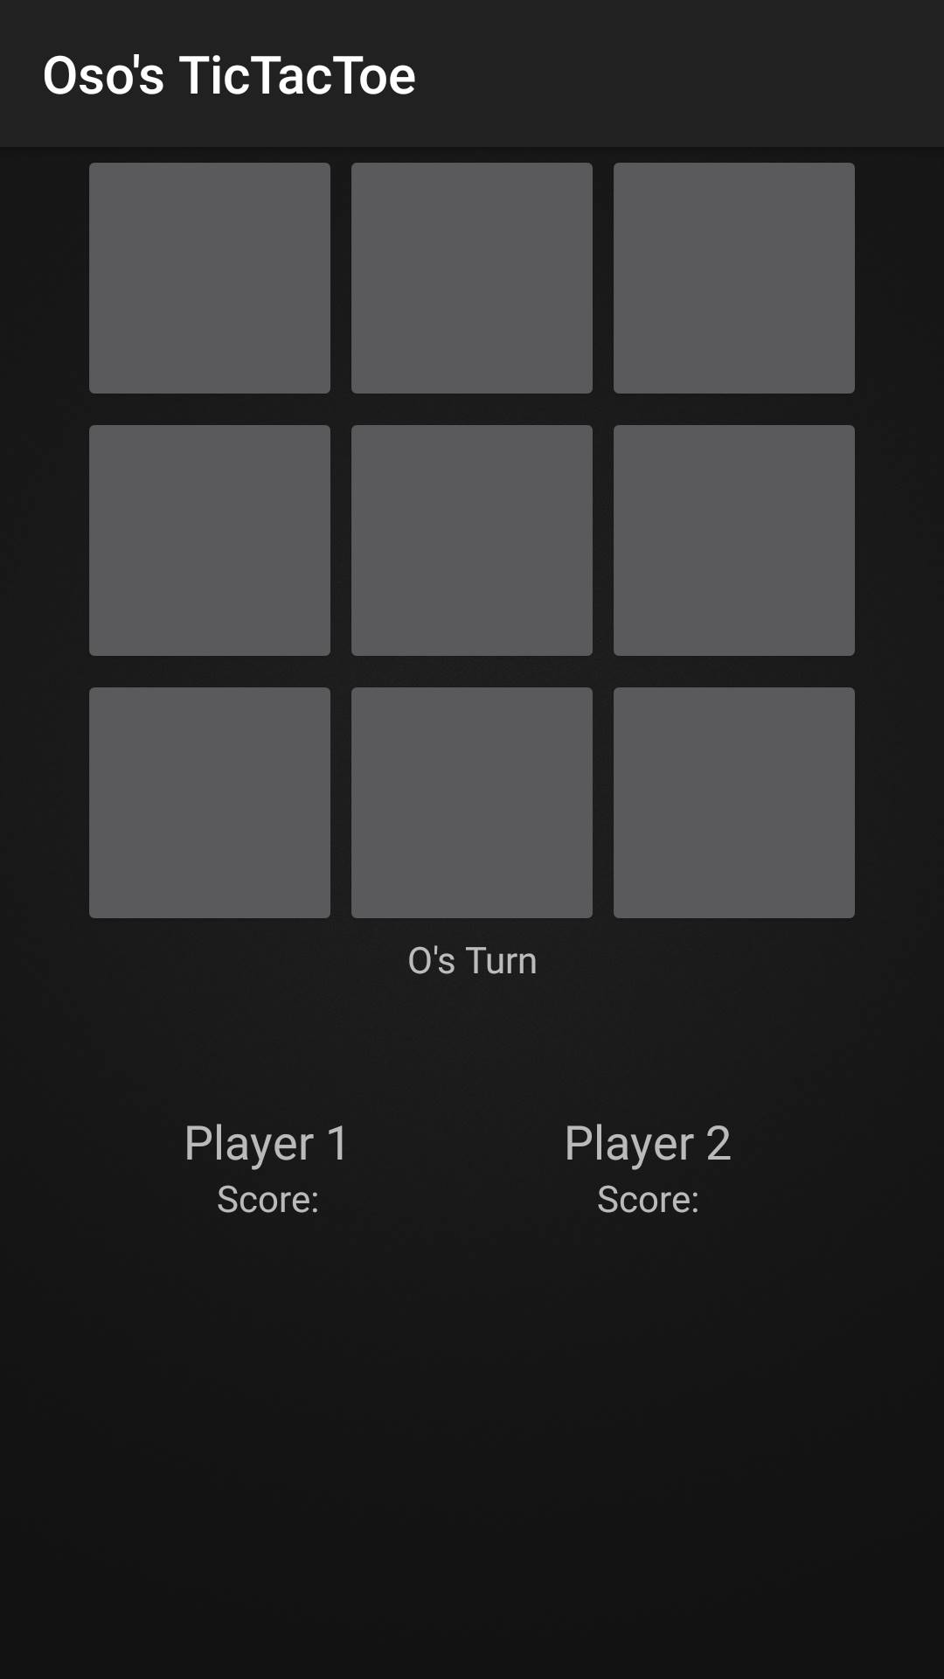
Screenshots Initial Screen

Slide 5

Screenshots On Game

Slide 6
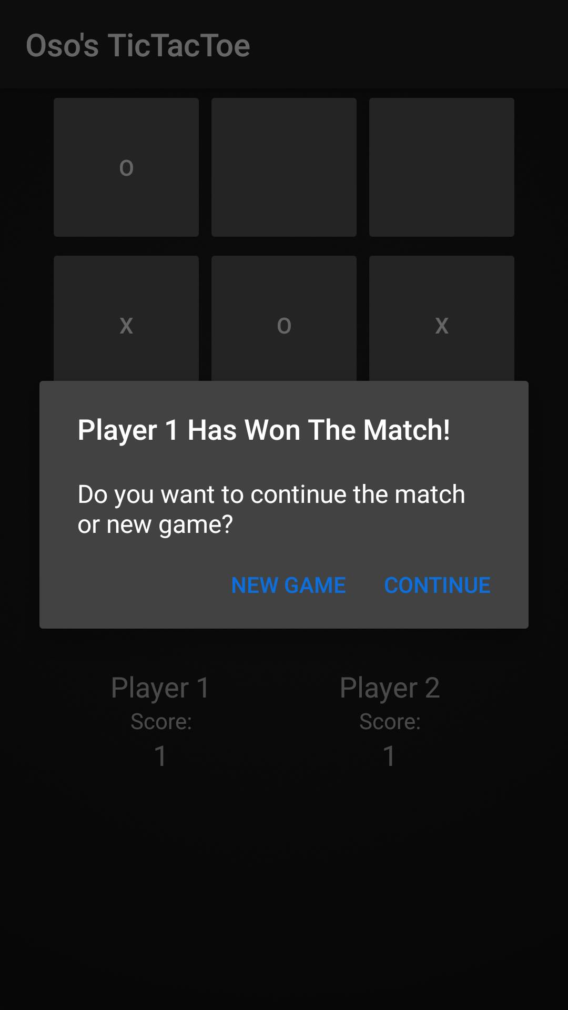
Screenshots Player 1 Wins

Slide 7
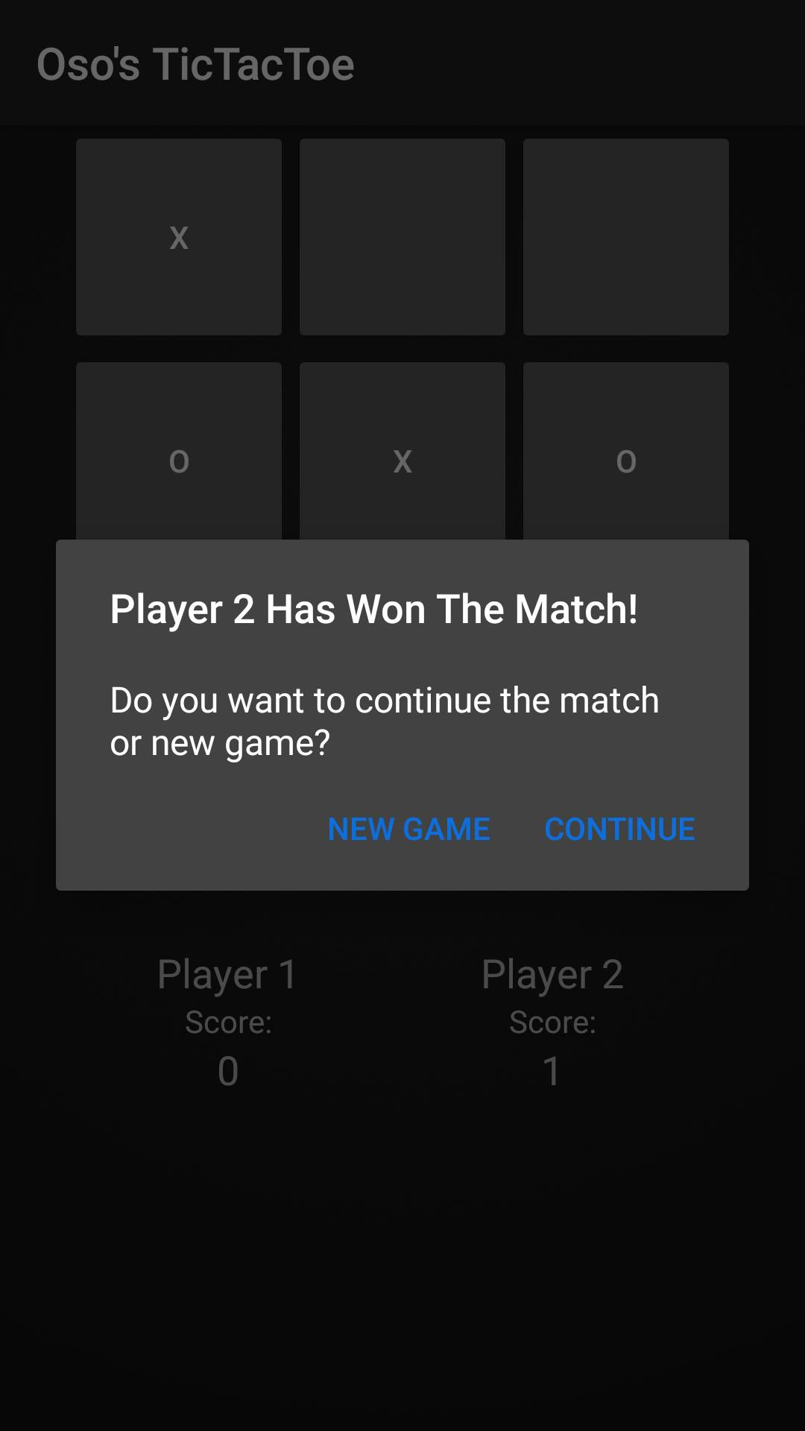
Screenshots Player 2 Wins

Slide 8
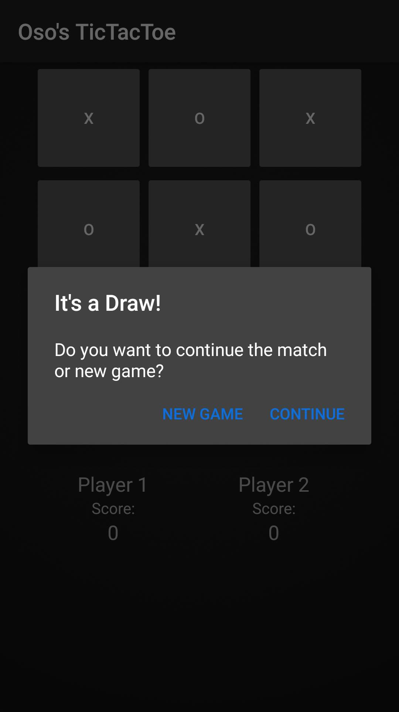
Screenshots Draw

