Slide 1
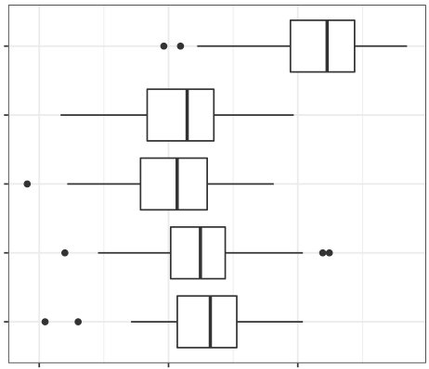
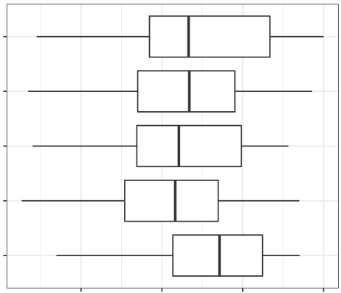
Yosef Lab
Kwak&Gong(WHD)
Kwak&Gong(KRD)
Hu
Guan&Zhang
0.4
0.6
0.8
0.25
0.50
0.75
1.00
Robinson-Foulds distance
Triplet distance

