Slide 1
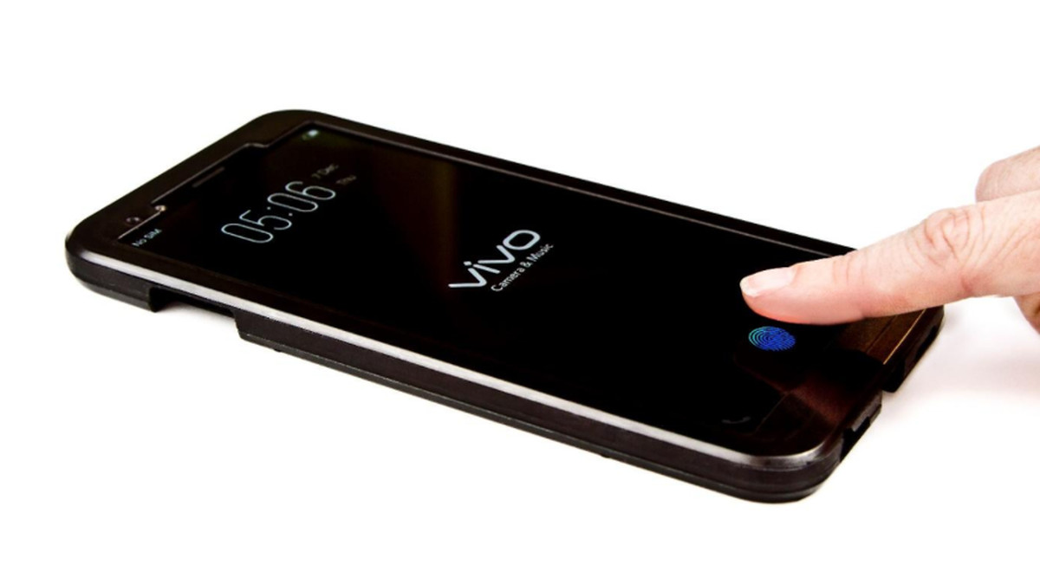
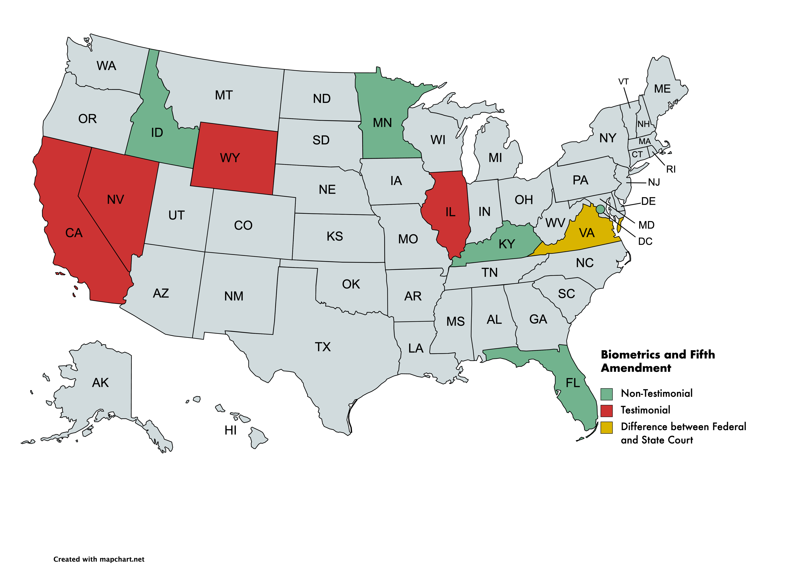
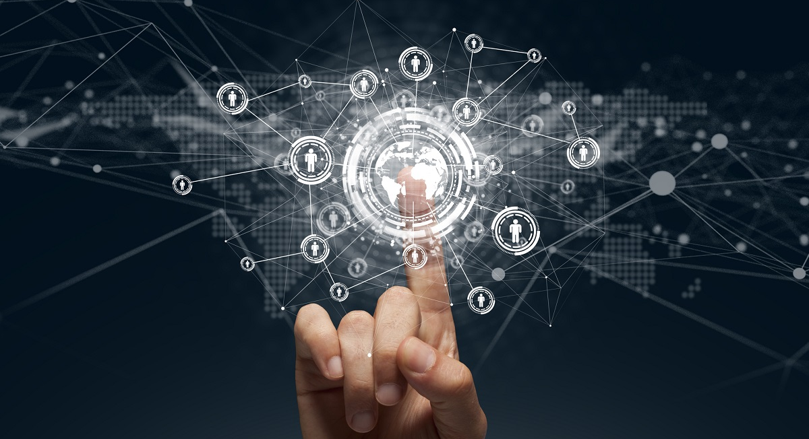
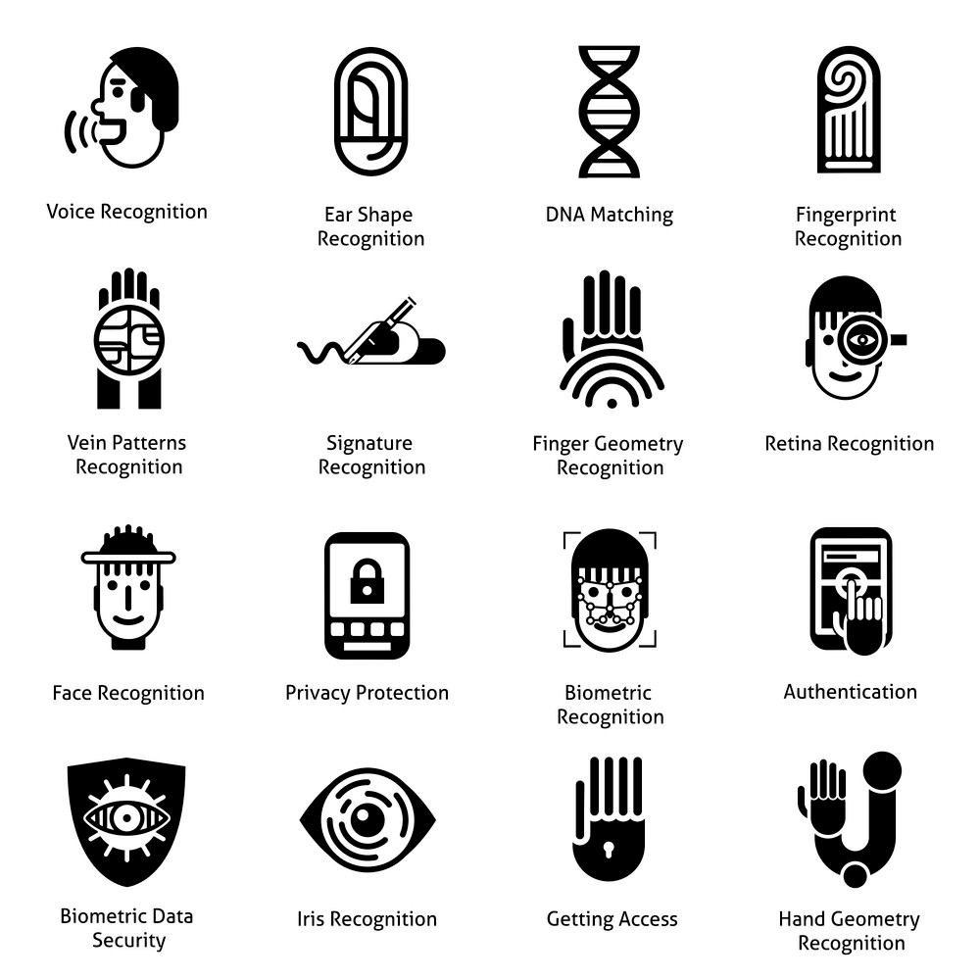

Password Protected?
Assessing the Fifth Amendment's Privilege Against Self-Incrimination in the Age of Biometrics
James Boyer, Mathematics, NSM, Hobson Wildenthal Honors College, jsb170130@utdallas.edu
Introduction
The Fifth Amendment and Biometrics
The Circuit Split over Biometrics
Conclusions
One of the greatest incorporations of new technology into everyday life has been biometrics. According to a 2020 survey by Mercator Advisory Group, around 41% of smartphone owners are using biometrics and this percentage is expected to rise to 66% by 2024 (PaymentsJournal).
Although the convenience of this technology is undeniable, it does raise some challenging legal questions. The question is whether the government can compel an individual to unlock their smartphone without violating the Fifth Amendment protection from self-incrimination. I hope to explore the Supreme Court precedent surrounding this issue while also summarizing how lower courts have ruled on this issue. I will also review the extent to which lower courts are factoring in technological advancements in their decisions.
The Fifth Amendment’s protections from self-incrimination requires three things; the evidence must be compelled, testimonial, and incriminating. The primary point of contention with regards to biometrics is the testimonial component. There are two important lines of Fifth Amendment case law that need investigation.
The first line of relevant Fifth Amendment case law is the distinction between testimonial and non-testimonial evidence. Testimonial or communicative evidence is evidence that reveals the contents of the mind of the suspect on trial whereas non-testimonial includes everything else. In the 1966 case of Schmerber v. United States, the court held that withdrawing blood was merely the extraction of physical evidence and did not contain a communicative element. Non-Testimonial evidence has been extended to include participating in a lineup in United States v. Wade, handwriting samples in Gilbert v. United States, voice exemplars in United States v. Dionisio, and slurring of speech in Pennsylvania v. Muniz. Facially, it seems that compelling the use of biometrics to unlock a smartphone produces Non-Testimonial evidence because using biometrics is merely a physical action such as placing your thumb on a screen and does not reveal the contents of one’s mind.
The second line of case law involves the “act-of-production” doctrine. This doctrine states that the Fifth Amendment can be invoked when the act of producing documents is implicitly testimonial. In the 1976 case of Fisher v. United States, the court held that producing documents is not necessarily a testimonial action. The Supreme Court found that if the government knows the existence and location of certain papers, then the act of producing those documents is non-testimonial as the individual is not giving the government any new information. In 1984, the court held in United States v. Doe that producing documents can become testimonial if the act implicitly communicates information about the existence, custody, or authenticity of the documents. Finally, in 2000, the court held in United States v. Hubbell that in order to compel the production of incriminating documents, the government must describe those documents with reasonable particularity.
Since 2014, thirteen lower courts both state and federal have ruled on the constitutionality of biometrics and the fifth amendment. So far, nine courts have held that using biometrics is non-testimonial, four courts have ruled it is testimonial, and one court remains undecided.
Lower courts that decided using biometrics are non-testimonial reasoned biometrics are more akin to physical evidence as they do not reveal the contents of a person’s mind. In contrast, lower courts that ruled biometrics are testimonial reasoned that although biometrics are functionally equivalent to passwords which are of the mind and biometrics implicitly communicate information about one’s ownership and use of the cellphone.
One point I wanted to investigate is the relevance of rising technology in the decisions of these lower courts. The three recent cases decided by the Supreme Court are Kyllo v. United States in 2001, Riley v. California in 2014, and Carpenter v. United States in 2018. The opinions are best summarized by a closing thought in Carpenter: “When confronting new concerns wrought by digital technology, this Court has been careful not to uncritically extend existing precedents.”
Only nine out of the thirteen decisions utilized Riley in their reasoning and five out of eight post-2018 courts cited Carpenter. Similarly, only seven out of the thirteen decisions bothered to include the word “technology” at all or any discussion of technology. Unsurprisingly, courts that cited Riley or Carpenter were more likely to hold that biometric passwords are testimonial and cannot be compelled.
Biometrics are a useful case study into how lower courts are responding to the Supreme Court’s warning not to uncritically apply precedent to new technology. Although several courts made great efforts to consider the implications of categorizing biometric decryption as non-testimonial, it is still concerning that several lower courts did not find it relevant to consider the purpose of the Fifth Amendment given new technologies. One potential explanation is that lower courts are trying to apply the law and not rewrite the law. Even if this were the case, the Supreme Court, has repeatedly evaluated the spirit of constitutional protections to ensure they are not being eroded by technological advancements and therefore it seems that biometrics should be just as protected as our passwords.
Biometrics and the Legal System
Testimonial vs. Non-Testimonial Evidence
Schmerber v. United States
(Withdrawing blood is non-testimonial)
United States v. Wade
(Participating in a lineup is non-testimonial)
References
Biometrics have posed unprecedented challenges when it comes to issues of privacy and our personal data. Over the last few years, several states starting with Illinois have already passed laws setting standards on what types of data companies can collect and how they are allowed to do so (Prescott). One important feature of biometrics and cellphones is that the data on our cellphones is encrypted by our passwords meaning that the information they contain is unintelligible until the user unlocks the device. Thus, if the government believes there is incriminating evidence on a smartphone, then there only option is to compel the believed owner of the phone to unlock it. One other point of clarification is that the Fifth Amendment only applies when the government has a warrant. In 2014, the Supreme Court ruled in Riley v. California that the government may not search the contents of a cellphone without a warrant. Thus, the government may not unlock a phone using biometrics without a warrant.
Supreme Court Cases:
Carpenter v. United States, 484 U.S. 19, 108 S. Ct. 316, 98 L. Ed. 2d 275 (1987).
Fisher v. United States, 425 U.S. 391, 96 S. Ct. 1569, 48 L. Ed. 2d 39 (1976).
Gilbert v. United States, 370 U.S. 650, 82 S. Ct. 1399, 8 L. Ed. 2d 750 (1962).
Holt v. United States, 218 U.S. 245, 31 S. Ct. 2, 54 L. Ed. 1021 (1910).
Kyllo v. United States, 533 U.S. 27, 121 S. Ct. 2038, 150 L. Ed. 2d 94 (2001).
Pennsylvania v. Muniz, 496 U.S. 582, 110 S. Ct. 2638, 110 L. Ed. 2d 528 (1990).
Riley v. California, 134 S. Ct. 2473, 573 U.S. 373, 189 L. Ed. 2d 430 (2014).
Schmerber v. California, 384 U.S. 757, 86 S. Ct. 1826, 16 L. Ed. 2d 908 (1966).
United States v. Doe, 465 U.S. 605, 104 S. Ct. 1237, 79 L. Ed. 2d 552 (1984).
United States v. Dionisio, 410 U.S. 1, 93 S. Ct. 764, 35 L. Ed. 2d 67 (1973).
United States v. Hubbell, 530 U.S. 27, 120 S. Ct. 2037, 147 L. Ed. 2d 24 (2000).
United States v. Wade, 388 U.S. 218, 87 S. Ct. 1926, 18 L. Ed. 2d 1149 (1967).
Citations:
“Biometrics.” Merriam-Webster.com Dictionary, Merriam-Webster, https://www.merriam-webster.com/dictionary/biometrics. Accessed 27 Apr. 2021.
PaymentsJournal, June 4th, 2020. https://www.paymentsjournal.com/by-2024-how-many-smartphone-owners-will-use-biometrics/ Prescott, Natalie. “The Anatomy of Biometric Laws: What U.S. Companies Need To Know in 2020” The National Review. January 15th, 2020. https://www.natlawreview.com/article/anatomy-biometric-laws-what-us-companies-need-to-know-2020
SCOTUS Blog. “Andrews v. New Jersey”. Accessed on April 24, 2020. https://www.scotusblog.com/case-files/cases/andrews-v-new-jersey/
Supreme Court of the United States. Petition for Writ of Certiorari for Diamond v. State. Accessed on April 24, 2020. https://www.supremecourt.gov/search.aspx?filename=/docket/docketfiles/html/public/17-8336.html
Uresk, Carissa A. "Compelling Suspects to Unlock Their Phones: Recommendations for Prosecutors and Law Enforcement." BYU Law Review 46.2 (2021): 601-656. (This source includes citations to all 13 lower court decisions on pages 637-644))
Image Citation (Listed in order and Accessed on April 27, 2020:
https://www.theverge.com/circuitbreaker/2017/12/15/16779916/vivo-fingerprint-sensor-embedded-in-screen.
www.zerosuniverse.com/biometrics/.
https://www.healthline.com/health/pregnancy/blood-test-for-gender
https://www.sciencemag.org/news/2020/02/single-paper-mill-appears-have-churned-out-400-papers-sleuths-find
https://www.aeaweb.org/news/aer-insights-call-for-papers-dec-1-2017
Made using https://mapchart.net/usa.html
http://supremeopinion.com/kyllo-v-united-states-thermal-search-without-warrant-061101/
https://www.niehs.nih.gov/health/topics/agents/cellphones/index.cfm
https://www.wired.com/story/carpenter-v-united-states-supreme-court-digital-privacy/
https://www.qlik.com/blog/the-rise-of-digital-and-four-tectonic-technology-shifts
Lower Courts and Factoring in Technological Changes
“Act-of-production” Doctrine
Fisher v. United States
(Producing documents is not testimonial if the existence and location of the papers are a “foregone conclusion”)
United States v. Hubbell
(Government must specify the documents with reasonable particularity)
Supreme Court and Technology
Kyllo v. United States
(Cannot use thermal imaging to infer information inside a house)
Riley v. California
(Cannot search a cellphone seized incident to arrest without a warrant)
Carpenter v. United States
(Cannot endlessly track an individual using their cellphone data without a warrant)
Acknowledgements
Dr. Douglas Dow for first introducing me to Constitutional Law and approving this topic. Dr. Thomas Gray for teaching Civil Liberties. Dr. Barbara Kirby for being a wonderful moot court coach over the last three years.

