Slide 1
A Comparative Study and Ensemble of Multiple Models
for Imbalanced Multiclass Medical Diagnosis
Liner Zhang
CUG ID:20231003496
IIT ID:A20563408

Slide 2

Project Objective
Migraine affects 10–15% of the global population, with women three times more likely to suffer than men (Lipton et al., 2001).
In China, over 90 million people are affected, 70% of them women (Li et al., 2018).
This project aims to build an efficient, data-driven diagnostic tool to help patients quickly identify their migraine type, enabling precise treatment and improving quality of life.

Slide 3

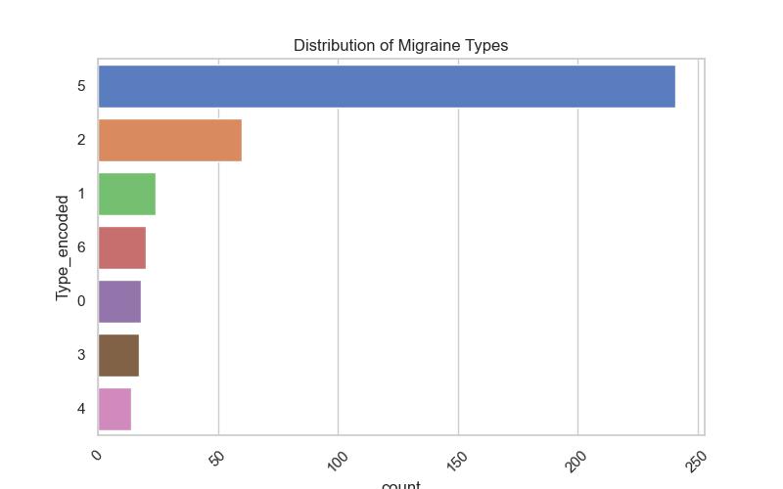
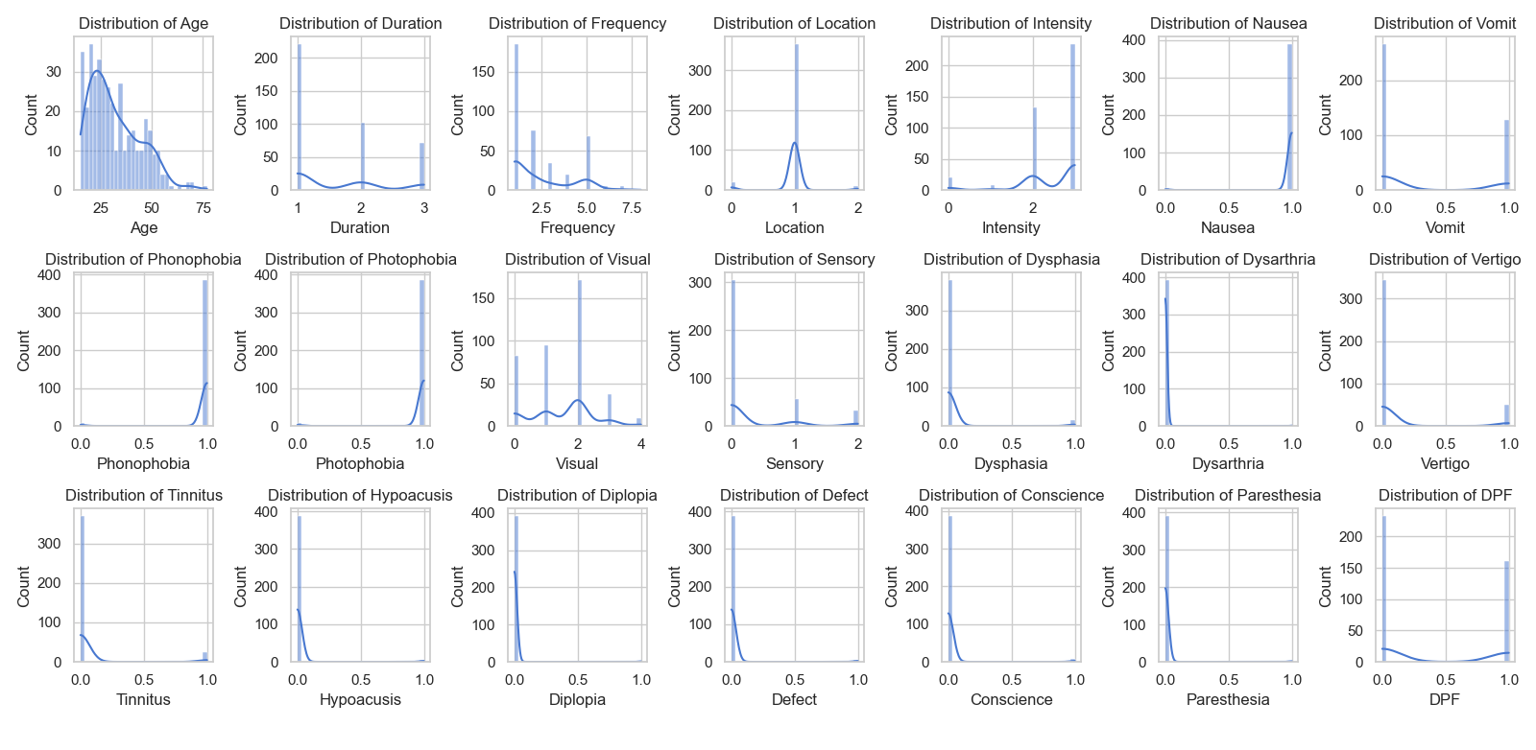
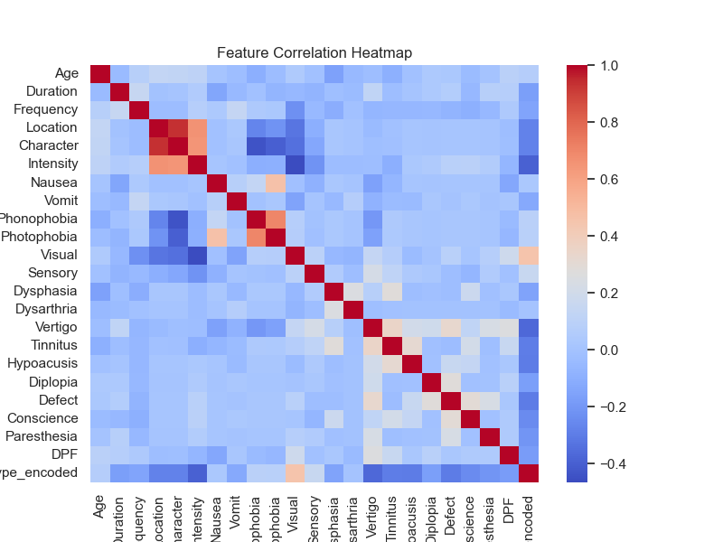
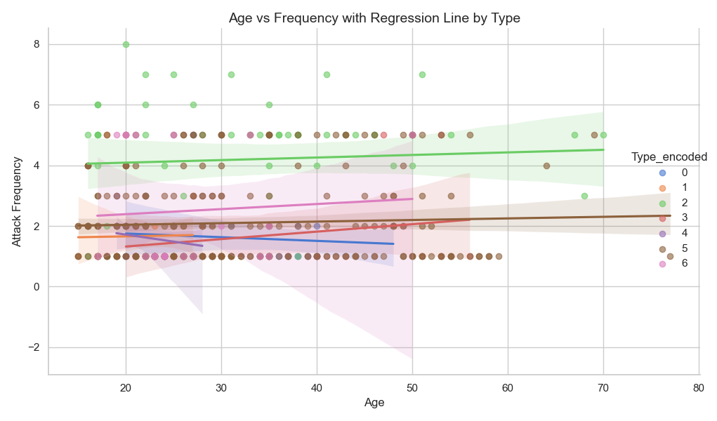
Data Exploration
Data Transformation
394 entries*24 columns
Original Data
400 entries*24 columns
Type | Code
Basilar-type aura | 0
Familial hemiplegic migraine | 1
Migraine without aura | 2
Other | 3
Typical aura with migraine | 4
Typical aura without migraine | 5
missing value imputation
duplicates deletion
394 entries*24 columns
Other Visualization...
Feature Engineering
394 entries *24 columns

Slide 4
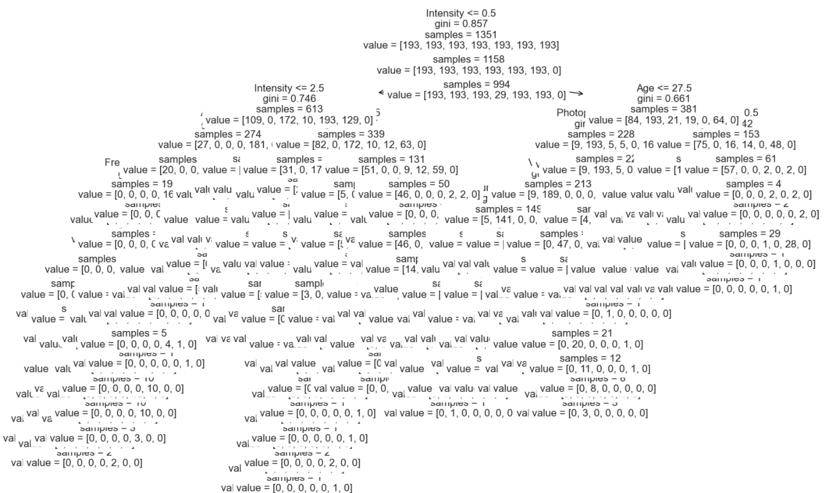
Predictive Classification
SMOTE
Model 1:Decision Tree
Best alpha: 0.0
Model 2:KNN
knn__metric: manhattan knn__n_neighbors: 31 'nn__weights: distance
Model 4:Random Forest
Model 5:Adaboost
Model 3:Naive Bayes
Stacking Model
Accuracy, Precision, Recall, F1 Score, ROC AUC
Model 3:Naive Bayes

Slide 5
Thank you!
Liner Zhang
CUG ID:20231003496
IIT ID:A20563408

