Slide 1
Predicting Zillow prices with machine learning
Linet osoro, Jennifer savage, madeline riley

Slide 2
Project overview and objectives
Project task is to solve a problem or answer a question using machine learning in conjunction with other techniques
Our objective is to use machine learning models to predict the price of homes based on set variables

Slide 3
process
Data load
Pre-process
Clean the data
Convert & encode
Train & test data
Display results

Slide 4
Machine learning models
Decision Tree
Random Forest
Support Vector Machine
Linear Regression Model

Slide 5
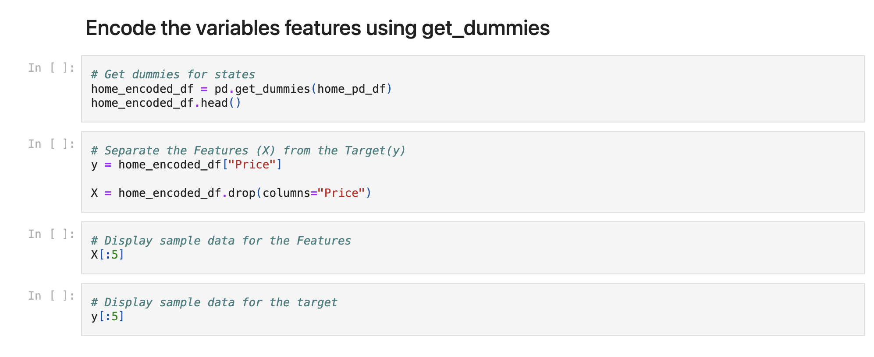
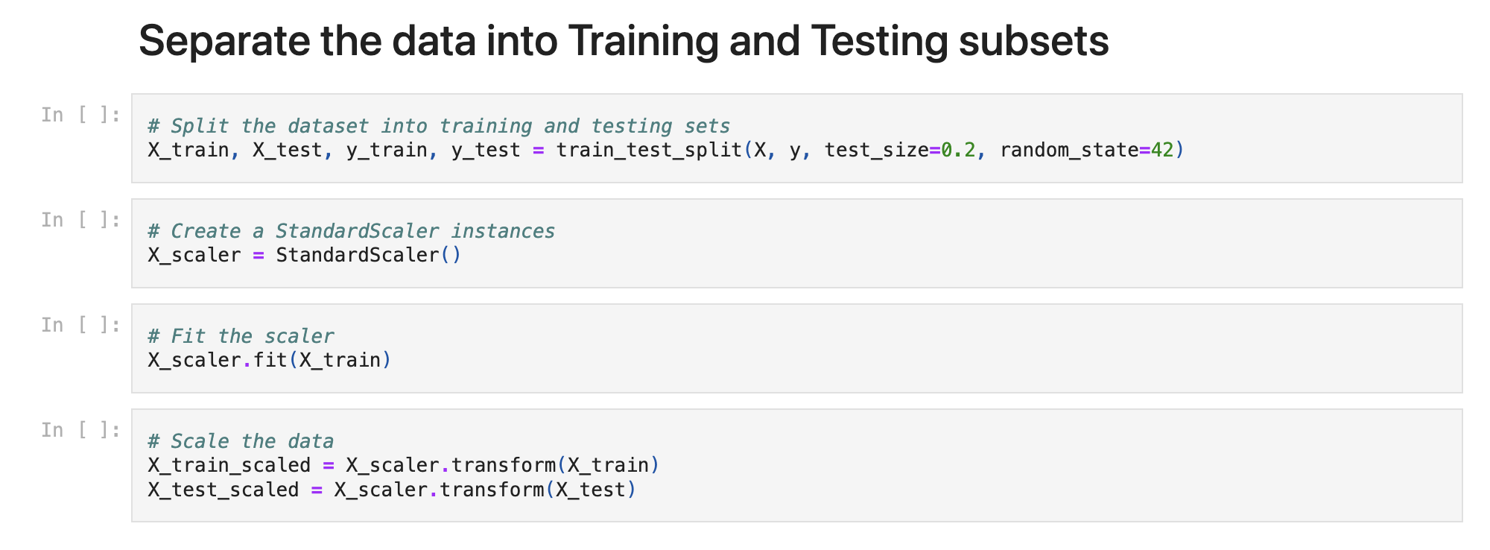
processing the data

Slide 6
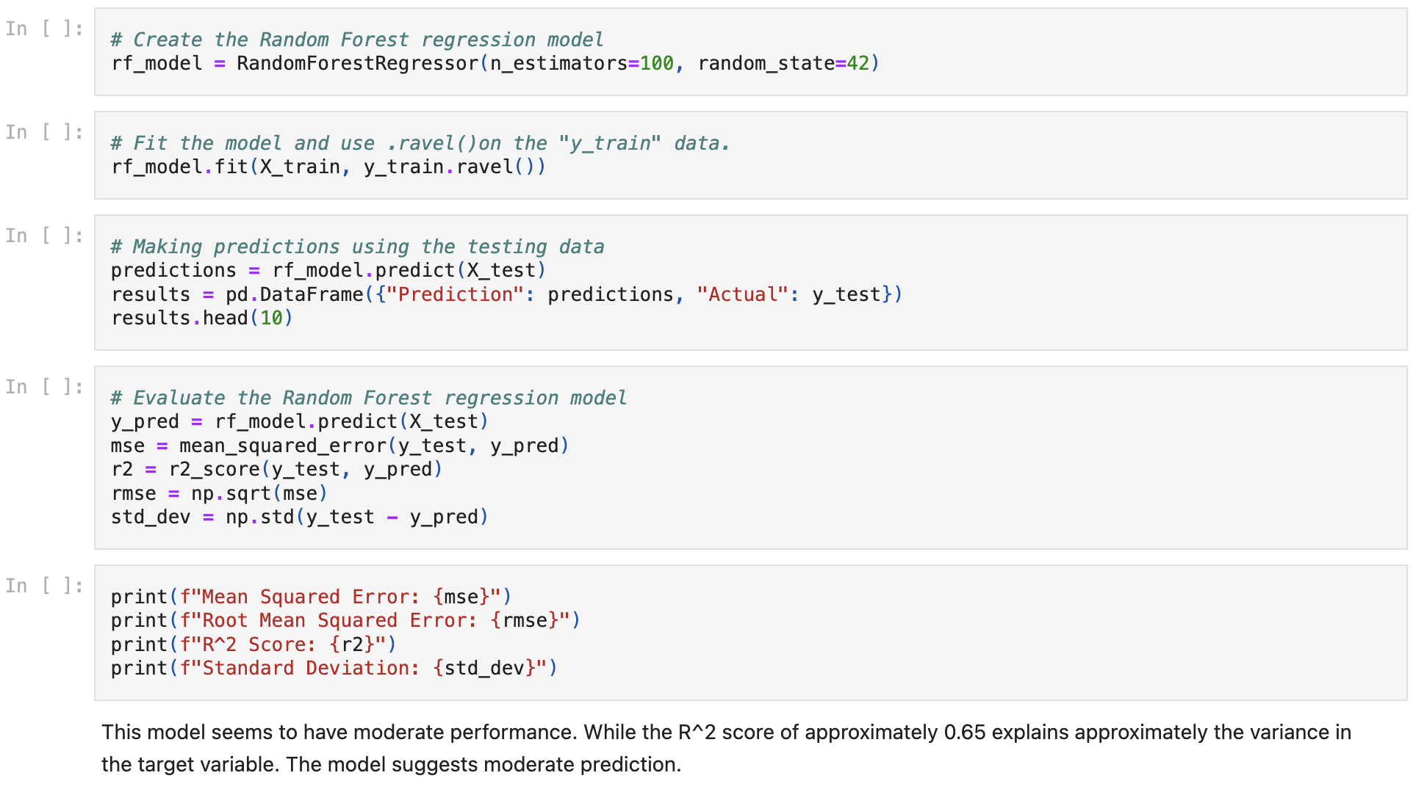
Random forest

Slide 7
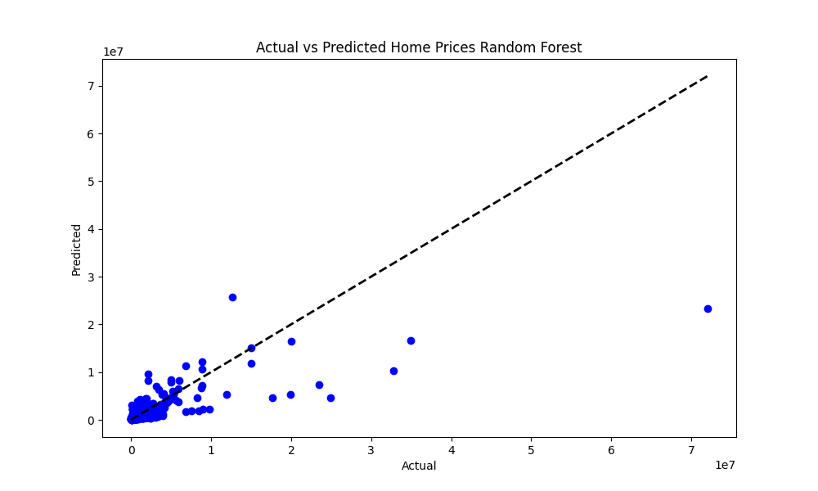
Random forest method

Slide 8
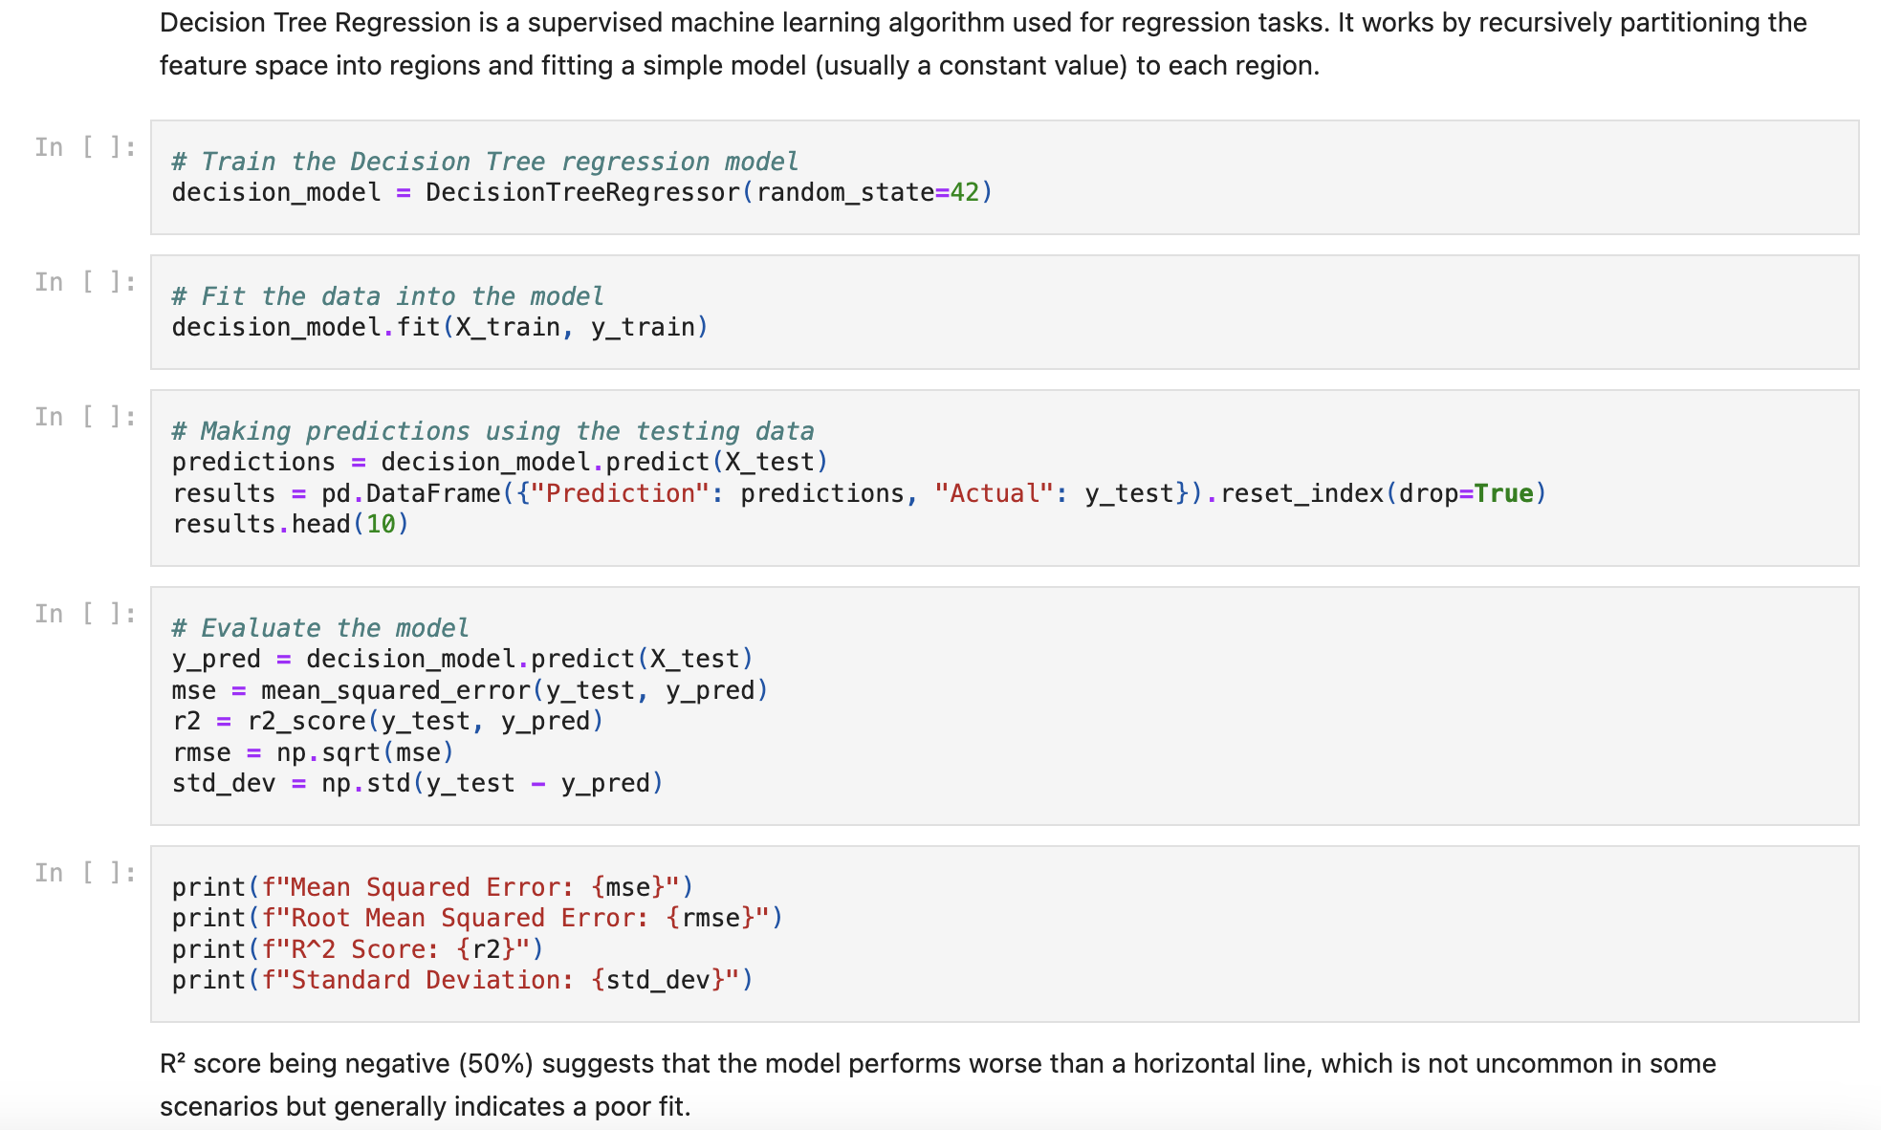
Decision tree

Slide 9
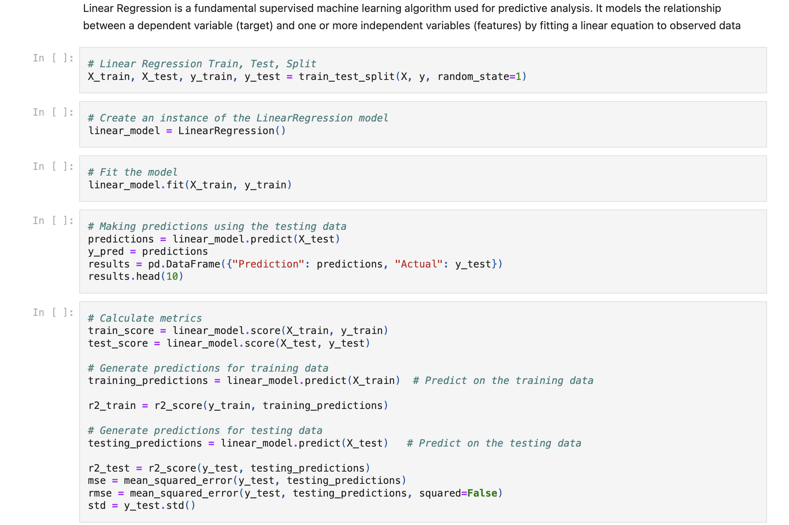
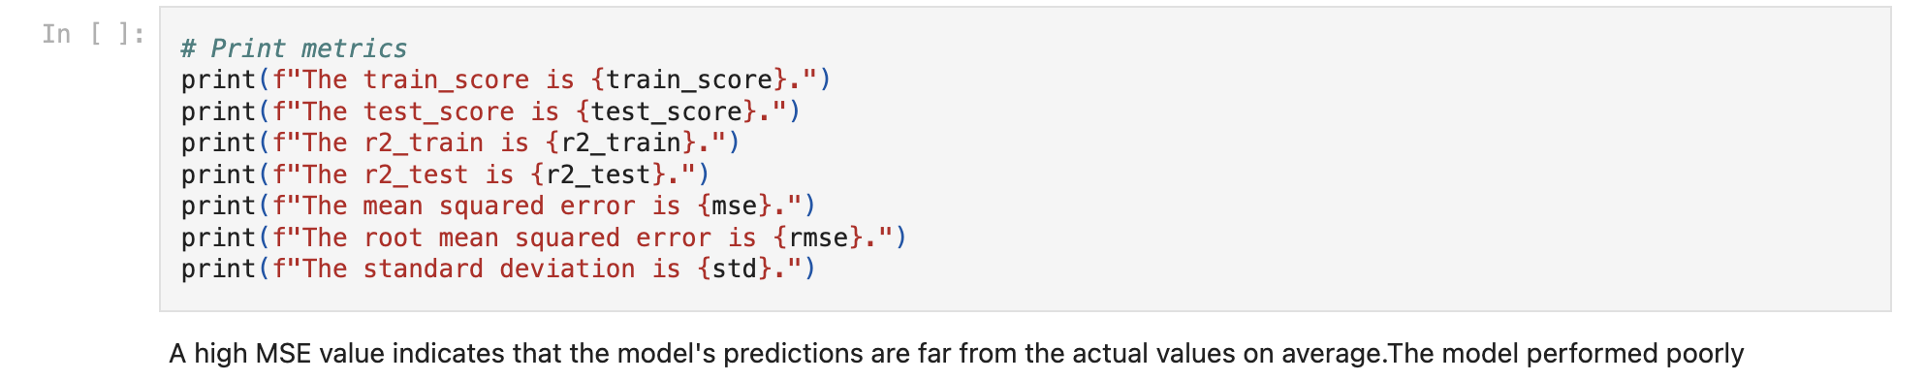
Linear regression model

Slide 10
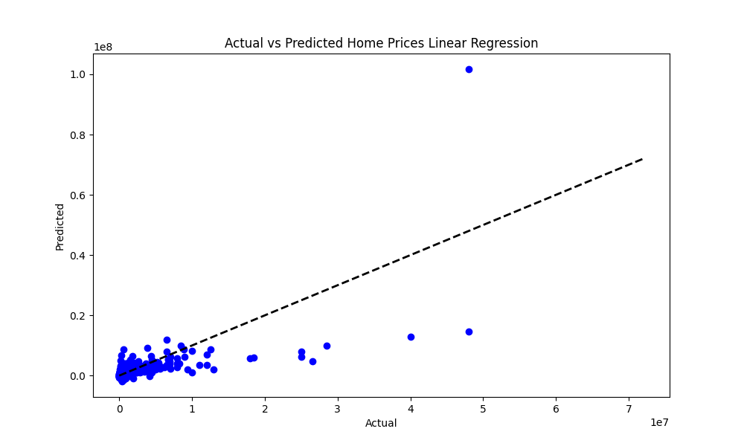
Linear regression method

Slide 11
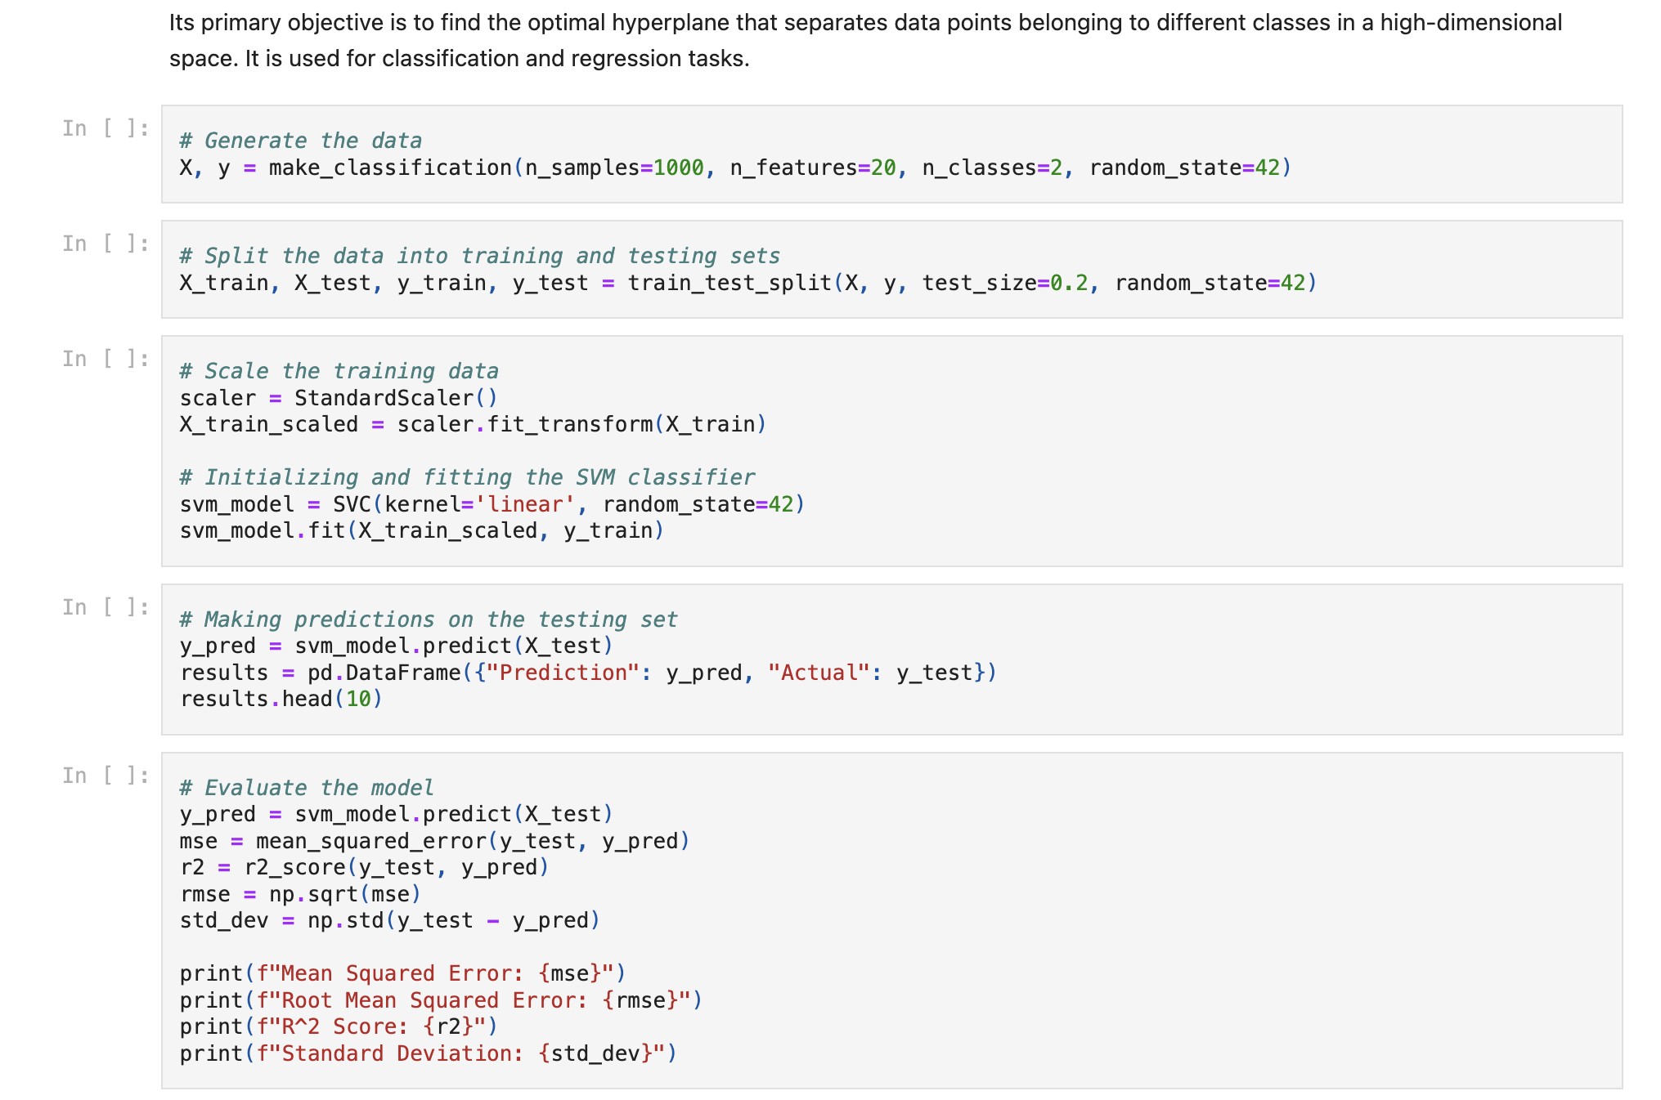
Support vector machine

Slide 12
results

Slide 13
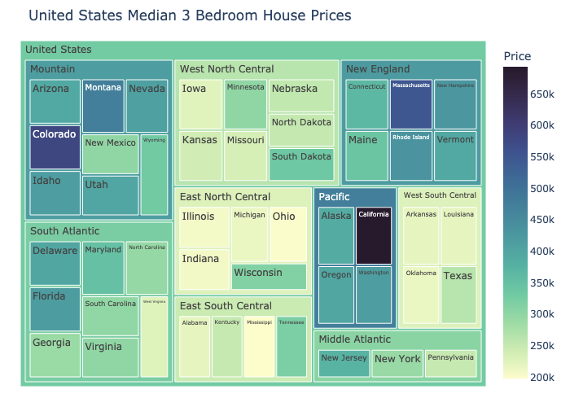
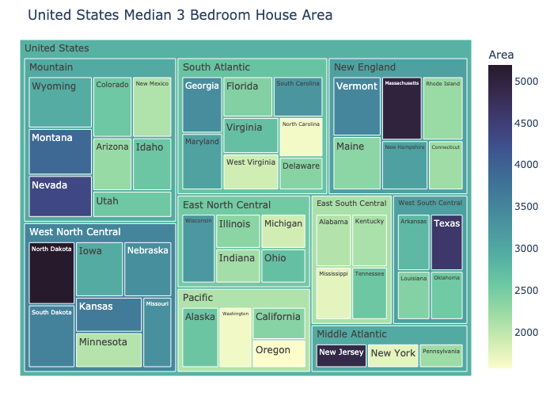
House prices vs square feet

Slide 14
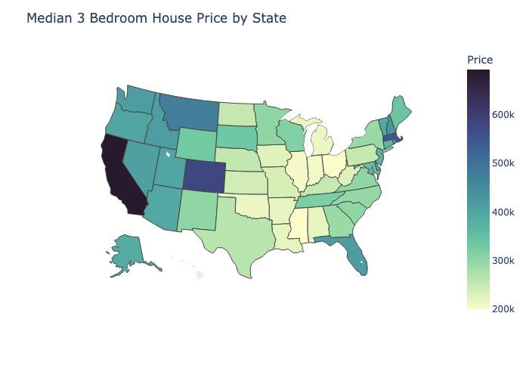
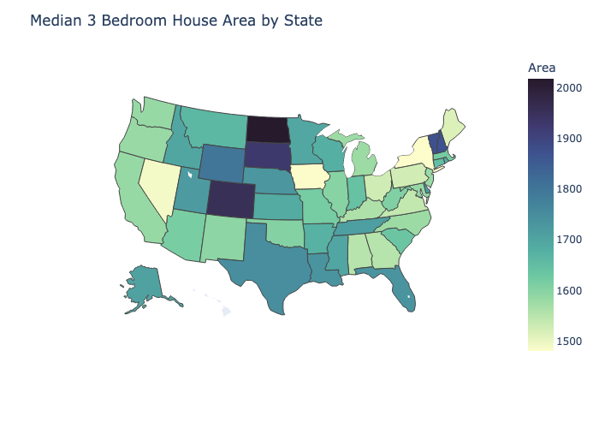
House prices vs square feet

Slide 15
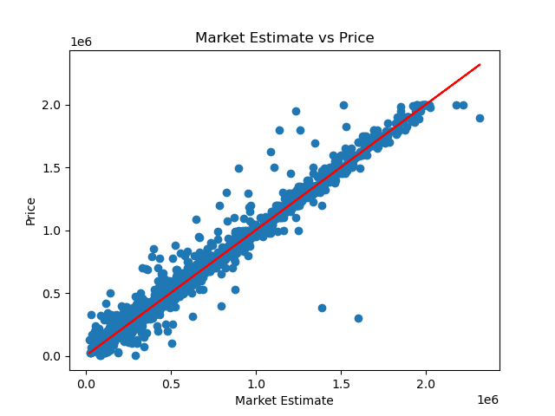
Linear regression correlation

Slide 16
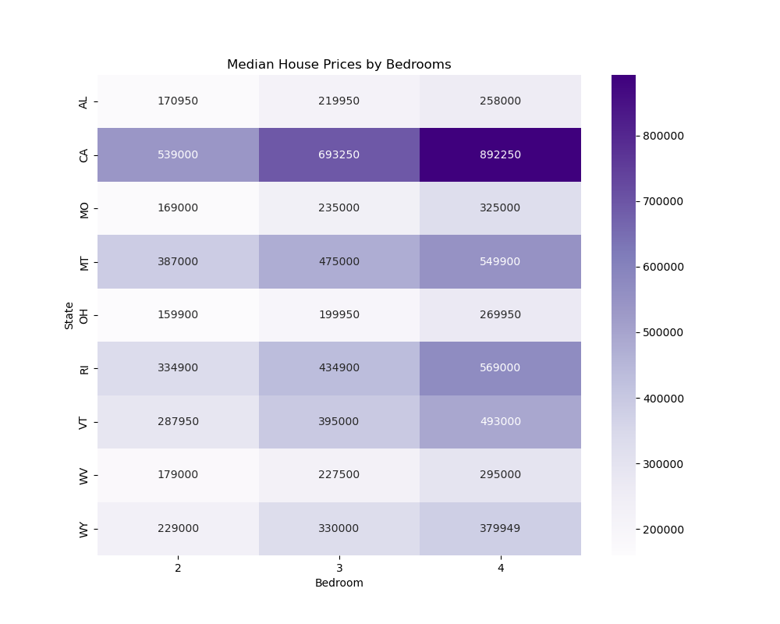
House price by bedroom,

Slide 17
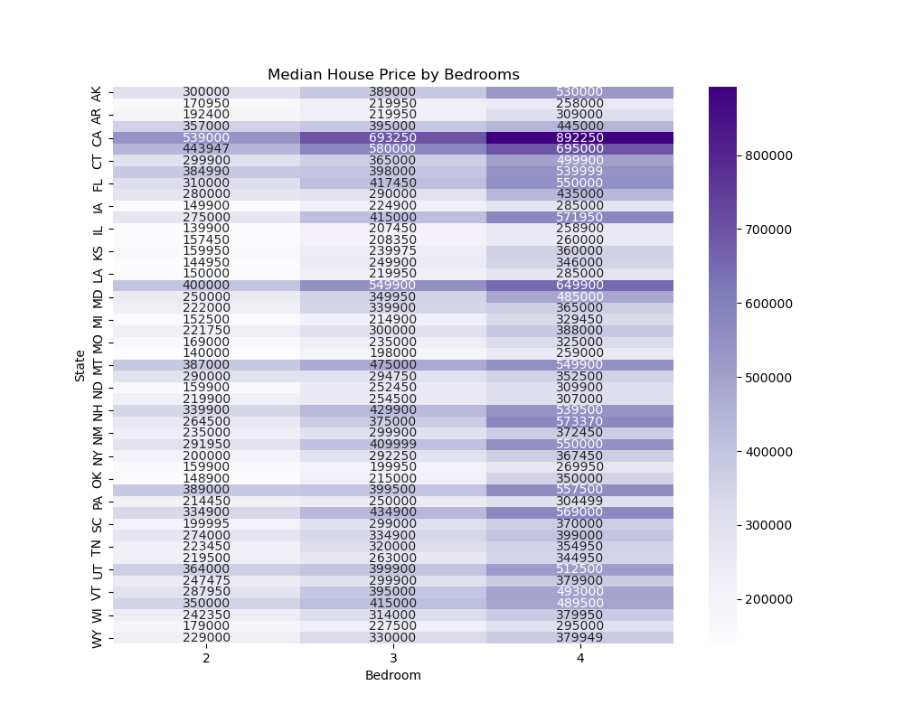
Median house price by bedroom

Slide 18
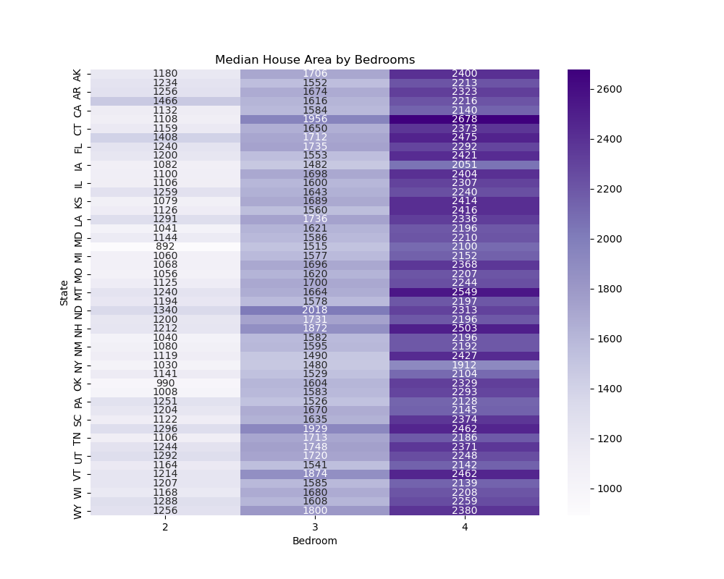
House price by square feet

Slide 19
analysis
Random Forest: moderate performance at 65%
Decision Tree: poor performance at 50%
Linear Regression: poor performance at 41% training and 30% testing
Support Vector Machine: poor performance at 46%
Notes:
Pre-machine learned data shows there is linear regression between market estimate and sale price

Slide 21

Thank you!

