Slide 1
Hellman’s TMTO Attack
Hellman’s TMTO <number>

Slide 2
Popcnt
Before we consider Hellman’s attack, consider simpler Time-Memory Trade-Off
“Population count” or popcnt
  Let x be a 32-bit integer
  Define popcnt(x) = number of 1’s in binary expansion of x
How to compute popcnt(x) efficiently?
Hellman’s TMTO <number>

Slide 3
Simple Popcnt
Most obvious thing to do is
popcnt(x) // assuming x is 32-bit value
t = 0
for i = 0 to 31
t = t + ((x >> i) & 1)
next i
return t
end popcnt
Is this the most efficient method?
Hellman’s TMTO <number>

Slide 4
More Efficient Popcnt
Pre-compute popcnt for all 256 bytes
Store pre-computed values in a table
Given x, lookup its bytes in this table
  Sum these values to find popcnt(x)
Note that pre-computation is done once
Each popcnt now requires 4 steps, not 32
Hellman’s TMTO <number>

Slide 5
More Efficient Popcnt
Initialize: table[i] = popcnt(i) for i = 0,1,…,255
popcnt(x) // assuming x is 32-bit word
p = table[ x & 0xff ]
+ table[ (x >> 8) & 0xff ]
+ table[ (x >> 16) & 0xff ]
+ table[ (x >> 24) & 0xff ]
return p
end popcnt
Hellman’s TMTO <number>

Slide 6
TMTO Basics
Pre-computation
  One-time work
  Results stored in a table
Pre-computation results used to make each subsequent computation faster
Try to balance “memory” and “time”
In general, larger pre-computation requires more initial work and larger “memory” but then each computation takes less “time”
Hellman’s TMTO <number>

Slide 7
Block Cipher Notation
Consider a block cipher
C = E(P, K)
where
P is plaintext block of size n
C is ciphertext block of size n
K is key of size k
Hellman’s TMTO <number>

Slide 8
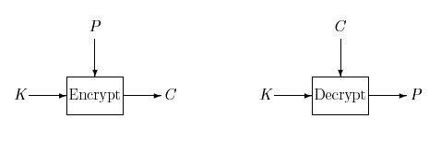
Block Cipher as Black Box
For TMTO, treat block cipher as black box
Details of crypto algorithm not important
Hellman’s TMTO <number>

Slide 9
Hellman’s TMTO Attack
Chosen plaintext attack: choose P and obtain C, where C = E(P, K)
Want to find the key K
Two “obvious” approaches
  Exhaustive key search
    “Memory” is 0, but “time” of 2^{k-1} for each attack
  Pre-compute C = E(P, K) for all keys K
    Given C, simply look up key K in the table
    “Memory” of 2^{k} but “time” of 0 for each attack
TMTO lies between 1. and 2.
Hellman’s TMTO <number>

Slide 10
Chain of Encryptions
Assume block length n and key length k are equal: n = k
Then a chain of encryptions is
SP = K₀ = Starting Point
K₁ = E(P, SP)
K₂ = E(P, K₁)
:
:
EP = K_{t} = E(P, K_{t−1}) = End Point
Hellman’s TMTO <number>

Slide 11
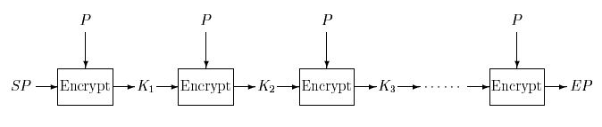
Encryption Chain
Ciphertext used as key at next iteration
Same (chosen) plaintext P used at each iteration
Hellman’s TMTO <number>

Slide 12
Pre-computation
Pre-compute m encryption chains, each of length t +1
Save only the start and end points
(SP₀, EP₀)
(SP₁, EP₁)
:
(SP_{m-1}, EP_{m-1})
EP₀
SP₀
EP₁
SP₁
EP_{m-1}
SP_{m-1}
Hellman’s TMTO <number>

Slide 13
TMTO Attack
Memory: Pre-compute encryption chains and save (SP_{i}, EP_{i}) for i = 0,1,…,m−1
  This is one-time work
  Must be sorted on EP_{i}
To attack a particular unknown key K
  For the same chosen P used to find chains, we know C where C = E(P, K) and K is unknown key
  Time: Compute the chain (maximum of t steps)
X₀ = C, X₁ = E(P, X₀), X₂ = E(P, X₁),…
Hellman’s TMTO <number>

Slide 14
TMTO Attack
Consider the computed chain
X₀ = C, X₁ = E(P, X₀), X₂ = E(P, X₁), …
Suppose for some i we find X_{i} = EP_{j}
EP_{j}
SP_{j}
C
K
Since C = E(P, K) key K should lie before ciphertext C in chain!
Hellman’s TMTO <number>

Slide 15
TMTO Attack
Summary of attack phase: we compute chain
X₀ = C, X₁ = E(P, X₀), X₂ = E(P, X₁),…
If for some i we find X_{i} = EP_{j}
Then reconstruct chain from SP_{j}
Y₀ = SP_{j}, Y₁ = E(P,Y₀), Y₂ = E(P,Y₁),…
Find C = Y_{t−i} = E(P, Y_{t−i−1}) (always?)
Then K = Y_{t−i−1} (always?)
Hellman’s TMTO <number>

Slide 16
Trudy’s Perfect World
Suppose block cipher has k = 56
  That is, the key length is 56 bits
Spse we find m = 2²⁸ chains each of length t = 2²⁸ and no chains overlap (unrealistic)
Memory: 2²⁸ pairs (SP_{j}, EP_{i})
Time: about 2²⁸ (per attack)
  Start at C, find some EP_{j} in about 2²⁷ steps
  Find K with about 2²⁷ more steps
Attack never fails!
Hellman’s TMTO <number>

Slide 17
Trudy’s Perfect World
No chains overlap
Every ciphertext C is in one chain
SP₀
EP₀
C
EP₁
SP₁
K
EP₂
SP₂
Hellman’s TMTO <number>

Slide 18
The Real World
Chains are not so well-behaved!
Chains can cycle and merge
K
C
EP
SP
Chain beginning at C goes to EP
But chain from SP to EP does not give K
Is this Trudy’s nightmare?
Hellman’s TMTO <number>

Slide 19
Real-World TMTO Issues
Merging chains, cycles, false alarms, etc.
Pre-computation is lots of work
  Must attack many times to amortize cost
Success is not assured
  Probability depends on initial work
What if block size not equal key length?
  This is easy to deal with
What is the probability of success?
  This is not so easy to compute…
Hellman’s TMTO <number>

Slide 20
To Reduce Merging
Compute chain as F(E(P, K_{i−1})) where F permutes the bits
Chains computed using different functions can intersect, but they will not merge
SP₀
F₀ chain
EP₁
SP₁
F₁ chain
EP₀
Hellman’s TMTO <number>

Slide 21
Hellman’s TMTO in Practice
Let
  m = random starting points for each F
  t = encryptions in each chain
  r = number of “tables”, i.e., random functions F
Then mtr = total pre-computed chain elements
Pre-computation is about mtr work
Each TMTO attack requires
  About mr “memory” and about tr “time”
If we choose m = t = r = 2^{k/3} then probability of success is at least 0.55
Hellman’s TMTO <number>

Slide 22
Success Probability
Throw n balls into m urns
What is expected number of urns that have at least one ball?
This is classic “occupancy” problem
  See Feller, Intro. to Probability Theory
Why is this relevant to TMTO attack?
  “Urns” correspond to keys
  “Balls” correspond to constructing chains
Hellman’s TMTO <number>

Slide 23
Success Probability
Using occupancy problem approach
Assuming k-bit key and m,t,r defined as previously discussed
Then, approximately,
P(success) = 1 − e^{−mtr/2k}
An upper bound can be given that is slightly “better”
Hellman’s TMTO <number>

Slide 24
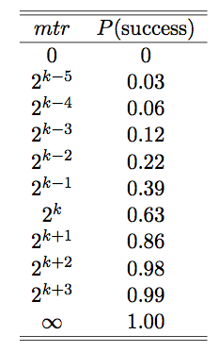
Success Probability
Success probability
P(success) = = 1 − e^{−mtr/2k}
Hellman’s TMTO <number>

Slide 25
TMTO: The Bottom Line
Attack is feasible against DES
Pre-computation is about 2⁵⁶ work
Each attack requires about
  2³⁷ “memory” and 2³⁷ “time”
Attack not particular to DES
No fancy math is required!
Lesson: Clever algorithms can break crypto!
Hellman’s TMTO <number>

Slide 26
Reference
M. Hellman, A cryptanalytic time-memory tradeoff, IEEE transactions on Information Theory, Vol. 26, 1980, pp. 401–406.
Hellman’s TMTO <number>

