Slide 1

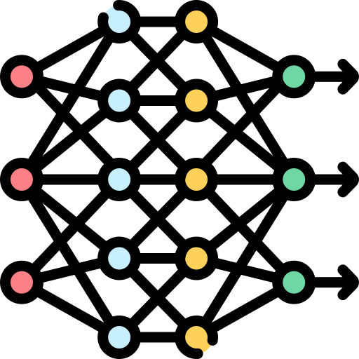
Predicting Hotel Booking Cancellations to Minimize Revenue Loss due to False Negatives¹
Fractal Labs
Adelia Januarto
Data Analyst
¹The model predicts that the booking will not be canceled, but in reality, the booking is canceled
Notes:
Fractal Labs is a fictional company
Icon: https://www.flaticon.com/free-icon/deep-learning_8637101

Slide 2
Executive Summary
Fractal Labs
Key Point
Description
Problem
Booking cancellations significantly challenge the hospitality industry by causing revenue loss and reducing operational efficiency, and manual risk assessments, though useful, are labor-intensive and often unreliable.
1
Goal
Build a classification model to predict hotel booking cancellations so that the hotel can reduce revenue loss.
2
Findings
Naïve Bayes algorithm can be used for flagging high risk bookings (bookings which more likely to be canceled) with F2 = 0.72.
3
Recommendations
Hotel managers can leverage model predictions to proactively manage bookings and staff allocation, while tracking metrics to measure the model's impact.
4

Slide 3
Fractal Labs
The challenge now is….
What the problem is
Success metric
Problem
Hospitality industry faces significant revenue loss and operation inefficiency due to booking cancellations (23%).
Predicting cancellations in advance allows for proactive mitigation of negative impacts.
Traditional methods (e.g., historical data analysis) are labor intensive and often unreliable.
Type I error
Incorrectly identifying a booking as canceled can lead to unnecessary compensation for room upgrades
Estimated financial impacts
Average loss per false positive: $10 to $67.5
Total monthly loss for 100 errors: $1,000 to $6,750
Objective
Developing a classification model to predict hotel booking cancellations.
Leverage historical booking data to classify bookings as “Canceled” and “Not Canceled”.
Enable managers to allocate resources more effectively and reduce potential revenue loss due to cancellations
Type II error
Incorrectly predicting a cancellations
Estimated financial impacts
Revenue loss per false negative: $99 per night
Total monthly loss for 100 errors: $9,900
Metric
Mainly focus on mitigating the impact of false negatives (Type II errors) due to higher financial risk.
F2 (emphasis on recall to reduce Type II errors) will be used to evaluate the model’s performance.
Analytic approach
Develop a predictive model to assist the hotel in forecasting the likelihood of booking cancellations

Slide 4
Outline
Fractal Labs
1
Experiment design
2
Experiment results
3
Best model’s evaluation: How good the model works
4
Best model’s explanation: How the best model works
5
Conclusions and recommendations

Slide 5
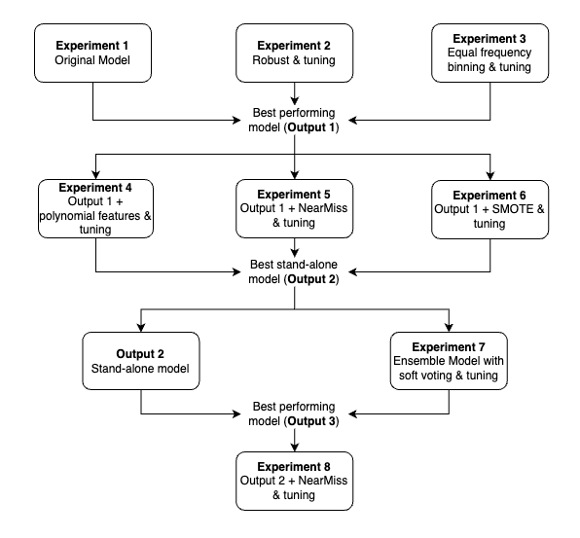
Experiment design: Experiment flow
Fractal Labs
Name
Setup
Experiment flow
Experiment 1
Focuses on basic setup (categorical encodings only)
Experiment 2
Basic setup + robust scaling
Experiment 3
Basic setup + equal frequency binning
Evaluation 1
Evaluating Experiment 1 – 3
Experiment 4
Evaluation result 1 + polynomial features
Experiment 5
Evaluation result 1 + NearMiss v3
Experiment 6
Evaluation result 2 + SMOTE
Evaluation 2
Evaluating Experiment 4 – 6
Experiment 7
Blended model based on Evaluation 2
Evaluation 3
Evaluating best model vs blended model
Experiment 8
Evaluation result 3 + NearMiss v3 (standalone model only)

Slide 6
Outline
Fractal Labs
1
Experiment design
2
Experiment results
3
Best model’s evaluation: How good the model works
4
Best model’s explanation: How the best model works
5
Conclusions and recommendations

Slide 7
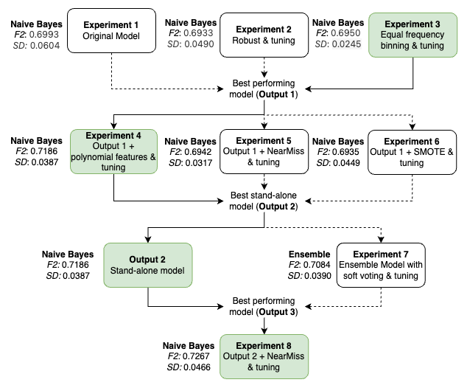
Naïve Bayes is the best performing model
Fractal Labs
Naïve Bayes algorithm performed the best across experiments (based on F2)
Insights
Naïve Bayes appears to be a strong baseline across all experiments. It performs well (F2 score above 0.69) in 6 experiments with the best performance at 0.7186.
Ensemble method with soft voting achieves an F2 score of 0.7084 which is slightly lower than the best model (0.7186).
As the best model among the 7th experiments remains Naïve Bayes with no specific treatments on class imbalance issue, another experiment (Experiment 8) was setup, and gave the highest F2 score (0.7267).

Slide 8
Outline
Fractal Labs
1
Experiment design
2
Experiment results
3
Best model’s evaluation: How good the model works
4
Best model’s explanation: How the best model works
5
Conclusions and recommendations

Slide 9
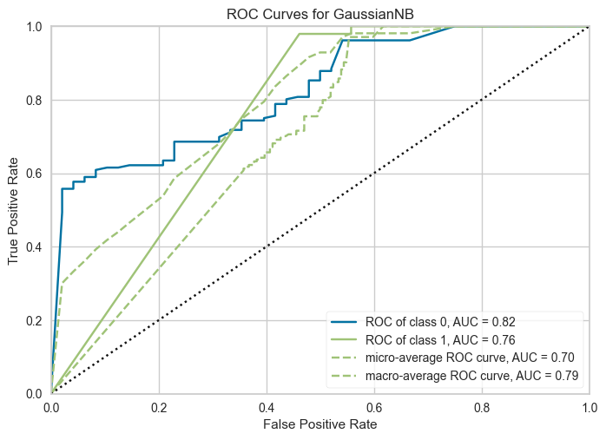
ROC-AUC plot
Fractal Labs
NB model is good at both predicting cancellations and non-cancellations
Insights
The AUC for class 1 (Canceled) is 0.76, indicating the model is reasonably good at distinguishing between canceled and non-canceled bookings. Ideally, a higher AUC would improve true cancellation detection.
For class 0 (Not Canceled), the AUC is 0.82, suggesting the model is quite effective at identifying non-canceled bookings. While this is less critical for reducing type II errors, it still demonstrates good performance.
The micro-average AUC is 0.70, considering all classes together, and the macro-average AUC is 0.79, averaging the metric independently for each class.
In short, the model performs well at both classifying cancellations and non-cancellations.

Slide 10
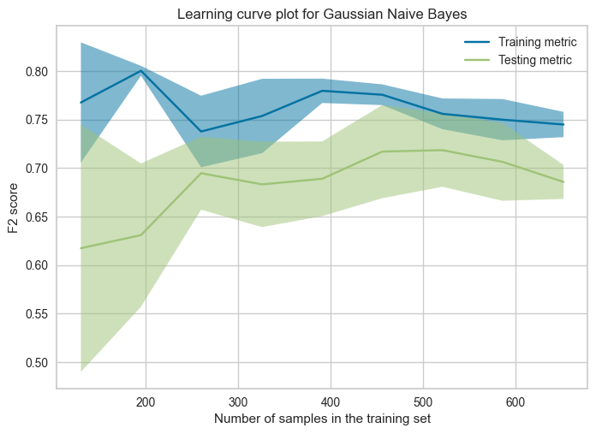
Learning curve plot
Fractal Labs
More data can be beneficial for NB to perform consistently
Insights
The training score (blue line) starts high and slightly decreases, indicating the model initially fits the training data well.
The testing score begins low and increases, showing the model gets better at predicting new data.
The lines converge around F2=0.75.
In short, although the model doesn't not show any signs of underfitting or overfitting.

Slide 11
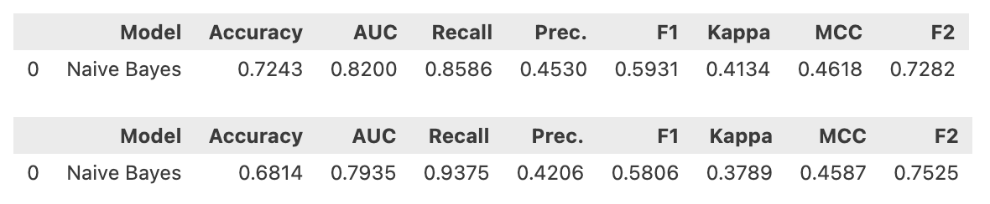
Performance across training vs test sets
Fractal Labs
NB model performs better in the test set than in training one
Insights
The Gaussian Naive Bayes Classifier achieves an F2 score of 0.7282 on the training set and 0.7525 on the test set.
The better performance on the test set means that model performs better on this dataset, and hence a good indication of generalization.
NB performance on training set
NB performance on test set

Slide 12
Outline
Fractal Labs
1
Experiment design
2
Experiment results
3
Best model’s evaluation: How good the model works
4
Best model’s explanation: How the best model works
5
Conclusions and recommendations

Slide 13
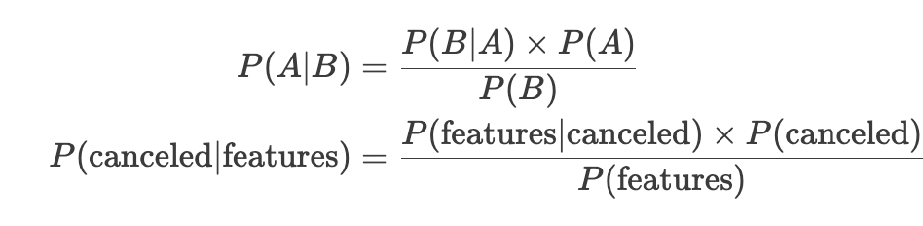
How the model (Naïve Bayes model) works
Fractal Labs
Method
Note
Naive Bayes Classifier works by applying Bayes' Theorem with the assumption that features are independent (naïve) and follow Gaussian distribution.
It calculates the probability of each class given the input features and predicts the class with the highest probability.
This method is simple and fast for many types of classification tasks.
Note:
P(Canceled | Features): probability of a booking being canceled given observed features (e.g., customer type)
P(Features | Canceled): probability of observing features given the booking was canceled.
P(Canceled): prior probability of a booking being canceled.
P(Features): probability of observing the features

Slide 14
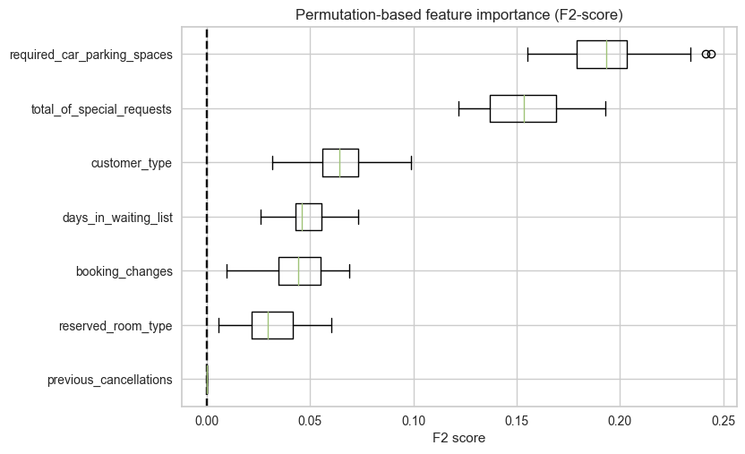
Permutation importance
Fractal Labs
Number of parking spaces has the highest importance in NB predictions
Insights
Permutation importance checks the relative importance of each feature in making predictions.
It works by shuffling feature values and observing changes in model performance.
The `required_car_parking_spaces` has the highest importance, suggesting that the number of parking spaces required by a guest is the strongest predictor of cancellation.
Notes:
Sekarang setelah kita memahami rumus Naive Bayes, mari kita mempelajari aspek penting lainnya dari interpretasi model kita: pentingnya permutasi.
Dengan memahami bagaimana pentingnya fitur ditentukan melalui kepentingan permutasi, kita dapat memperoleh insight yang lebih mendalam tentang fitur mana yang paling berpengaruh dalam proses pemodelan prediktif kita.

Slide 15
Outline
Fractal Labs
1
Experiment design
2
Experiment results
3
Best model’s evaluation: How good the model works
4
Best model’s explanation: How the best model works
5
Conclusions and recommendations

Slide 16
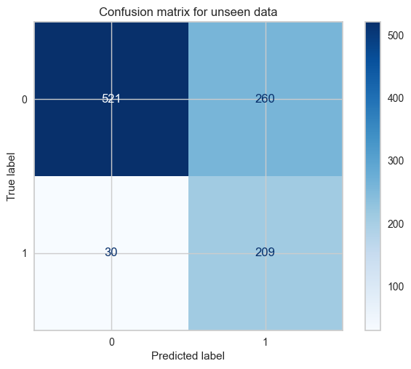
Implications
Fractal Labs
With Model
Without Model
Assume 60% incorrect predictions with FP of 20% and FN 40%
FP: 0.2 x 1020 bookings
204 bookings x $67.5 = $13,770
FN: 0.4 x 1020 bookings
408 bookings x $99 = $40,394
Total: $54,162
TN
FP
FN
TP
FP (Type I error): actual 0, pred 1
260 x $67.5 = $17,550
FN (Type II error): actual 1, pred 0
30 x $99 = $2,970
Total: $20,520
Difference:
$54,162 - $20,520 = $33,642 saved by the model

Slide 17
Conclusions and recommendations
Fractal Labs
Summary
Recommendations
This project aims to develop a machine learning classification model to predict hotel booking cancellations with a main focus of minimizing False Negative (Type II Error).
A series of machine learning experiments on the hotel's historical data have been carried out to find the best model in achieving such goal.
Among these experiments, Naïve Bayes algorithm performs the best to predict hotel cancellations with F2 score of 0.72
The model can help catch some cancellations that might have been missed before.
By knowing which bookings are more likely to cancel, the hotel can avoid wasting staff, supplies or preparing rooms that might not be needed.
For hotel managers
Use model predictions to proactively manage bookings (e.g., reminding guests about their stays or offering deals to keep them from cancelling) and optimize resource allocation based on cancellations.
Track metrics to see if the model improves hotel operations (consider A/B testing).
For future directions
Improve data quality by double-checking the source.
Experiment with different model configurations to potentially achieve a better performing model.

