Slide 1
Efficient Nonlinear Behavior Modeling Method for Voltage-Variable Capacitors
1. background
The nonlinear characteristic of the voltage-variable capacitor produces unwanted harmonics when driven by a large exciting signal, which causes electromagnetic radiation spurious emission (RSE) complications.
developing an accurate analysis model for the nonlinear behavior of the RF devices becomes essential
Behavioral model research:
parameterized approaches
Winner models
polynomial models
black-box models
neural networks
support vector machines

Slide 2
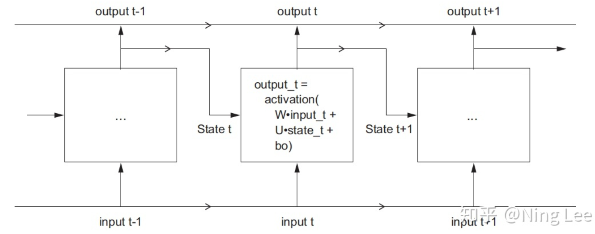
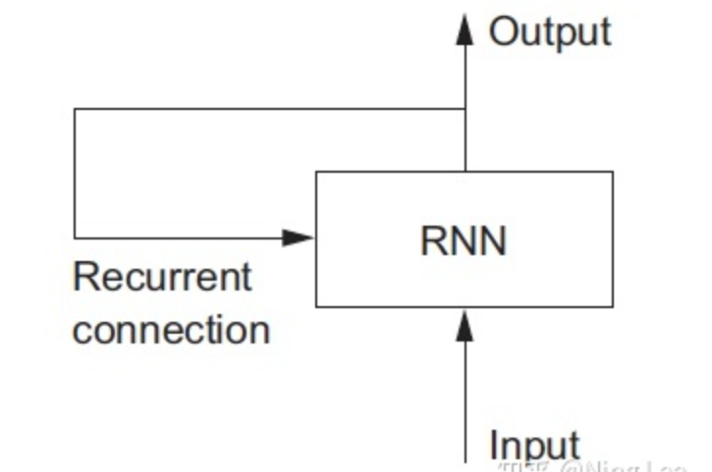
Efficient Nonlinear Behavior Modeling Method for Voltage-Variable Capacitors
1. background
循环神经网络
原理：以渐进的方式处理信息，同时保存一个关于所处理内容的内部模型，该模型根据过去的信息所构建，并随着新信息的进入而不断更新。
主要应用：1.文本相关（自然语言处理、对话系统、情感分析）2.时序相关（天气、温度预测）
区别（与全连接或卷积）：有记忆性
优缺点：
优点：处理序列化问题效果比DNN好
缺点：由于梯度消失的原因，不能处理长序列问题。

Slide 3
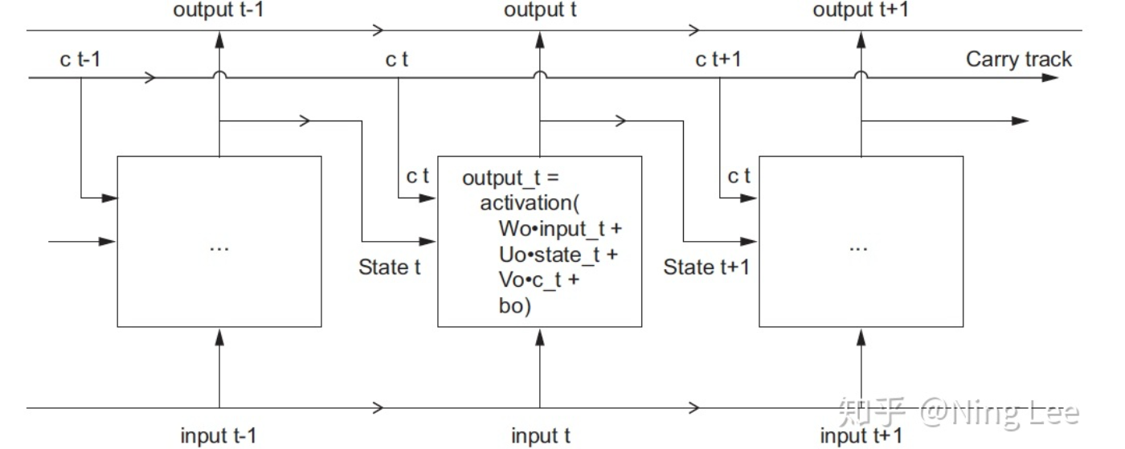
Efficient Nonlinear Behavior Modeling Method for Voltage-Variable Capacitors
1. background
b) LSTM
原理：在RNN的基础上保存信息以便以后使用，从而防止早期信号在处理过程中逐渐消失。
优点：解决了梯度消失的问题，能够处理长序列。

Slide 4
Efficient Nonlinear Behavior Modeling Method for Voltage-Variable Capacitors
2. contribution
Presents an efficient nonlinear capacitance polynomial model method coupling with harmonics test systems to predict the nonlinear behavior of the voltage-variable capacitor.
A simple neural network model is trained to reduce the need to manually obtain the nonlinear parameters.
For devices exhibiting strong nonlinearity, an improved long short-term memory (LSTM) network is proposed to predict harmonics.
the nonlinear parameter prediction for such devices is obtained quickly by implementing our developed method, which provides intuitive guidance in the design phase.

Slide 5
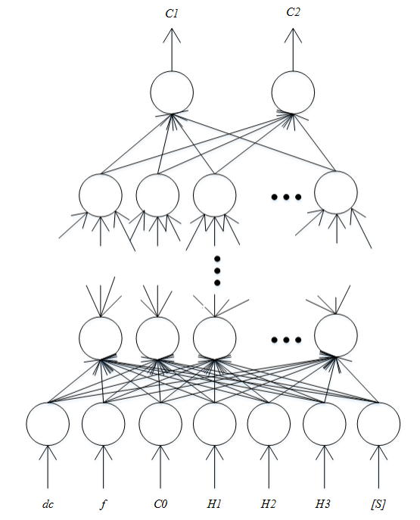
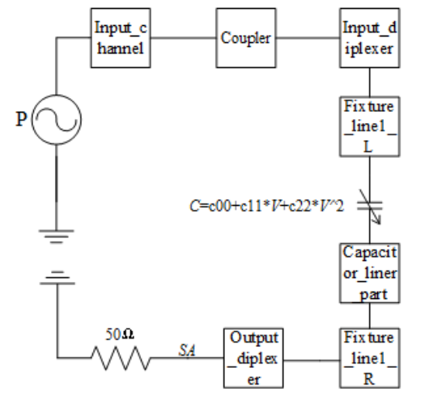

Efficient Nonlinear Behavior Modeling Method for Voltage-Variable Capacitors
3. System structure

Slide 6
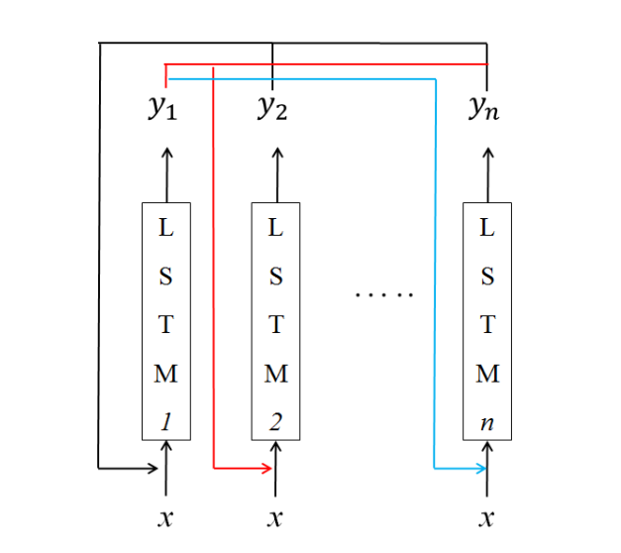
Efficient Nonlinear Behavior Modeling Method for Voltage-Variable Capacitors
3. System structure
对各阶基波和谐波的训练，得到n个LSTM网络
N个LSTM网络组合训练，各个波互相影响。
Improved LSTM network

Slide 7
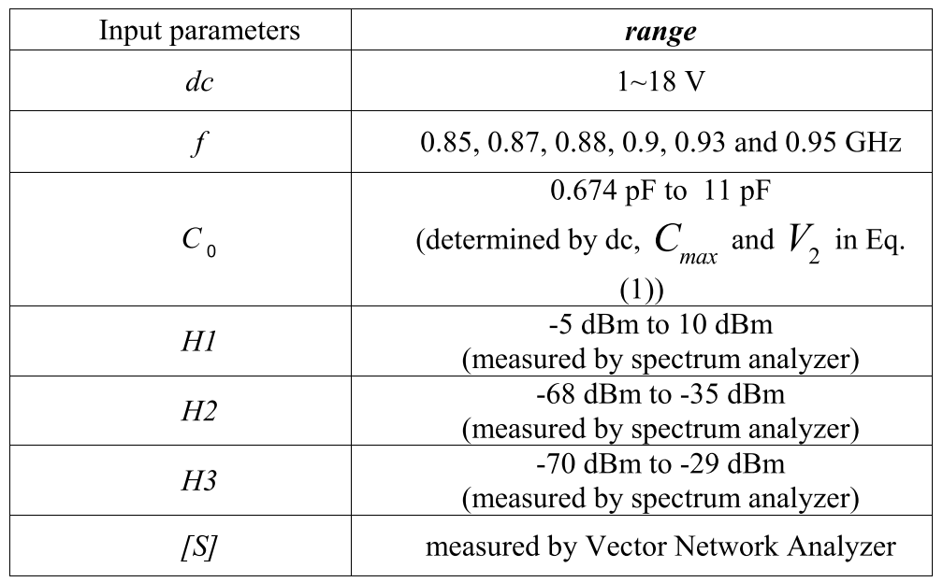
Efficient Nonlinear Behavior Modeling Method for Voltage-Variable Capacitors
4. sets

Slide 8
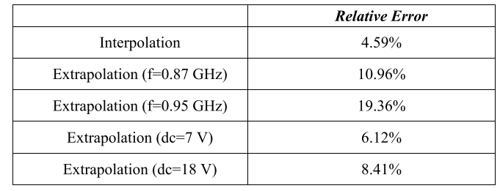
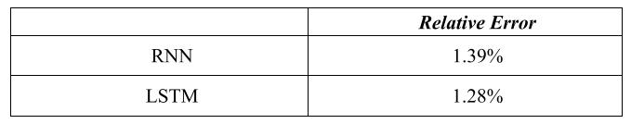
Efficient Nonlinear Behavior Modeling Method for Voltage-Variable Capacitors
5. Results
weak nonlinear data

Slide 9
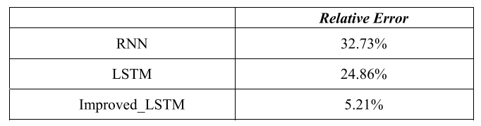
Efficient Nonlinear Behavior Modeling Method for Voltage-Variable Capacitors
5. Results
strong nonlinear data

