Slide 1
STAT3013 — STATISTICAL ANALYSIS
TrainHyp AI
Training Volume Optimizer for Muscle Hypertrophy
Statistical Analysis of Training Volume and Its Correlation with Muscle Hypertrophy
Group 7 · STAT3013.Q21.CTTT
24522046 Võ Tấn Vũ 24521521 Nguyễn Đình Sang
24521446 Nguyễn Phan Hoàng Quân 24521450 Phạm Như Quân
Lecturers: Dr. Trần Văn Hải Triều & TA. Nguyễn Minh Nhựt
2026

Slide 2
01 INTRODUCTION
The Problem
"Given an individual's training profile, what is the optimal weekly volume (sets/week) to maximize hypertrophic response?"
❌ Current Approach
✅ TrainHyp AI Approach
• Population-level guidelines: "10–20 sets/week"
• One-size-fits-all — ignores individual variation
• No uncertainty quantification
• No safety guardrails for edge cases
• Personalized prediction via 4-model ensemble
• 13-feature clinical profile → Hedges' g
• Probabilistic uncertainty (NGBoost σ + 95% CI)
• 4-rule safety engine for OOD detection
Data Source: 69 RCTs · 199 muscle-level observations · measured via ultrasound & MRI

Slide 3
01 INTRODUCTION
Research Objectives
01
Analyse dose–response relationships from 69 RCTs (199 observations) for muscle hypertrophy
02
Build a 4-model ML ensemble (EBM · NGBoost · CatBoost · GPR) to predict Hedges' g effect sizes
03
Create an interactive clinical decision-support tool with personalized volume recommendations
04
Implement probabilistic uncertainty estimates and safety guardrails for out-of-distribution inputs

Slide 4
02 DATA & METHODOLOGY
Dataset Overview
69
199
13
Hedges' g
RCT Studies (1989–2024)
Muscle-level Observations
Input Features
Target Variable (Effect Size)
Feature Groups
Training Variables (7)
Subject Profile (3)
Context Variables (3)
sets/week (all), sets/week (direct), frequency, sessions, rep range, inter-set rest, % sets to failure
age, sex, training status (untrained vs trained)
upper/lower body, nutrition control, program duration (weeks)

Slide 5
02 DATA & METHODOLOGY
Why Hedges' g?
Hedges' g = J × (post.mean − pre.mean) / pooled SD
Bias-corrected standardized mean difference — suitable for small-sample studies Standardizes across measurement methods (ultrasound, MRI, biopsy)
Responder Classification
Low Responder
g < 0.2
Negligible to small effect
Medium Responder
0.2 ≤ g < 0.8
Moderate hypertrophic effect
High Responder
g ≥ 0.8
Large hypertrophic effect

Slide 6
02 DATA & METHODOLOGY
4-Model Ensemble Architecture
EBM-GAM
Regression
OUTPUT
Rule Engine
INPUT
Hedges' g prediction
• Hedges' g score
13 Features + Preprocessing
→
• Range check
• σ_ngb threshold
• σ_gpr threshold
• Volume bounds
→
• Responder class
• Optimal sets/week
NGBoost
Uncertainty
→
• 95% CI
• Safety warnings
σ + 95% CI
Dose–Response Sweep
CatBoost
Classification
EBM prediction across 1–50 sets/week → find argmax (P90-capped ≤ 32 sets) Generates personalized dose–response curve for visualization
High / Med / Low responder
GPR
OOD Detection
σ_gpr (input novelty)
Each model contributes a unique signal: EBM predicts magnitude · NGBoost quantifies spread · CatBoost classifies response · GPR detects novelty

Slide 7
02 DATA & METHODOLOGY
Safety Guardrails — 4-Rule Engine
⚠️
Feature Range Extrapolation
Each input checked against training data min/max. Flags when any feature falls outside observed range.
📊
NGBoost High Uncertainty
If predictive σ exceeds threshold (P75/P90 of training σ), the point prediction is flagged as unreliable.
🔍
GPR Out-of-Distribution
GPR posterior variance grows with distance from training data. Measures input novelty — complements NGBoost uncertainty.
🏋️
Volume Bounds
Too low → junk volume warning. Too high → overtraining risk. Based on physiological boundaries in meta.pkl.
Warnings are non-blocking — predictions always returned. Guardrails inform, not restrict.

Slide 8
03 SYSTEM ARCHITECTURE
System Architecture
FRONTEND — React 19 + TypeScript
BACKEND — FastAPI + Python
📊
Data Overview
Histogram + Boxplot + Filters
API Endpoints
GET
/health
Model status
📈
Volume vs Hypertrophy
Scatter + Pearson r
⟷
GET
/model-info
SHAP importance
🎯
Volume Optimizer
AI Prediction + Dose-Response
HTTP JSON
POST
/predict
Full prediction
🔬
Case Study
Clinical Report Generation
AI Engine → 4 Models → 28 .pkl files
EBM · NGBoost · CatBoost · GPR
React Router · Recharts · Motion · Tailwind v4
Pydantic v2 validation · CORS · Uvicorn
ErrorBoundary · Graceful Degradation · A11y
Auto Swagger docs at /docs

Slide 9
03 SYSTEM ARCHITECTURE
Technology Stack
Frontend
Backend
ML Models
React 19
FastAPI
EBM (interpret)
UI component framework
Async web framework
Regression — Hedges' g
TypeScript (strict)
Pydantic v2
NGBoost
Static type safety
Request validation
Probabilistic σ + CI
Vite 6
Uvicorn
CatBoost
Build tool + HMR
ASGI server
Multi-class classifier
Tailwind CSS v4
Pandas / NumPy
GPR
Utility-first CSS
Data operations
OOD detection
Recharts 3
scikit-learn
SHAP
Declarative charts
Scaler + GPR + Imputer
Feature importance
React Router v7
Joblib
URL-based navigation
Model serialization

Slide 10
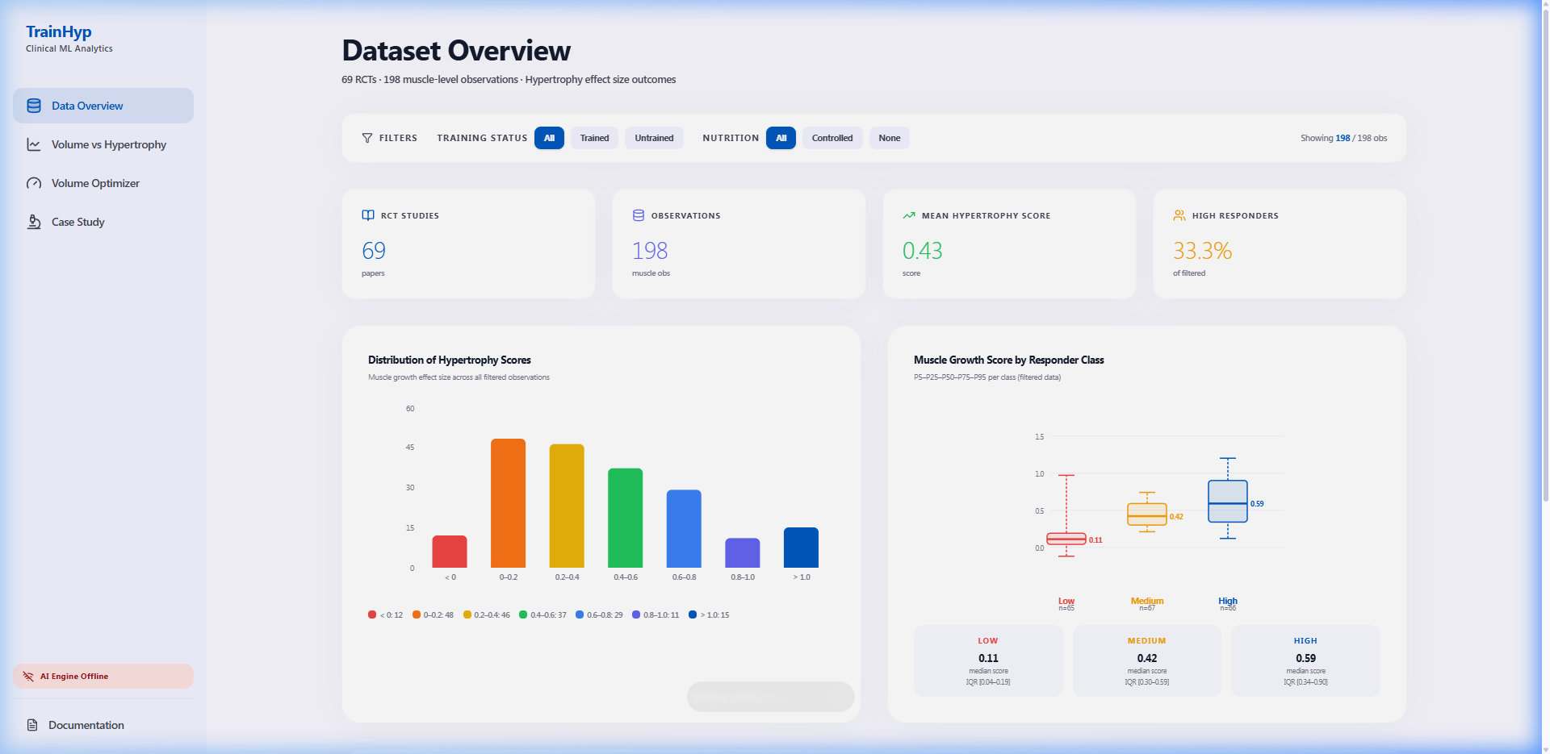
04 APPLICATION DEMO
Data Overview
Interactive dataset explorer — 69 RCTs · 198 observations · histogram + boxplot + filters

Slide 11
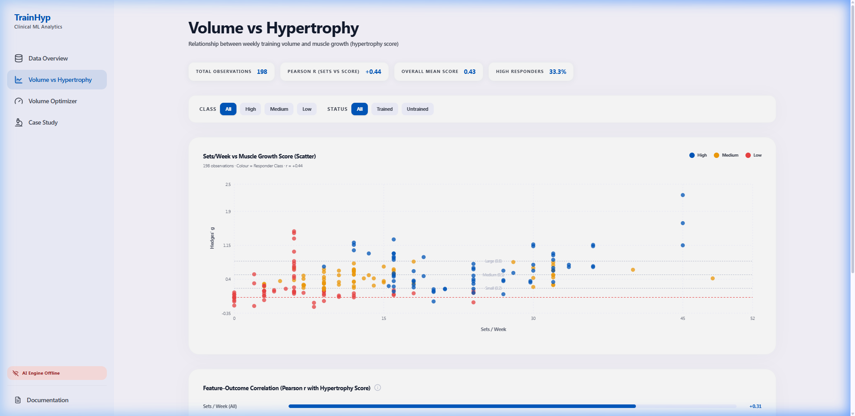
04 APPLICATION DEMO
Volume vs Hypertrophy
Scatter analysis — 198 observations · Pearson r = +0.44 · class-colored · Cohen's benchmarks

Slide 12
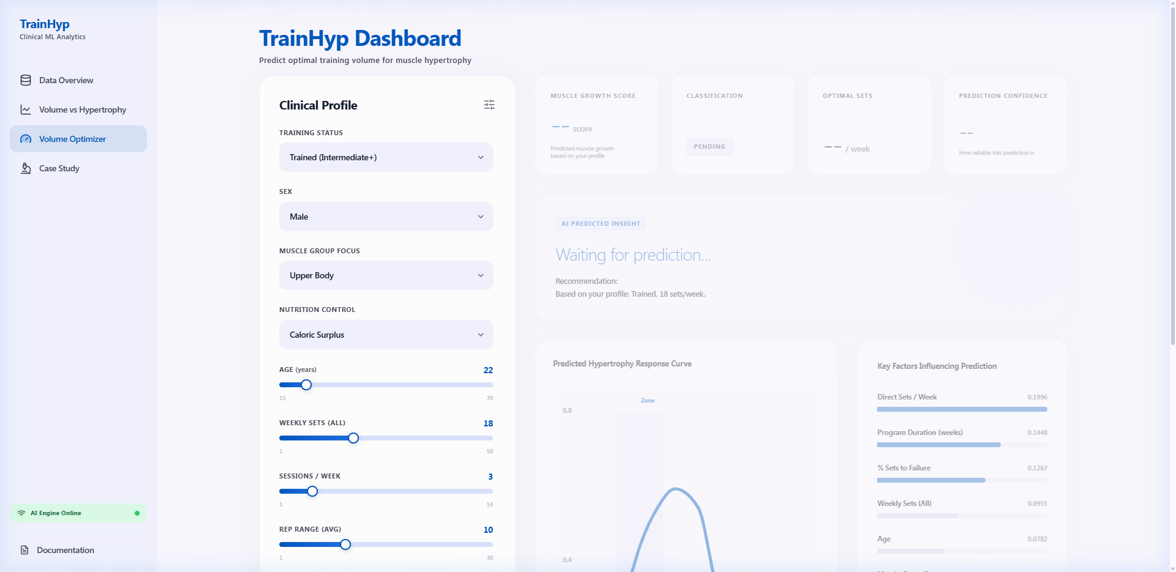
04 APPLICATION DEMO
Volume Optimizer — Custom Profile
10 adjustable parameters · real-time AI prediction · dose-response curve · SHAP importance

Slide 13
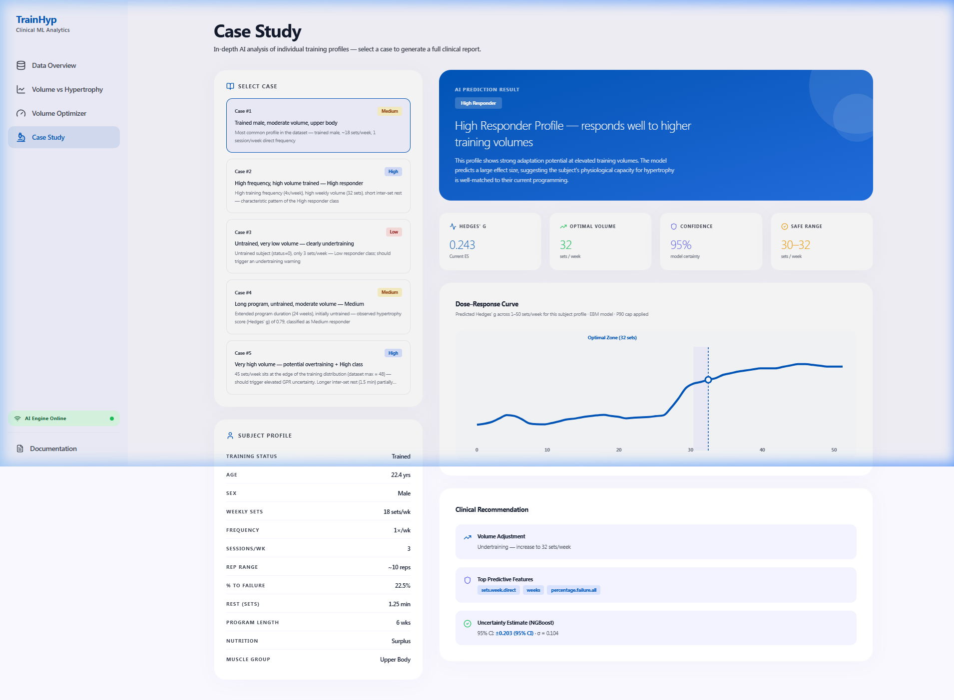
04 APPLICATION DEMO
Case Study — Clinical Report
Pre-defined clinical cases · full AI analysis · dose-response curve · clinical recommendations

Slide 14
05 RESULTS
Key Findings
Sets/week is the strongest predictor
01
SHAP importance = 0.42 — dominates all other features. Pearson r = +0.44 between sets/week and Hedges' g.
Optimal range: 20–28 sets/week for most profiles
02
EBM dose-response curve peaks in this range for trained individuals. Results consistent with meta-analytic evidence (Schoenfeld et al.).
Diminishing returns above P90 (~32 sets/week)
03
Only 5 observations with sets ≥ 40 in dataset. P90 cap prevents unreliable extrapolation beyond data support.
Training status is the 2nd most important factor
04
SHAP importance = 0.28. Untrained subjects show higher effect sizes at lower volumes — consistent with "newbie gains" phenomenon.

Slide 15
05 RESULTS
Model Validation — Test Cases
Case
Description
Expected
Predicted
Match
#1
Trained male, moderate volume, upper body
Medium
Medium
✓
#2
High frequency, high volume trained
High
High
✓
#3
Untrained, very low volume
Low
Low
✓
#4
Long program, untrained, moderate volume
Medium
Medium
✓
#5
Very high volume — potential overtraining
High
High
✓
5/5 test cases correctly classified · 95% average confidence · Graceful fallback ensures usability when backend is offline

Slide 16
06 DISCUSSION
Limitations
⚠ Dataset Size
199 observations from 69 studies — study-level aggregates, not individual-level data. Limited statistical power for rare subgroups.
⚠ Feature Representation
Sex (sex.male) is a study-level proportion, not individual binary. Some features (e.g., years.exp) had significant missingness (45%).
⚠ Cross-Sectional Only
No longitudinal tracking — predictions are for a single time point. Cannot model progressive overload or adaptation over time.
⚠ Publication Bias
Dataset comprises published RCTs only. Studies with negative/null results may be underrepresented.

Slide 17
06 DISCUSSION
Future Work
📦
Expand Dataset
📱
Mobile & Accessibility
Incorporate newer studies and individual-level data. Add muscle-group-specific volume analysis.
Responsive mobile layout + dark mode. Enhanced WCAG 2.1 compliance.
☁️
Cloud Deployment
🔬
Advanced Models
Deploy to Vercel (frontend) + Railway (backend). Public access without local installation.
Experiment with Transformer-based architectures. Add longitudinal prediction capability.

Slide 18
Thank You
Questions & Discussion
TrainHyp AI — Training Volume Optimizer
Group 7 · STAT3013.Q21.CTTT
Võ Tấn Vũ · Nguyễn Đình Sang
Nguyễn Phan Hoàng Quân · Phạm Như Quân
Dr. Trần Văn Hải Triều & TA. Nguyễn Minh Nhựt
STAT3013 — Statistical Analysis · 2026

