Slide 1
DBMS and RDBMS Concepts

Slide 2
Objective
At the end of this module, you will be able to:
Explain how DBMS overcomes issues in file system
Describe DBMS Functions
Identify data Models
Explain data Independence
Explain Concepts of RDBMS
Describe keys & entities
Develop ER Diagrams
Identify normalization concepts

Slide 3
Objective of Module 1 - DBMS
At the end of this module, you will be able to:
Understand about How DBMS overcomes issues in file system
Describe DBMS Functions
Explain database Approach
Identify data Models
Explain data Independence
Describe database Architecture
Identify types of Database Models

Slide 4
Database management System
DBMS – A Database is a collection of interrelated data and a Database Management System is a set of programs to use and/or modify this data.
DBMS contains information about a particular enterprise
Collection of interrelated data
Set of programs to access the data
An environment that is both convenient and efficient to use

Slide 5
DBMS
We can also define DBMS as, a software system that enables users to define, create, and maintain the database and provides controlled access to this database.
DBMS are categorized according to their data structures or types, sometime DBMS is also known as Data base Manager.
It is a set of prewritten programs that are used to store, update and retrieve a Database.

Slide 6
Database Applications
Banking: all transactions
Airlines: reservations, schedules
Universities: registration, grades
Sales: customers, products, purchases
Manufacturing: production, inventory, orders, supply chain
Human resources: employee records, salaries, tax deductions

Slide 7
Purpose of DBMS
In the early days, database applications were built on top of file systems
But file system has lot of drawbacks
Let us discuss few points on Drawbacks of using file systems to store data

Slide 8
Drawbacks of File System
Data redundancy and inconsistency
Multiple file formats, duplication of information in different files
Difficulty in accessing data
Need to write a new program to carry out each new task
Data isolation — multiple files and formats
Integrity problems
Integrity constraints (e.g. account balance > 0) become part of program code
Hard to add new constraints or change existing ones

Slide 9
Drawbacks of File System
Atomicity of updates
Failures may leave database in an inconsistent state with partial updates carried out
E.g. transfer of funds from one account to another should either complete or not happen at all
Concurrent access by multiple users
Concurrent accessed needed for performance
Uncontrolled concurrent accesses can lead to inconsistencies
E.g. two people reading a balance and updating it at the same time
Security problems
Database systems offer solutions to all the above problems

Slide 10
DBMS
This issue can be address by Database systems.
The four most common types of organizations are the hierarchical, network, relational and object models.
Inverted lists and other methods are also used.
The optimal structure depends on the natural organization of the application's data, and on the application's requirements.
which include transaction rate (speed), reliability, maintainability, scalability, and cost

Slide 11
DBMS Benefits
Improved strategic use of corporate data
Reduced complexity of the organization’s information systems environment
Reduced data redundancy and inconsistency
Enhanced data integrity
Application-data independence
Improved security

Slide 12
DBMS Benefits
Reduces application development and maintenance costs
Improves flexibility of information systems
Increases access and availability of data and information
Provides Logical & Physical data independence
Concurrent access anomalies
Facilitates atomicity problem
Provides central control on the system through DBA

Slide 13
DBMS Functions
There are several functions that a DBMS performs to ensure data integrity and consistency of data in the database.
They are
Data dictionary management
Data storage management
Data transformation and presentation
Security management
Multiuser access control

Slide 14
DBMS Functions
Backup and recovery management
Data integrity management
Database access languages and application programming interfaces
Database communication interfaces
Transaction management.

Slide 15
Data Dictionary Management
Data Dictionary is where the DBMS stores definitions of the data elements and their relationships (metadata).
The DBMS uses this function to look up the required data component structures and relationships.

Slide 16
Data Storage Management
This particular function is used for the storage of data and any related data entry forms or screen definitions, report definitions, data validation rules, procedural code, and structures that can handle video and picture formats.
Users do not need to know how data is stored or manipulated.

Slide 17
Security Management
This is one of the most important functions in the DBMS.
Security management sets rules that determine specific users that are allowed to access the database.
Users are given a username and password.

Slide 18
Multiuser Access Control
Data integrity and data consistency are the basis of this function. Multiuser access control is a very useful tool in a DBMS. It enables multiple users to access the database simultaneously without affecting the integrity of the database.

Slide 19
Backup and Recovery Management
Backup and recovery is brought to mind whenever there is potential outside threats to a database.
For example if there is a power outage, recovery management.
Backup management refers to the data safety and integrity.

Slide 20
Data Integrity Management
The DBMS enforces these rules to reduce things such as data redundancy
Maximizing data consistency

Slide 21
Database Access Languages and Application Programming Interfaces
A query language is a nonprocedural language.
An example of this is SQL (structured query language).
SQL is the most common query language supported by the majority of DBMS vendors.

Slide 22
Database Communication Interfaces
This refers to how a DBMS can accept different end user requests through different network environments.
An example of this can be easily related to the internet.
A DBMS can provide access to the database using the Internet through Web Browsers (Mozilla Firefox, Internet Explorer, Netscape).

Slide 23
Transaction Management
This refers to how a DBMS must supply a method that will guarantee that all the updates in a given transaction are made or not made.
All transactions must follow what is called the ACID properties.

Slide 24
ACID
A – Atomicity - States a transaction is an indivisible unit that is either performed as a whole and not by its parts, or not performed at.
C – Consistency - A transaction must alter the database from one constant state to another constant state.
I – Isolation - Transactions must be executed independently of one another. Part of a transaction in progress should not be able to be seen by another transaction.
D – Durability - A successfully completed transaction is recorded permanently in the database and must not be lost due to failures.

Slide 25
Evolution of Database/ Types
Mid 1940’s-File System
Mid 1950’s-Hierarchical Database System
Mid 1960’s-Network Database System
Mid 1970’s-Relational Database System (Mathematical Set Theory)
Mid 1980’s-Object Database System
Mid 1990’s-Object Relational Database System
ATTRIBUTE / COLUMN
TUPLE / ROW
VALUE
TABLE
Notes:
Relational model: In this model, each database item is viewed as a record with attributes. A set of records with similar attributes is called a table. Most of the popular commercial DBMS products like Oracle, Sybase, MySQL, etc. are based on relational model.
Network model: represents data as record types. However, unlike the relational model, here we have explicit linkages (expressed in the form of pointers) which relate various records. Each record has a link field corresponding to every relationship which it participates in. IDS (Integrated Data Store) is one of the DBMS product based on network models.
Hierarchical Model: represents data as hierarchical tree. This is a special kind of a network model in which the relationship is essentially a tree-like structure, where one parent may have many children but one child can not have more than one parent. The relationship borrower to books in a library system satisfies this condition. One of the popular DBMS based on hierarchical model is Information Management System (IMS) from IBM.
Object Oriented model: represents DB in terms of objects, their attributes, and their behaviors

Slide 26
Database System
The term database system refers to an organization of components that define and regulate the collection, storage, management, and use of data with in a database environment.
Components are
Hardware
Software
People
Procedures
Data

Slide 27
Database System
Users
Query Processor
Parses query
Returns compiled
query
Application Software / Query
Compiled Query
Database Manager
Identifies underlying
logical object(s)
Contacts file manager
Processing Query
Software to Access Stored DATA
File Manager
Identifies physical file name and location of the logical object
Retrieves and returns the data
Metadata
Database
Notes:
A database management system is a complex piece of software that usually consists of a number of modules. The DBMS may be considered as an agent that allows communication between the various types of users with the physical database and the operating system without the users being aware of every detail of how it is done. This also maintains Meta Data which is data about data
E.g
Bank Stores customer information which is similar to the application Data.
RBI stores information about all the banks which is similar to metadata. Like how the data maintained by RBI helps in effective and efficient management of processes, compliance and regulations, meta data helps in maintaining an effective and efficient database system.
Classification of users:
End Users : Who has a need to access the data stored or store new data
Application Programmer : Develops logic to access a specific data and to perform a specific operations
Database Administrators : Manages the database for its efficiency and day to day issues.

Slide 28
Data in the Database
Data are the very important basic entity in a database.
It is the collection of facts stored in the database.
Data Model
Data modeling is a process used to define and analyze data requirements needed to support the business processes within the scope of corresponding information systems in organizations.

Slide 29
Data in the Database
The use of data modeling standards is strongly recommended for all projects requiring a standard means of defining and analyzing data within an organization.
E.g., using data modeling:
to manage data as a resource;
for the integration of information systems;
for designing databases/data warehouses (aka data repositories)

Slide 30
Data Model
Data Model is a collection of tools for describing
data
data relationships
data semantics
data constraints
Entity-Relationship model
Relational model
Other models:
object-oriented model
Older models: network model and hierarchical model

Slide 31
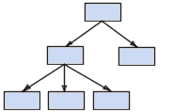
Hierarchical model
The data is sorted hierarchically, using a downward tree. This model uses pointers to navigate between stored data.
It was the first DBMS model.

Slide 32
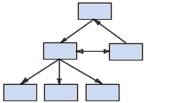
Network model
Like the hierarchical model, this model uses pointers toward stored data. However, it does not necessarily use a downward tree structure.

Slide 33
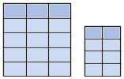
Relational model
Relation Model - RDBMS, Relational database management system.
The data is stored in two-dimensional tables (rows and columns).
The data is manipulated based on the relational theory of mathematics.

Slide 34
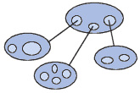
Object Model
The object model (ODBMS, object-oriented database management system)
The data is stored in the form of objects, which are structures called classes that display the data within.
The fields are instances of these classes:

Slide 35
Levels of Abstraction
Physical level describes how a record (e.g., customer) is stored.
Logical level: describes data stored in database, and the relationships among the data.
type customer = record
name : string;
street : string;
city : integer;
end;
View level: application programs hide details of data types.
Views can also hide information (e.g., salary) for security
purposes.

Slide 36
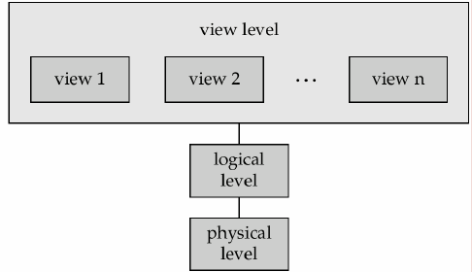
View of Data

Slide 37
Instances and Schemas
Similar to types and variables in programming languages
Schema – the logical structure of the database
e.g., the database consists of information about a set of customers and accounts and the relationship between them
Analogous to type information of a variable in a program
Physical schema: database design at the physical level
Logical schema: database design at the logical level

Slide 38
Instances and Schemas
Instance – the actual content of the database at a particular point in time
Analogous to the value of a variable
Physical Data Independence – the ability to modify the physical schema without changing the logical schema
Applications depend on the logical schema
In general, the interfaces between the various levels and components should be well defined so that changes in some parts do not seriously influence others.

Slide 39
DBMS Architecture
Three-Schema Architecture
Proposed to support DBMS characteristics of: - Insulation of programs and data/program and operations (program-data and program-operation independence) - Support of multiple views of the data. - Use of catalog (database description)

Slide 40
DBMS Architecture
Defines DBMS schema at three levels:
Internal schema
at the internal level to describe data storage structures and access paths.
Typically uses a physical data model.
Conceptual schema
at the conceptual level to describe the structure and constraints for the whole database.
Uses a conceptual or an implementation data model.
External schema
at the external level to describe the various user views.
Usually uses the same data model as the conceptual level or high-level data model.

Slide 41
DBMS Architecture
Mappings among schema levels are also needed.
Programs refer to an external schema, and are mapped by the DBMS to the internal schema for execution.

Slide 42
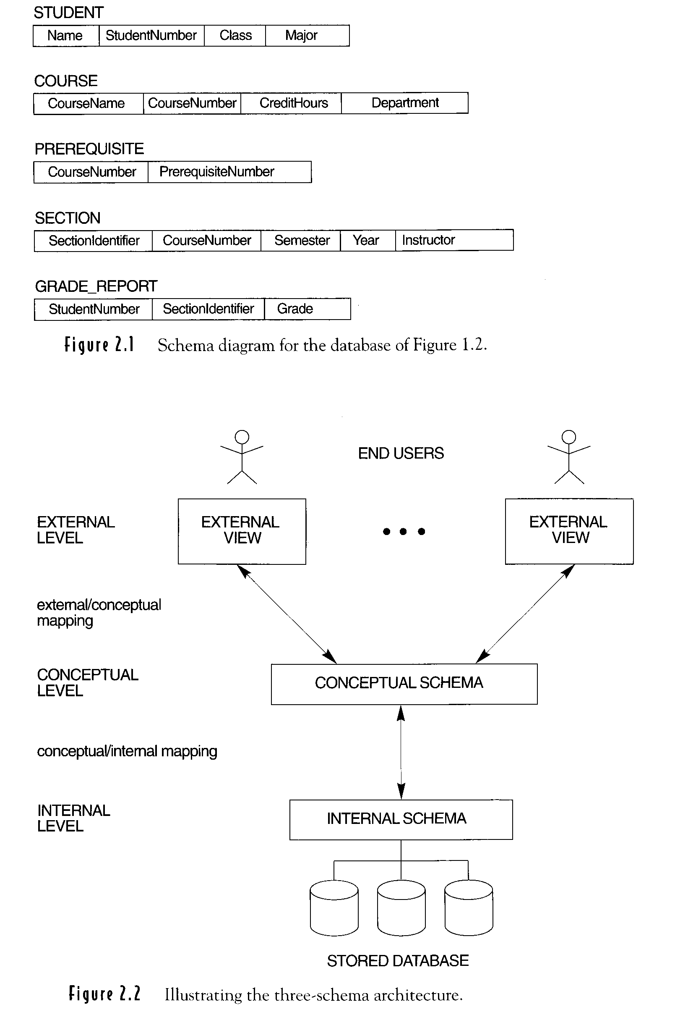
Three-schema architecture

Slide 43
Data Independence
Logical Data Independence: The capacity to change the conceptual schema without having to change the external schemas and their application programs.
Physical Data Independence: The capacity to change the internal schema without having to change the conceptual schema.

Slide 44
Database Design
The process of database design is divided
Requirement Analysis
Conceptual Database Design (ER-Diagram)
Logical Database Design (Tables, Normalization etc.)
Physical Database design (Table Indexing, Clustering etc.)

Slide 45
Summary
In this module, we have learnt about:
Concepts of DBMS
Benefits of DBMS
Level of Abstraction
Data Independence
Data Models
Three schema Data Architecture
Database Design

Slide 46
RDBMS

Slide 47
Objective of Module 2 - RDBMS
At the end of this module, you will be able to:
Explain RDBMS
List Terminologies in RDBMS
Explain Dr. Codd’s rule
Describe properties of Relations
Explain Normalization and Normal Forms

Slide 48
RDBMS
Relational Database is a collection of programs that enables user to create and maintain a database based on formal mathematical concepts and definitions.
It has to maintain the data integrity and data consistency.
In relational database, the data’s are arranged in row and column wise and there is only one value for each column.

Slide 49
Relational Concepts -Terminology
Relation : A table or File
Tuple : Row contains an entry for each attribute
Attributes : Columns or the characteristics that define the entity
Domain : A range of values (or Pool)
Entity : Some object about which we wish to store information

Slide 50
Relational Concepts -Terminology
Null : Represents an unknown/empty value
Atomic value : Smallest unit of data; the individual data value
Candidate key : Some attribute (or a set of attributes) that may uniquely identify each row (tuple) in the relation (table)
Primary key : The candidate key is chosen for primary attributes to uniquely identify each row.

Slide 51
Relational Concepts -Terminology
Alternate key : The remaining candidate keys that were not chosen as primary key
Foreign key : An attribute of one relation that might be a primary key of another relation.

Slide 52
CODD’s Relational Rules
All information in a relational database is represented explicitly at the logical level and in exactly one way - by values in tables.
Each and every datum(atomic value) in a relational database is guaranteed to be logically accessible by resorting to a combination of table name, primary key value, and column name.
Null values are supported for representing missing information in a systematic way irrespective of the data type.

Slide 53
CODD’s Relational Rules
4. The database description is represented at the logical level in the same way as ordinary data, so that authorized users can apply the same relational language to its interrogation as they apply to the regular data.

Slide 54
CODD’s Relational Rules
5. A relational system may support several languages and various modes of terminal use. However there must be one language whose statements can express all of the following items:
(1) data definitions
(2) view definitions
(3) data manipulation (interactive and by program)
(4) integrity constraints
(5) authorization
(6) transaction boundaries (begin, commit, rollback)

Slide 55
CODD’s Relational Rules
6. All views are theoretically updatable, are also updatable by the system.
7. The capability of handling a base relation or a derived relation (view) as a single operand applies not only to the retrieval of data but also to the insertion, updation and deletion of data.
8. Application programs and terminal activities remain logically unimpaired whenever any changes are made in either storage representations or access methods.

Slide 56
CODD’s Relational Rules
9. Application programs and terminal activities remain logically unimpaired when information-preserving changes of any kind that theoretically permit unimpairment are made to the base tables.
10. Integrity constraints specific to a particular relational database must be definable in relational data sublanguage and storable in the catalog, not in application programs.

Slide 57
CODD’s Relational Rules
11. The data manipulation sublanguage of a relational DBMS must enable application programs and inquiries to remain logically the same whether and whenever data are physically centralized or distributed.
12. If a relational system has a low-level (single-record-at-a-time) language, that low level cannot be used to subvert or bypass the integrity rules and constraints expressed in the higher-level relational language (multiple-records-at-a-time).

Slide 58
Relational Database Terms
Entity: an object about which you want to store data
Relationships: links that show how different records are related
Key Fields: establish relationships among records in different tables
Five main types of key fields:
primary keys
candidate keys
surrogate keys
foreign keys
composite keys

Slide 59
Primary Keys
Primary key
Value must be unique for each record
Serves to identify the record
Present in every record
Can’t be NULL
Should be numeric

Slide 60
Candidate Keys
Candidate key
Any field that could be used as the primary key
Should be a unique, unchanging numeric field

Slide 61
Surrogate Keys
Surrogate key: It is created to be the record’s primary key identifier when no suitable primary key exists.
Surrogate key has no real relationship to the record to which it is assigned, other than to identify the record uniquely.
Developers configure the database to generate surrogate key values automatically.
In an Oracle database, you can automatically generate surrogate key values using a sequence.
Surrogate keys are always numerical fields, because the database generates surrogate key values automatically by incrementing the previous value by one.

Slide 62
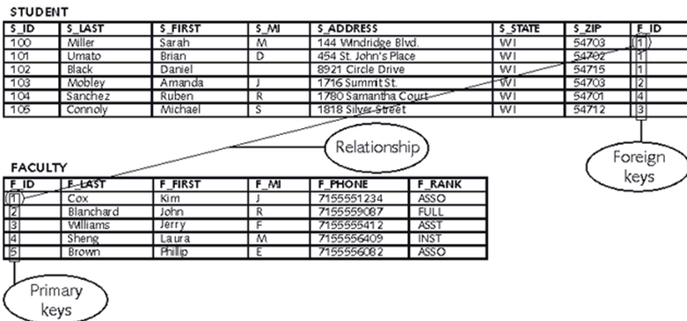
Foreign Keys
Foreign key: a field in a table that is a primary key in another table
Foreign key creates a relationship between the two tables
Foreign key value must exist in the table where it is a primary key

Slide 63
Database Design Techniques
• Top down Approach
- E R Modeling
• Bottom Up approach
- Normalization

Slide 64
ER modeling
• ER modeling: A graphical technique for understanding and organizing the data independent of the actual database implementation
• Entity: Any thing that may have an independent existence and about which we intend to collect data.
Also known as Entity type.
• Entity instance: a particular member of the entity type e.g. a particular student
• Attributes: Properties/characteristics that describe entities
• Relationships: Associations between entities

Slide 65
Simple Vs composite attribute
• Simple attribute: cannot be divided into simpler components E.g age of an employee
• Composite attribute: can be split into components E.g Date of joining of the employee.
- Can be split into day, month and year

Slide 66
Single Vs Multi-valued Attributes
• Single valued : can take on only a single value for each entity instance E.g. age of employee. There can be only one value for this
• Multi-valued: can take many values
E.g. skill set of employee

Slide 67
Stored Vs Derived attribute
• Stored Attribute: Attribute that need to be stored permanently.
E.g. name of an employee
• Derived Attribute: Attribute that can be calculated based on other attributes
E.g. : years of service of employee can be calculated from date of joining and
current date

Slide 68
Regular Vs. Weak entity type
• Regular Entity: Entity that has its own key attribute. E.g.: Employee, student ,customer, policy holder etc.
• Weak entity: Entity that depends on other entity for its existence and doesn’t have key attribute of its own
E.g. : spouse of employee

Slide 69
Relationships
• A relationship type between two entity types defines the set of all associations between these entity types
• Each instance of the relationship between members of these entity types is called a relationship instance

Slide 70
Degree of a Relationship
• Degree: the number of entity types involved
One
Unary
Two
Binary
Three
Ternary
E.g.: employee manager-of employee is unary employee works-for department is binary
customer purchase item, shop keeper is a ternary relationship

Slide 71
Cardinality
• Relationships can have different connectivity
- one-to-one
(1:1)
– one-to-many
(1:N)
– many-to- One
(M:1)
– many-to-many
(M:N)
E.g.:
Employee head-of department (1:1)
Lecturer offers course (1:n) assuming a course is taught by a single lecturer Student enrolls course (m:n)

Slide 72
Cardinality - One - To - One
P1
P2
P3
p4
C1
C2
C3
C4
Person
Chair
One instance of entity type Person is related to one
instance of the entity type Chair.

Slide 73
Cardinality - One -to- Many
CMP1
CMP2
E1
E2
E3
E1
E2
E3
Organization
Employee
One instance of entity type Organization is relatedto multiple instances of entity type Employee

Slide 74
Cardinality - Many-to-One
E1
E2
E3
E4
E5
E6
DEP1
DEP2
Employee
Department
Reverse of the One to Many relationship.

Slide 75
Cardinality - Many-to-Many
S1
S2
S3
S4
C1
C2
C3
C4
Student
Course
Multiple instances of one Entity are related to multiple instances of
another Entaity.

Slide 76
ER Modeling -Notations

Slide 77
ER modeling notations
ENTITY TYPE
WEAK ENTITY TYPE
ATTRIBUTE TYPE
WEAK RELATIONSHIP TYPE
RELATIONSHIP TYPE

Slide 78
ER modeling: Entity
Employee table
Ename
salary
Emp on
Empno | Ename | salary
Employee
Entity set

Slide 79
Attributes
Name
Dob
Address
Employee
E#
Designation

Slide 80
Multivalued Attribute
Name
Dob
Address
Employee
Designation
E#
Skill Set

Slide 81
Composite attribute
Floor
Building
Name
Dob
Address
Employee
E#
Designation

Slide 82
Relationship
Enrols in
Student
Course

Slide 83
Unary Relationship
Manages
Employee

Slide 84
Role names
• Role names may be added to make the meaning more explicit
subordinate
Manages
Employee
Manager

Slide 85
Binary Relationship
Working For
Employee
Department

Slide 86
Ternary Relationship
Medicine
Prescription
Doctor
Patient

Slide 87
Normalization
Normalization is a database design approach that
minimizes data redundancy and
optimizes data structures
A normalized data model can be translated into a physical database that is organized correctly.

Slide 88
Normal Forms: Review
Unnormalized – There are multivalued attributes or repeating groups:
1 NF – No multivalued attributes or repeating groups
2 NF – 1 NF plus no partial dependencies
3 NF – 2 NF plus no transitive dependencies

Slide 89
Example 1: Determine NF
All attributes are directly or indirectly determined by the primary key; therefore, the relation is at least in 1 NF
ISBN → Title
ISBN → Publisher
Publisher → Address

Slide 90
Example 1: Determine NF
The relation is at least in 1NF. There is no COMPOSITE primary key, therefore there can’t be partial dependencies. Therefore, the relation is at least in 2NF
ISBN → Title
ISBN → Publisher
Publisher → Address

Slide 91
Example 1: Determine NF
Publisher is a non-key attribute, and it determines Address, another non-key attribute. Therefore, there is a transitive dependency, which means that the relation is NOT in 3 NF.
ISBN → Title
ISBN → Publisher
Publisher → Address

Slide 92
Example 1: Determine NF
We know that the relation is at least in 2NF, and it is not in 3 NF. Therefore, we conclude that the relation is in 2NF.
ISBN → Title
ISBN → Publisher
Publisher → Address

Slide 93
Example 1: Determine NF
In your solution you will write the following justification:
No M/V attributes, therefore at least 1NF
No partial dependencies, therefore at least 2NF
There is a transitive dependency (Publisher → Address), therefore, not 3NF
Conclusion: The relation is in 2NF
ISBN → Title
ISBN → Publisher
Publisher → Address

Slide 94
Example 2: Determine NF
Product_ID → Description
All attributes are directly or indirectly determined by the primary key; therefore, the relation is at least in 1 NF

Slide 95
Example 2: Determine NF
Product_ID → Description
The relation is at least in 1NF.
There is a COMPOSITE Primary Key (PK) (Order_No, Product_ID), therefore there can be partial dependencies. Product_ID, which is a part of PK, determines Description; hence, there is a partial dependency. Therefore, the relation is not 2NF. No sense to check for transitive dependencies!

Slide 96
Example 2: Determine NF
Product_ID → Description
We know that the relation is at least in 1NF, and it is not in 2 NF. Therefore, we conclude that the relation is in 1 NF.

Slide 97
Example 2: Determine NF
Product_ID → Description
In your solution you will write the following justification:
1) No M/V attributes, therefore at least 1NF
2) There is a partial dependency (Product_ID → Description), therefore not in 2NF
Conclusion: The relation is in 1NF

Slide 98
Example 3: Determine NF
Comp_ID and No are not determined by the primary key; therefore, the relation is NOT in 1 NF. No sense in looking at partial or transitive dependencies.
Part_ID → Description
Part_ID → Price
Part_ID, Comp_ID → No

Slide 99
Example 3: Determine NF
In your solution you will write the following justification:
There are M/V attributes; therefore, not 1NF
Conclusion: The relation is not normalized.
Part_ID → Description
Part_ID → Price
Part_ID, Comp_ID → No

Slide 100
Bringing a Relation to 1NF

Slide 101
Bringing a Relation to 1NF
Option 1: Make a determinant of the repeating group (or the multivalued attribute) a part of the primary key.
Composite Primary Key

Slide 102
Bringing a Relation to 1NF
Option 2: Remove the entire repeating group from the relation. Create another relation which would contain all the attributes of the repeating group, plus the primary key from the first relation. In this new relation, the primary key from the original relation and the determinant of the repeating group will comprise a primary key.

Slide 103
Bringing a Relation to 1NF

Slide 104
Bringing a Relation to 2NF
Composite Primary Key

Slide 105
Bringing a Relation to 2NF
Goal: Remove Partial Dependencies
Partial Dependencies
Composite Primary Key

Slide 106
Bringing a Relation to 2NF
Remove attributes that are dependent from the part but not the whole of the primary key from the original relation. For each partial dependency, create a new relation, with the corresponding part of the primary key from the original as the primary key.

Slide 107
Bringing a Relation to 2NF

Slide 108
Bringing a Relation to 3NF
Goal: Get rid of transitive dependencies.
Transitive Dependency

Slide 109
Bringing a Relation to 3NF
Remove the attributes, which are dependent on a non-key attribute, from the original relation. For each transitive dependency, create a new relation with the non-key attribute which is a determinant in the transitive dependency as a primary key, and the dependent non-key attribute as a dependent.

Slide 110
Bringing a Relation to 3NF

Slide 111
Denormalization
Speeding the retrieval of data from DB2 tables is a frequent requirement for DBAs and performance analysts.
One way to accomplish this is to denormalize DB2 tables for physical implementation.
The opposite of normalization, denormalization is the process of putting one fact in many places.
This speeds data retrieval at the expense of data modification

Slide 112
Summary
In this module, have learnt about:
RDBMS
Terminologies in RDBMS
Dr. Codd’s rule
Properties of Relations
ER Diagram
Normalization and Normal Forms

