Slide 1
Installation of mysql

Slide 2
MySQL on Windows environment
To install MySQL on Windows environment, using MySQL installer is the easiest way.
MySQL installer provides you with an easy-to-use wizard that helps you to install MySQL with the following components:
MySQL Server
All Available Connectors
MySQL Workbench with Sample Data Models
MySQL Notifier
Tools for Excel and Microsoft Visual Studio
MySQL Sample Databases
MySQL Documentation

Slide 3
To download MySQL installer, go to the following link http://dev.mysql.com/downloads/installer/.
There are two files available.
If you are connecting to the internet while installing MySQL, you can choose the online installation version mysql-installer-web-community.exe .
If you want to install MySQL offline, you can download the mysql-installer-community.exe file.

Slide 4
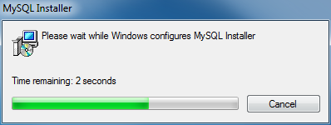
Install MySQL via MySQL Installer
To install MySQL using the MySQL installer, double-click on the MySQL installer file and follow the steps below:

Slide 5
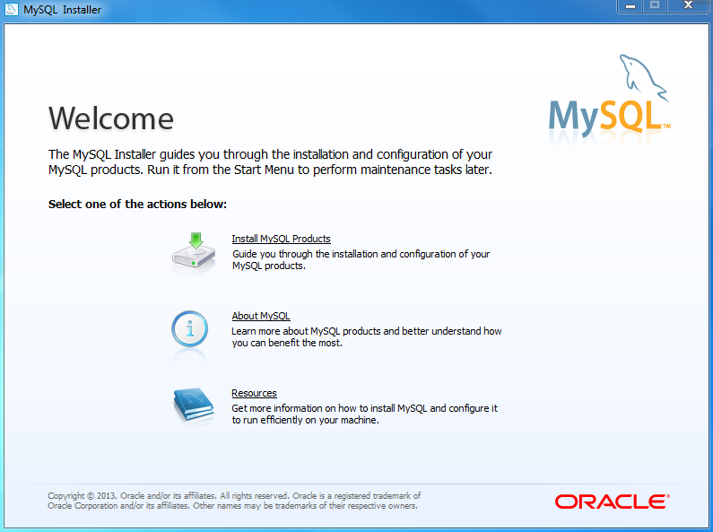
Install MySQL Step 2 – Welcome Screen: A welcome screen provides several options. Choose the first option: Install MySQL Products

Slide 6
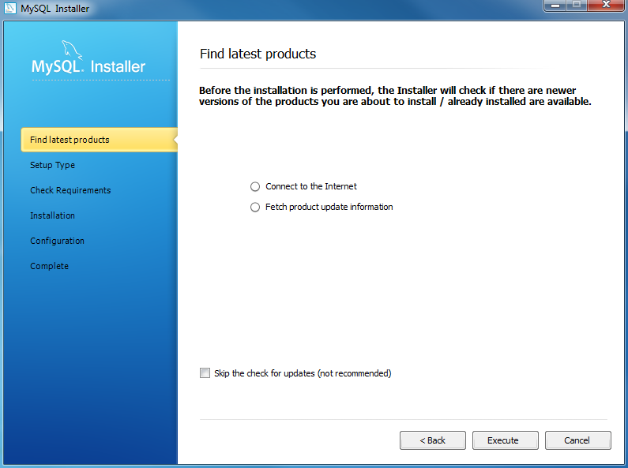
Install MySQL Step 3 – Download the latest MySQL products: MySQL installer checks and downloads the latest MySQL products including MySQL server, MySQL Workbench, etc.

Slide 7
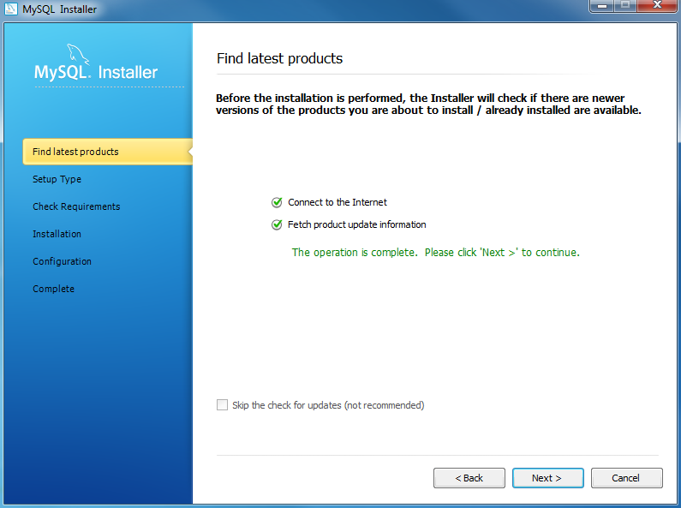
Install MySQL Step 4: Click Next button to continue

Slide 8
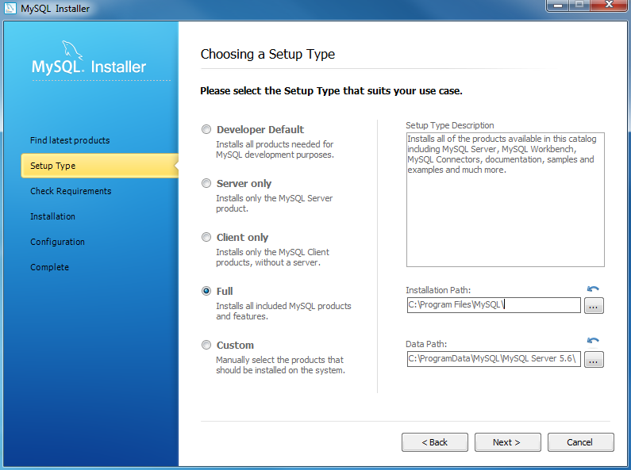
Install MySQL Step 5 – Choosing a Setup Type: there are several setup types available. Choose the Full option to install all MySQL products and features.

Slide 9
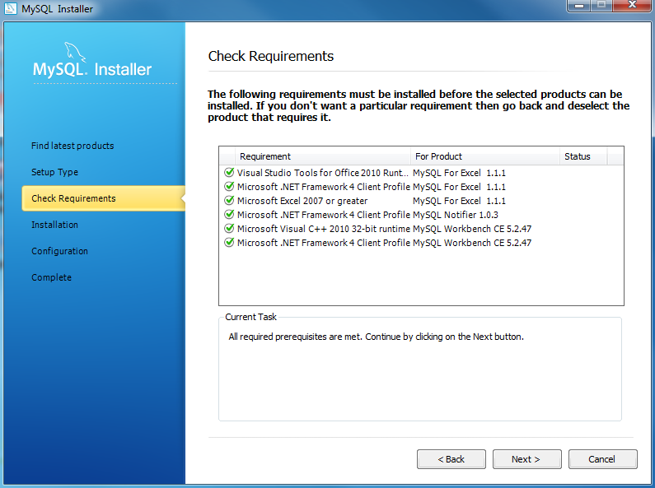
Install MYSQL Step 6 – Checking Requirements

Slide 10
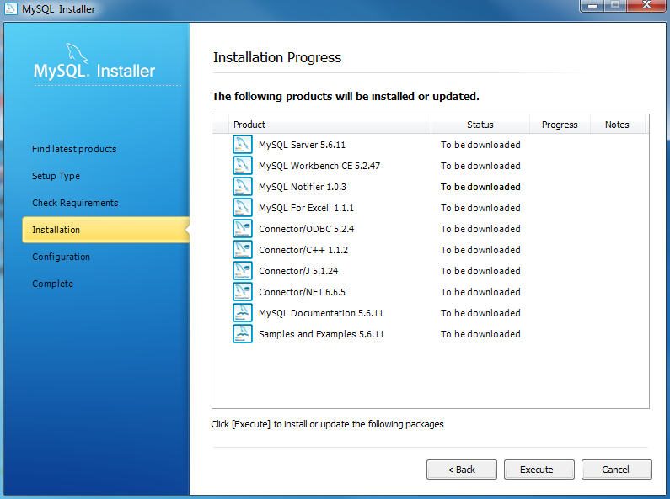
Install MySQL Step 7 – Installation Progress: MySQL Installer downloads all selected products. It will take a while, depending on which products that you selected and the speed of your internet connection.

Slide 11
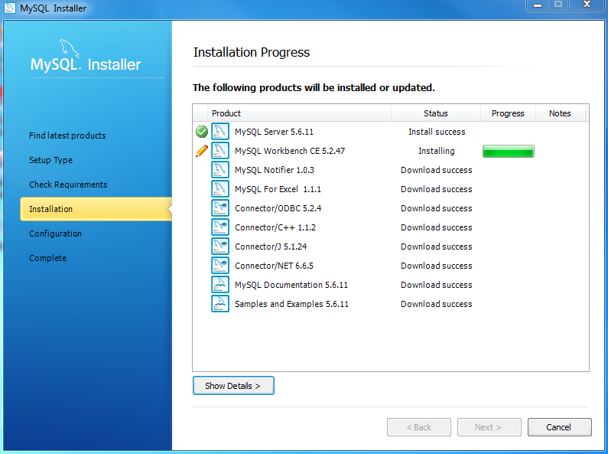
Install MySQL Step 7 – Installation Progress: downloading Products in progress.

Slide 12
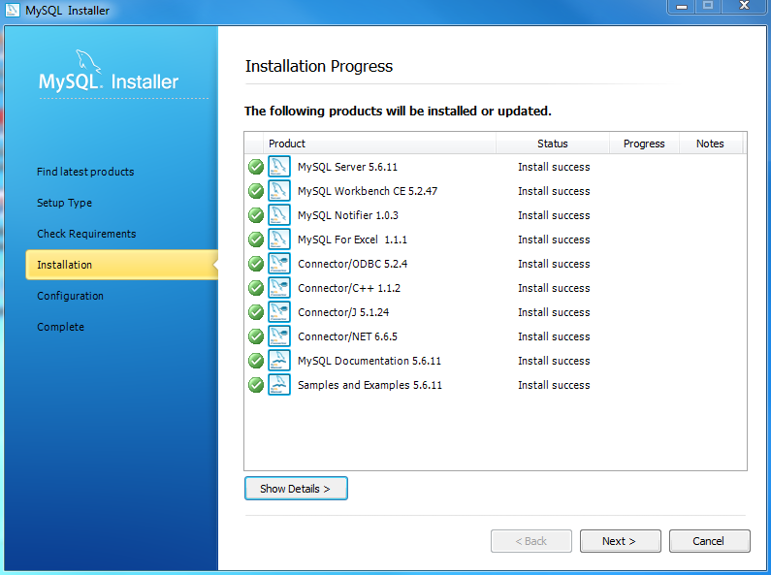
Install MySQL Step 7 – Installation Progress: Complete Downloading. Click Next button to continue…

Slide 13
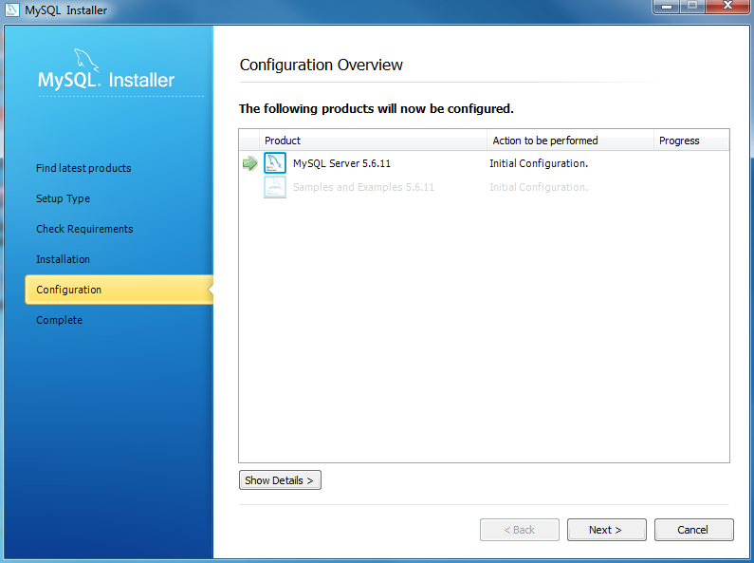
Install MySQL Step 8 – Configuration Overview. Click Next button to configure MySQL Database Server

Slide 14
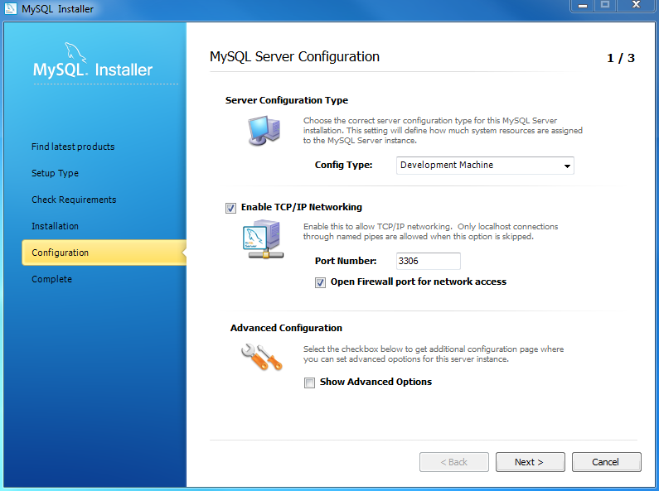
Install MySQL Step 8.1 – MySQL Server Configuration: choose Config Type and MySQL port (3006 by default) and click Next button to continue.

Slide 15
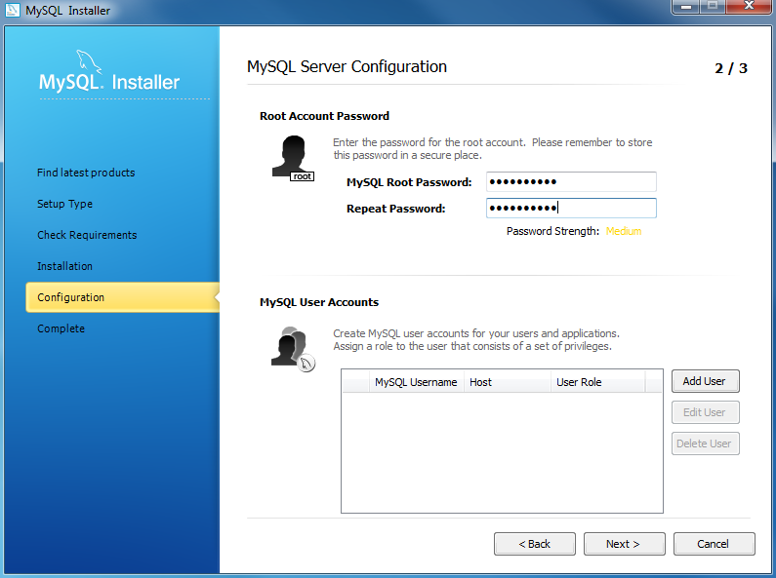
Install MySQL Step 8.1 – MySQL Server Configuration: choose a password for the root account. Please note the password download and keep it securely if you are installing MySQL database server on a production server. If you want to add a more MySQL user, you can do it in this step.

Slide 16
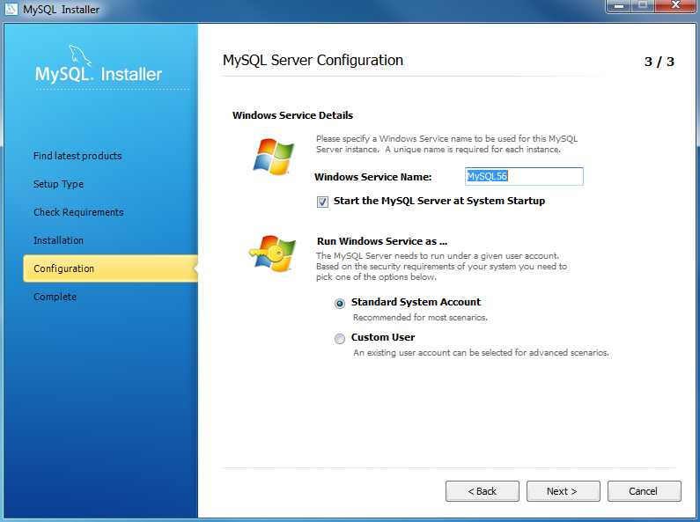
Install MySQL Step 8.1 – MySQL Server Configuration: choose Windows service details including Windows Service Name and account type, then click Next button to continue.

Slide 17
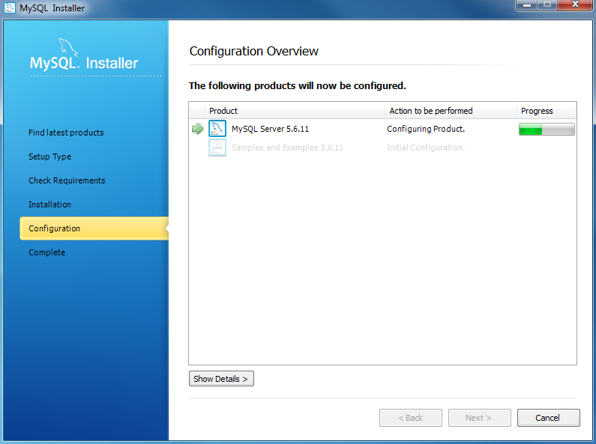
Install MySQL Step 8.1 – MySQL Server Configuration – In Progress: MySQL Installer is configuring MySQL database server. Wait until it is done and click Next button to continue.

Slide 18
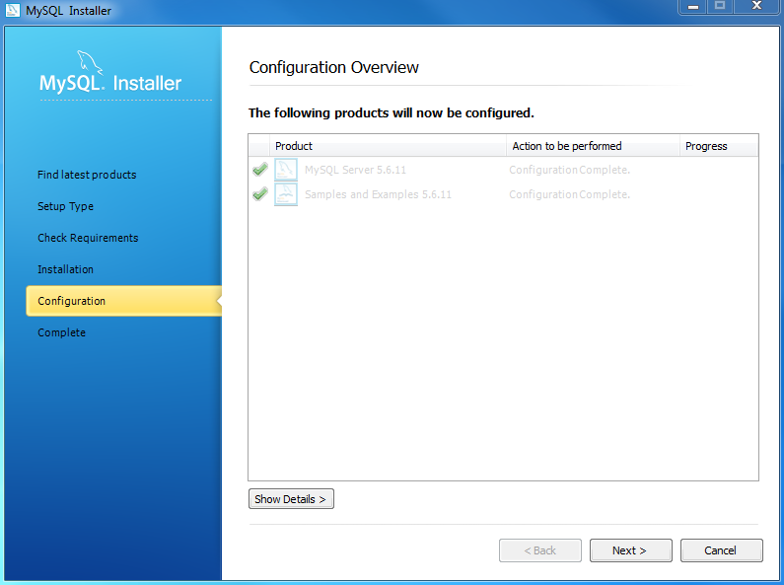
Install MySQL Step 8.1 – MySQL Server Configuration – Done. Click the Next button to continue.

Slide 19

Install MySQL Step 8.2 – Configuration Overview: MySQL Installer installs sample databases and sample models.

Slide 20
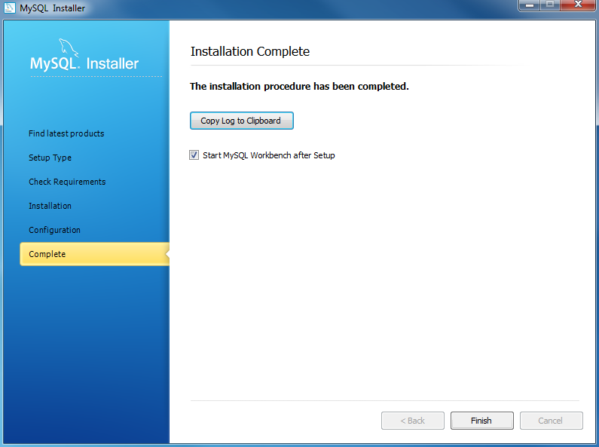
Install MySQL Step 9 – Installation Completes: the installation completes. Click finish button to close the installation wizard and launch the MySQL Workbench.

Slide 21
Installation MySQL Database Server in MAC OSX
Please follow the instructions given in the below link
https://dev.mysql.com/doc/refman/5.7/en/osx-installation-pkg.html

Slide 22
Installation of MySQL Database Server in Ubuntu [Linux]
Please follow the instructions given in the below link
https://dev.mysql.com/doc/refman/5.7/en/linux-installation.html

Slide 23
Starting MySQL from the Windows Command Line
The MySQL server can be started manually from the command line.
This can be done on any version of Windows.
To start the mysqld server from the command line, you should start a console window (or “DOS window”) and enter this command:
C:\> "C:\Program Files\MySQL\MySQL Server 8.0\bin\mysqld“
The path to mysqld may vary depending on the install location of MySQL on your system.

Slide 24
Stopping MySQL from the Windows Command Line
can stop the MySQL server by executing this command:
C:\> "C:\Program Files\MySQL\MySQL Server 8.0\bin\mysqladmin" -u root shutdown

Slide 25
Connecting to the MySQL Server with the mysql Client
Once your MySQL server is up and running, you can connect to it as the superuser root with the mysql client.
On Linux, enter the following command at the command line terminal (for installation using generic binaries, you might need to go first to the bin folder under the base directory of your MySQL installation):
shell> mysql -u root -p
On Windows, click Start, All Programs, MySQL, MySQL 5.7 Command Line Client. If you did not install MySQL with the MySQL Installer, open a command prompt, go to the bin folder under the base directory of your MySQL installation, and issue the following command:
C:\> mysql -u root –p
You are then asked for the root password, which was assigned in different manners according to the way you installed MySQL

Slide 26
Connecting to the MySQL Server with the mysql Client
Once you are connected to the MySQL server, a welcome message is displayed and the mysql> prompt appears, at which SQL statements are to be sent to the server for execution:
Welcome to the MySQL monitor. Commands end with ; or \g.
Your MySQL connection id is 4
Server version: 5.7.13 MySQL Community Server (GPL)
Copyright (c) 2000, 2016, Oracle and/or its affiliates. All rights reserved.
Oracle is a registered trademark of Oracle Corporation and/or its affiliates. Other names may be trademarks of their respective owners.
Type 'help;' or '\h' for help. Type '\c' to clear the current input statement.
mysql>

Slide 27
useful things to remember when using the mysql client:
Client commands (for example, help, quit, and clear) and keywords in SQL statements (for example, SELECT, CREATE TABLE, and INSERT) are case insensitive.
Column names are case-sensitive.
Table names are case sensitive on most Unix-like platforms, but case insensitive on Windows platforms.
Case sensitivity during string comparison depends on the character collation you use. In general, it is a good idea to treat all identifiers (database names, table names, column names, etc.) and strings as case-sensitive.
You can type your SQL statements in multiple lines by pressing Enter in the middle of it. Typing a semi-colon (;) followed by an Enter ends an SQL statement and sends it to the server for execution; the same happens when a statement is ended with \g or \G (with the latter, returned results are displayed vertically).
However, client commands (for example, help, quit, and clear) do not require a terminator.
To disconnect from the MySQL server, type QUIT or \q at the client:
mysql> QUIT

