Slide 1
A Formal Hierarchy of RNN Architectures
Merrill et. al. 2020
Paper Review
Neisarg Dave

Slide 2
Pre-requisite Concepts
Space Complexity:
Measures the size of RNN memory i.e. hidden state
Rational Recurrence:
The recurrent connection can be modelled as weighted finite state machine
Rational RNN:
Internal state of RNN can be computed by independent weighted finite automata
Saturated RNN:
All activation functions in the RNN cell are replaced by a step function.

Slide 3
Automaton, Acceptor, Transducer
Acceptor:
A machine that either accepts or rejects an input string
Transducer:
A machine that takes an input string and given an output string
Automaton:
An abstract machine that takes an input and may provide an output. Acceptance or rejection is based on the state of the automaton

Slide 4
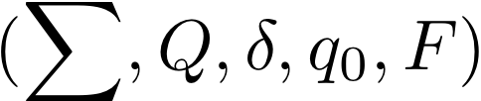


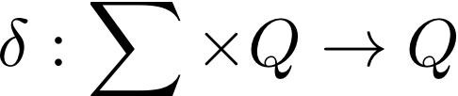


Finite State Automata
A deterministic finites state automata is a 5 tuple
is a set of alphabets recognized by the automaton
is a set of states
is a transition function
is initial state
is a set of final states

Slide 5
Regular Languages
E.g. Strings with 3 consecutive zeros : 10001100011
Languages accepted by FSA are called Regular Languages.
Regular Languages are also Rational Languages.

Slide 6
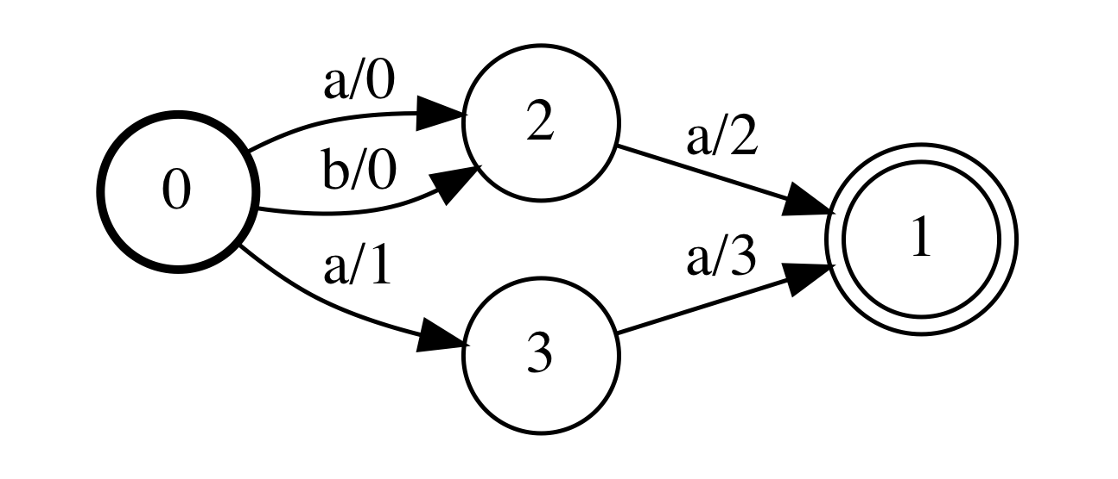
Weighted Finite State Automaton

Slide 7
Counter Machines
Finite State Automaton with an integer counter
Counter operations: INC, DEC, NO-OP
Acceptance by Counter : String is accepted when counter is zero.
Acceptance by State : String is accepted when Automata reaches Final State
E.g. Dyck Languages: ((()))()()

Slide 8
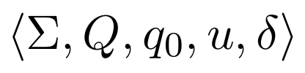
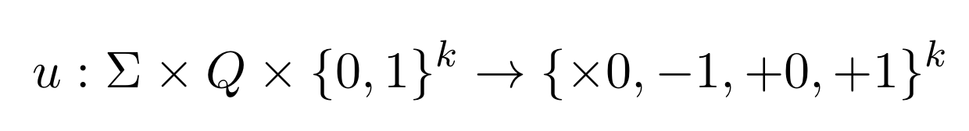
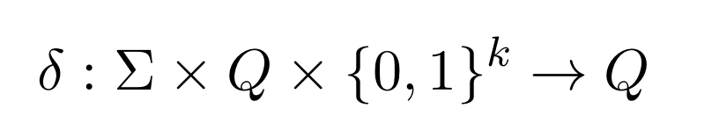

Counter Machines
A $k$- Counter is a 5 tuple:
Counter Update Function
State Transition Function

Slide 9


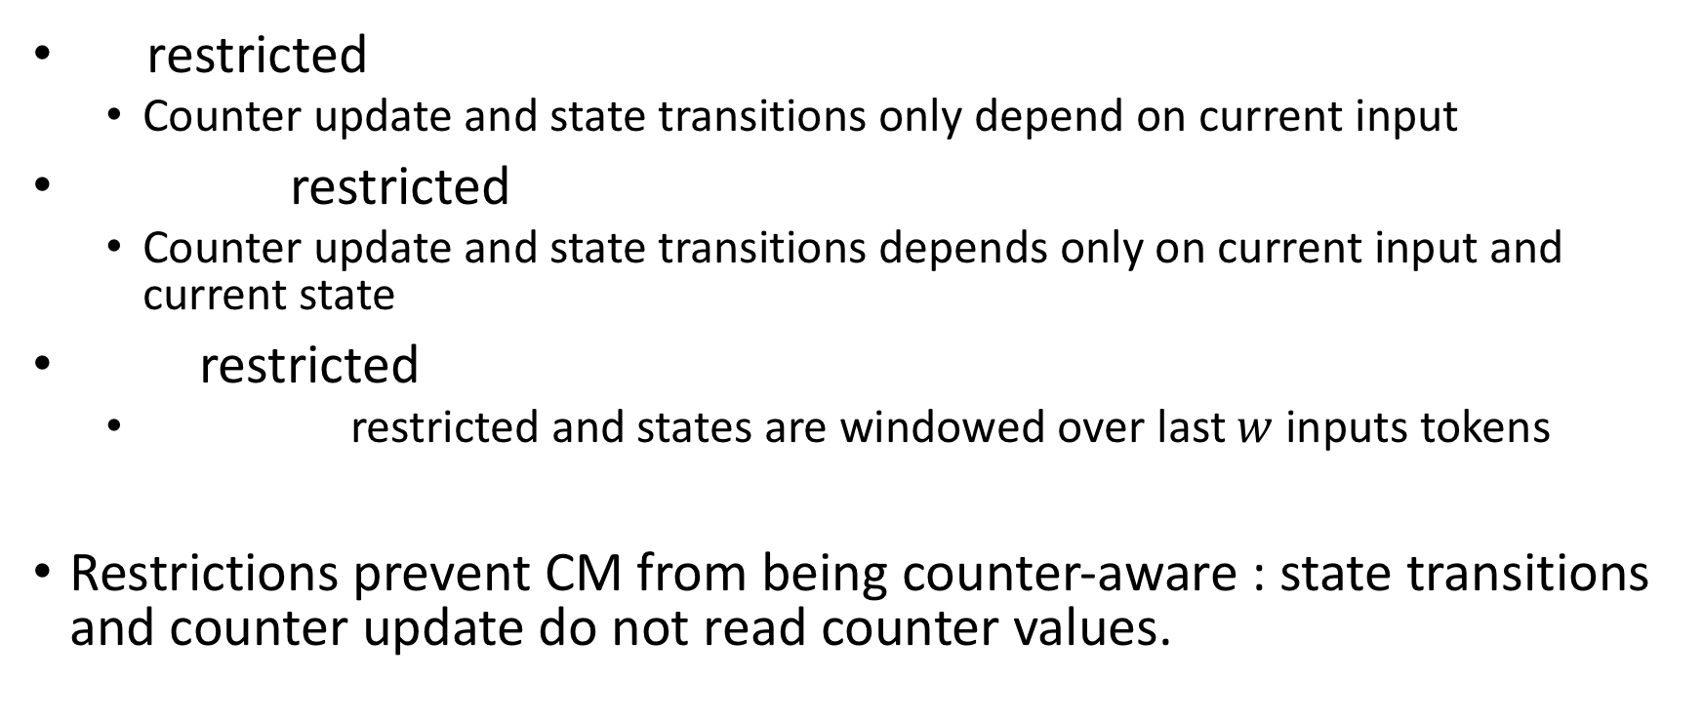
Restricted CM
restricted
Counter update and state transitions only depend on current input
restricted
Counter update and state transitions depends only on current input and current state
restricted
restricted and states are windowed over last $w$ inputs tokens
Restrictions prevent CM from being counter-aware : state transitions and counter update do not read counter values.

Slide 10
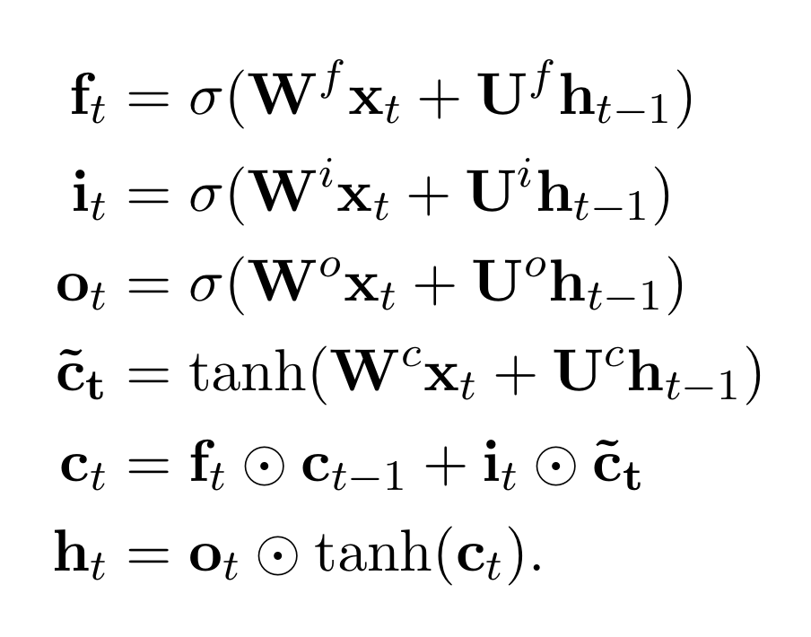
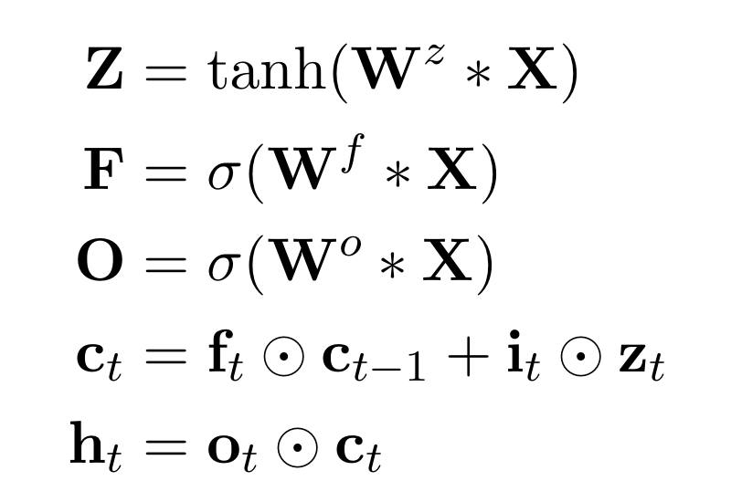
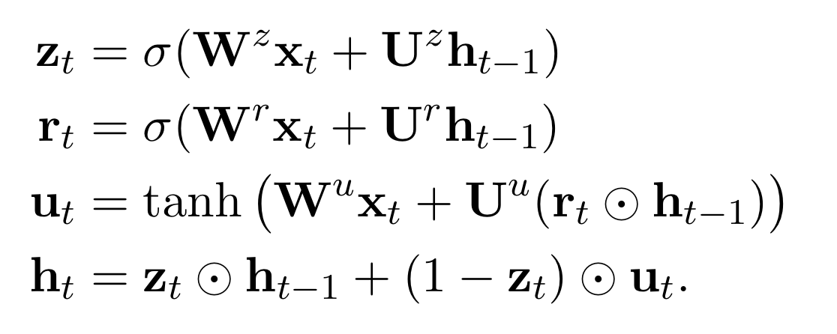
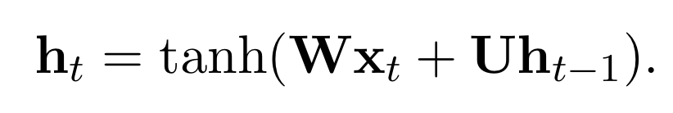
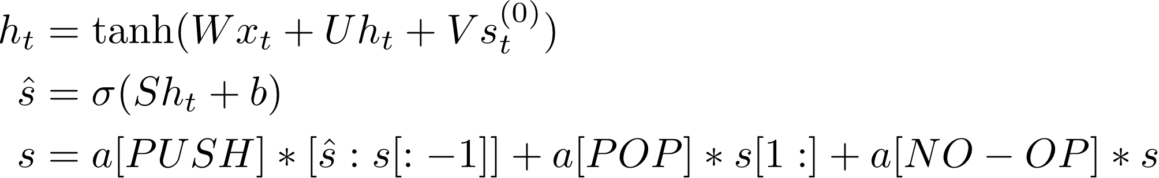
RNN Architectures
LSTM
GRU
QRNN
Elman RNN
Stack RNN

Slide 11

Related Work
﻿Symbolic Rules can be extracted, inserted and refined from Recurrent Neural Networks (Giles and Omlin, 1993)
Second Order RNNs can learn regular grammars and DFA’s can be extracted by quantization of hidden states of RNN (Giles, et. al. 1992)
Linear second-order RNN is equivalent to weighted automaton (Rabusseau et. al. 2019)
LSTMs can learn to recognize well balanced parentheses (Dyck- 𝑘 languages) by emulating 𝑘 -counter machines (Suzgun et. al. 2019)
LSTMs can model counter machine with space complexity 𝑂(log 𝑛) where 𝑛 is the sequence length. (Merrill et. al. 2020)
LSTMs can model Dyck-(𝑘, 𝑚) languages with empirical Complexity of (Merrill et. al. 2020)

Slide 12
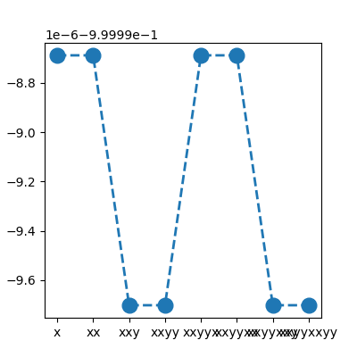
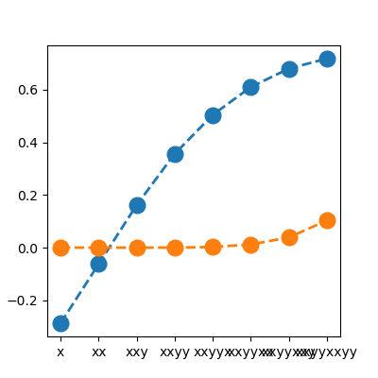
Looking at the Hidden State of size 2
LSTM
Elman RNN
Input String : xxyyxxyy

Slide 13
State Expressiveness
Rationally Recurrent (RR):
An encoder is RR iff it can recognize a subset of rational sequences. e.g. Finite State Automata
RR-Complete
An encoder can recognize all rational sequences. E.g. a vector of k WFAs
RR-Hard
An encoder is RR hard iff it can at-least recognize all rational sequences
e.g. Turing Machine

Slide 14
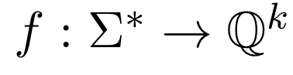
Building Blocks
Encoder:
A machine that can compute a set of functions that map input string to a a set of Rational real numbers.
Decoder:
Additional layers that take set of rational real numbers and map it to prediction.
For classification tasks : MLP
For Sequence Generation : another RNN

Slide 15
Role of Decoder
If the state is not expressive enough, Decoder can help in the performance
Increasing the number of layers in decoder, helps QRNN to recognizes some non-rational language

Slide 16
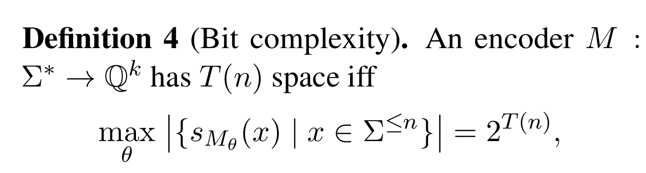
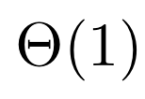
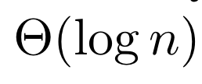
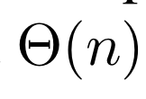
Space Complexity
Number of configurations remain constant with the length of input string
Number of configurations increases polynomial times the length of input string
Number of configurations increases exponentially with the length of input string

Slide 17
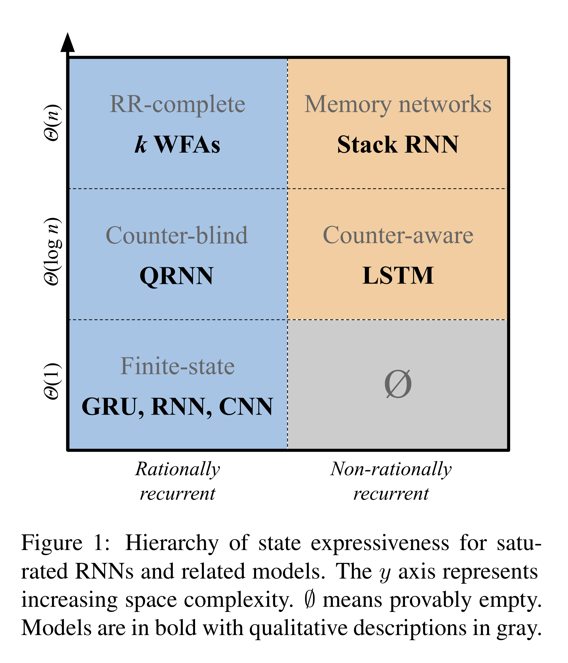
*Merrill et. al. 2020

Slide 18
Experimental Details
Datasets of length :
64, 128, 256, 512, 1024, 2048
Train sets : 100,000 samples
Val sets: 10,000 samples
Test sets: 10,000 samples
Samples generated by random uniform sampling from alphabet space
All models trained to maximum 100 epochs
20 GPU hours on Quadro RTX 8000.

Slide 19
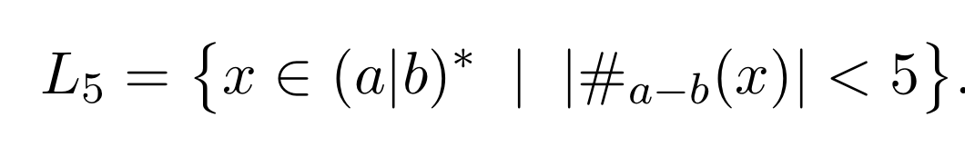
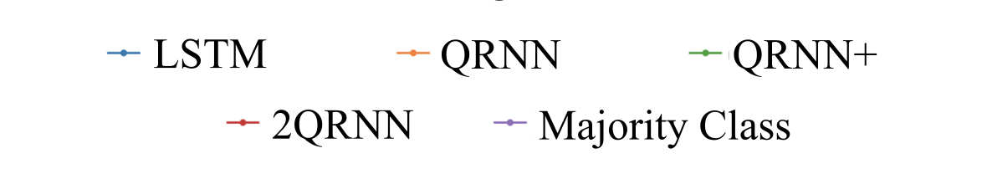
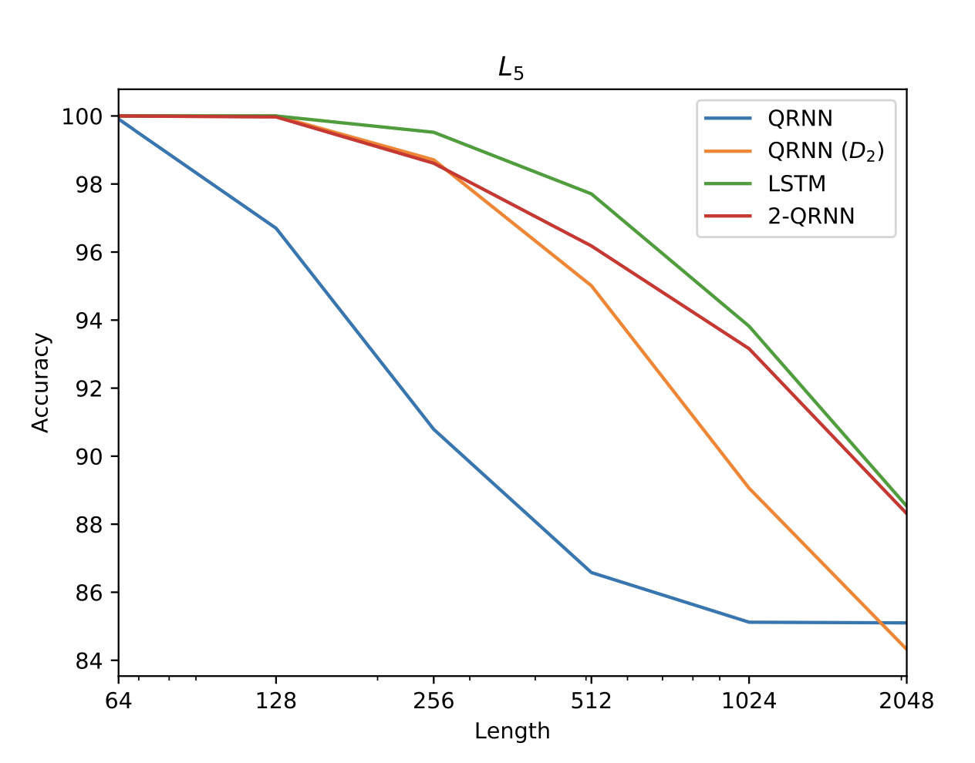
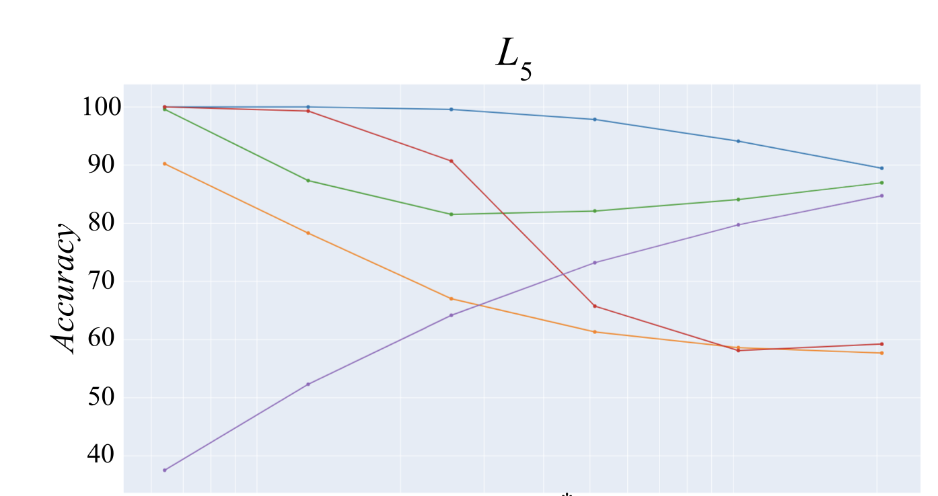
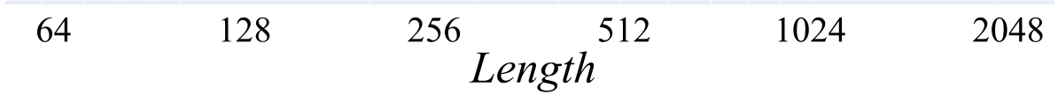
Experiment -1
Dataset generated from :
E.g. aaabbabab #a-b = 1

Slide 20
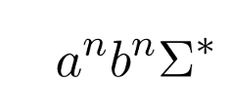
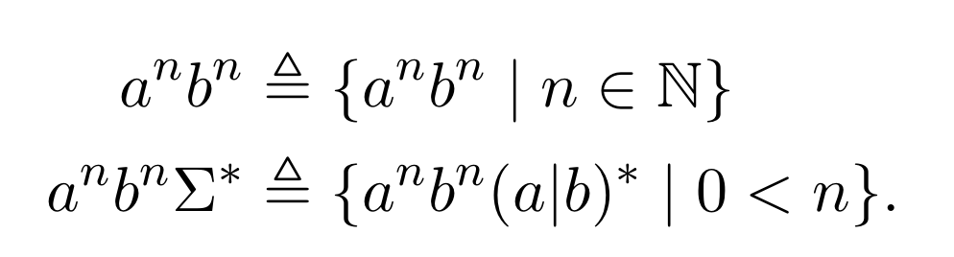
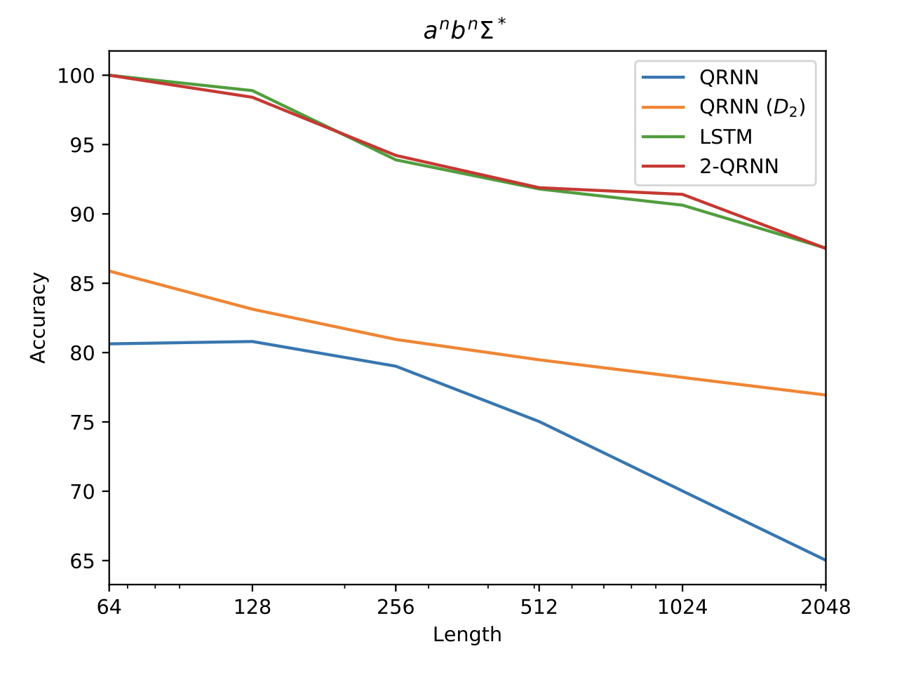
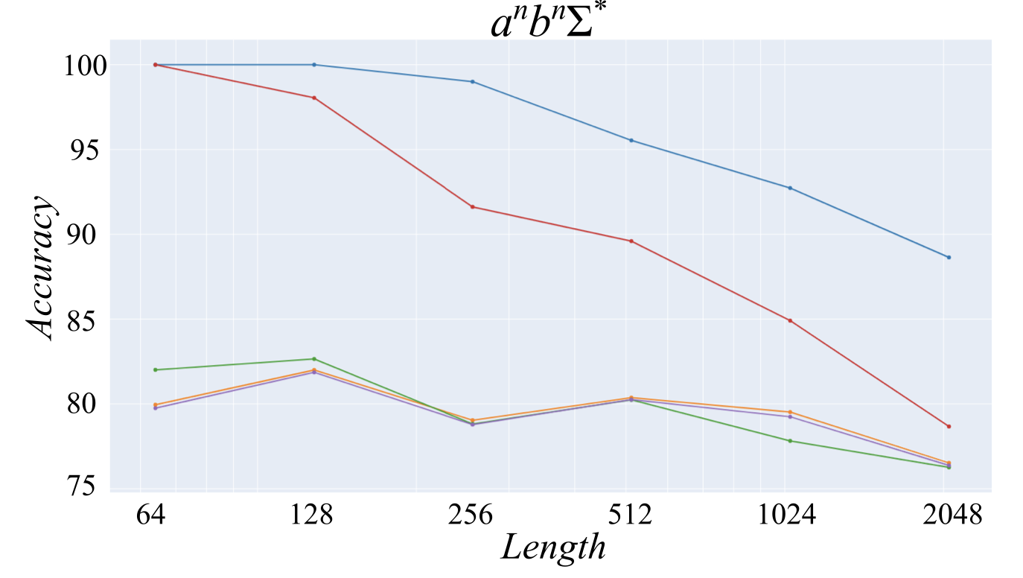
Experiment-2
Dataset generated from

Slide 21
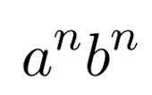
Conclusion and Future Work
LSTM can recognize with a single decoding layer
QRNN provably cannot recognize until the decoder has two layers
QRNN < QRNN (D2) < 2-QRNN < LSTM
This paper provided a hierarchy of RNNs based on their computational capability in terms of their ability to accept rational sequences
They did not include 2nd order RNN networks in their study
Possible Candidates : mRNN, mLSTM, MI-RNN, MI-LSTM, O2RNN
They did not extend their theory for higher order recurrent connections.

Slide 22
References
Mirac Suzgun, Yonatan Belinkov, Stuart Shieber, and Sebastian Gehrmann. 2019. LSTM Networks Can Perform Dynamic Counting. In Proceedings of the Workshop on Deep Learning and Formal Languages: Building Bridges, pages 44–54, Florence. Association for Computational Linguistics.
Guillaume Rabusseau, Tianyu Li, and Doina Precup. Connecting weighted automata and recurrent neural networks through spectral learning. In The 22nd International Conference on Artificial Intelligence and Statistics, pp. 1630–1639. PMLR, 2019
C Lee Giles and Christian W Omlin. Extraction, insertion and refinement of symbolic rules in dynamically driven recurrent neural networks. Connection Science, 5(3-4):307–337, 1993.
C Lee Giles, Clifford B Miller, Dong Chen, Hsing-Hen Chen, Guo-Zheng Sun, and Yee-Chun Lee. Learning and extracting finite state automata with second-order recurrent neural networks. Neural Computation, 4(3):393–405, 1992

