Slide 1
Stack RNN

Slide 2
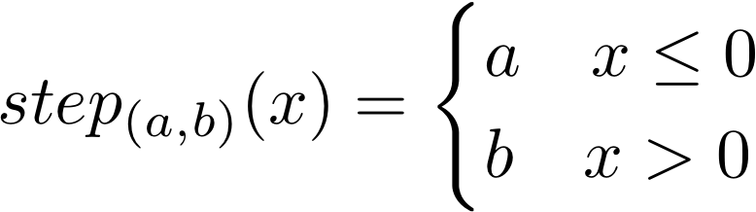
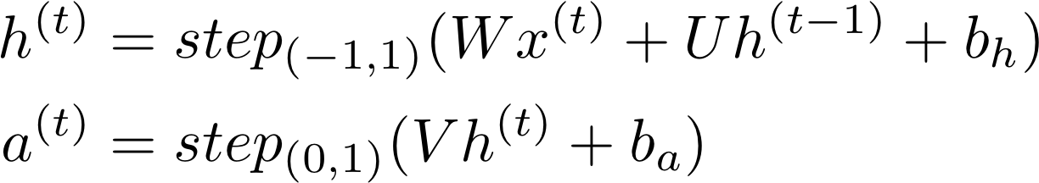
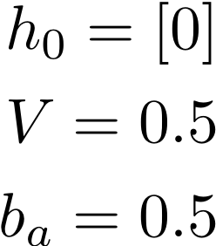
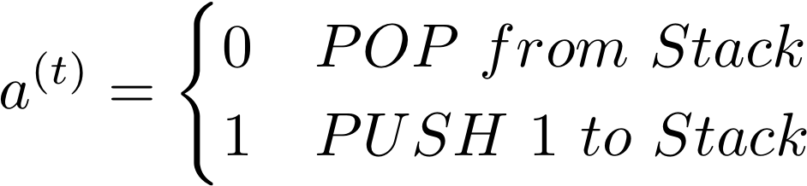
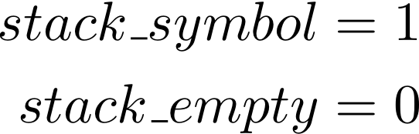
Stack RNN

Slide 3
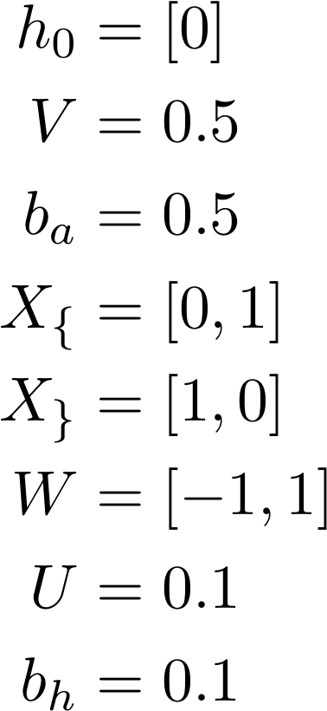


Weights, biases and initial state

Slide 4

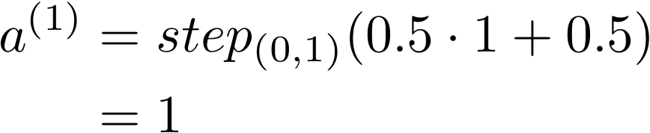
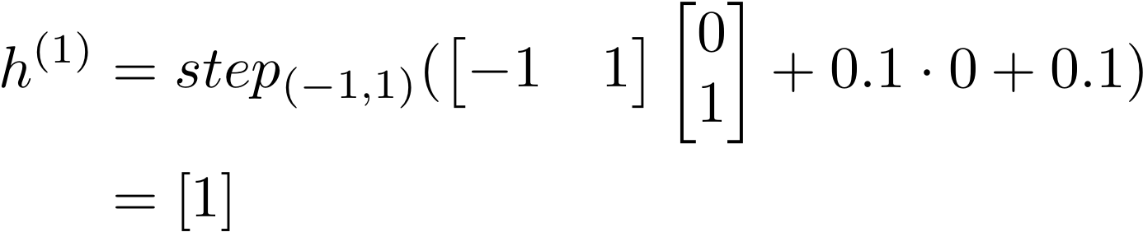

Model Forward
1
0
0
[0, 1]
{

Slide 5
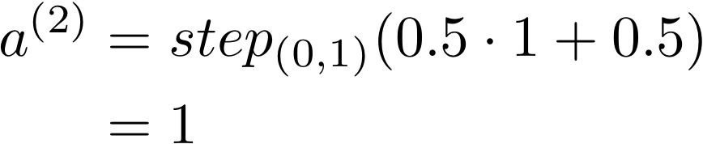
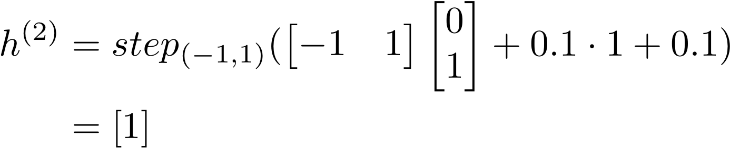

1
1
1
0
0
0
[0, 1]
[0, 1]
{
{

Slide 6

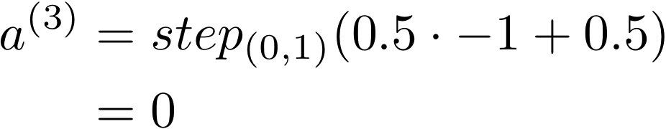

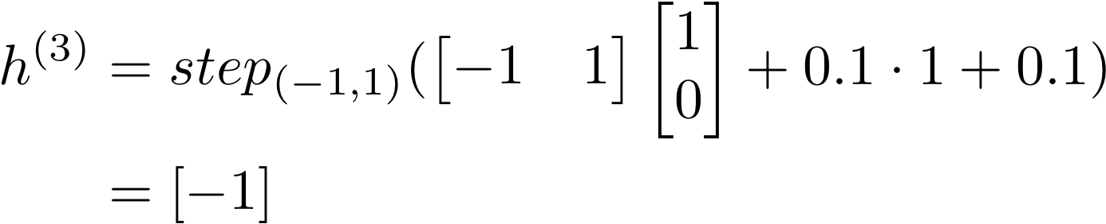
1
1
1
1
0
0
0
0
[0, 1]
[0, 1]
[1, 0]
{
{
}

Slide 7
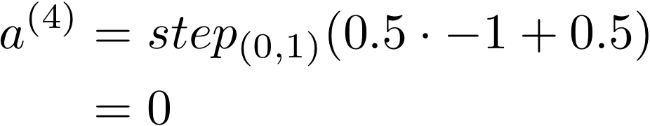
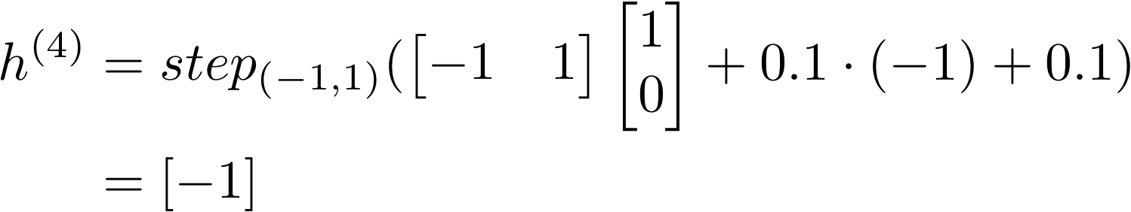

1
1
1
1
Accepted
0
0
0
0
0
[0, 1]
[0, 1]
[1, 0]
[1, 0]
{
{
}
}

Slide 8
Observations
The stack has only one symbol. It is a counter!
Not a stack(counter) aware network.
The prediction is not based on state but on stack(counter) value.

