Slide 1
Back Propagation
Neisarg Dave

Slide 2














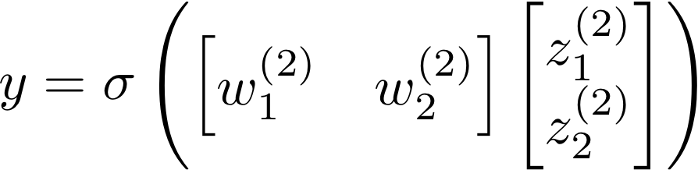
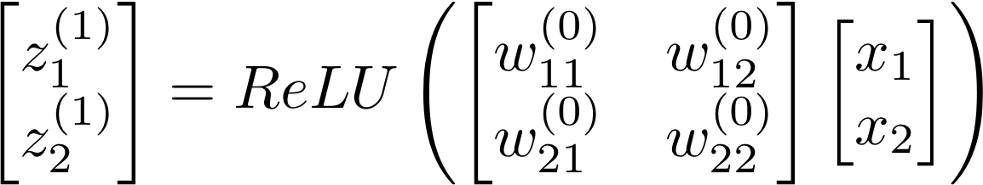
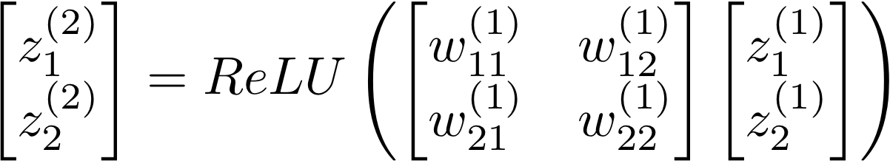





$$z_{1}^{(1)}$$
ReLU
ReLU
$$z_{1}^{(2)}$$
$$y$$
ReLU
$$z_{2}^{(1)}$$
ReLU
$$z_{2}^{(2)}$$

Slide 3
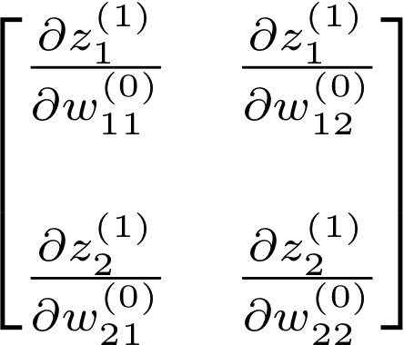
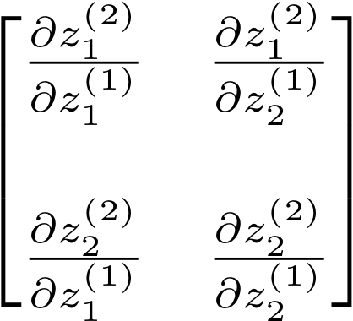
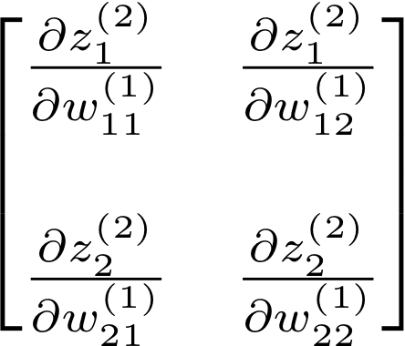
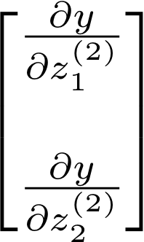
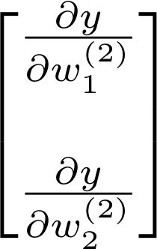
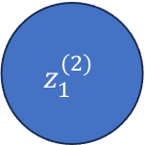
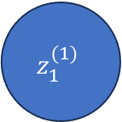
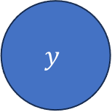
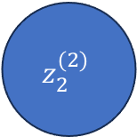
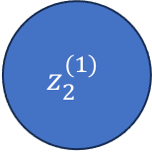
$$z_{1}^{(1)}$$
$$z_{1}^{(2)}$$
$$y$$
$$z_{2}^{(1)}$$
$$z_{2}^{(2)}$$

Slide 4
$$z_{1}^{(1)}$$
$$z_{1}^{(2)}$$
$$y$$
$$z_{2}^{(1)}$$
$$z_{2}^{(2)}$$

Slide 5
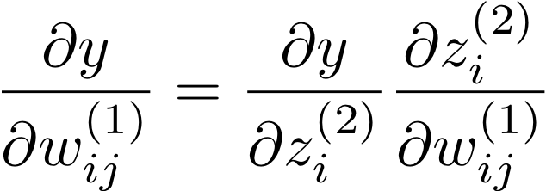
$$z_{1}^{(1)}$$
$$z_{1}^{(2)}$$
$$y$$
$$z_{2}^{(1)}$$
$$z_{2}^{(2)}$$

Slide 6
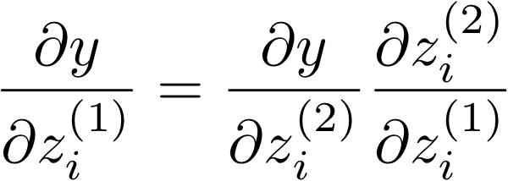
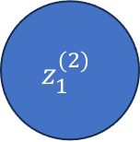
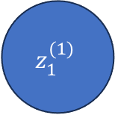
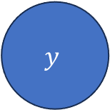
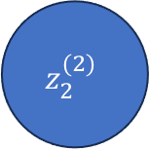
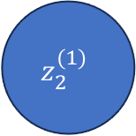
$$z_{1}^{(1)}$$
$$z_{1}^{(2)}$$
$$y$$
$$z_{2}^{(1)}$$
$$z_{2}^{(2)}$$

Slide 7
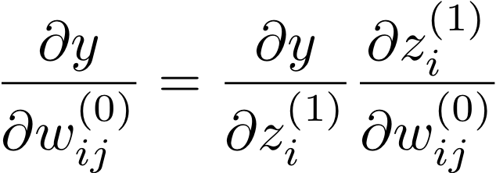
$$z_{1}^{(1)}$$
$$z_{1}^{(2)}$$
$$y$$
$$z_{2}^{(1)}$$
$$z_{2}^{(2)}$$

Slide 8
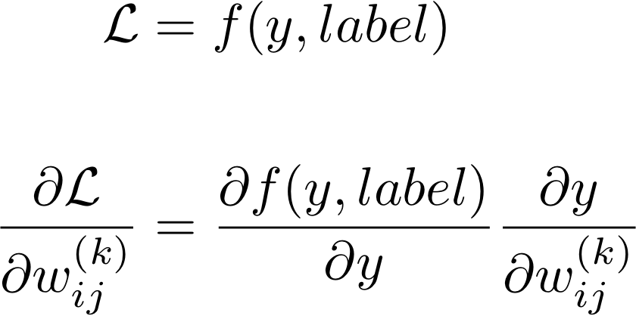
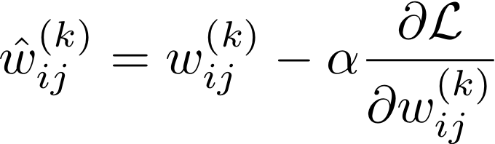
Parameter Update Equation:

