Slide 1
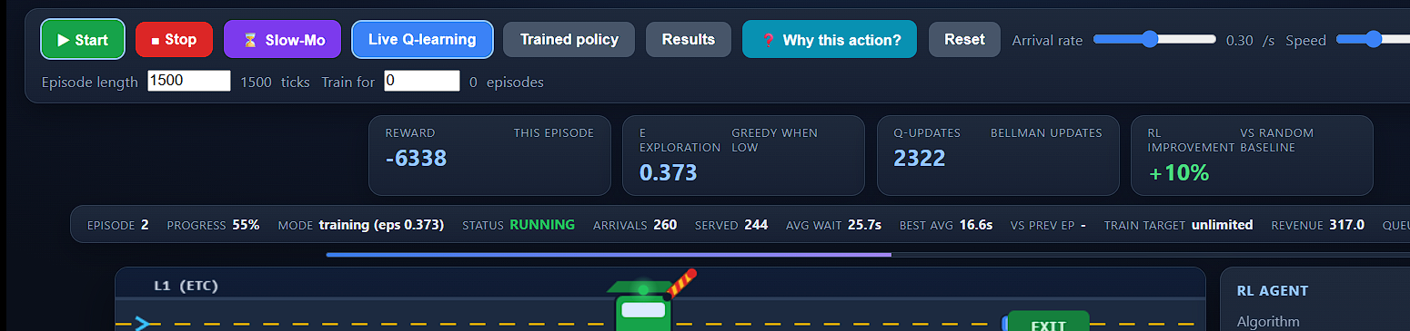
REINFORCEMENT LEARNING Â· PROJECT PRESENTATION
Toll Plaza using
Reinforcement Learning
Smart lane dispatch with tabular Q-learning â€” observe, learn, train, exploit
Lingesh Kumar M
Reg No: 2511022250064 Â· Section: MCA 'B'
Subject: Reinforcement Learning
Toll Plaza using Reinforcement Learning Â· Lingesh Kumar M Â· 2511022250064 Â· MCA 'B 1

Slide 2
The Problem: Toll Plaza Congestion
Waiting at booths wastes time â€” the agent must learn where to send each vehicle
• Peak-hour queues pile up at toll booths
• Fixed rules and manual dispatch ignore live queue lengths
• Random dispatch causes long, unfair average waits
• ETC lanes serve ~35% faster but are often empty
GOAL
Learn a dispatch policy that minimizes total queueing time,
using reinforcement learning â€” then exploit it in real time.
Why Reinforcement Learning?
The plaza is a sequential decision problem:
state → action → reward → next state.
The agent learns from its own experience which
lane minimises waiting â€” no hand-coded rules.
Live interactive simulation built for this project
Toll Plaza using Reinforcement Learning Â· Lingesh Kumar M Â· 2511022250064 Â· MCA 'B 2

Slide 3
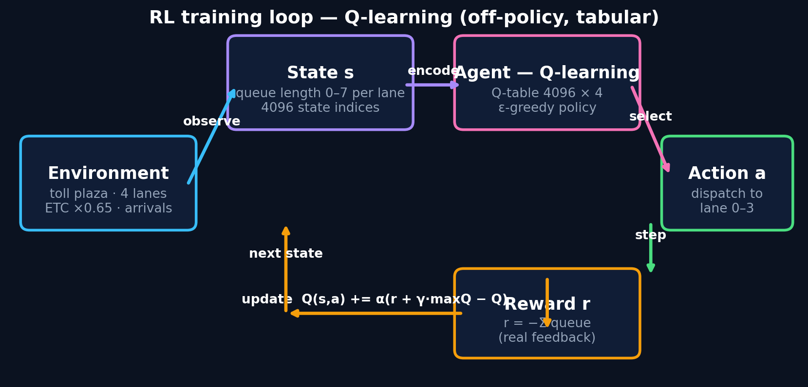
Environment Design: The Toll Plaza
Everything the agent perceives and everything it controls
Lanes
4 lanes â€” lane 1 is ETC (35% faster service)
Vehicles
Car / Motorcycle / Truck / Bus (fees & service times)
State s
queue length 0â€“7 per lane → 4096 state indices
Action a
dispatch the arriving vehicle to lane 0â€“3
Reward r
r = −Σ(queue) every tick — true feedback
The RL loop
Observe state → pick lane → vehicle arrives → queue changes → reward → update Q
Every value is real: computed live from the running simulation.
Episode
1500 ticks (user-adjustable) · arrival rate 0.05–0.60
Toll Plaza using Reinforcement Learning Â· Lingesh Kumar M Â· 2511022250064 Â· MCA 'B 3

Slide 4
The Algorithm: Tabular Q-Learning
Off-policy learning with ε-greedy exploration
Q(s, a) ← Q(s, a) + α [ r + γ · maxₒ Q(s′, a′) − Q(s, a) ]
α = 0.10
learning rate
γ = 0.95
discount
ε: 1.0 → 0.01
×0.999 per update
ε restart ×0.85
per episode, floor 0.05
Why it works
• Bootstraps from max Q(s′, a′)
• ε-greedy balances explore vs exploit
• Every episode restarts ε lower → learns faster
• Trained 300 episodes in Python + live in the browser
repeat for each episode: s ← encode(queue lengths of 4 lanes) repeat until episode ends: a ← ε-greedy(s) # explore vs exploit r, s′ ← step(a) # dispatch + arrival Q[s, a] += α (r + γ maxQ[s′] − Q[s, a]) s ← s′ after N fixed episodes: ε = 0 → pure exploitation
Toll Plaza using Reinforcement Learning Â· Lingesh Kumar M Â· 2511022250064 Â· MCA 'B 4

Slide 5
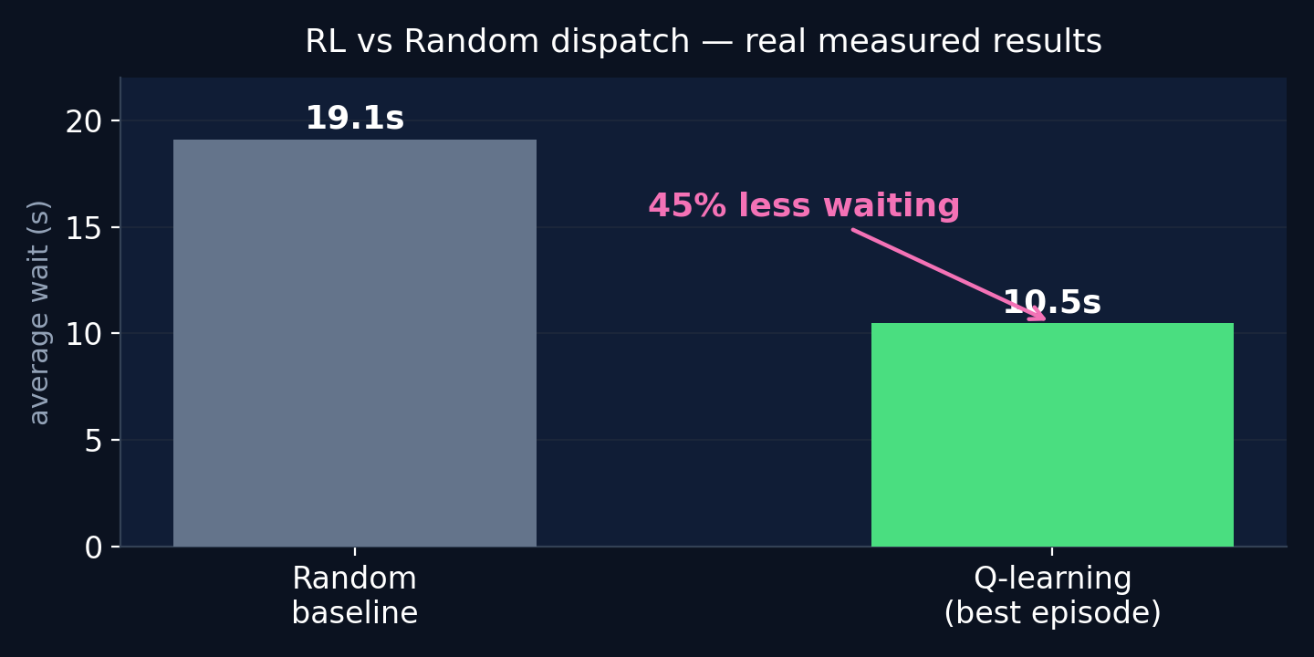
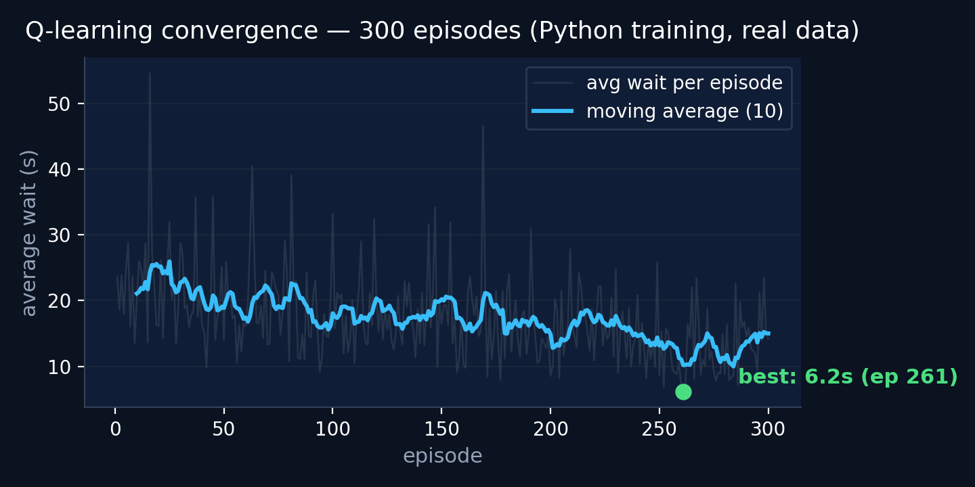
Results: Real Measured Improvement
Best episode vs random dispatch baseline â€” live browser measurements
• Best episode average wait 10.5 s vs 19.1 s random (−45%) • Learning curve converges within ~60 episodes • Improvement is visible after every episode
• Python training: 300 episodes, 4096×4 Q-table • Browser live training matches the Python environment exactly
Toll Plaza using Reinforcement Learning Â· Lingesh Kumar M Â· 2511022250064 Â· MCA 'B 5

Slide 6
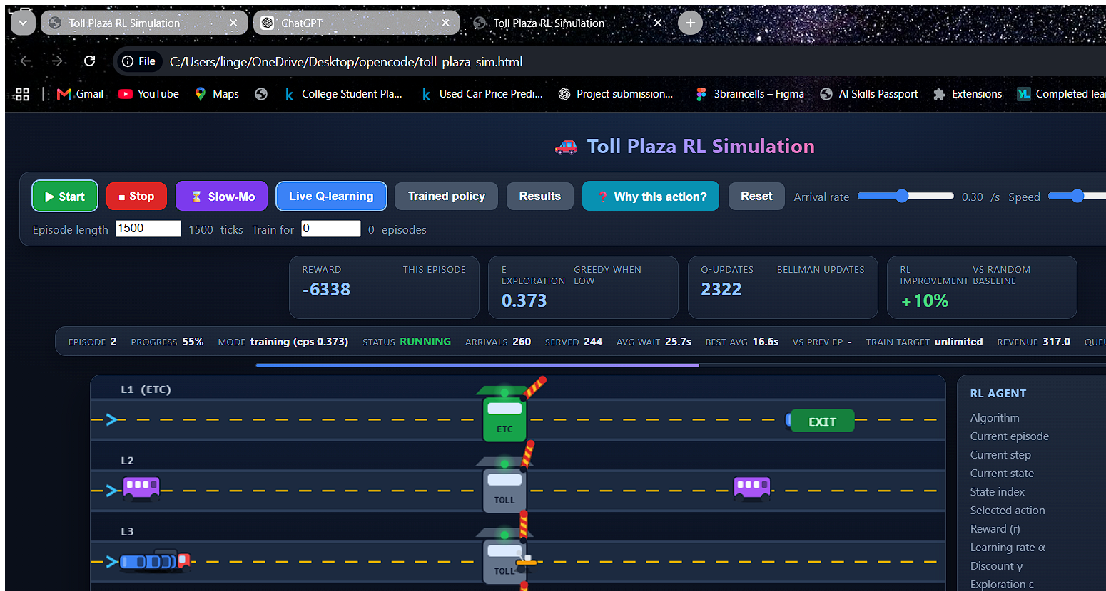
Live Simulation: See the Agent Learn
A fully interactive browser demo â€” every number is real
Live Q-learning agent panel
State → Action → Reward → Q-update flow
Q-table viewer with heat map
“Why this action?” explainer (rule-based)
RL vs Random comparison, live
User controls: arrival rate, speed, episode length, fixed episodes
Auto-switch to exploitation (ε = 0) after N episodes
Distinct car / motorcycle / truck / bus visuals
The working simulation â€” Q-learning dispatches vehicles live in the browser
Toll Plaza using Reinforcement Learning Â· Lingesh Kumar M Â· 2511022250064 Â· MCA 'B 6

Slide 7
Thank You
Toll Plaza using Reinforcement Learning
Lingesh Kumar M Â· Reg No: 2511022250064 Â· Section: MCA 'B'
Subject: Reinforcement Learning
Questions welcome
Toll Plaza using Reinforcement Learning Â· Lingesh Kumar M Â· 2511022250064 Â· MCA 'B 7

