Slide 1
Project 1B: Random Walk, Diffusion, and Mixing
Lingfei Zhao, Yuan Ji, Melissa Wu

Slide 2
2D Random Walk
Simulated a random walker in 2 dimensions, taking steps of unit length in ±x or ±y direction on a discrete square lattice
Plotted ❬x_{n}❭, ❬x²_{n}❭, and ❬r²_{n}❭ versus n by averaging over at least 10⁴ different walks for each n > 3

Slide 3
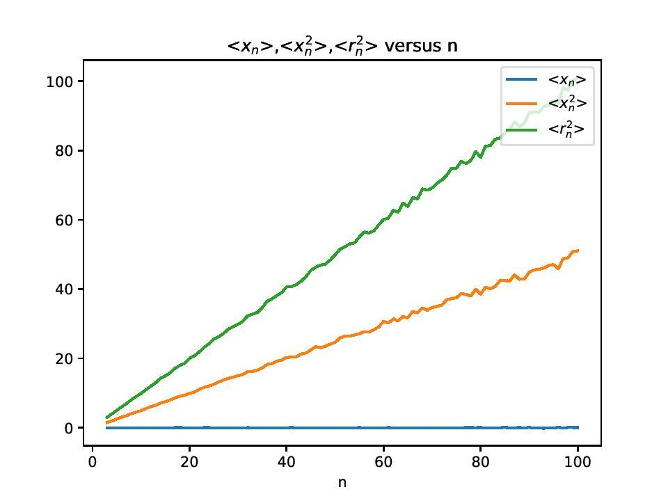
Motion is diffusive, i.e. ❬r²_{n}❭ ∝ t
Estimate D = 2

Slide 4

Diffusion Equation
First, show that < x² > of 1D Normal Distribution
is equal to σ²(t).

Slide 5
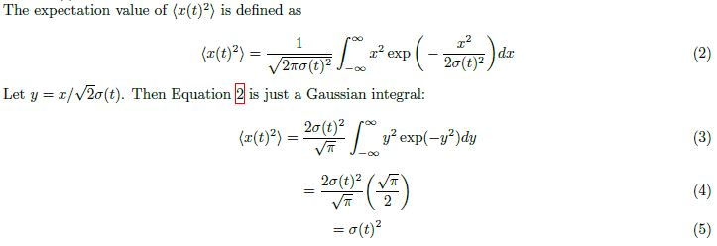
Diffusion Equation

Slide 6
Diffusion Equation
Wrote a program to solve the 1D diffusion equation using finite difference form with diffusion constant D = 2
Started with initial density profile that is sharply peaked but extends over a few grid sites

Slide 7
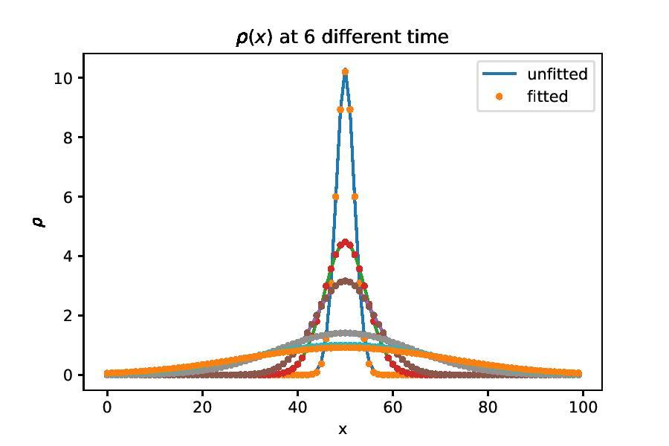
Density profiles at various times with fits overlayed
Profiles at later times correspond to normal distribution with 𝜎(t) = √2Dt

Slide 8
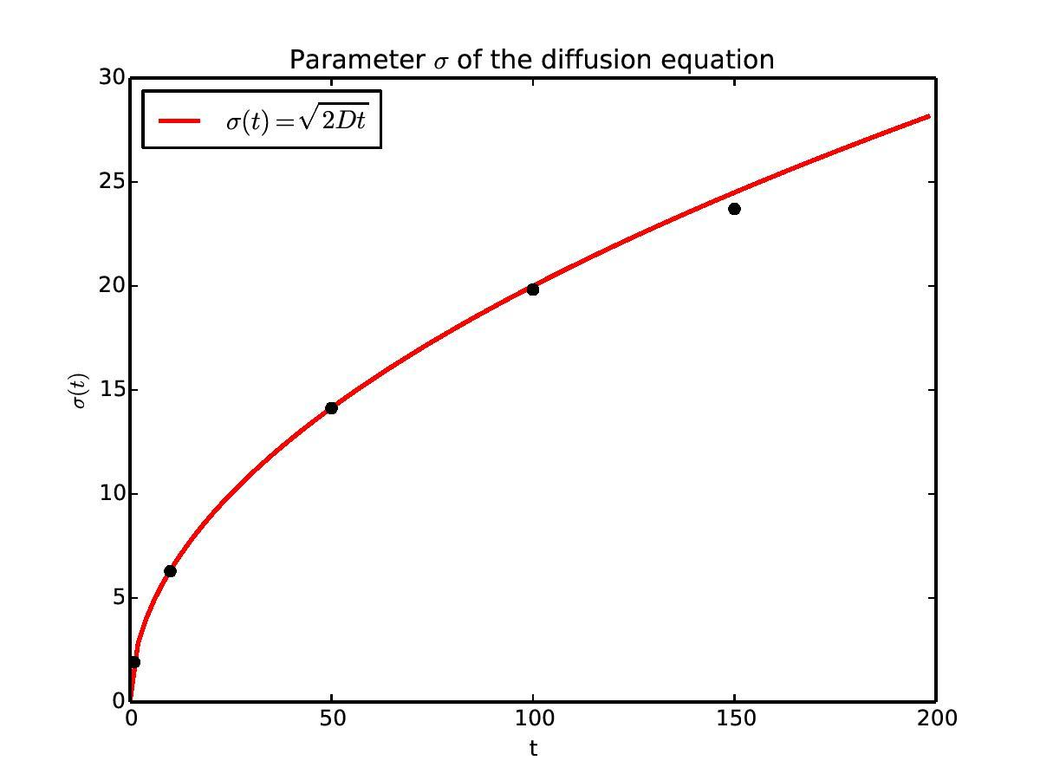
𝜎(t) versus time

Slide 9
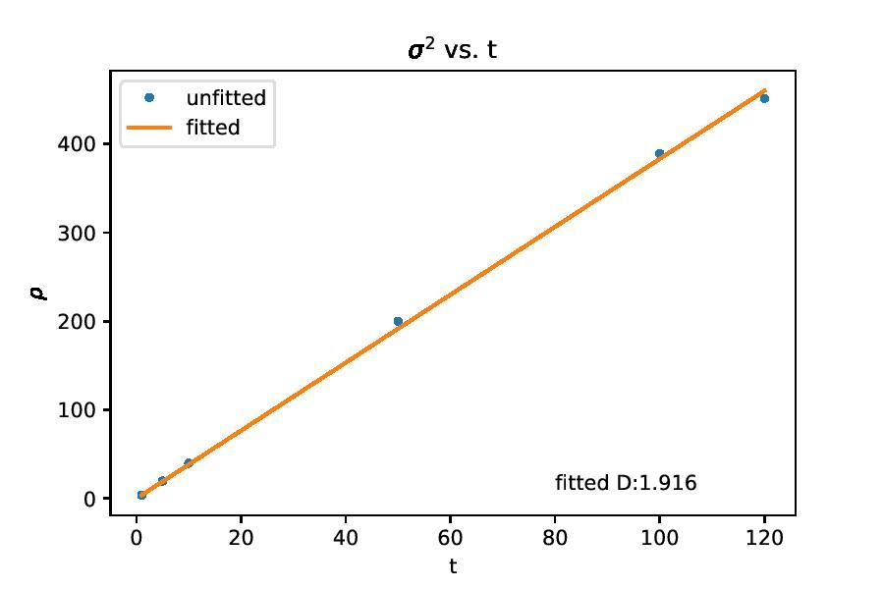
𝜎(t) versus time
𝜎²(t) versus time

Slide 10
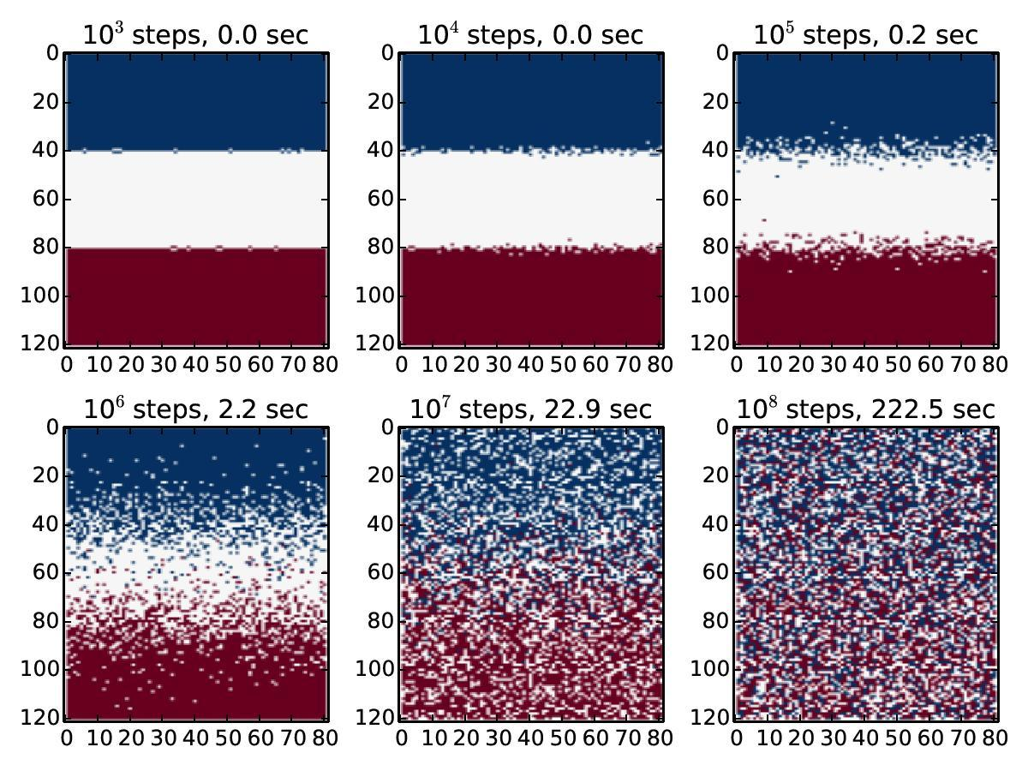
Mixing of Two Gases
Picked random location on grid, and had gas particle move one position up/down/left/right
If occupied, reject and pick another particle

Slide 11
Mixing of Two Gases
Three things that made algorithm run faster:
Choose unoccupied sites (⅓) instead of occupied (⅔)
Generate one random integer for both selecting location, and selecting neighbour of location
Create a boundary of unoccupied sites around grid to avoid assertions for sites at the edge

Slide 12
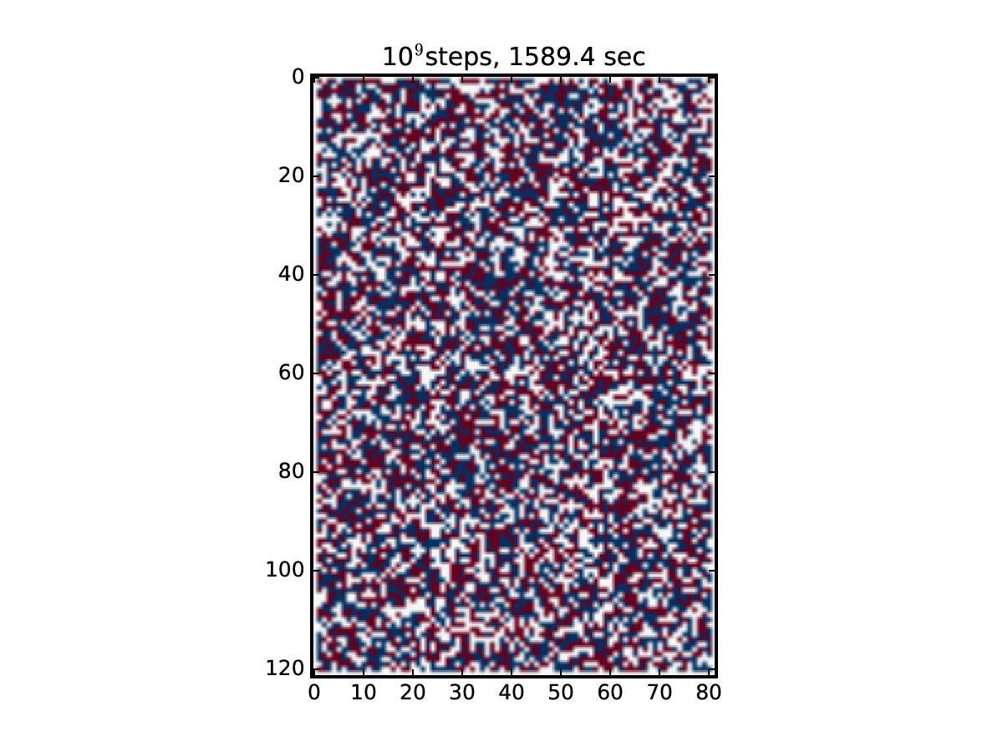
Fully mixed gases

Slide 13
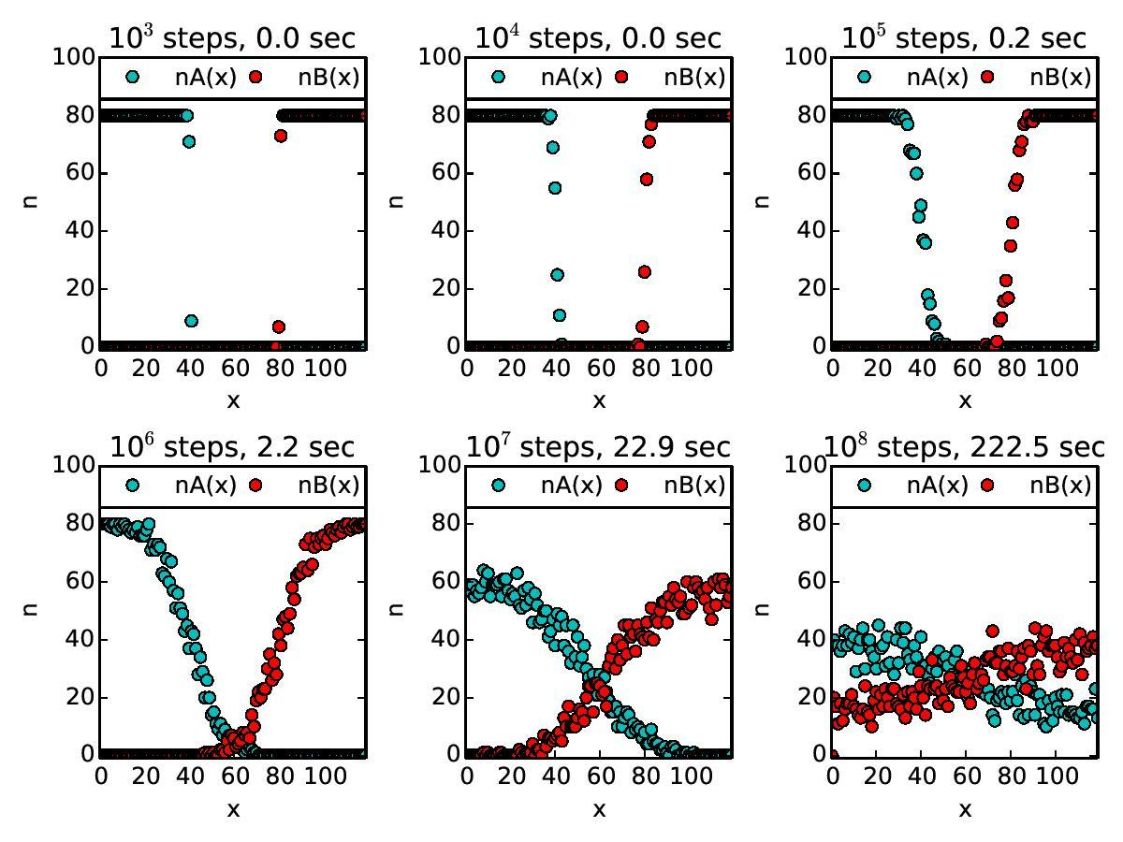
Linear population densities at same time intervals

Slide 14
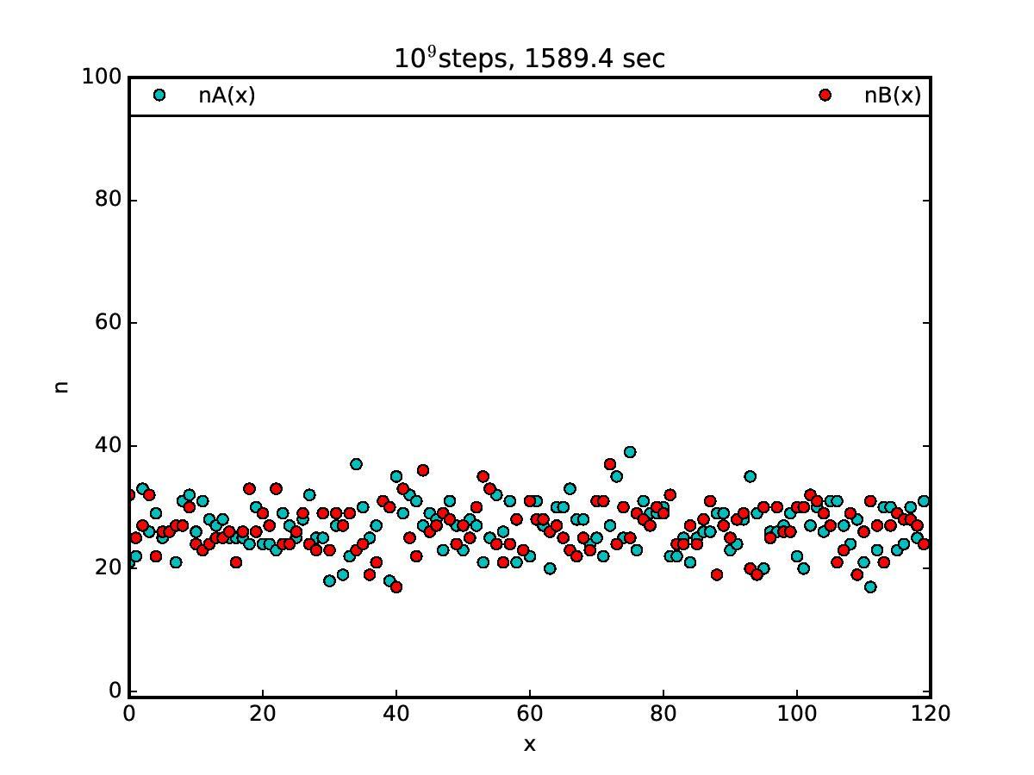
Linear population densities of fully mixed gases

Slide 15
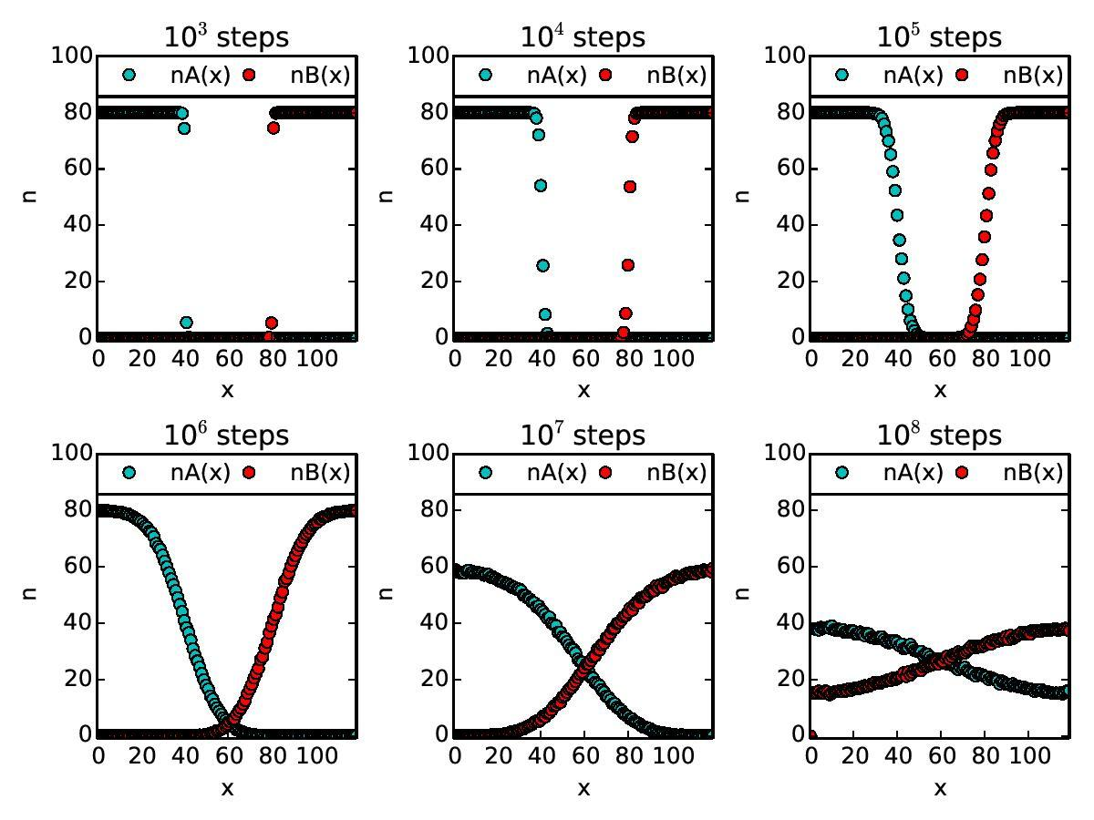
Linear population densities averaged over 100 trials

