Slide 1
A Baysiean Approach to Identifying Fake News
CS5100 FALL 2017

Slide 2
Team Veritas
Emily Dutile
Linghan Xing
Shubhi Mittai

Slide 3
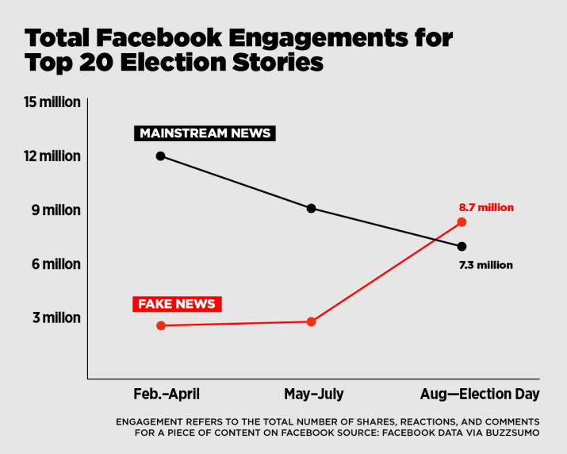
The Problem
In late 2016, the top 20 fake news stories on Facebook were reported to outperform the top 20 real news stories
‘Fake News’ was a headline in 27,000 articles in 2016

Slide 4
Approaches
Text Processing
Lemmintization
Stemming
Stop words
Filtering
Translation
Feature Extraction
Bag-of-words (count vector)
TF-IDF
Word2Vec
Modeling
Bayes
Gradient-boosted decision trees
Deep neural network

Slide 5
Goal
Build a model that can differentiate between “Real” news vs “Fake” news

Slide 6
Implementation
01
02
03
04
05
Generate/get labeled data set
Selected training data and testing data (70%, 30%)
Extract features: count vectorization and Term Frequency - Inverse Doc Frequency
Multinominal Naïve Bayes that classifies fake and real articles based on words and phrases
Run and evaluate Random Forest + other models that classifies fake news and real news

Slide 7
Feature extraction
Document 1:
There are two fundamental truths in this world: Paul Ryan desperately wants to be president. And Paul Ryan will never be president. Today proved it.
Feature could be:
Occurrence of words
Certain patterns
Specific symbols

Slide 8
Preprocessing
There are two fundamental truths in this world: Paul Ryan desperately wants to be president. And Paul Ryan will never be president. Today proved it.
Stop words extraction:
the words that are frequent in our natural language but usually doesn’t have additional information, such as words like a, on, this, the, is, etc.
Tokenization:
document will be tokenized into a list of words, with all the punctuation being taken away, all words are lower cased.
Stemming:
words that has the same roots are assigned to a same root word. For example: attack, attacking and attacked will be categorized as the same root word: attack.

Slide 9
Working on the matrix!
Construct a matrix with:
Num of document rows
Length of vocabulary columns
f(w1, d1) | f(w2, d1) | f(w3, d1) | … | f(wn, d1)
f(w1, d2) | … | … | … | …
… | … | … | … | …
f(w1, dm) | … | … | … | f(wn, dm)

Slide 10
Working on the matrix!
Steps:
Counting term frequency:
Boolean counting, naïve counting, log counting
Inverse-document frequency
Normalization:
To avoid cases like
[12, 0, 32] --> [.62, 0, .92]
TF * IDF gives us a balanced matrix!
f(w1, d1) | f(w2, d1) | f(w3, d1) | … | f(wn, d1)
f(w1, d2) | … | … | … | …
… | … | … | … | …
f(w1, dm) | … | … | … | f(wn, dm)

Slide 11
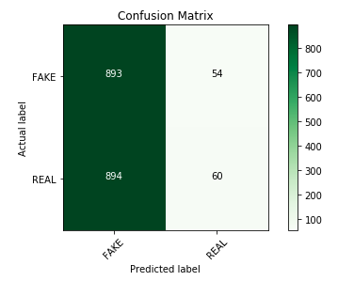
Naïve Bayes
70% training, 30% testing
Tokens->Features>vocabulary->Model>Results
Trained model (38586 x 2)
Vocabulary | FAKE | REAL
trump | 128 | 1024
truce | 256 | 32
israel | 512 | 2048
president | 16 | 64

Slide 12
Prediction
P(c) = N_{c} / N , N_{c} is the number of documents in class c, N is the total number of documents
P(w|c) = count(w, c) + S/ count(c) + |V| ,
count(w, c) is the count of word w in class c
count(c) is the count of total words in class c
|V| is the length of vocabulary
S is the smoothing factor with value 1
p(sample/c_{i}) = P(c_{i})* P(w₁|c_{i}) * P(w₂|c_{i}) * P(w₃|c_{i}) ………………………. P(w_{|sample|}|c_{i})
p(sample/c₂) = P(c₂)* P(w₁|c₂) * P(w₂|c₂) * P(w₃|c₂) ………………………. P(w_{|sample|}|c₂)
MAX(p(sample/c_{i}) , p(sample/c₂))

Slide 13
Results
Model | Accuracy
Naïve Bayes (own implementation) | 0.533
Naïve Bayes Multiplier (CV) | 0.888
Naïve Bayes Multiplier (TF-IDF) | 0.835
Random Forest (CV) | 0.839
Random Forest (TF-IDF) | 0.838
SVM (CV) | 0.870
SVM (TF-IDF) | 0.930
Linear Regression (CV) | 0.851
Linear Regression (TF-IDF) | 0.923

Slide 14
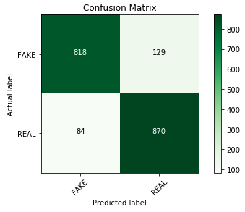
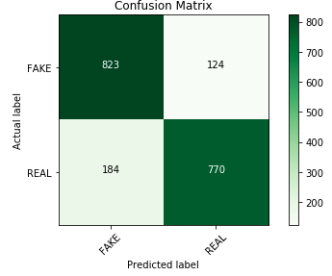
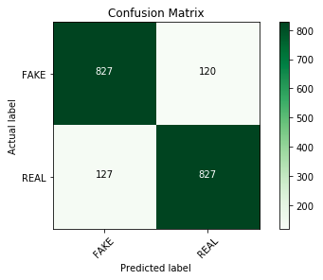
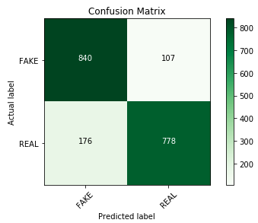
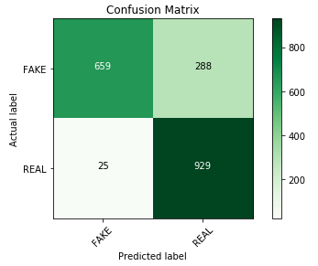
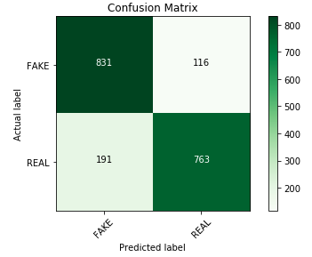
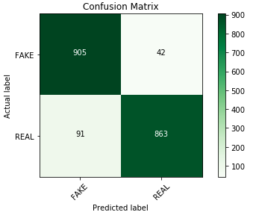
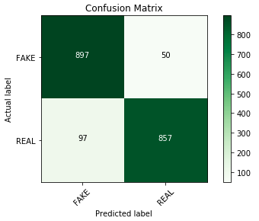
Evaluation – Confusion Matrix
Naïve Bayes
Random Forest
SVM
Linear Regression
CV
TF-IDF

Slide 15
Division of Work
MNB Implementation – All
Preprocessing – Shubhi
Feature Extraction – Linghan
Models & Evaluations - Emily

Slide 16
