Slide 1
A Bayseian Approach to Identifying Fake News
CS5100 Fall 2017

Slide 2
Meet the Developers. Team Veritas
Emily Dutile
Shubhi Mittai
Linghan Xing

Slide 3
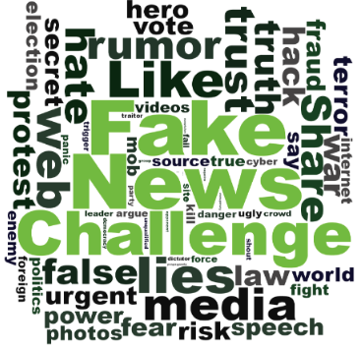
Notes:
http://www.fakenewschallenge.org/
Explore how artificial intelligence technologies could be leveraged to combat fake news
<number>

Slide 4
The Problem
“A lie gets halfway around the world before the truth has a chance to get its pants on.”
Winston Churchill

Slide 5
Goal
Build a model that can differentiate between “Real” news vs “Fake” news

Slide 6
False Connection: Headlines, visuals or captions don’t support the content
False Context: Genuine content is shared with false contextual information
Manipulated content: Genuine information or imagery is manipulated
Satire or Parody: No intention to cause harm but potential to fool
Misleading Content: Misleading use of information to frame an issue/individual
Imposter Content: Impersonation of genuine sources
Fabricated content: New content that is 100% false
What is Fake News?

Slide 7
Implementation
Assemble a dataset of fake and real news from Kaggle and other outside sources
Select the training data and testing data
Extract features: text transformation using count vectorization or Term Frequency–Inverse Document Frequency (TF-IDF) & choose type of text to use (headline vs. full text)
Develop a Naive Bayes classifier to create a model to classify an article as fake or real based on its words and phrases
1
2
3
4

Slide 8
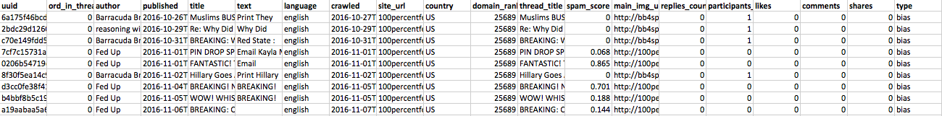
The Dataset
The Fake News: Kaggle dataset of ~13,000 articles published in the 2016 election cycle
The Real News: 10,558 articles from All Sides published in 2015 and 2016

Slide 9
Dividing the Work
Peer to peer coding / team coding
4 Sprints
Plan work every Saturday/Sunday

