Slide 1
Ad A/B testing
Lingjie He, PhD

Slide 2
Overview
Problems to solve
Solutions:
Data processing
Exploratory data analysis (EDA)
Statistical analysis
Data Insights

Slide 3
Problems
Does the new ad generate more responses to their questionnaire?
Is the company justified in using the new ad?

Slide 4
Solutions
Data Processing
Statistical analysis
Data
Insights
EDA
•Missing values
•Duplicates
•Feature distribution
• Check Imbalance
•Total clicks
•Conversion rate
•Test hypothesis
•insight for new Ad

Slide 5
Results
Data Processing
No missing value
No duplicates
EDA
Feature distribution: users were tested within 3 days on the similar browser and os platform
Balanced participants in control and exposed groups

Slide 6
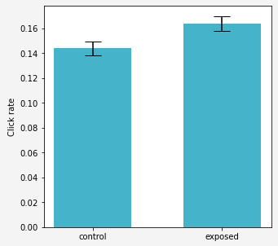
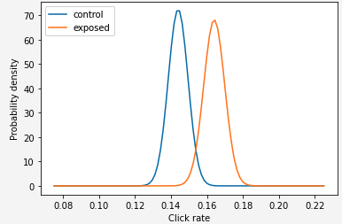
Problem 1: does the new ad generate more responses to their questionnaire?
Null hypothesis for click rate
H0: exposed – control = 0
H1: exposed – control > 0
p value < 0.05, we reject the null hypothesis and conclude that new ad generate significantly more responses to their questionnaire.

Slide 7
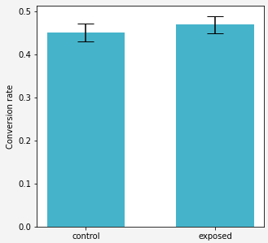
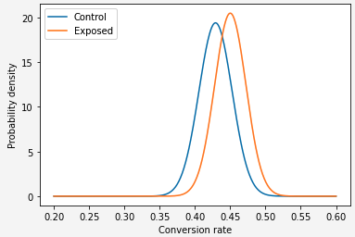
Problem 2: Is the company justified in using the new ad?
Null hypothesis for conversion rate
H0: exposed – control = 0
H1: exposed – control > 0
p value > 0.5, we failed to reject the null hypothesis.

Slide 8
Business insights
Compared to the dummy ad, new ad makes more users respond.
Using the new ad doesn't lead to more conversion to answer the questionnaire.

