Slide 1
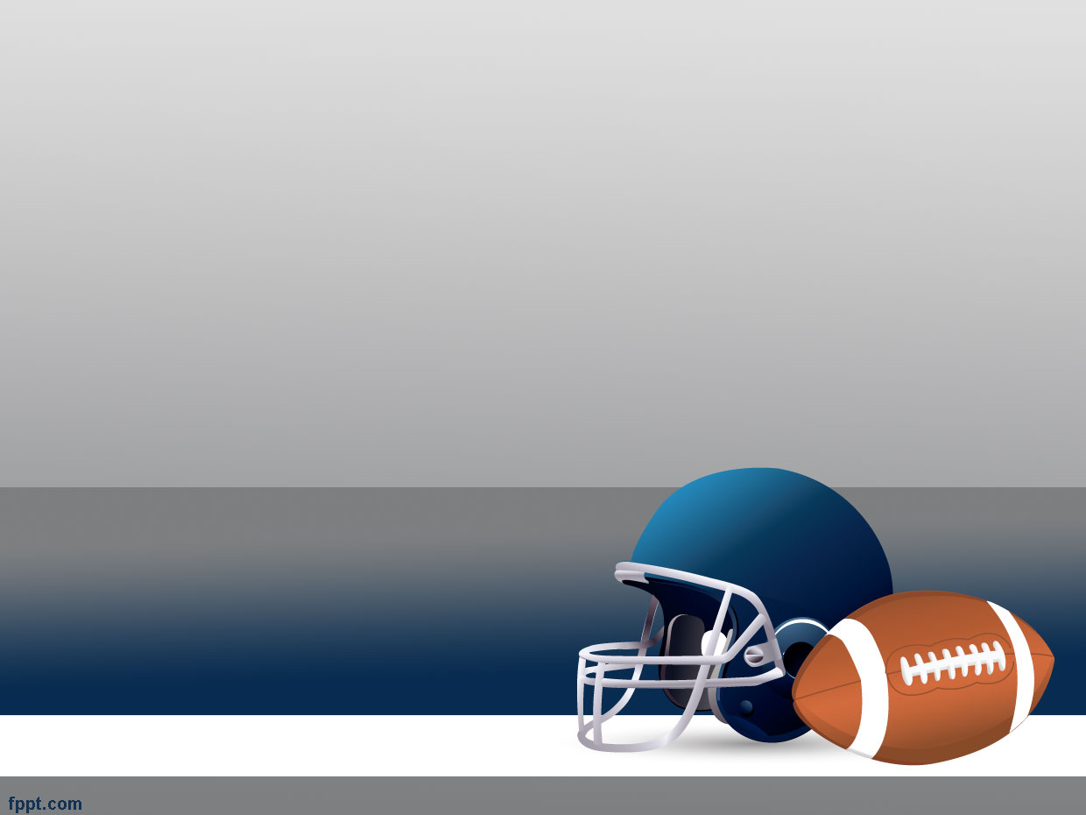

NEW ENGLAND PATRIOTS

Slide 2
Whatever Shall We Do?
Harnessing Twitter API to observe fan
loyalty of eliminated teams
Helen Hong, Haley Huang,
Tom Meagher, and Tyler Reese
--INSTRUCTOR: Prof. Randy Paffenroth
--02/06/2016
Patriots

Slide 3
Motivation

Slide 4
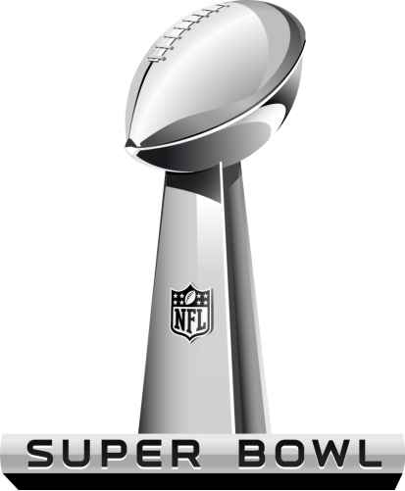
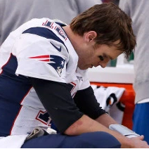
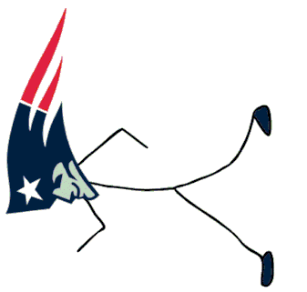
We are all Patriots fans!
Jan 24, 2016 , the Patriots lost to the Denver Broncos at 18-20.
Partriots were one step away from final ☹
Quarterback Tom Brady said
“it was a tough day”
Patriots

Slide 5
With our team eliminated, what are we to do during the upcoming the Super Bowl?

Slide 6
We are not alone!
There are lots of Patriots fans!
How are they reacting post-elimination?

Slide 7


Pre-Super Bowl sentiments surrounding the Patriots
Thoughts or attitudes
Patriots fans
Who are likely to be?
Broncos vs. Panthers?

Slide 8
Data Source
Twitter API
Widely-used social platform
Lots of Data available
Allowed for collection in the days leading up to the Super Bowl

Slide 9
Question 1:
What are current thoughts or
attitudes surrounding the patriots?
(Is everyone as sad as us?)

Slide 10
Data
Collected tweets in real-time using the Twitter streaming API
Refined using search-term “Patriots”
Collected 2,500 tweets

Slide 11
Results
Average words per tweet | 14.55
Lexical Diversity | 0.1906
Table 1.1: Average words and Lexical diversity

Slide 12
Results
Table 1.2: Most Common Words

Slide 13
Results (cont.)
Table 1.3: Popular user Mentions
Table 1.4: Popular Hashtags

Slide 14
Results (cont.)
Retweets | Screen Name | Text
0 | vlewey | RT @vlewey: @jillarie85 https://t.co/5CCdYV2F3t
0 | vitorsergio | RT @vitorsergio: E ainda levei uma sacaneada retroativa ao dizer que torço para o Patriots...
0 | vaneessab3 | RT @vaneessab3: Me: I need to buy a Broncos Sara: ya I need to buy a patriots @SaraEchelberry
0 | usosports1 | RT @usosports1: @Patriots RB @joeyiosefa back to community/spends time with local elementary kids. #PatriotNation #NFL #NFLPA https:/…
0 | usosports1 | RT @vlewey: @jillarie85 https://t.co/5CCdYV2F3t
0 | usosports1 | RT @vitorsergio: E ainda levei uma sacaneada retroativa ao dizer que torço para o Patriots...
0 | uhatremblay | RT @vaneessab3: Me: I need to buy a Broncos Sara: ya I need to buy a patriots @SaraEchelberry
0 | tweet4upatriots | RT @usosports1: @Patriots RB @joeyiosefa back to community/spends time with local elementary kids. #PatriotNation #NFL #NFLPA https:/…
0 | tweet4upatriots | RT @vlewey: @jillarie85 https://t.co/5CCdYV2F3t
0 | tweet4upatriots | RT @vitorsergio: E ainda levei uma sacaneada retroativa ao dizer que torço para o Patriots...
Table 1.4: Most “Popular” Tweets

Slide 15
Question 2:
Which Twitter users are likely
To be Patriots Fans?
(Perhaps we can sympathize with them!)

Slide 16
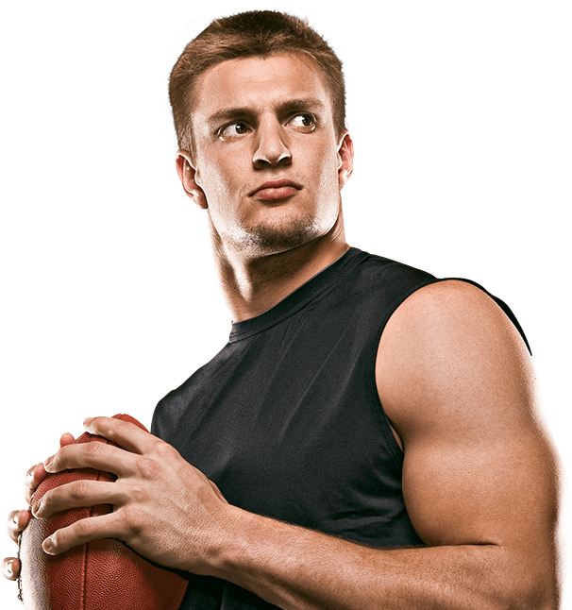
Data
To determine users who are likely to be Patriots fans, it is reasonable to consider those users who “follow” accounts related to the Patriots.
Collected all user ID’s of Rob Gronkowski’s 384 Friends
Collected all user ID’s of Rob Gronkowski’s 1,263,239 followers
@RobGronkowski

Slide 17
Results
Table 2.1: Example Friends(left) Table 2.2: Example Followers(right)
User ID | Screen Name |  | User ID | Screen Name
20575752 | marcelluswiley |  | 4876598751 | newtonkn1
890891 | BleacherReport |  | 1025779262 | y_yohn
29925371132 | GronkPartyBus |  | 3021470789 | penelopecg24h
966774301 | uninterrupted |  | 4876845639 | BarrieaultFund
218748456 | Drubnation |  | 2153522761 | ohpatriotsgirl
25367082 | samanthapeszek |  | 2879975514 | RayMcP3
3020277803 | ninko50 |  | 713746011 | Javiii_Castro15
67381805 | StaffordBros |  | 4876856416 | ecosurfinc1
63253045 | MonsterEnergy |  | 3334787685 | poppy_carlton
123276343 | BarstoolBigCat |  | 27335788 | DivyaBahl
Table 2.3: Example mutual friends of @RobGronkowski
User ID | Screen Name |  | User ID | Screen Name
1059194370 | kobebryant |  | 84451338 | QuintonAaron
191650646 | viccarucci |  | 26053643 | jimmykimmel
314298886 | Simzy18 |  | 101852687 | ZIMMERWIZ
17587207 | boburnham |  | 145745936 | RobinMeade
20575752 | marcelluswiley |  | 22938645 | EricStangel

Slide 18
Question 3:
Are Patriots fans more interested in the
Denver Broncos or the Carolina Panthers?
(Maybe we can still watch the Super Bowl…)

Slide 19
Data
Two data sets:
Collected all followers of @Patriots, @Panthers, and @Broncos
Periodically filtered the streaming API for tweets containing “Panthers” or “Broncos”
Restricted to tweets geo-tagged in the Boston area
Collected 3,600 tweets total

Slide 20
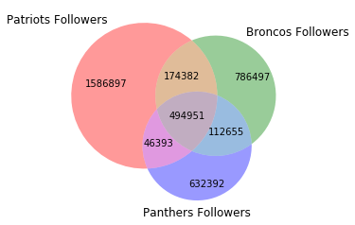
Results 1.
Figure 3.1: Common Twitter followers

Slide 21
Results 2.
 | Total No. of Tweets | Average Tweets per 2.5 mins | Average Tweets per min
“Broncos” | 1,671 | 334.2 | 133.68
“Panthers” | 1,489 | 297.8 | 119.12

Slide 22
Results 2.

Slide 23
Results 2.

Slide 24
Conclusions

Slide 25
Data limitations
The majority of the most dedicated football fans may not choose Twitter to share opinion
The fans of Patriots may not follow the Twitter account, while the account has “general” fans
Geo-search on greater Boston area may not represent the national Patriots fans

Slide 26
Conclusions
The effective popular words don’t reveal definitive attitudes towards Patriots
Patriots fans in greater Boston area are more interested in the Denver Broncos over the Carolina Panthers in Super Bowl

Slide 27
Reference
Python for Data analysis_O’Reilly
Mining the Social Web 2nd version _O’Reilly
http://profootballtalk.nbcsports.com/2016/01/24/tom-brady-it-was-a-tough-day/

Slide 28
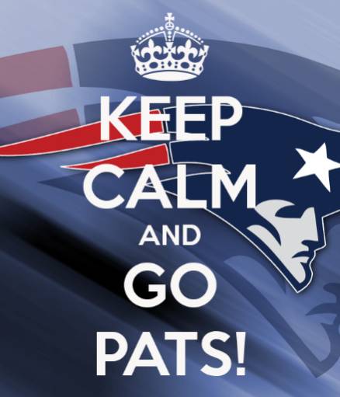
Let’s go Patriots!
Thanks & Question?
http://www.keepcalm-o-matic.co.uk/p/keep-calm-and-go-pats-5/

