Slide 1
Seen any good movies lately?
Understanding Film Preferences for Recommendations
Solely on Background Information

Slide 2
Motivation

Slide 3
Seen any good movies lately?
Have you seen any movies
I would like to see?
What movies do they like?
What movies have they seen?

Slide 4
WE DON’T KNOW!
We only know their personal information
Age, Gender, Occupation, Area of Residence

Slide 5
This is a problem encountered by online movie-streaming companies every day...

Slide 6
Sign up
Name
Email
Birth date
Male
Female
Sign up
By clicking Sign up, I accept the Terms of Service and Privacy Policy.

Slide 7
“
Based solely on their personal information, how do we recommend movies to others?
Notes:
Extends far beyond maintaining personal social relationships
Netflix® acquires new customers every day
Each time a new member logs-in for the first time, Netflix® must recommend a movie to that new user based solely on login demographic information. Positive first experience vital in maintaining and growing a satisfied subscriber-base

Slide 8
Data

Slide 9
6k
3.8k
1m
users
movies
reviews
gender
age
occupation
zip code
title
genre
movie
user
rating
timestamp
MovieLens 1M Ratings
Notes:
Extends far beyond maintaining personal social relationships
Netflix® acquires new customers every day
Each time a new member logs-in for the first time, Netflix® must recommend a movie to that new user based solely on login demographic information. Positive first experience vital in maintaining and growing a satisfied subscriber-base

Slide 10
Objectives

Slide 11
1. Analyze Basic Statistics

Slide 12
Conjecture: The older a person gets, the more difficult they are to please.
Before we even recommend a movie, our success or failure could depend on the inherent happiness level in various groups of people.
Method: We consider the percent of each type of rating (1-5) given by each age group
Mean ratings are not representative
Total ratings of each type are disproportionate based on viewership
1. Analyze Basic Statistics
12

Slide 13
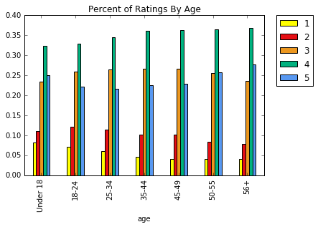
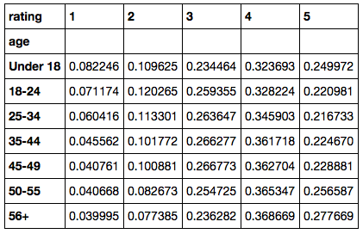
Results
1. Analyze Basic Statistics
13

Slide 14
Conclusion
False. In fact, the data supports the opposite conjecture:
Older people are:
more likely than younger people to give a rating of 5
less likely to give a rating of 1
Therefore our data supports that people become easier to
please as they get older!
1. Analyze Basic Statistics
14

Slide 15
2. Expand Our Investigation
to Histograms

Slide 16
Conjecture: The distribution of all ratings of older movies is less normally-distributed than that of newer movies.
Due to bias in sample means, we consider cumulative data, in the form of histograms.
Method: We consider distributions as there is a gap in quantity of ratings: new movies rated more frequently
Extract the Release-Year from the title
2. Expand Our Investigation to Histograms
16

Slide 17
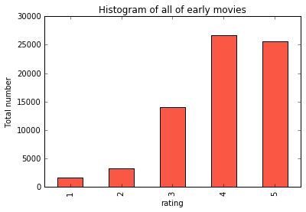
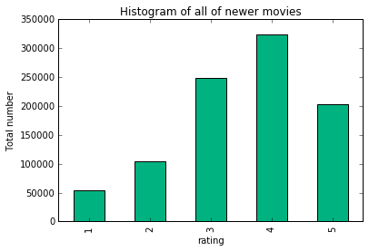
Results All ratings of movies made before and after 1960
2. Expand Our Investigation to Histograms
17

Slide 18
Conclusion
This conjecture is supported by the data.
Older movies receive disproportionately more high-end ratings
Hypothesis: This difference arises from a Nostalgia Factor. People watch new movies to be entertained. Older movies are watched to reminisce and reflect.
2. Expand Our Investigation to Histograms
18

Slide 19
3. Explore Male Versus Female Ratings

Slide 20
Conjecture: Genders agree on what is “funny”
Perhaps the most basic demographic difference is between men and women. Understanding when they agree can lead to sound advice.
Method: We consider three metrics per comedy movie among men and women.
Average rating
Percent ratings of 5
Percent ratings of 1 or 2
3. Explore Male Versus Female Ratings
20

Slide 21
Results
High correlation ( > 0.85) in each of these data sets indicates a linear relationship
Therefore we train linear regression models on 20% of our data, and test on the remaining 80% to examine predictability
3. Explore Male Versus Female Ratings
21

Slide 22
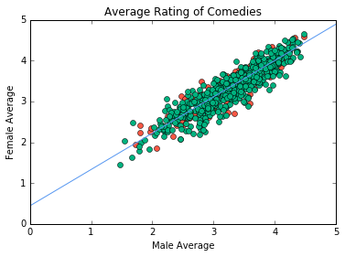
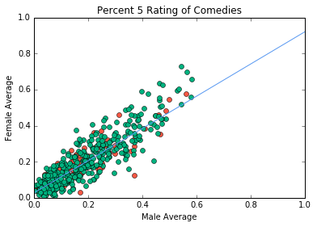
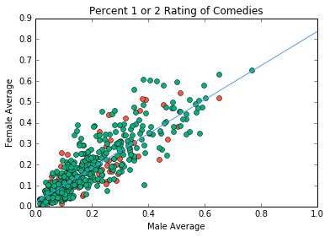
Results
Training data
Testing data
Linear model
3. Explore Male Versus Female Ratings
22

Slide 23
Results
Testing Error:
 | Mean Squared Error
Average Rating | 0.054
Percent 5 Ratings | 0.0046
Percent 1 or 2 Ratings | 0.005
3. Explore Male Versus Female Ratings
23

Slide 24
Conclusion
The conjecture is supported by the data. Given that the
average rating per comedy
percent 5 rating per comedy
percent 1 or 2 rating per comedy
Are all reliably (and linearly) predictable between genders,
Genders tend to agree on what is “funny”
3. Explore Male Versus Female Ratings
24

Slide 25
4. Relate to Business Intelligence

Slide 26
Movie subsrciption companies such as Netfix ® acquire new customers every day.
They must recommend a first-movie to these customers based solely on their log-in information.
We propose the following question.
4. Relate to Business Intelligence
26

Slide 27
What genre of Movie should Netflix recommend to a first-time user?
Method: We focus our analysis on the three most “active” genres:
Comedy, Drama and Adventure
We propose three very specific Questions.
4. Relate to Business Intelligence
27

Slide 28
What is the best time to recommend a drama for each gender?
A
Which occupation is most likely to enjoy a comedy?
B
What age group watches the most adventure movies?
C
4. Relate to Business Intelligence
28

Slide 29
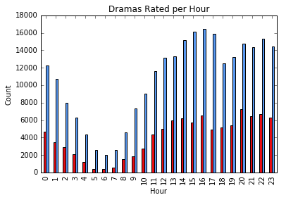
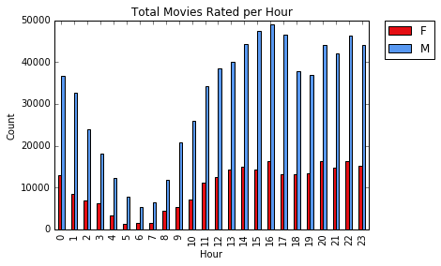
A. What is the best time to recommend a drama for each gender?
Dramas Rated
Per Hour
Movies Rated
Per Hour
4. Relate to Business Intelligence
29

Slide 30
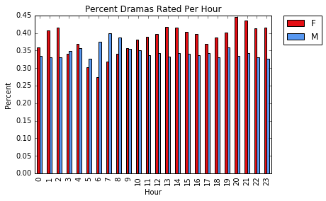
A. What is the best time to recommend a drama for each gender?
Percent of Movies Rated per hour that are Dramas
4. Relate to Business Intelligence
30

Slide 31
Conclusion
Women show significantly higher interest in Dramas in the evening than in the morning
Men are more interested in morning Drama-viewing compared to women
Further analysis: Movie length, run-time
4. Relate to Business Intelligence
31

Slide 32
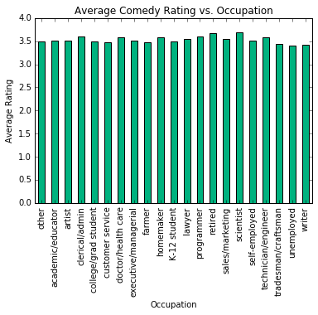
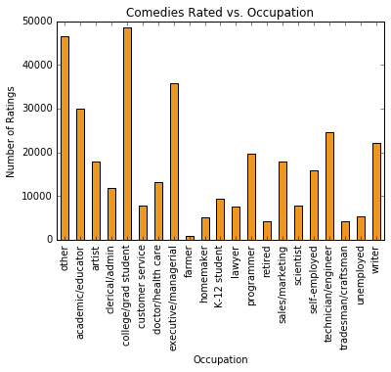
B. Which occupation is most likely to enjoy a comedy?
Average Rating
Total Comedies Rated
4. Relate to Business Intelligence
32

Slide 33
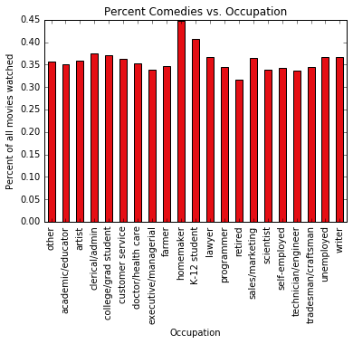
B. Which occupation is most likely to enjoy a comedy?
Percent of Movies watched that are Comedies
4. Relate to Business Intelligence
33

Slide 34
Conclusion
College students, homemakers, and children all show high interest in comedies compared to other occupations
Further analysis Greater stratification within the “other” occupation
4. Relate to Business Intelligence
34

Slide 35
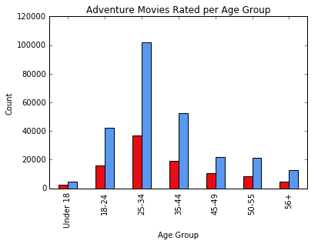
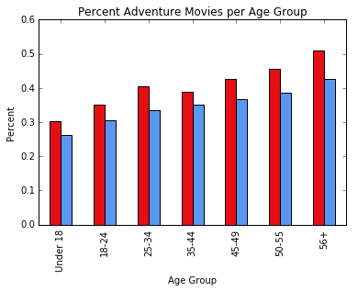
C. What age group watches the most adventure movies?
Total Adventure movies rated
Percent of all movies rated that are Adventure
4. Relate to Business Intelligence
35

Slide 36
Conclusion
Women show a particularly strong interest in Adventure movies
Nearly half of movies watched by older women were adventure movies
Older people are more interested in adventure movies than younger individuals
Further analysis: Greater representation among women, finer age-group segmentation
4. Relate to Business Intelligence
36

Slide 37
Overall Conclusions
People rarely conform to all demographic trends
Unwise to “bet-the-farm” recommending a single genre
Instead determine multiple genres (4 or 5) that each individual is likely to show interest in, and offer a first-time selection of genres
Each question above suggests good choices to include in such a selection
No “first-time” recommendation silver bullet given the data
4. Relate to Business Intelligence
37

Slide 38
Data Limitations

Slide 39
Data Limitations
All movies released before 2000
Under representation (rating-response) bias
Only 6k users submit ratings
All from United States
Sampling bias
3:1 male to female ratio
Data Limitations
39

Slide 40
Summary of Conclusions

Slide 41
Summary of Conclusions
Older people are easier to please (among “popular” movies)
Nostalgia factor
Genders tend to agree what is funny
Unwise to “bet-the-farm” recommending a single genre
Instead determine multiple genres (4 or 5) that each individual is likely to show interest in
No “first-time” recommendation silver bullet given the data
Summary of Conclusions
41

Slide 42
Questions
Helen Hong
Haley Huang
Tom Meagher
Tyler Reese

