Slide 1
The Reviews Are In
Text & Sentiment Analysis Of Movie Reviews

Slide 2
Motivation

Slide 3

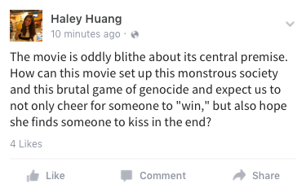
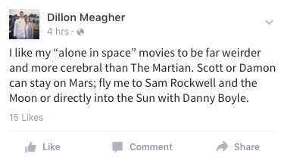
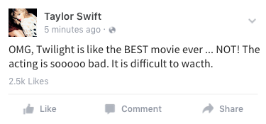
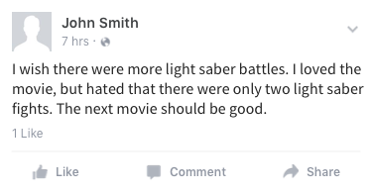
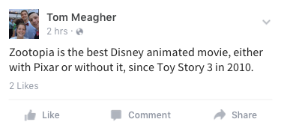
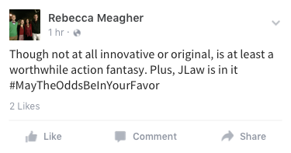
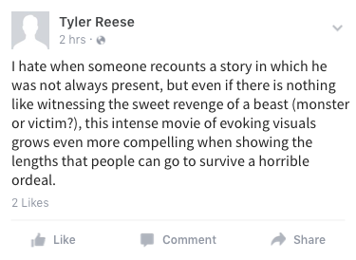

Slide 4
“
Comprehension of this unstructured text informs our decisions.

Slide 5
Volume
Veracity
Machine Learning
Variety
Velocity
Notes:
Not so much variety and velocity, but you could imagine another example including those two.

Slide 6
2k
text reviews
1k
1k
positive
negative

Slide 7
Objectives

Slide 8
1. Preliminary sentiment analysis
on movie reviews

Slide 9
Methodology
Randomly split 2k movie reviews into two groups
Built vectorizer-classifier pipeline (TfidVectorizer)
Filtered out rare or too frequent tokens
Fit Linear Support Vector Classifier with relatively high penalty
Determined grid search token set for text files
words (1-grams) or words and word pairs (1- and 2-grams)
Performed grid search cross-validation
75% training
25% testing
1. Preliminary sentiment analysis on movie reviews

Slide 10
Results
Grid Search CV scores
n-gram Range | Score
(1,1) | 0.82533
(1,2) | 0.84733
On training data, the linear SVC pipeline is more accurate when it considers both words and pairs of words.
Classification Report
Class | Precision | Recall | f1-Score | Support
Negative | 0.84 | 0.87 | 0.58 | 247
Positive | 0.87 | 0.84 | 0.85 | 253
1. Preliminary sentiment analysis on movie reviews

Slide 11
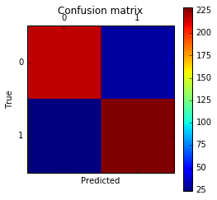
Results (continued)
Number of false negatives and false positives are both small compared to the number of true positives and negatives.
Model performed quite well on our test data set.
Test accuracy ~89%
Confusion Matrix, Grid Search SVC
[[217 30] [ 24 229]]
1. Preliminary sentiment analysis on movie reviews

Slide 12
2. Explore the scikit-learn
TfidVectorizer class

Slide 13
Methodology
Define the term frequency-inverse document frequency (TF-ID) statistic.
measures how important a word is to a document in a particular collection of documents
Run the TfidVectorizer class on the training data.
min_df: filter terms with lower frequency
max-df: filter terms with greater frequency; stop words.
n-gram range: how many n-gram words are to considered
2. Explore the scikit-learn TfidVectorizer class

Slide 14
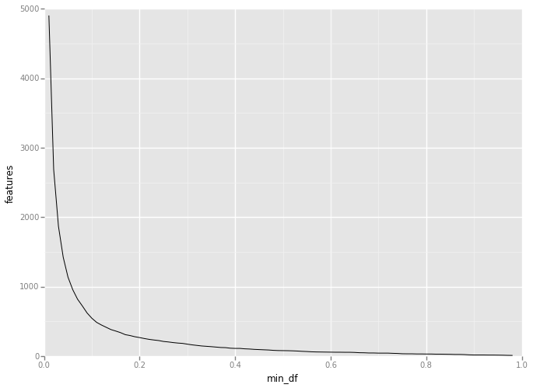
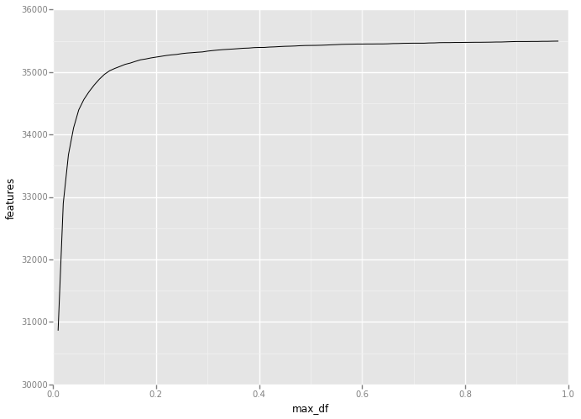
Results
Min_df vs. TfidVectorizer Features
Max_df vs. TfidVectorizer Features
Relationship between number of features in our vocabulary and values of min_df and max_df
Vocabulary size inversely related to min_df, directly related to max_df
2. Explore the scikit-learn TfidVectorizer class

Slide 15
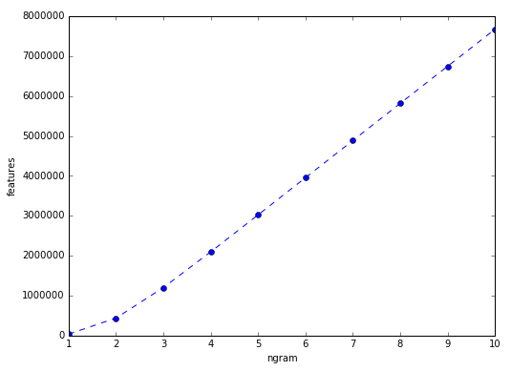
Results
Number of features in TdifVectorizer vocabulary increases as n-gram is increased in the form (1 , n-gram)
Growth appears to be roughly linear.
ngram_range = (1, n-gram) vs. TfidVectorizer Features
2. Explore the scikit-learn TfidVectorizer class

Slide 16
3. Machine Learning Algorithms

Slide 17
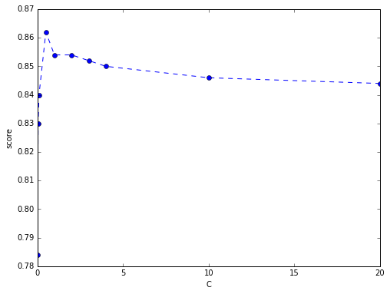
Methodology
Linear Support Vector Classifier (SVC)
penalty parameter ({0.01, 0.05, 0.1, 0.5, 1 , 2, 3, 4, 10, 20})
Testing Accuracy vs. Penalty, Linear SVC
3. Machine Learning Algorithms

Slide 18
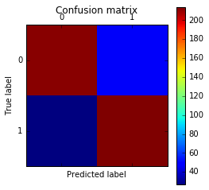
Results
Comparatively small number of false positives and negatives against a much larger amount of true positives and negatives
SVC does well predicting review polarity (test accuracy ~85%)
Confusion Matrix, Linear SVC model with C = 10
[[212 47] [ 27 214]]
3. Machine Learning Algorithms

Slide 19
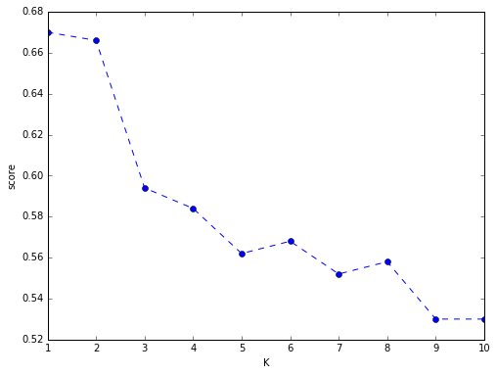
Methodology
K-Nearest Neighbors
neighbor parameter, k({1, 2, 3, 4, 5, 6, 7, 8, 9, 10})
Testing Accuracy vs. k, K-NN
3. Machine Learning Algorithms

Slide 20
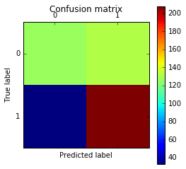
Results
Model has more false positives than it does true negatives
Predicted that more than half of (actually) negative reviews were positive
Test accuracy ~67%
Confusion Matrix, K-NN with k = 1
[[127 132] [ 33 208]]
3. Machine Learning Algorithms

Slide 21
Conclusion
SVC: Little or no penalty models are more lenient to choosing linear separators, which misclassify training points.
K-NN: As k, number of neighbors considered increases, testing accuracy decreases
Linear SVC classifier performed much better than K-NN
worst SVC testing accuracy: ~83%
best K-NN testing accuracy: ~67%
3. Machine Learning Algorithms

Slide 22
4. Finding the right plot

Slide 23
Do negative reviews always end with a short final sentence?
Do positive reviews always begin with long, glowing sentences?
Do confused viewers (writing negative reviews) ask more questions?
Do positive reviews use more words in general?

Slide 24
Methodology
Conjecture The polarity (positive/negative tendencies) of a given text can be determined based on the structure of the text itself.
Structure-based predictors can be computed for all reviews (regardless of their word content)
Restricted to a much smaller, relevant number
Easier to interpret
4. Finding the right plot

Slide 25
Methodology (continued)
New predictor set
Total Words
Total Sentences
Number of “not” Contractions
Total Number of “Not”
Last Sentence Length
First Sentence Length
Longest Sentence
Shortest Sentence
Sentence Deviation
Number of Punctuation
Number of Contractions
Number of Negative Prefixes
Total “You”
Closest “Not”
Performed Kernel PCA, using scikit-learn kernel functions
linear, radial basis, and cosine
4. Finding the right plot

Slide 26
Methodology (continued)
Decision trees are a very flexible, and widely used, classification method
There may be subsets of the predictor space where the data is separable
Conjecture Can we use a high-level decision tree to build a sequence of scatter plots which separate the data?
4. Finding the right plot

Slide 27
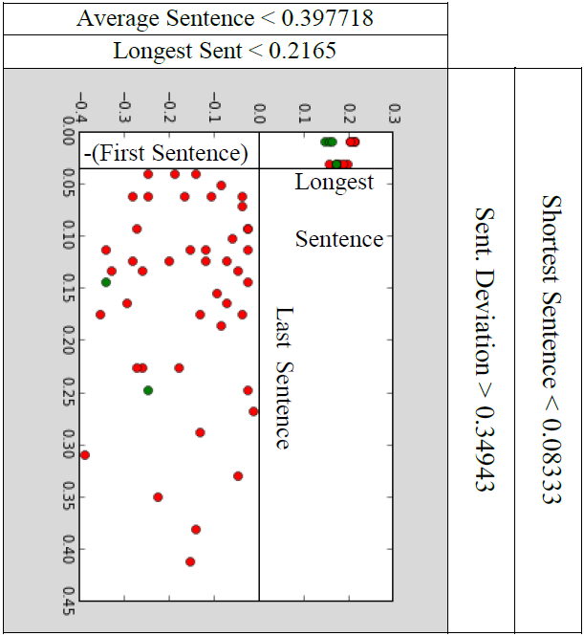
Results
4. Finding the right plot

Slide 28
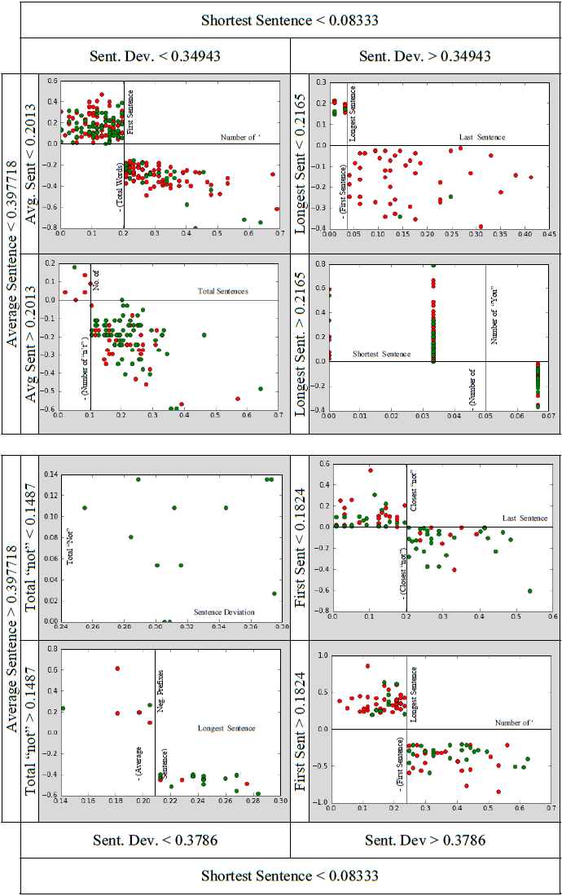
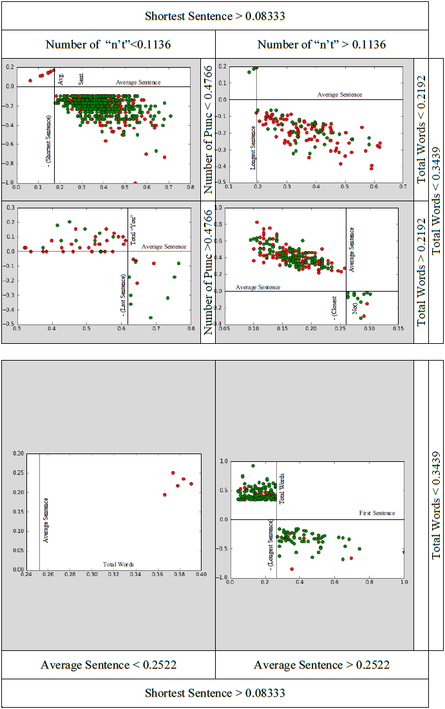

Slide 29
Conclusion
Somewhat successful, yet convoluted
Some regions do an excellent job of separating the data, while others fail
Whole data set scatter plots were always sufficiently “mixed up”
4. Finding the right plot

Slide 30
Business Intelligence & Decision Making

Slide 31
Business Intelligence & Decision Making
Sentiment can be extremely valuable to movie studios.
Determine demographic performance
Make advertising decisions
Future re-release of a film
Movie studios can collect (and analyze) similar data for the movies of other studios.

Slide 32
Overall Conclusions

Slide 33
Overall Conclusions
Conjectured review polarity could be determined based on the test structure
Further analysis required to affirm
Did not find anything surprising in the data
Other than how difficult textual analysis can be
Further, computationally-expensive analysis could reveal surprising trends

Slide 34
Questions
Helen, Haley, Tom, Tyler

