Slide 1



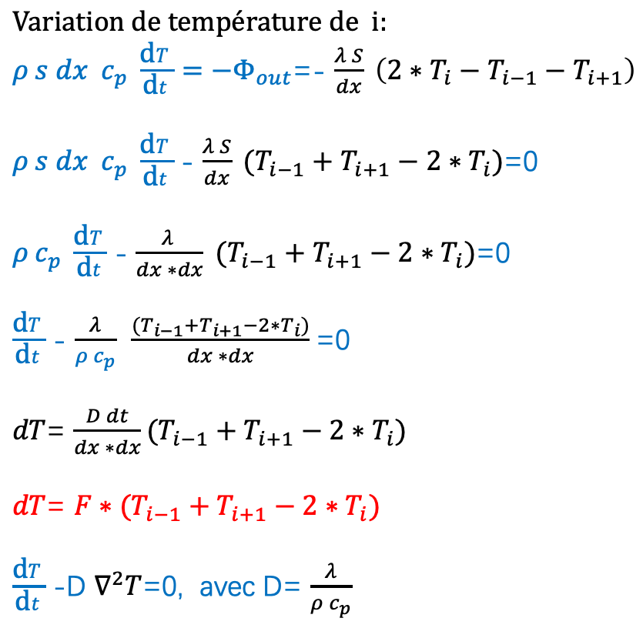


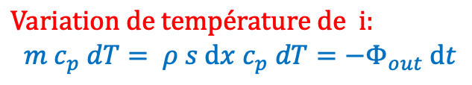

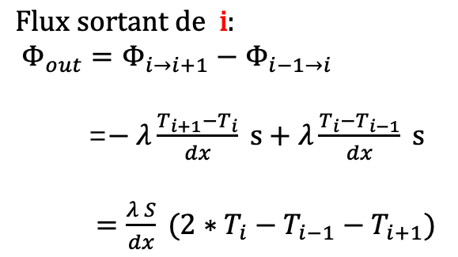
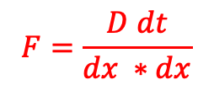




$$\text{d}x$$
$$\text{Variation} \text{de} \text{temp}\text{é}\text{rature} \text{de} \text{i}:$$
$${m c_{p} dT= ρ s \text{d}x c_{p} dT=−Φ}_{out} \text{d}t$$
$$T_{0}$$
$$T_{1}$$
$$T_{i−1}$$
$$T_{i}$$
$$T_{i+1}$$
$$T_{n−1}$$
$$\text{Variation} \text{de} \text{temp}\text{é}\text{rature} \text{de} \text{i}:$$
${ρ s dx c_{p} \frac{\text{d}T}{\text{d}t}=−Φ}_{out}$=- $\frac{λ S}{dx} \left({{{2∗T}_{i}−T}_{i−1}−T}_{i+1}\right)$
$ρ s dx c_{p} \frac{\text{d}T}{\text{d}t}$- $\frac{λ S}{dx} ({T_{i−1}+T}_{i+1}−{2∗T}_{i})$=0
$ρ c_{p} \frac{\text{d}T}{\text{d}t}$- $\frac{λ }{dx ∗dx} ({T_{i−1}+T}_{i+1}−{2∗T}_{i})$=0
$\frac{\text{d}T}{\text{d}t}$- $\frac{λ}{ρ c_{p}}$ $\frac{({T_{i−1}+T}_{i+1}−{2∗T}_{i})}{dx ∗dx}$=0
$dT$= $\frac{D dt}{dx ∗dx}({T_{i−1}+T}_{i+1}−{2∗T}_{i})$
$dT$= $F∗({T_{i−1}+T}_{i+1}−{2∗T}_{i})$
$\frac{\text{d}T}{\text{d}t}$-D $∇^{2}T$=0, avec D= $\frac{λ}{ρ c_{p}}$
$\text{Flux} \text{entre} \text{i} \text{et} \text{i}\text{+1}: Φ_{i→i+1}$ =$− λ\frac{T_{i+1}−T_{i}}{dx} s$
$\text{Flux} \text{entre} \text{i}\text{−1 }\text{et} \text{i}: Φ_{i−1→i}$ =$− λ\frac{T_{i}−T_{i−1}}{dx} s$
$$\text{Flux} \text{sortant} \text{de} \text{i}:$$
${Φ_{out}=Φ_{i→i+1}−Φ}_{i−1→i}$
=$− λ\frac{T_{i+1}−T_{i}}{dx} s+λ\frac{T_{i}−T_{i−1}}{dx} s$
$=\frac{λ S}{dx} ({{{2∗T}_{i}−T}_{i−1}−T}_{i+1})$
$dT$=$T_{après i}$ - $T_{avant i}$
$$F=\frac{D dt}{dx ∗dx}$$

Slide 2

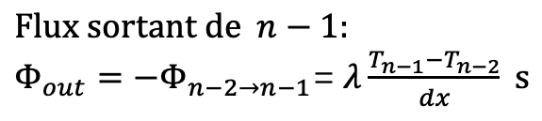


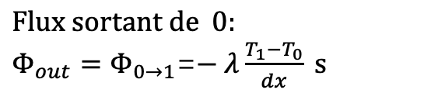


$$\text{d}x$$
$$T_{n−2}$$
$$T_{n−1}$$
$\text{Flux} \text{entre} \text{n}\text{−2 }\text{et} n−1: Φ_{n−2→n−1}$ =$− λ\frac{T_{n−1}−T_{n−2}}{dx} s$
$$T_{0}$$
$$T_{1}$$
$$T_{i−1}$$
$$T_{i}$$
$$T_{i+1}$$
$$\text{Flux} \text{sortant} \text{de} n−1:$$
$Φ_{out}=−Φ_{n−2→n−1}$=$λ\frac{T_{n−1}−T_{n−2}}{dx} s$
$\text{Flux} \text{entre}\text{ 0 }\text{et} 1: Φ_{0→1}$ =$− λ\frac{T_{1}−T_{0}}{dx} s$
$$\text{Flux} \text{sortant} \text{de} 0:$$
$Φ_{out}=Φ_{0→1}$=$− λ\frac{T_{1}−T_{0}}{dx} s$
$$\text{Variation} \text{de} \text{temp}\text{é}\text{rature} \text{de} n:$$
$${m c_{p} dT= ρ s \text{d}x c_{p} dT=−Φ}_{out} \text{d}t$$
${ρ s dx c_{p} \frac{\text{d}T}{\text{d}t}=−Φ}_{out}$=- $\frac{λ S}{dx} \left({T_{n−1}−T}_{n−2}\right)$
$$\frac{\text{d}T}{\text{d}t}=−\frac{λ}{ρ c_{p}} \frac{\left({T_{n−1}−T}_{n−2}\right)}{dx ∗dx}$$
$\frac{\text{d}T}{\text{d}t}$= - D $\frac{\left({T_{n−1}−T}_{n−2}\right) }{dx∗dx}$
$dT$=- $\frac{D dt}{dx∗dx}$ $\left({T_{n−1}−T}_{n−2}\right)$
$dT$=- $F$ $\left({T_{n−1}−T}_{n−2}\right)$
$$\text{Variation} \text{de} \text{temp}\text{é}\text{rature} \text{de} 0:$$
$${m c_{p} dT= ρ s \text{d}x c_{p} dT=−Φ}_{out} \text{d}t$$
${ρ s dx c_{p} \frac{\text{d}T}{\text{d}t}=−Φ}_{out}$= $\frac{λ S}{dx} \left({T_{1}−T}_{0}\right)$
$\frac{\text{d}T}{\text{d}t}$= $\frac{λ}{ρ c_{p}}$ $\frac{\left({T_{1}−T}_{0}\right) }{dx∗dx}$
$dT$= $\frac{D dt}{dx∗dx}$ $\left({T_{1}−T}_{0}\right)$
$dT$= $F$ $\left({T_{1}−T}_{0}\right)$

Slide 3
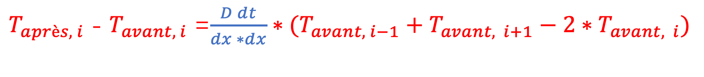

$T_{après, i}$ - $T_{avant, i}$ =$\frac{D dt}{dx ∗dx}∗({T_{avant, i−1}+T}_{avant, i+1}−{2∗T}_{avant, i})$
$$F$$
Le programme python devrait prendre en compte :
La géométrie
Les matériaux
Les conditions limites
Le calcul numérique : T= f (x, t)
Traitement des données
Présentation des résultats

Slide 4












$$\text{d}x$$
$$T_{0}$$
$$T_{1}$$
$$T_{i−1}$$
$$T_{i}$$
$$T_{i+1}$$
$$T_{n−1}$$
$$x_{0}$$
$$x_{1}$$
$$x_{i}$$
$$x_{n−1}$$
$$L$$

Slide 5
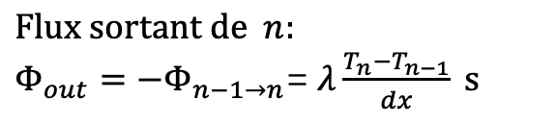



$$\text{d}x$$
$$T_{n−1}$$
$$T_{n}$$
$\text{Flux} \text{entre} \text{n}\text{−1 }\text{et} n: Φ_{n−1→n}$ =$− λ\frac{T_{n}−T_{n−1}}{dx} s$
$$T_{0}$$
$$T_{1}$$
$$T_{i−1}$$
$$T_{i}$$
$$T_{i+1}$$
$$\text{Flux} \text{sortant} \text{de} n:$$
$Φ_{out}=−Φ_{n−1→n}$=$λ\frac{T_{n}−T_{n−1}}{dx} s$
$\text{Flux} \text{entre}\text{ 0 }\text{et} 1: Φ_{0→1}$ =$− λ\frac{T_{1}−T_{0}}{dx} s$
$$\text{Flux} \text{sortant} \text{de} 0:$$
$Φ_{out}=Φ_{0→1}$=$− λ\frac{T_{1}−T_{0}}{dx} s$
$$\text{Variation} \text{de} \text{temp}\text{é}\text{rature} \text{de} n:$$
$${m c_{p} dT= ρ s \text{d}x c_{p} dT=−Φ}_{out} \text{d}t$$
${ρ s dx c_{p} \frac{\text{d}T}{\text{d}t}=−Φ}_{out}$=- $\frac{λ S}{dx} \left({T_{n}−T}_{n−1}\right)$
$$\frac{\text{d}T}{\text{d}t}=−\frac{λ}{ρ c_{p}} \frac{\left({T_{n}−T}_{n−1}\right)}{dx ∗dx}$$
$\frac{\text{d}T}{\text{d}t}$= - D $\frac{\left({T_{n}−T}_{n−1}\right) }{dx∗dx}$
$dT$=- $\frac{D dt}{dx∗dx}$ $\left({T_{n}−T}_{n−1}\right)$
$dT$=- $F$ $\left({T_{n}−T}_{n−1}\right)$
$$\text{Variation} \text{de} \text{temp}\text{é}\text{rature} \text{de} 0:$$
$${m c_{p} dT= ρ s \text{d}x c_{p} dT=−Φ}_{out} \text{d}t$$
${ρ s dx c_{p} \frac{\text{d}T}{\text{d}t}=−Φ}_{out}$= $\frac{λ S}{dx} \left({T_{1}−T}_{0}\right)$
$\frac{\text{d}T}{\text{d}t}$= $\frac{λ}{ρ c_{p}}$ $\frac{\left({T_{1}−T}_{0}\right) }{dx∗dx}$
$dT$= $\frac{D dt}{dx∗dx}$ $\left({T_{1}−T}_{0}\right)$
$dT$= $F$ $\left({T_{1}−T}_{0}\right)$

