Slide 1
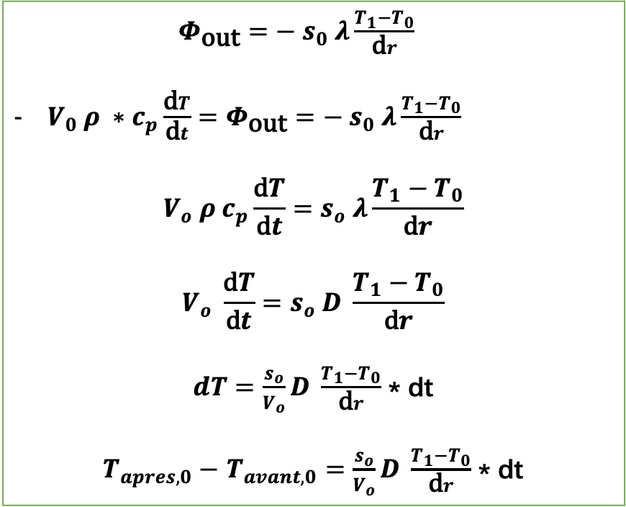
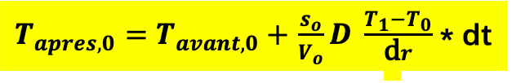
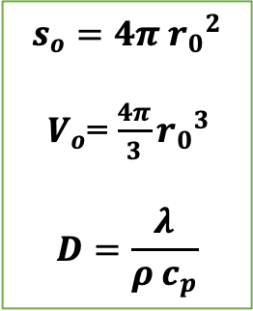
La couche 0
$Φ_{\text{out}}=− s_{0} λ\frac{T_{1}−T_{0}}{\text{d}r}$
$V_{0} ρ ∗c_{p}\frac{\text{d}T}{\text{d}t}=Φ_{\text{out}}=− s_{0} λ\frac{T_{1}−T_{0}}{\text{d}r}$
$$V_{o} ρ c_{p}\frac{\text{d}T}{\text{d}t}=s_{o} λ\frac{T_{1}−T_{0}}{\text{d}r}$$
$$V_{o} \frac{\text{d}T}{\text{d}t}=s_{o} D \frac{T_{1}−T_{0}}{\text{d}r}$$
$dT=\frac{s_{o}}{V_{o}}D \frac{T_{1}−T_{0}}{\text{d}r}$ * dt
$T_{apres,0}−$ $T_{avant,0}=$ $\frac{s_{o}}{V_{o}}D \frac{T_{1}−T_{0}}{\text{d}r}$ * dt
$$s_{o}=4π{{ r}_{0}}^{2}$$
$V_{o}$= $\frac{4π}{3}{r_{0}}^{3}$
$$D=\frac{λ}{ρ c_{p}}$$
$T_{apres,0}=$ $T_{avant,0}+$ $\frac{s_{o}}{V_{o}}D \frac{T_{1}−T_{0}}{\text{d}r}$ * dt

Slide 2
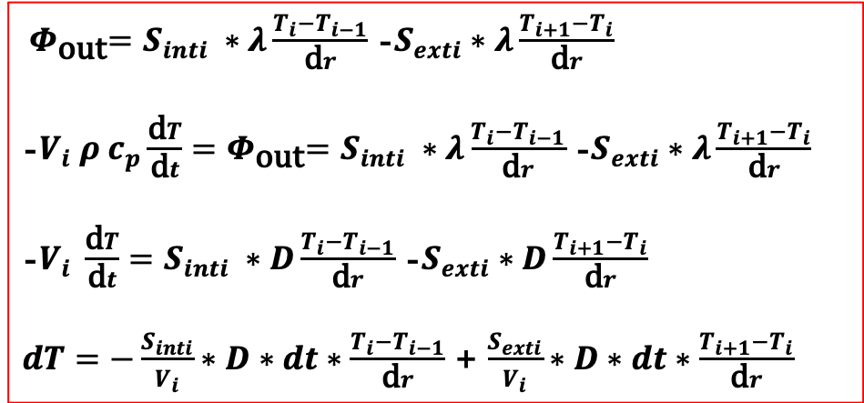
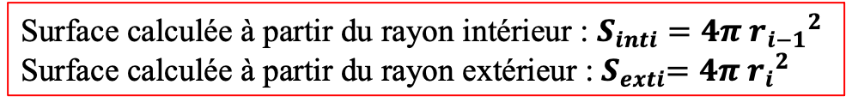
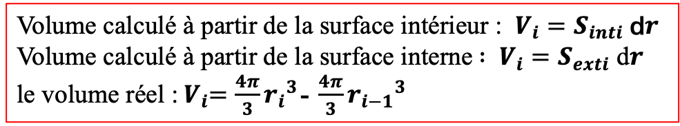
La couche i (i=1, …, n-2)
${ Φ}_{\text{out}}=S_{inti} ∗λ\frac{T_{i}−T_{i−1}}{\text{d}r}$ -$S_{exti}∗λ\frac{T_{i+1}−T_{i}}{\text{d}r}$
-$V_{i} ρ c_{p}\frac{\text{d}T}{\text{d}t}{=Φ}_{\text{out}}=S_{inti} ∗λ\frac{T_{i}−T_{i−1}}{\text{d}r}$ -$S_{exti}∗λ\frac{T_{i+1}−T_{i}}{\text{d}r}$
-$V_{i} \frac{\text{d}T}{\text{d}t}=S_{inti} ∗D\frac{T_{i}−T_{i−1}}{\text{d}r}$ -$S_{exti}∗D\frac{T_{i+1}−T_{i}}{\text{d}r}$
$dT=−\frac{S_{inti}}{V_{i}}∗D∗dt∗\frac{T_{i}−T_{i−1}}{\text{d}r}$ + $\frac{S_{exti}}{V_{i}}∗D∗dt∗\frac{T_{i+1}−T_{i}}{\text{d}r}$
$T_{apres,i}= T_{avant,i}−\frac{S_{inti}}{V_{i}}∗D∗dt∗\frac{T_{i}−T_{i−1}}{\text{d}r}$ + $\frac{S_{exti}}{V_{i}}∗D∗dt∗\frac{T_{i+1}−T_{i}}{\text{d}r}$
Surface calculée à partir du rayon intérieur : $S_{inti}=4π {r_{i−1}}^{2}$
Surface calculée à partir du rayon extérieur :${ S}_{exti}=4π {r_{i}}^{2}$
Volume calculé à partir de la surface intérieur : $V_{i}=S_{inti} \text{d}r$
Volume calculé à partir de la surface interne$: V_{i}=S_{exti} \text{d}r$
le volume réel :${ V}_{i}=\frac{4π}{3}{r_{i}}^{3}$- $\frac{4π}{3}{r_{i−1}}^{3}$

Slide 3
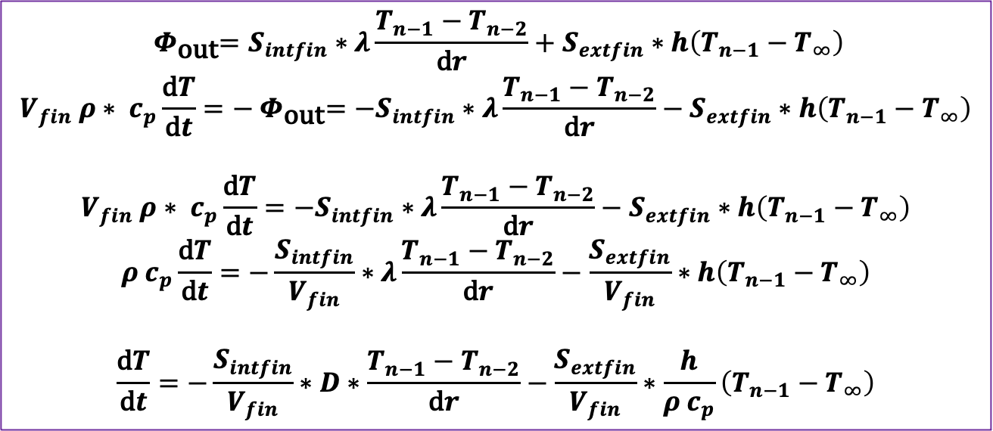
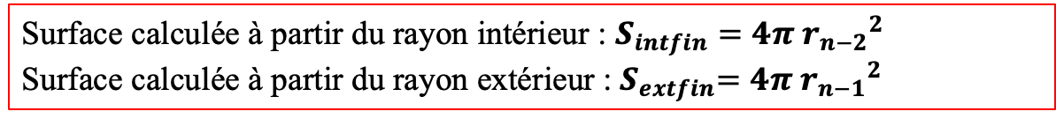
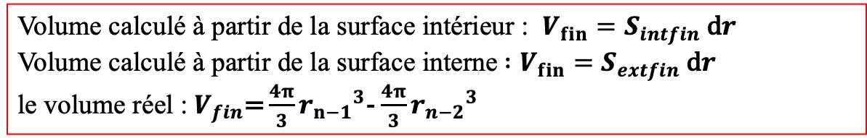
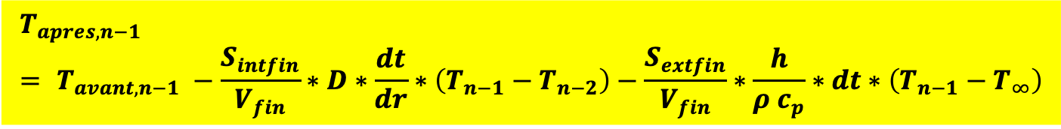
La couche n-1
$${ Φ}_{\text{out}}=S_{intfin}∗λ\frac{T_{n−1}−T_{n−2}}{\text{d}r}+S_{extfin}∗h\left(T_{n−1}−T_{∞}\right)$$
$$V_{fin} ρ∗ c_{p}\frac{\text{d}T}{\text{d}t}={− Φ}_{\text{out}}=−S_{intfin}∗λ\frac{T_{n−1}−T_{n−2}}{\text{d}r}−S_{extfin}∗h\left(T_{n−1}−T_{∞}\right)$$
$$V_{fin} ρ∗ c_{p}\frac{\text{d}T}{\text{d}t}=−S_{intfin}∗λ\frac{T_{n−1}−T_{n−2}}{\text{d}r}−S_{extfin}∗h\left(T_{n−1}−T_{∞}\right)$$
$$ρ c_{p}\frac{\text{d}T}{\text{d}t}=−\frac{S_{intfin}}{V_{fin}}∗λ\frac{T_{n−1}−T_{n−2}}{\text{d}r}−\frac{S_{extfin}}{V_{fin}}∗h\left(T_{n−1}−T_{∞}\right)$$
$$\frac{\text{d}T}{\text{d}t}=−\frac{S_{intfin}}{V_{fin}}∗D∗\frac{T_{n−1}−T_{n−2}}{\text{d}r}−\frac{S_{extfin}}{V_{fin}}∗\frac{h}{ρ c_{p}}\left(T_{n−1}−T_{∞}\right)$$
$$T_{apres, n−1}= T_{avant, n−1} −\frac{S_{intfin}}{V_{fin}}∗D∗\frac{dt}{dr}∗\left(T_{n−1}−T_{n−2}\right)−\frac{S_{extfin}}{V_{fin}}∗\frac{h}{ρ c_{p}}∗dt∗\left(T_{n−1}−T_{∞}\right)$$
Surface calculée à partir du rayon intérieur : $S_{intfin}=4π {r_{n−2}}^{2}$
Surface calculée à partir du rayon extérieur :${ S}_{extfin}=4π {r_{n−1}}^{2}$
Volume calculé à partir de la surface intérieur : $V_{fin}=S_{intfin} \text{d}r$
Volume calculé à partir de la surface interne$:V_{fin}=S_{extfin} \text{d}r$
le volume réel :${ V}_{fin}\text{=}\frac{4π}{3}{r_{n−1}}^{3}$- $\frac{4π}{3}{r_{n−2}}^{3}$

Slide 4
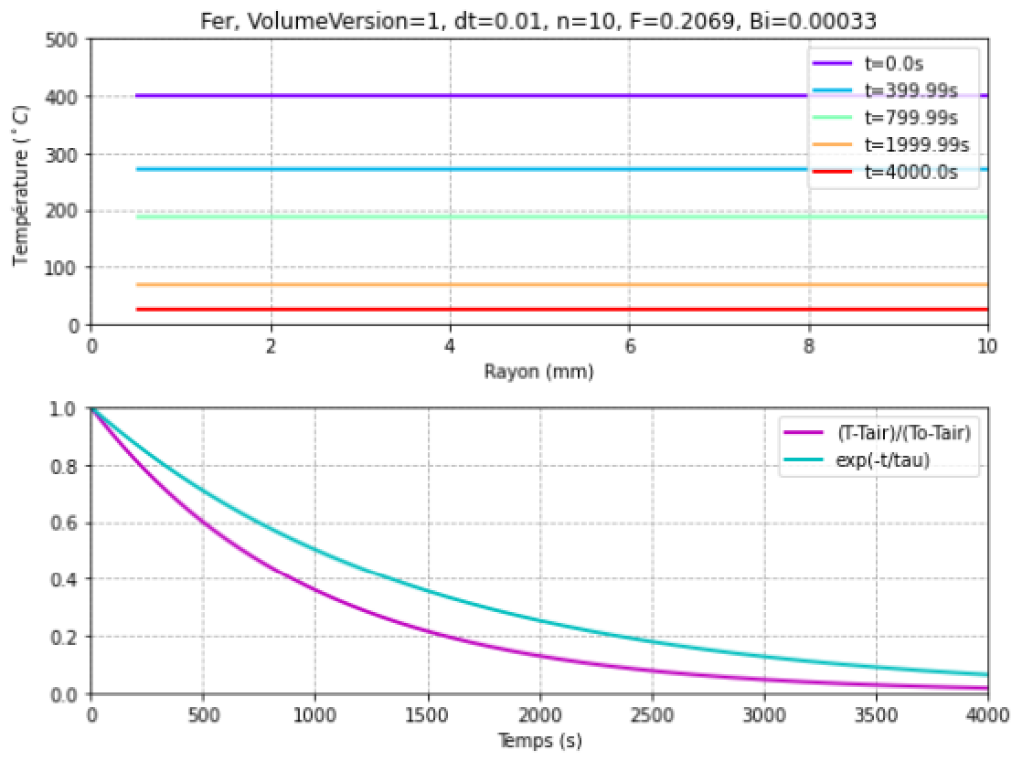

Slide 5
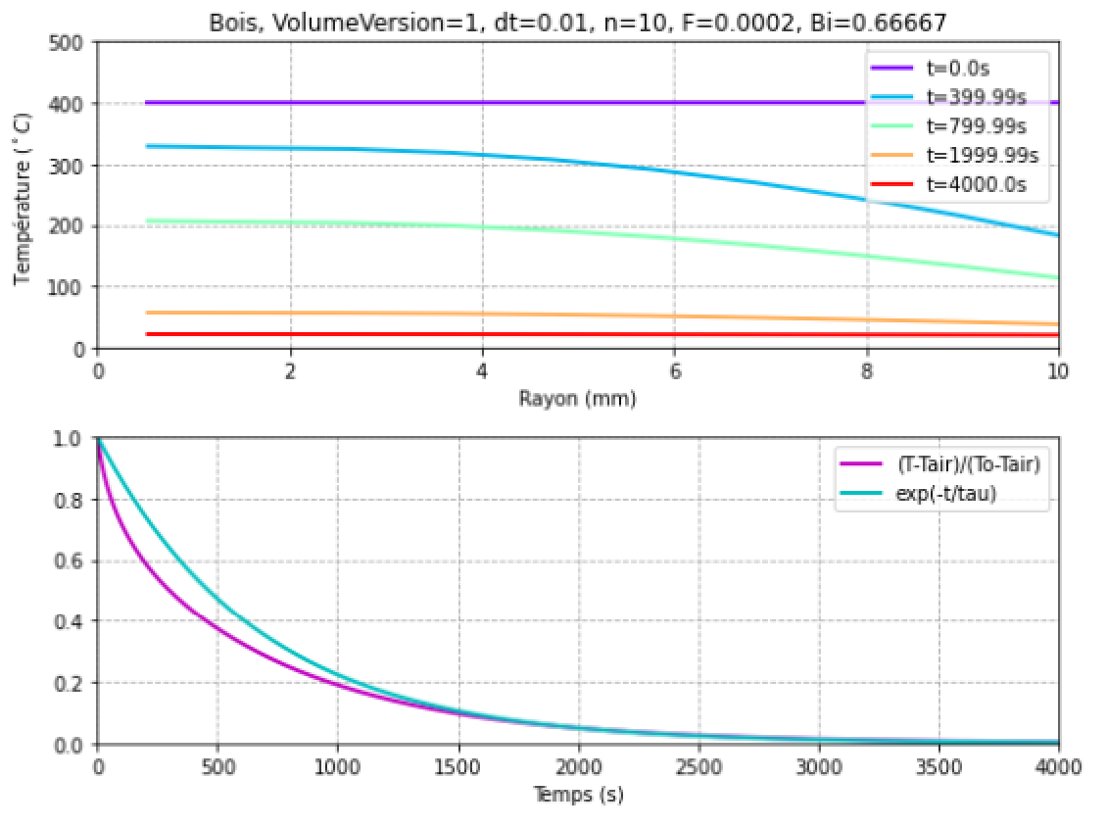

Slide 6
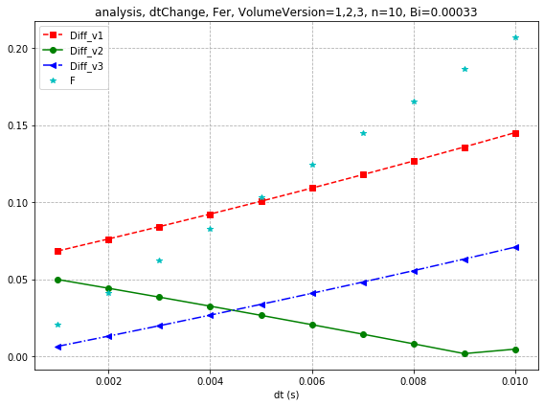

Slide 7
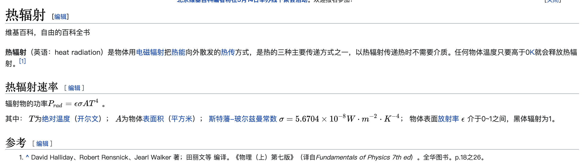

Slide 8
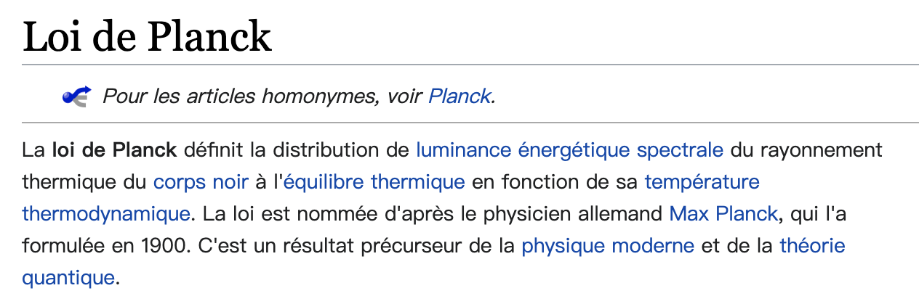
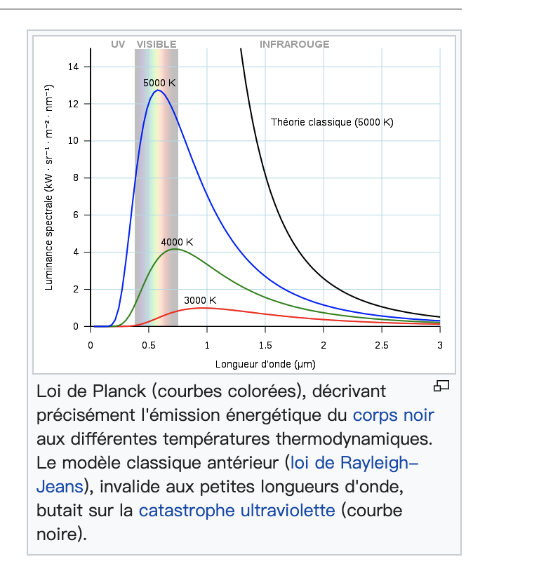
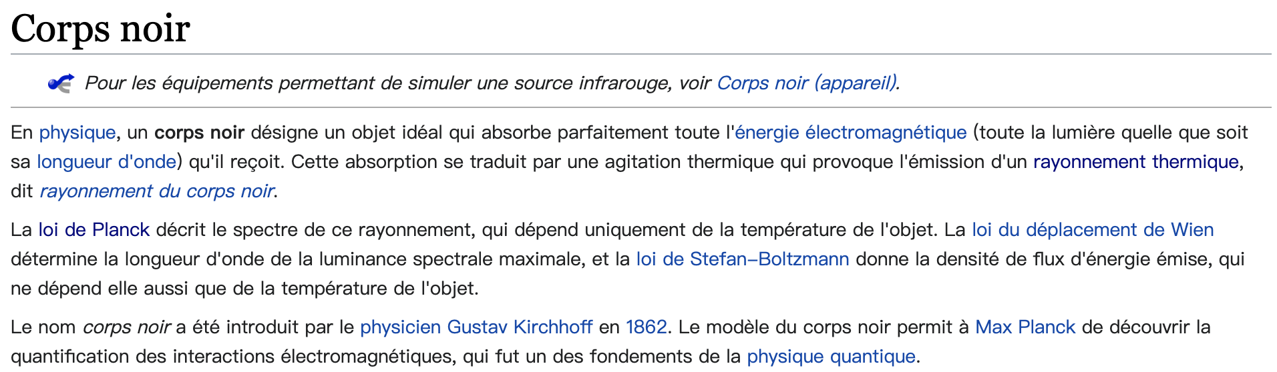

Slide 9
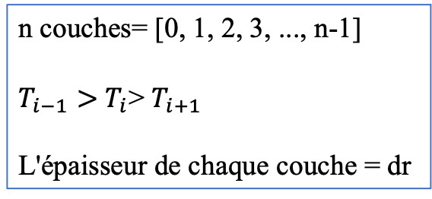
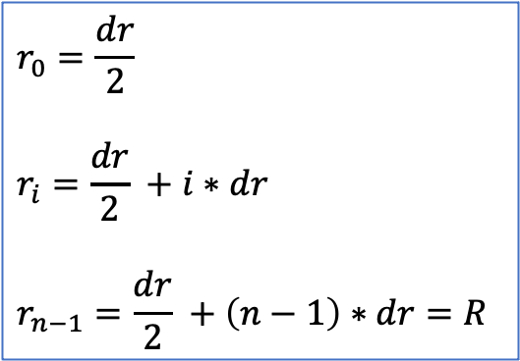
n couches= [0, 1, 2, 3, ..., n-1]
$T_{i−1}>$ $T_{i}$> $T_{i+1}$
L'épaisseur de chaque couche = dr
$$r_{0}=\frac{dr}{2}$$
$$r_{i}=\frac{dr}{2} +i∗dr$$
$$r_{n−1}=\frac{dr}{2} +\left(n−1\right)∗dr=R$$

Slide 10
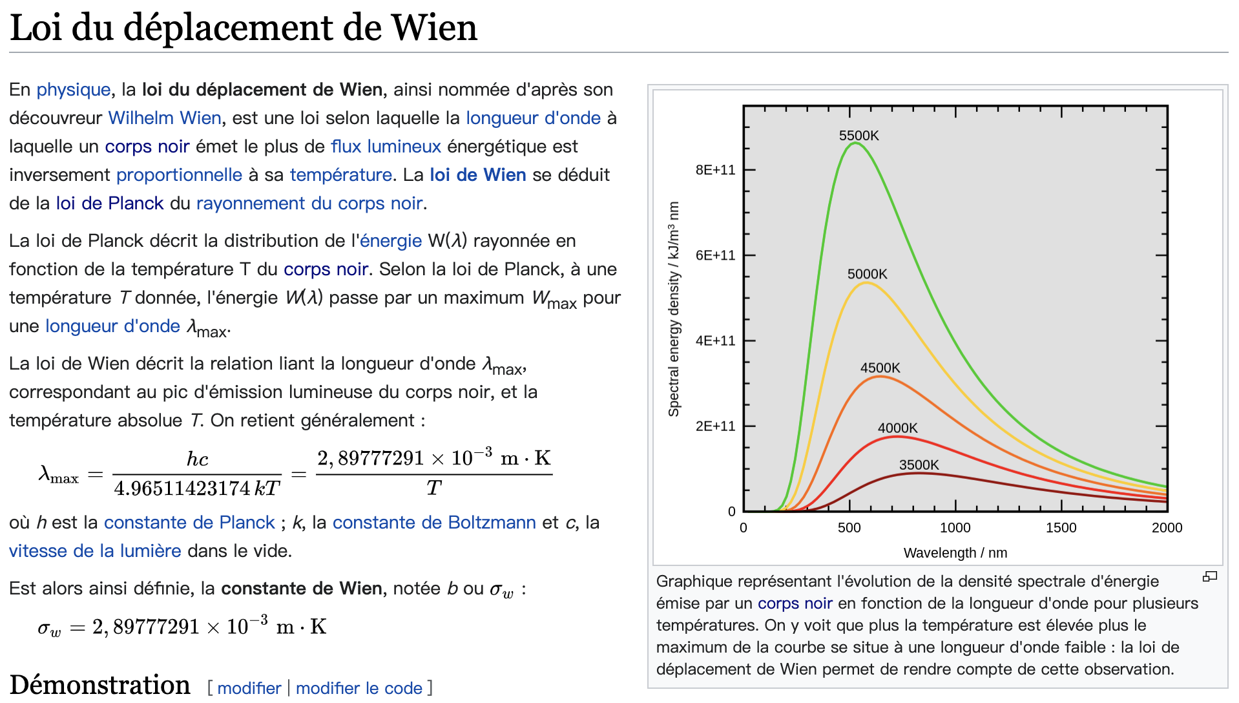

Slide 11
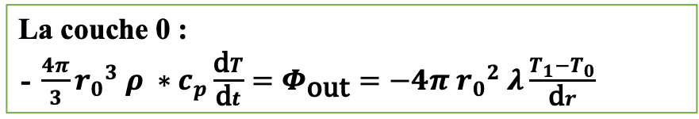
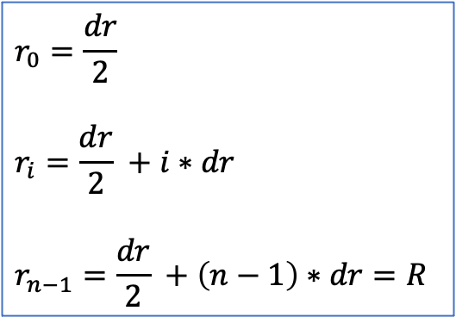

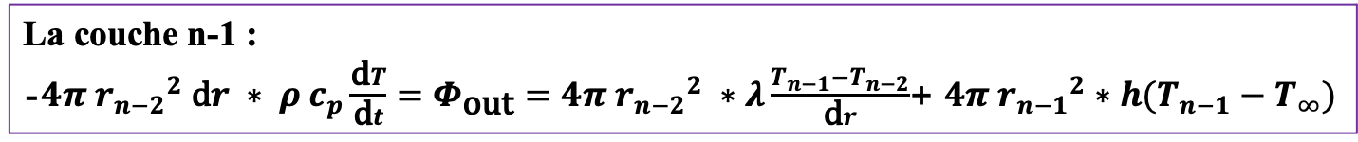
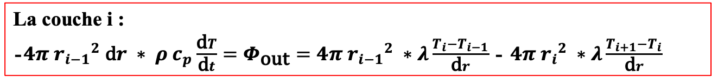
n couches= [0, 1, 2, 3, ..., n-1]
$T_{i−1}>$ $T_{i}$> $T_{i+1}$
L'épaisseur de chaque couche = dr
$$r_{0}=\frac{dr}{2}$$
$$r_{i}=\frac{dr}{2} +i∗dr$$
$$r_{n−1}=\frac{dr}{2} +\left(n−1\right)∗dr=R$$
La couche 0 :
- $\frac{4π}{3}{r_{0}}^{3} ρ ∗c_{p}\frac{\text{d}T}{\text{d}t}=Φ_{\text{out}}=−4π{{ r}_{0}}^{2} λ\frac{T_{1}−T_{0}}{\text{d}r}$
La couche i :
-$4π {r_{i−1}}^{2} \text{d}r ∗ ρ c_{p}\frac{\text{d}T}{\text{d}t}=Φ_{\text{out}}=4π{{ r}_{i−1}}^{2} ∗λ\frac{T_{i}−T_{i−1}}{\text{d}r}$ - $4π{{ r}_{i}}^{2} ∗λ\frac{T_{i+1}−T_{i}}{\text{d}r}$
La couche n-1 :
-$4π {r_{n−2}}^{2} \text{d}r ∗ ρ c_{p}\frac{\text{d}T}{\text{d}t}=Φ_{\text{out}}=4π{{ r}_{n−2}}^{2} ∗λ\frac{T_{n−1}−T_{n−2}}{\text{d}r}$+ $4π{{ r}_{n−1}}^{2}∗h(T_{n−1}−T_{∞})$

Slide 12
La bonne version
n couches= [0, 1, 2, 3, ..., n-1]
$T_{i−1}>$ $T_{i}$> $T_{i+1}$
L'épaisseur de chaque couche = dr
$$r_{0}=\frac{dr}{2}$$
$$r_{i}=\frac{dr}{2} +i∗dr$$
$$r_{n−1}=\frac{dr}{2} +\left(n−1\right)∗dr=R$$
La couche 0 :
- $\frac{4π}{3}{r_{0}}^{3} ρ ∗c_{p}\frac{\text{d}T}{\text{d}t}=Φ_{\text{out}}=−4π{{ r}_{0}}^{2} λ\frac{T_{1}−T_{0}}{\text{d}r}$
La couche i :
-$4π {r_{i}}^{2} \text{d}r ∗ ρ c_{p}\frac{\text{d}T}{\text{d}t}=Φ_{\text{out}}=4π{{ r}_{i−1}}^{2} ∗λ\frac{T_{i}−T_{i−1}}{\text{d}r}$ - $4π{{ r}_{i}}^{2} ∗λ\frac{T_{i+1}−T_{i}}{\text{d}r}$
La couche n-1 :
-$4π {r_{n−1}}^{2} \text{d}r ∗ ρ c_{p}\frac{\text{d}T}{\text{d}t}=Φ_{\text{out}}=4π{{ r}_{n−2}}^{2} ∗λ\frac{T_{n−1}−T_{n−2}}{\text{d}r}$+ $4π{{ r}_{n−1}}^{2}∗h(T_{n−1}−T_{∞})$

Slide 13
La couche 0
La couche 0 :
$\frac{4π}{3}{r_{0}}^{3} ρ ∗c_{p}\frac{\text{d}T}{\text{d}t}=Φ_{\text{out}}=−4π{{ r}_{0}}^{2} λ\frac{T_{1}−T_{0}}{\text{d}r}$
$$V_{o} ρ c_{p}\frac{\text{d}T}{\text{d}t}=s_{o} λ\frac{T_{1}−T_{0}}{\text{d}r}$$
$$V_{o} ρ c_{p}\frac{\text{d}T}{\text{d}t}=s_{o} λ\frac{T_{1}−T_{0}}{\text{d}r}$$
$$V_{o} \frac{\text{d}T}{\text{d}t}=s_{o} D \frac{T_{1}−T_{0}}{\text{d}r}$$
$dT=\frac{s_{o}}{V_{o}}D \frac{T_{1}−T_{0}}{\text{d}r}$ * dt
$T_{apres}−$ $T_{avant}=$ $\frac{s_{o}}{V_{o}}D \frac{T_{1}−T_{0}}{\text{d}r}$ * dt
$T_{apres}=$ $T_{avant}+$ $\frac{s_{o}}{V_{o}}D \frac{T_{1}−T_{0}}{\text{d}r}$ * dt
$$s_{o}=4π{{ r}_{0}}^{2}$$
$V_{o}$= $\frac{4π}{3}{r_{0}}^{3}$
$$D=\frac{λ}{ρ c_{p}}$$

Slide 14
La couche i :
La couche i :
-$4π {r_{i}}^{2} \text{d}r ∗ ρ c_{p}\frac{\text{d}T}{\text{d}t}=Φ_{\text{out}}=4π{{ r}_{i−1}}^{2} ∗λ\frac{T_{i}−T_{i−1}}{\text{d}r}$ - $4π{{ r}_{i}}^{2} ∗λ\frac{T_{i+1}−T_{i}}{\text{d}r}$
-$V_{i} ρ c_{p}\frac{\text{d}T}{\text{d}t}=S_{inti} ∗λ\frac{T_{i}−T_{i−1}}{\text{d}r}$ -$S_{exti}∗λ\frac{T_{i+1}−T_{i}}{\text{d}r}$
-$V_{i} \frac{\text{d}T}{\text{d}t}=S_{inti} ∗D\frac{T_{i}−T_{i−1}}{\text{d}r}$ -$S_{exti}∗D\frac{T_{i+1}−T_{i}}{\text{d}r}$
$dT=−\frac{S_{inti}}{V_{i}}∗D∗dt∗\frac{T_{i}−T_{i−1}}{\text{d}r}$ + $\frac{S_{exti}}{V_{i}}∗D∗dt∗\frac{T_{i+1}−T_{i}}{\text{d}r}$
$T_{apres}= T_{avant}−\frac{S_{inti}}{V_{i}}∗D∗dt∗\frac{T_{i}−T_{i−1}}{\text{d}r}$ + $\frac{S_{exti}}{V_{i}}∗D∗dt∗\frac{T_{i+1}−T_{i}}{\text{d}r}$
$$V_{i}=4π {r_{i}}^{2} \text{d}r$$
$$S_{inti}=4π {r_{i−1}}^{2}$$
$$S_{exti}=4π {r_{i}}^{2}$$

Slide 15
La couche n-1 :
La couche n-1 :
-$4π {r_{n−1}}^{2} \text{d}r∗ ρ c_{p}\frac{\text{d}T}{\text{d}t}=Φ_{\text{out}}=4π{{ r}_{n−2}}^{2} ∗λ\frac{T_{n−1}−T_{n−2}}{\text{d}r}$+ $4π{{ r}_{n−1}}^{2}∗h\left(T_{n−1}−T_{∞}\right)$
$$V_{fin} ∗ρ c_{p}\frac{\text{d}T}{\text{d}t}=−S_{intfin}∗λ\frac{T_{n−1}−T_{n−2}}{\text{d}r}−S_{extfin}∗h\left(T_{n−1}−T_{∞}\right)$$
$$ρ c_{p}\frac{\text{d}T}{\text{d}t}=−\frac{S_{intfin}}{V_{fin}}∗λ\frac{T_{n−1}−T_{n−2}}{\text{d}r}−\frac{S_{extfin}}{V_{fin}}∗h\left(T_{n−1}−T_{∞}\right)$$
$$\frac{\text{d}T}{\text{d}t}=−\frac{S_{intfin}}{V_{fin}}∗D∗\frac{T_{n−1}−T_{n−2}}{\text{d}r}−\frac{S_{extfin}}{V_{fin}}∗\frac{h}{ρ c_{p}}\left(T_{n−1}−T_{∞}\right)$$
$$T_{apres}= T_{avant} −\frac{S_{intfin}}{V_{fin}}∗D∗\frac{dt}{dr}∗\left(T_{n−1}−T_{n−2}\right)−\frac{S_{extfin}}{V_{fin}}∗\frac{h}{ρ c_{p}}∗dt∗\left(T_{n−1}−T_{∞}\right)$$
$$V_{fin}=4π {r_{n−1}}^{2} \text{d}r$$
$$S_{intfin}=4π{{ r}_{n−2}}^{2}$$
$$S_{extfin}=4π{{ r}_{n−1}}^{2}$$

Slide 16
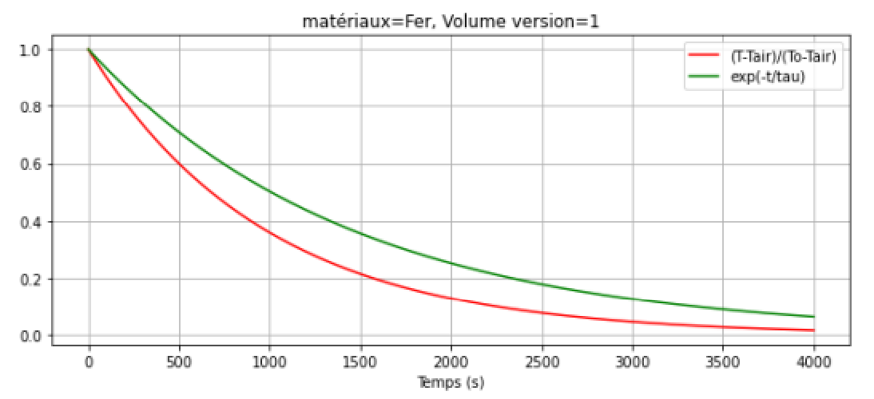
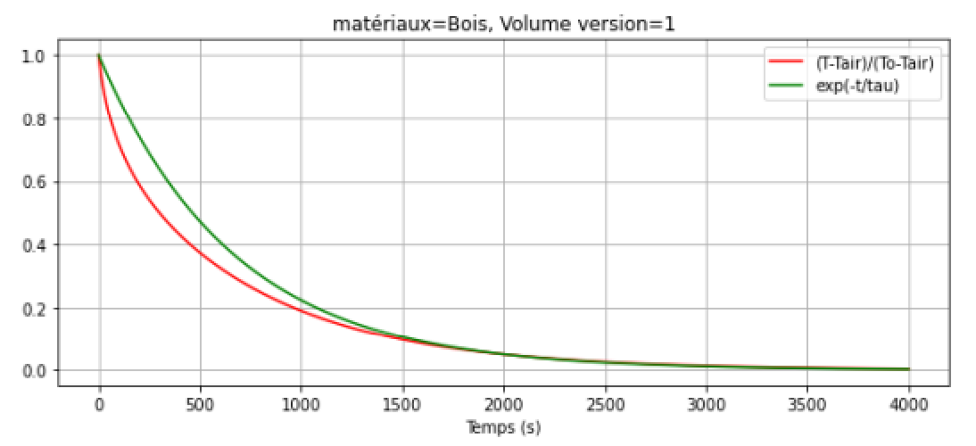
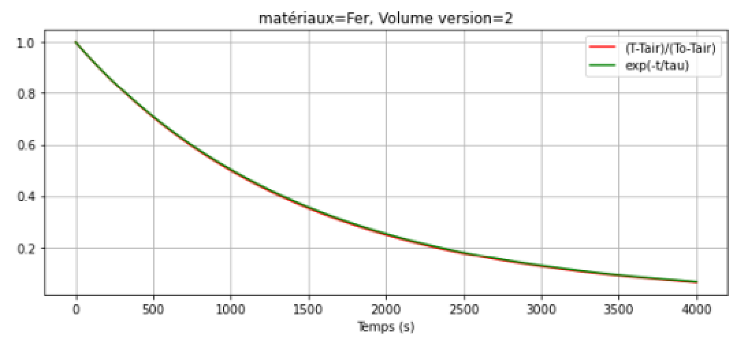
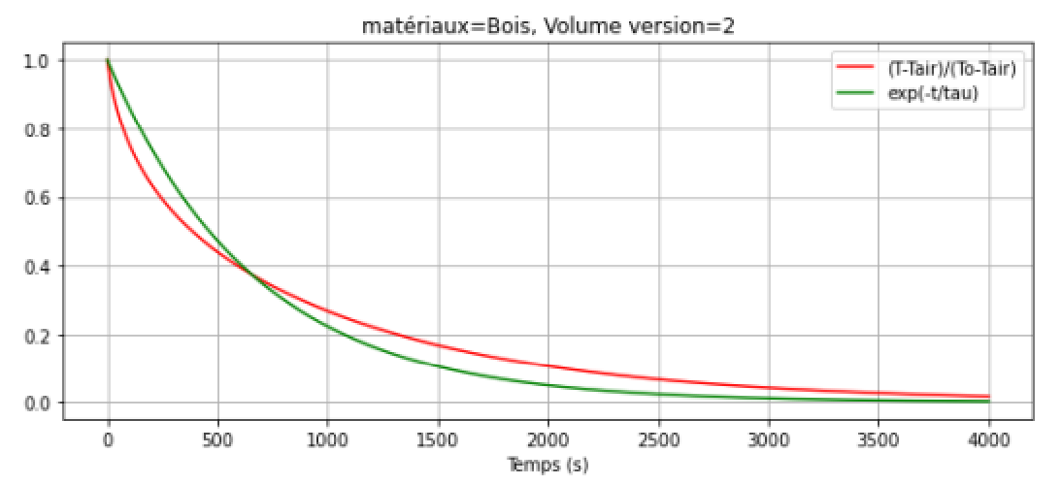
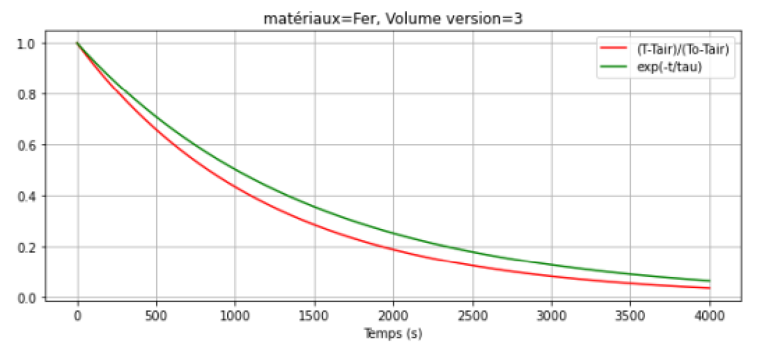
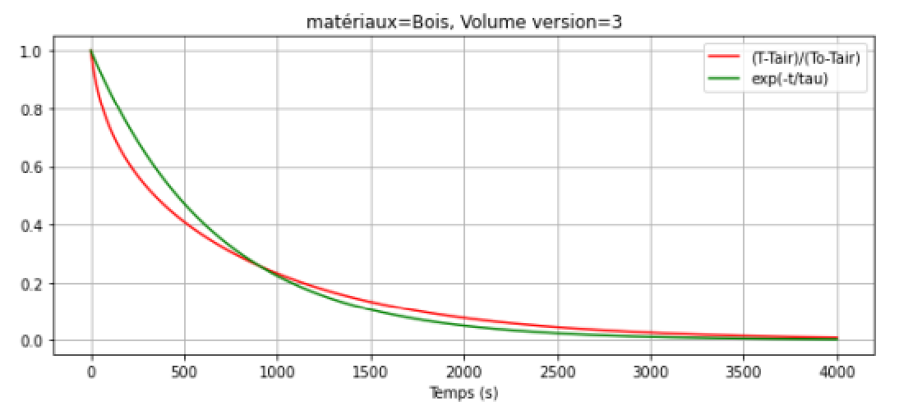

Slide 17
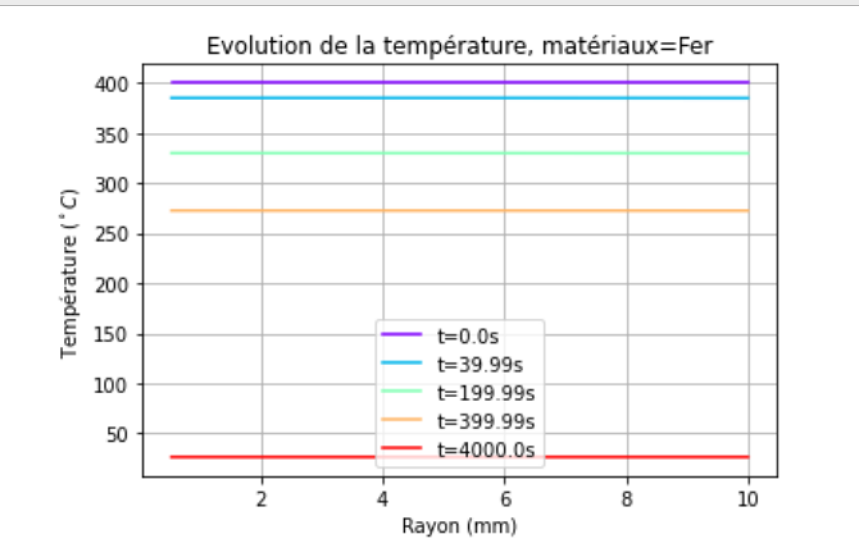

Slide 18
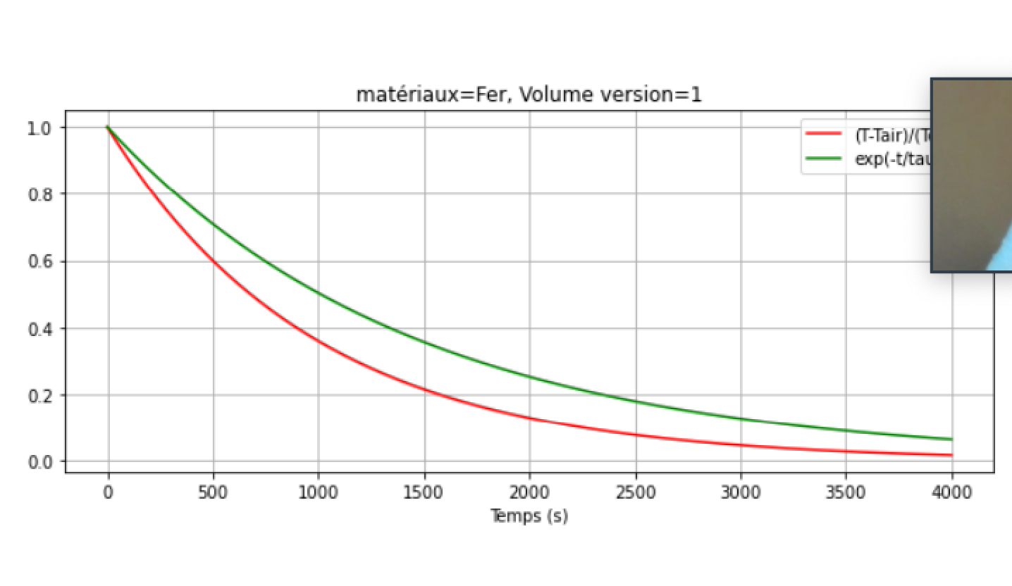

Slide 19
