Slide 1



LINGUALEARN
BENICO, JENNEFER DIANE S.
LLAMERA, ZYRYL GHUIN L.
MACARAYAN, PENELOPE E.
NARVASA, CHRISTYL JOY S.
ROMERO, SHEJARRA S.
NAME OF PRESENTER
Designation

Slide 2

INTRODUCTION
The Lingua Learn is one of the e-learning advances in teaching Chinese Mandarin and Nihongo or Japanese. In today globalized world, being able to speak numerous languages has become extremely important, especially for students taking tourism-related courses or for anyone in need of assistance in any of those languages. For them, a project like this would be enjoyable and productive. This application will provide a comprehensive and enjoyable experience and facilitating, Lingua Learn teaches languages and situates students in the cultural environments that shape them because it is interactive and culturally relevant. The user interface (UI) has been designed successfully, and the project has advanced significantly thus far. Prioritizing usability and accessibility to ensure that learners of all ages can traverse the platform with ease, this user-friendly design offers a solid foundation for additional functions.

Slide 3
OBJECTIVES
To develop an interactive, user-friendly e-learning platform for learning Chinese Mandarin and Nihongo, addressing the needs of students and professionals in tourism and related fields.
To provide basics lessons to the users.
To create a simple and intuitive interface for users of varying skill levels.
To enable learners to monitor their progress through progress tracking.
To ensure the system is accessible to diverse learners.

Slide 4
SCOPE AND DELIMITATIONS
The platform is designed to teach Chinese Mandarin and Nihongo (Japanese), targeting students in tourism-related courses and individuals seeking to learn these languages. It will operate as a desktop-based application, with no mobile or web versions available in this phase. The system will focus exclusively on these two languages, with no support for additional languages in the initial release. Core features include a home screen providing a Chinese and Japanese lessons, lesson content, and progress tracking. Quizzes will assess learner progress through basic text-based formats using multiple-choice, but will not include multimedia, interactive, or gamified question types. Advanced AI-driven features such as speech recognition, peer interaction, or adaptive learning algorithms will not be implemented. Additionally, the platform will require an active internet connection to access lessons, quizzes, and content, as offline access is not supported.

Slide 5
Flowchart
FLOW CHART
START
LogIn/Sign Up
Lesson Content
Progress tracking
Dashboard
END
Topics
Track Achievements

Slide 6
GANTT CHART
TASK | AUG. 25-SEP. 10, 2024 | SEP. 11-OCT. 27, 2024 | OCT. 28- NOV. 15, 2024 | NOV. 16- DEC. 1, 2024 | DEC. 2- DEC. 16, 2024
Planning
Conduct Research
UI Development and Testing
Software Testing and Debugging
Data Entry and Finalization
Converting of System

Slide 7
GANT CHARTT
1. Planning
This phase involves outlining the project's scope, setting objectives, creating a timeline, and identifying the resources required. Tasks include brainstorming, defining system requirements, and assigning responsibilities to team members.
2. Conduct Research
A thorough investigation is carried out to identify effective methodologies and tools for the project. This includes studying user needs, analyzing relevant technologies, and gathering data to ensure the project meets its goals.
3. UI Development and Testing
This task involves designing the system's User Interface (UI) for an optimal user experience. The team will develop test usability, improve navigation, and refine the design based on feedback from initial tests.

Slide 8
GANT CHARTT
4. Software Testing and Debugging
During this phase, the team identifies, analyzes, and fixes software errors or bugs to ensure the system runs smoothly. Both manual and automated testing methods may be used to validate system performance, functionality, and reliability.
5. Data Entry and Finalization
This task focuses on inputting all necessary data into the system and verifying its accuracy. The team finalizes configurations, ensures data integrity, and prepares the system for deployment.
6. Converting of System
The final phase involves converting the system into its fully functional form. This includes system integration, migrating data if needed, and ensuring compatibility across different environments before the official deployment.

Slide 9
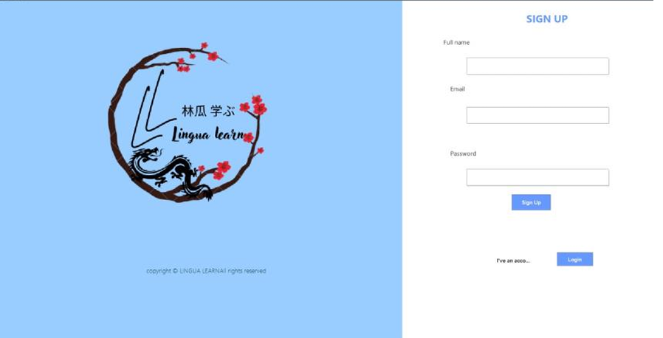
SYSTEM DESIGN
Figure 1 SIGNUP
This figure shows the sign up panel that users need to fill up.

Slide 10
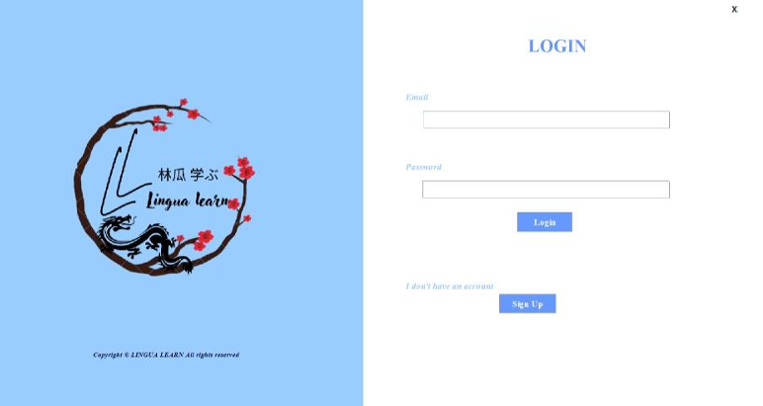
SYSTEM DESIGN
Figure 2 LOGIN After the sign up the log in panel well show up and fill up the email and password.

Slide 11
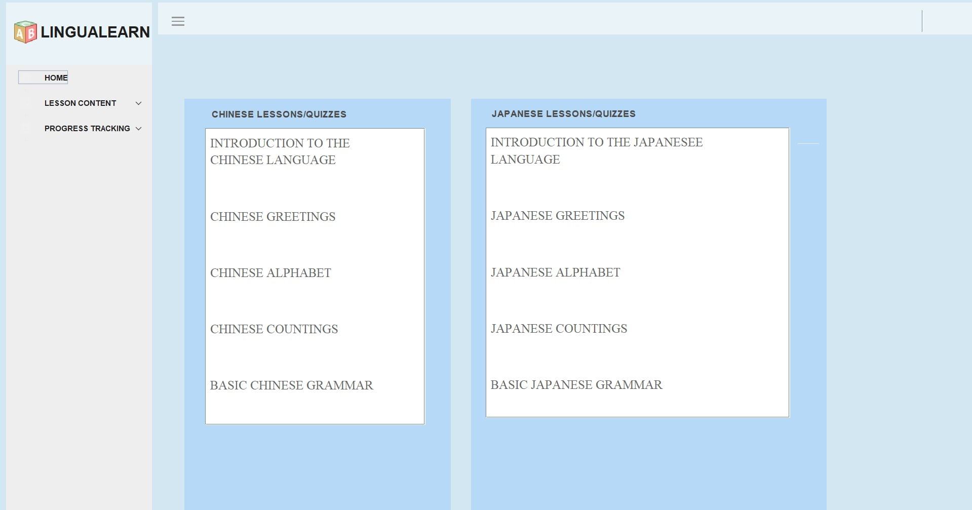
SYSTEM DESIGN
FIGURE 3 DASHBOARD This UI show the possible lesson of Chinese and Japanese along with lesson content of and the progress tracking.

Slide 12
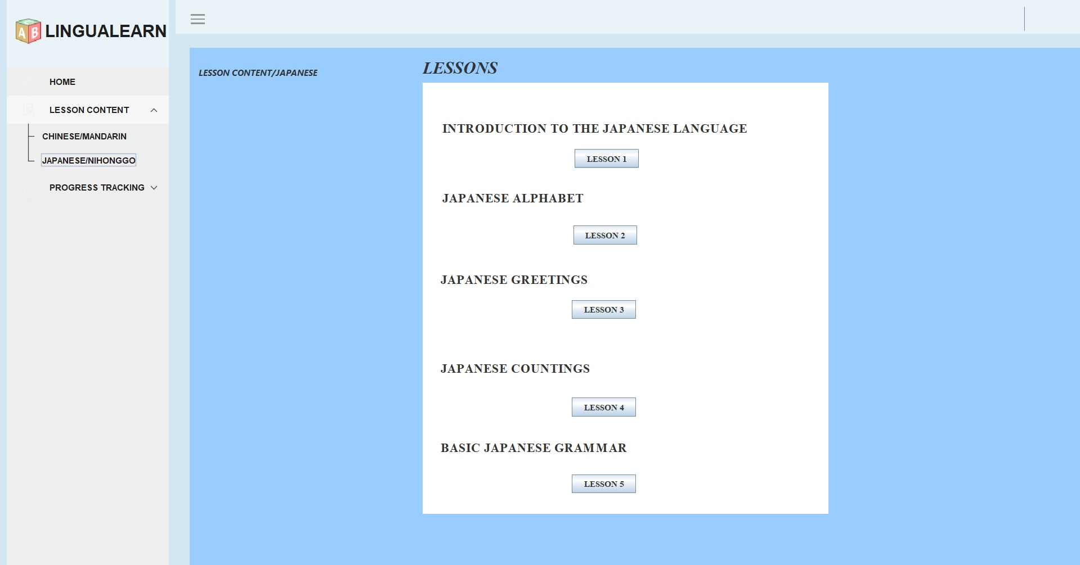
SYSTEM DESIGN
Figure 4 lesson content In this UI show the topics of Chinese and Japanese along with the quiz.

Slide 13
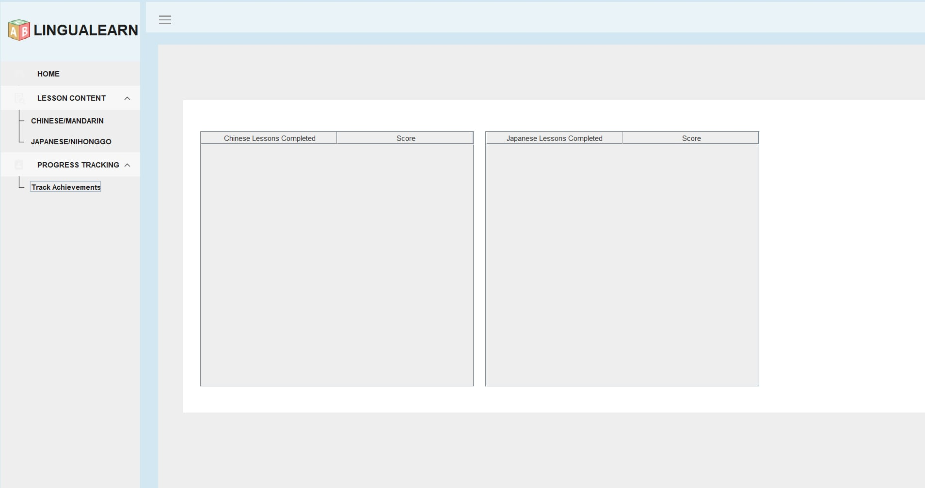
SYSTEM DESIGN
Figure 5 PROGRESS TRACKING
It shows the users achievement in learning.

Slide 14
CONCLUSION
The LinguaLearn project demonstrates a significant stride in e-learning innovation, focusing on teaching Chinese Mandarin and Nihongo to a targeted audience of students and professionals in the tourism industry. With its user-friendly interface.Although limited in scope to two languages and basic functionality, LinguaLearn provides a basic foundation for interactive and engaging language education. The progress made thus far underscores the project's potential to contribute to the educational landscape and meet the specific needs of its intended users. As development continues, the incorporation of additional features and improvements will further enhance the platform's value and impact.

Slide 15
RECOMMENDATION
To enhance LinguaLearn's future iterations, it is recommended to developed mobile and web versions will improve accessibility, while integrating multimedia elements like videos, audio pronunciations, and interactive exercises can boost learner engagement. Adding features such as speech recognition for pronunciation practice and gamified elements like badges and rewards could make the learning process more interactive and enjoyable. Offline access should be considered to accommodate users with limited internet connectivity, and AI-driven tools, such as adaptive learning systems and virtual tutors, could personalize the learning experience. Further, introducing cultural immersion activities, such as virtual tours and role-playing scenarios, would deepen learners understanding of the languages cultural contexts. These enhancements will position LinguaLearn as a comprehensive, innovative, and scalable e-learning solution.

