Slide 1
04
UNIT 4
History and traditions
WORDS & EXPRESSIONS
words and expressions
2026.11.10

Slide 2

CONTENTS目录
01
English-to-Chinese Translation(英译汉)
02
Chinese-to-English Translation(汉译英)
03
Word Derivation(单词派生)
04
Phrases(短语)
05
Word Analysis(单词解析)
UNIT 4 • HISTORY AND TRADITIONS
02 / 18

Slide 3
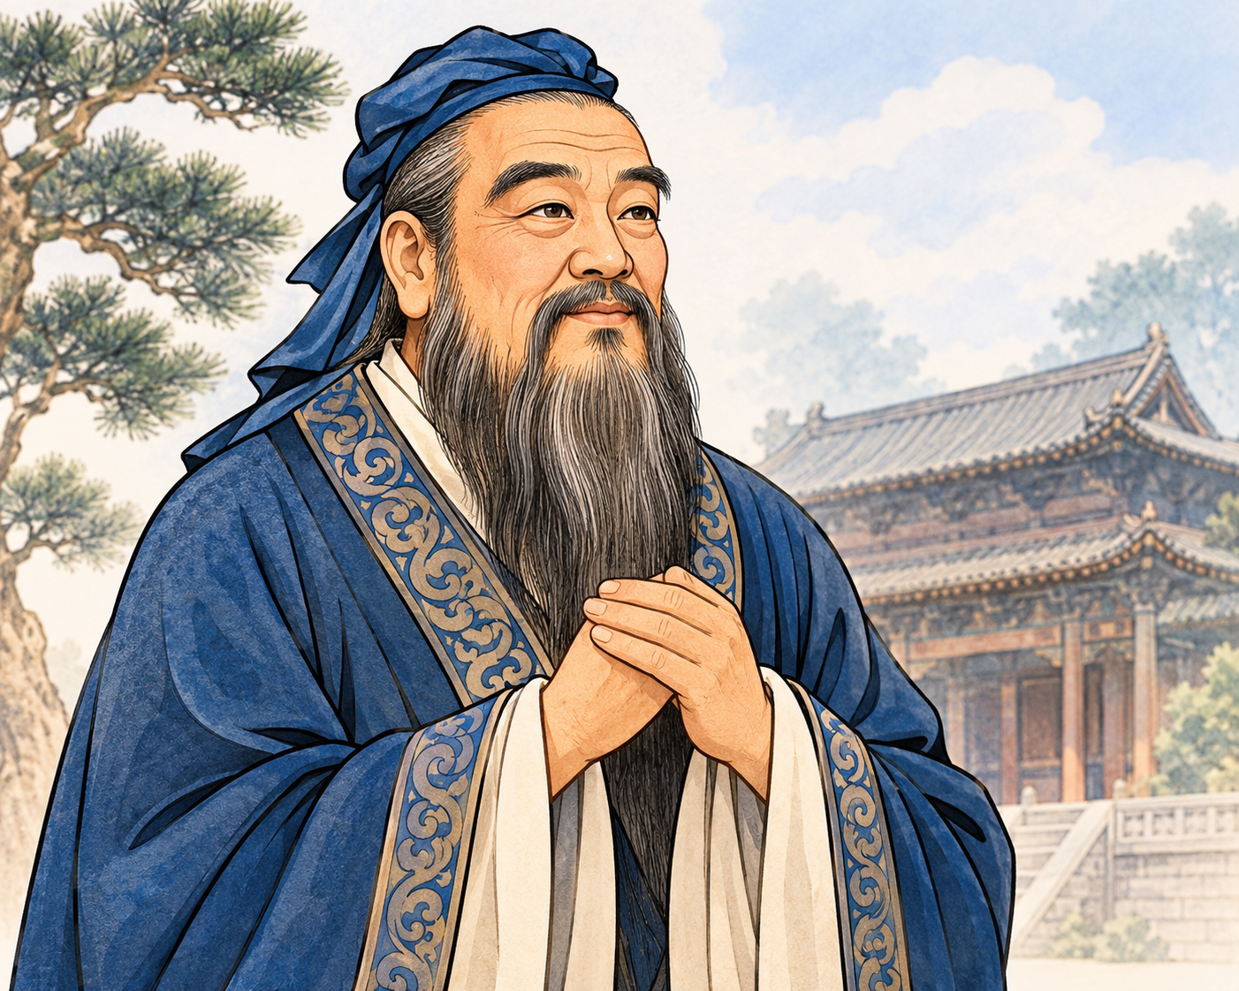
English-to-Chinese Translation(英译汉)
1.Confucius _______________
2.mansion n. _______________
3.cemetery n. _______________
4.philosophy n. _______________
5.kingdom n. _______________
6.currency n. _______________
7.military adj. _______________
8.conquer vt. _______________
孔子
公馆;宅第
墓地;公墓
哲学
王国;领域
通货;货币
军事的;军用的
占领;征服;控制
UNIT 4 • HISTORY AND TRADITIONS
03 / 18

Slide 4
Chinese-to-English Translation(汉译英)
1. _______________ adj. 最重要的;最高级别的 n. (公司或机构的)首领;酋长
2. _______________ adj. 附近的;邻近的 adv. 在附近
3. _______________ n. 战役;搏斗 vi.& vt. 搏斗;奋斗
4. _______________ n. 港口(城市)
chief
nearby
battle
port
UNIT 4 • HISTORY AND TRADITIONS
04 / 18

Slide 5
Word Derivation(单词派生)
1. _______________ vi.应在(某处);适应→ _______________ n.归属;(pl.)动产;财物
3. _______________ adj.法律的;合法的→ _______________ adj.不合法的→ _______________ adv.法律上
4. _______________ n.地方;地点;位置→ _______________ vt.位于;找出……的位置→ _______________ adj.坐落于;位于
5. _______________ adj.极有吸引力的;迷人的→ _______________ v.使……入迷;迷住→ _______________ adj.着迷的
belong
belonging
legal
illegal
legally
location
locate
located
fascinating
fascinate
fascinated
UNIT 4 • HISTORY AND TRADITIONS
05 / 18

Slide 6
Phrases(短语)
1.join ...to ... 把……和……连接或联结起来
2.break away (from sb/sth) 脱离;背叛;逃脱
3.belong to 属于
4.as well as 同(一样也);和;还
5.keep your eyes open (for) 留心;留意
UNIT 4 • HISTORY AND TRADITIONS
06 / 18

Slide 7
重点短语·练习
1.The new bridge will ____________ the two small islands, making transportation much easier.
2.Our English teacher is kind ____________ strict, which makes her very popular among students.
3.Some parts of the country tried to __________________ the central government in the past, but they failed.
join
as well as
break away from
UNIT 4 • HISTORY AND TRADITIONS
07 / 18

Slide 8
重点短语·练习
4.This ancient vase _______________ a famous collector and is worth a large amount of money.
5.The teacher asked us to ______________________ _ any unusual behavior during the experiment.
belongs to
keep our eyes open for
UNIT 4 • HISTORY AND TRADITIONS
08 / 18

Slide 9
Word Analysis(单词解析)
1. puzzle n.谜；智力游戏；疑问 vt.迷惑；使困惑
(1).教材原句：Getting to know a little bit about British history will help you solve this puzzle. （出自教材第40页阅读“What's in a name?”）
(2).高考真题：
① What puzzles me most about the play is how we should use proper stage languages for different roles.
UNIT 4 • HISTORY AND TRADITIONS
09 / 18

Slide 10
Word Analysis(单词解析)
(3).归纳拓展
(1) be in a puzzle (about) 对······感到困惑不解
a puzzle to sb 对某人来说是个谜
(2) puzzling adj. 令人迷惑的
puzzled adj. 感到困惑的
be puzzled with/about 对······迷惑不解
(4).单句语法填空
① He looked __________(puzzle), so I repeated the question.
② (全国卷)Some parents will buy any high-tech toy if they think it will help their child, but researchers said __________(puzzle)help children with math-related skills.
puzzled
puzzles
UNIT 4 • HISTORY AND TRADITIONS
10 / 18

Slide 11
Word Analysis(单词解析)
2. break away（from sb/sth）脱离；背叛；逃脱
(1).教材原句： Finally, in the 20th century, the southern part of Ireland broke away from the UK, which resulted in the full name we have today: the United Kingdom of Great Britain and Northern Ireland. （出自教材第40页阅读“What's in a name?”）
(2).高考真题：
① The truck my dad drove often broke down on the way, which made my dad in trouble.
我父亲驾驶的汽车常在路上出故障,这使我父亲陷人麻烦。
UNIT 4 • HISTORY AND TRADITIONS
11 / 18

Slide 12
Word Analysis(单词解析)
(3).归纳拓展
(4).单句语法填空
① The boy was so angry that he broke away ______ his mother and ran away.
② As the President's car arrived, the crowd broke ______ loud applause.
③ When the news came that the war broke ______, he decided to serve in the army.
④ They can sometimes break ______ and you have to spend time mending them.
break in | 打断;插嘴;强行闯入(不及物动词短语)
break into | 突然开始;强行闯入(及物动词短语)
break out | (战争)爆发;(火灾)突然发生
break down | 出故障;消除;分解;打破;堵掉
break up | 分解;解散;(关系)破裂
from
into
out
down
UNIT 4 • HISTORY AND TRADITIONS
12 / 18

Slide 13
Word Analysis(单词解析)
3. belong vi.应在(某处);适应
(1).教材原句： The four countries that belong to the United Kingdom work together in some areas. （出自教材第40页阅读“What's in a name?”）
(2).高考真题：
① If you plan on working out in a gym, that person must belong ______ the same gym.
如果你打算在健身房锻炼,你和健身伙伴一定得在同一个健身房。
② Many people feel like they need a sense of cultural belonging, which is something that studying your roots and being open-minded to the evolution of your culture can provide.
许多人觉得他们需要一种文化归属感,而这正是研究自己的根源并对自己文化的演变持开放态度所能提供的。
to
UNIT 4 • HISTORY AND TRADITIONS
13 / 18

Slide 14
Word Analysis(单词解析)
(3).归纳拓展
belong to 属于;是……的一员
belonging n.归属(感)
belongings n. (pl.) 所有物;财物
belong to 中的 to 是介词,该短语既不能用于被动语态,也不能用于进行时态;作后置定语时,常用现在分词形式。
(3). 单句语法填空
① The taxi driver often reminds passengers to take their _______________ (belong) when they leave the car.
② 我们希望通过一个属于所有艺术爱好者的活跃社区。
→We hope to build an active community belonging to all art lovers. (分词短语作定语)
belongings
UNIT 4 • HISTORY AND TRADITIONS
14 / 18

Slide 15
Word Analysis(单词解析)
as well as 同(一样也);和;还
(1).教材原句： They use the same flag, known as the Union Jack, as well as share the same currency and military defence. （出自教材第40页阅读“What's in a name?”）
(2).高考真题：
①(写作)Responsibility and reliability are necessary qualifications, as well as a friendly and outgoing personality.
责任和可靠性是必需的素质,友善和外向的性格也必不可少。
② He did well in the heats; hopefully he'll perform well in the final as well.
他在预赛中成绩很好,希望在决赛中他也有同样出色的表现。
③ The teacher as well as his students was interested in the film.
老师和他的学生都对这部电影感兴趣。
UNIT 4 • HISTORY AND TRADITIONS
15 / 18

Slide 16
Word Analysis(单词解析)
(3).归纳拓展
(1)as well as 常在句中连接两个并列的句子成分（若连接主语及其附属成分时,谓语动词与前面的主语保持一致）
(2)as well "除……之外;也,还",常位于肯定句句末,无需用逗号与句子分开。
(4).单句语法填空/完成句子
① Many students as well as Tom __________(be) present at the meeting.
② I can speak fluent English and I can speak French __________.
我会说流利的英语,也会说法语。
③ You will always have the bad __________ the good in the world.
人生在世总是有苦有甜。
were
as well
as well as
UNIT 4 • HISTORY AND TRADITIONS
16 / 18

Slide 17
重点派生词辨析填空
1. (puzzle)
This math problem ____________ me. The ____________ clues made the game interesting, and we were all ____________ by the result.
2. (defend)
Soldiers ____________ their country bravely. The castle’s ____________ system was strong, and they took a ____________ position in the debate.
3. (surround)
Tall trees ____________ the house. The ____________ area is beautiful, and we love the peaceful ____________.
UNIT 4 • HISTORY AND TRADITIONS
17 / 18

Slide 18
重点派生词辨析填空
4. (locate)
The hotel is ____________ in the city center. Can you ____________ the nearest hospital? The ____________ of the accident is unknown.
UNIT 4 • HISTORY AND TRADITIONS
18 / 18

