Slide 1


Restaurant business recommendation in Toronto

Slide 2
Aims and objectives
The idea of this project is to provide insights to investors who are interested in opening a new restaurant or purchase an existing restaurant in one of Toronto’s suburbs.
Traditionally, the investors would usually determine where to open or acquire a food business based on their own experience and judgement.
However, with the support of this project, people can determine the best suburbs to set up the restaurant and potentially the best location and food types served in the restaurant.
The result of the project can be used to inform the decision-making process of the investment, which would be data-driven.

Slide 3
Data source (Foursquare)
 | Postal Code | Neighbourhood | Borough | Latitude | Longitude
0 | M1B | Malvern, Rouge | Scarborough | 43.8066863 | -79.194353
1 | M1C | Rouge Hill, Port Union, Highland Creek | Scarborough | 43.7845351 | -79.160497
2 | M1E | Guildwood, Morningside, West Hill | Scarborough | 43.7635726 | -79.188712
3 | M1G | Woburn | Scarborough | 43.7709921 | -79.216917
4 | M1H | Cedarbrae | Scarborough | 43.773136 | -79.239476
5 | M1J | Scarborough Village | Scarborough | 43.7447342 | -79.239476
6 | M1K | Kennedy Park, Ionview, East Birchmount Park | Scarborough | 43.7279292 | -79.262029
7 | M1L | Golden Mile, Clairlea, Oakridge | Scarborough | 43.7111117 | -79.284577
8 | M1M | Cliffside, Cliffcrest, Scarborough Village West | Scarborough | 43.716316 | -79.239476
9 | M1N | Birch Cliff, Cliffside West | Scarborough | 43.692657 | -79.264848
…

Slide 4
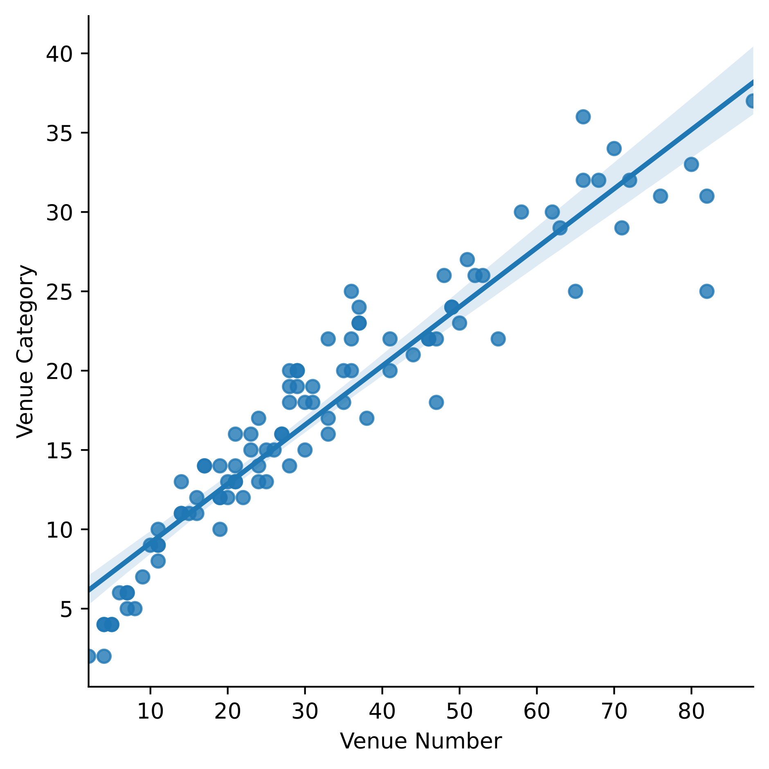
Venue diversity
The relationship between the number of venues and the number of venue categories is shown in the figure;
We notice that the diversity of the venue categories increases with the number of venues.

Slide 5
Top venue features
Neighbourhood | Borough | Cluster Labels | 1st Most Common Venue | 2nd Most Common Venue | 3rd Most Common Venue | 4th Most Common Venue
Agincourt | Scarborough | 2 | Chinese Restaurant | Restaurant | Bakery | Pizza Place
Milliken, … | Scarborough | 2 | Chinese Restaurant | BBQ Joint | Japanese Restaurant | Korean Restaurant
Willowdale, Newtonbrook | North York | 1 | Korean Restaurant | Middle Eastern Restaurant | Restaurant | Cafe
Don Mills | North York | 0 | Japanese Restaurant | Pizza Place | Restaurant | Cafe
Don Mills | North York | 0 | Japanese Restaurant | Pizza Place | Restaurant | Cafe
The Beaches | East Toronto | 0 | Pizza Place | Sandwich Place | Bakery | Breakfast Spot
Studio District | East Toronto | 0 | Bakery | Vietnamese Restaurant | Cafe | Diner
Humewood-Cedarvale | York | 0 | Pizza Place | Restaurant | Italian Restaurant | Sushi Restaurant
Canada Post Gateway Processing Centre | Mississauga | 0 | Restaurant | Middle Eastern Restaurant | Sandwich Place | Chinese Restaurant
Alderwood, Long Branch | Etobicoke | 0 | Pizza Place | Restaurant | Fast Food Restaurant | Sandwich Place
Mimico NW, … | Etobicoke | 0 | Restaurant | Sandwich Place | Fast Food Restaurant | Sushi Restaurant

Slide 6
Conclusions
The program developed in this project can be used to help investors to understand the feature of food venue business in different regions of Toronto.
By using the venue data provided by Foursquare, we can find the top suburbs where food venues are popular.
The program can also be used to explore the categories of existing food venue in a given suburb, which would guide the business decisions in terms of whether the investor should target a over-crowded but popular market, or should set up a restaurant venue which has never existed before in this suburb.

