Slide 1
Breakout
Lingxiang Yu (LY2305)

Slide 2
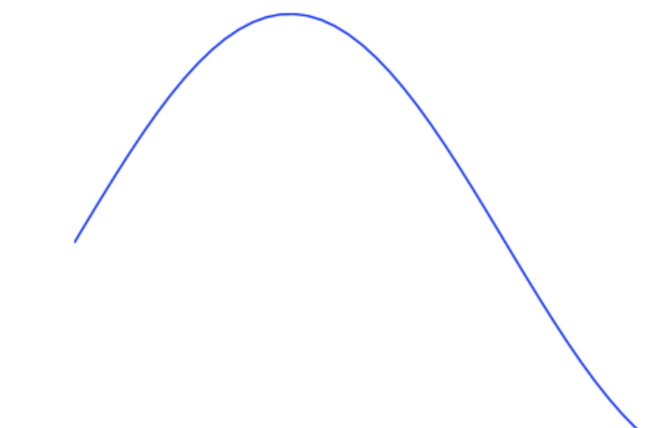
Definition
Breakout: Breakout trading is used by active investors to take a position within a trend's early stages.
This strategy can be the starting point for major price moves, expansions in volatility and, when managed properly, can offer limited downside risk.
Stop Position
Price diff
Entry Position

Slide 3
Algorithm
Set Time-Interval
Find entry_p, e.g., max(High Price)
if max(open_p, entry_p)=open_p, Buy; else, continue
Peak_p = max(entry_p, close_p)
Stop_p = peak_p*(1-stop percent) If peak price <= stop position, Sell
Back to step 2

Slide 4
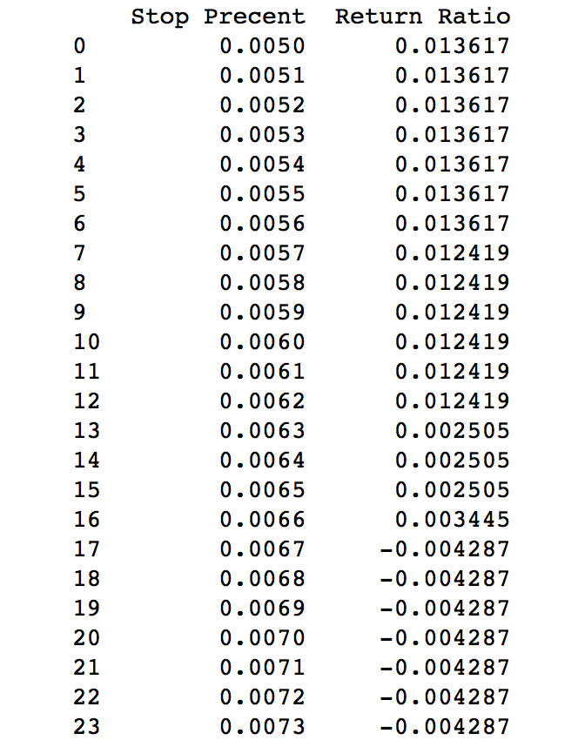
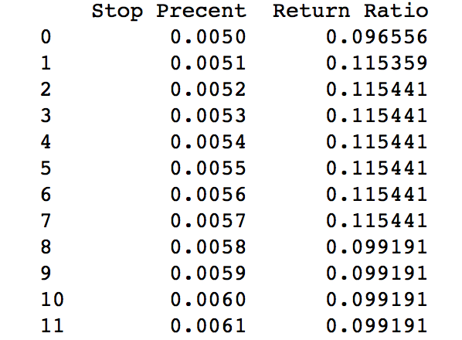
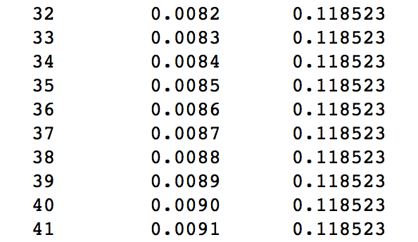
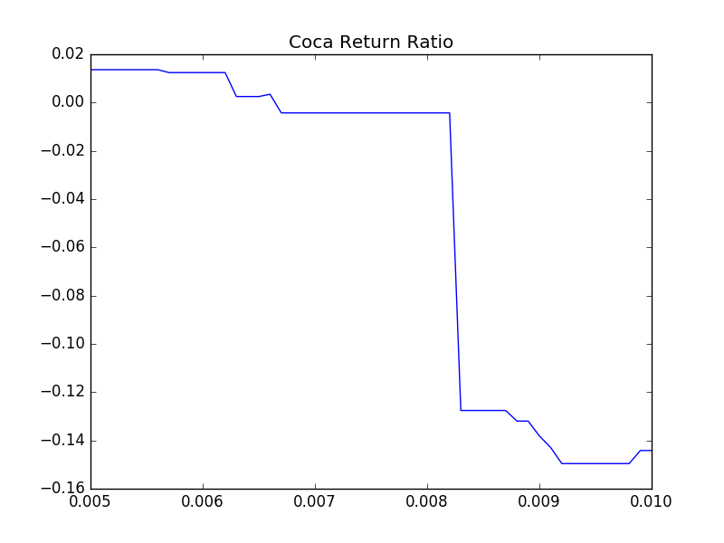
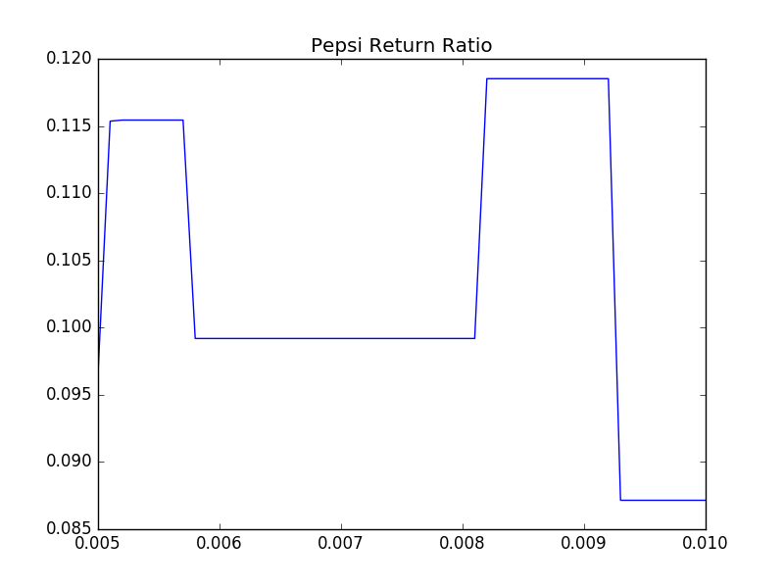
Test on Coca-Cola and Pepsi
Use 2014-2017 Coca and Pepsi stock data to test the algorithm
Set the stop percent from 0.5% to 1% and increased by 0.01% each time
To Pepsi, the best return ratio is 11.85%, happened at Stop percent 0.82% to 0.91%
To Coca, the best return ratio is 1.36%, happened at Stop percent 0.5% to 0.56%

Slide 5
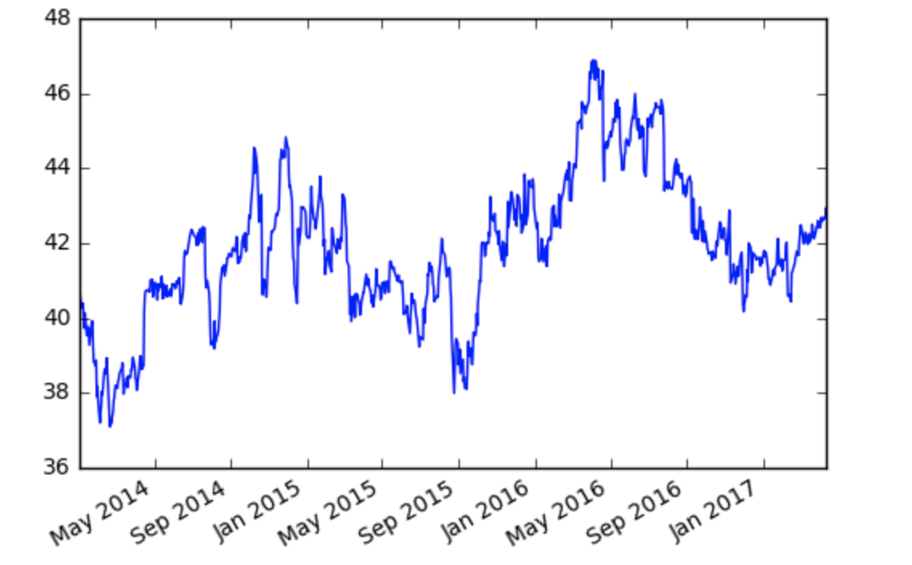
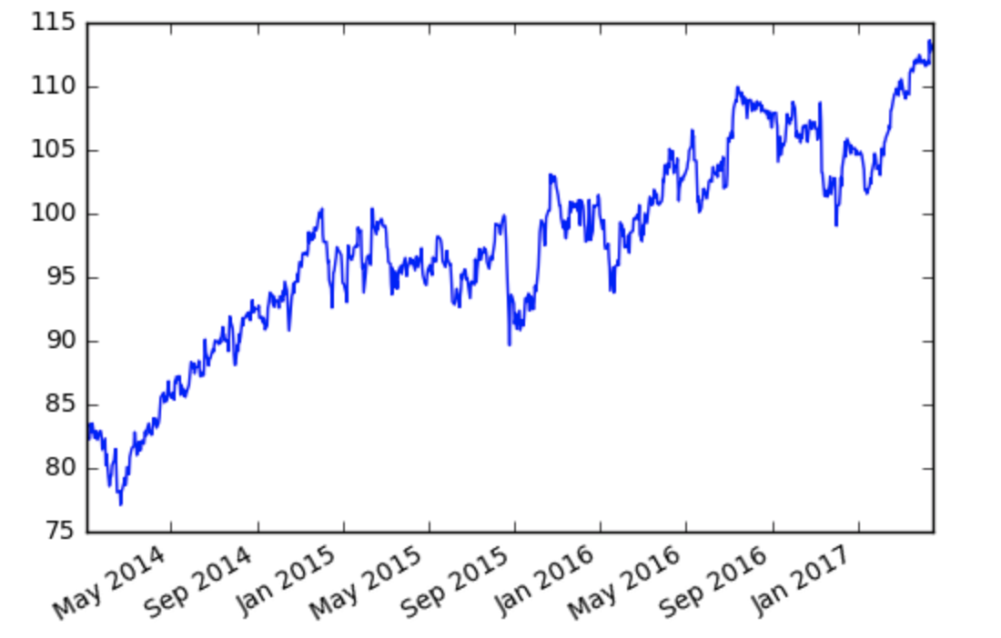
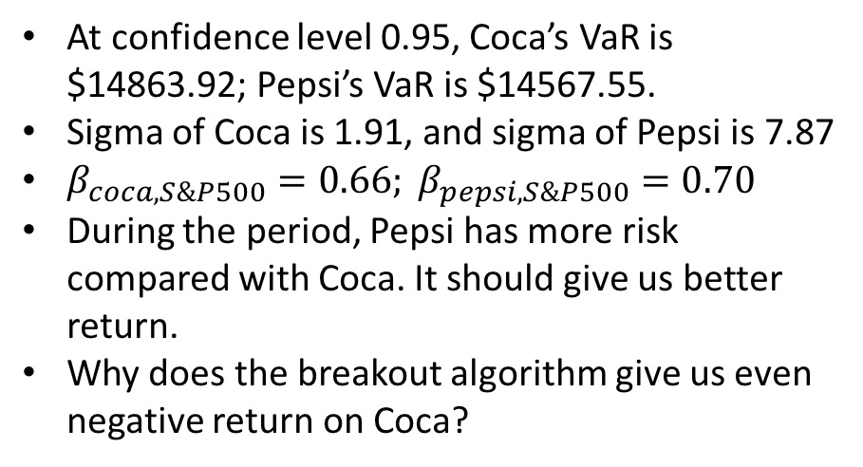
Analysis and Further Thoughts
At confidence level 0.95, Coca’s VaR is $14863.92; Pepsi’s VaR is $14567.55.
Sigma of Coca is 1.91, and sigma of Pepsi is 7.87
$β_{coca,S\&P500}=0.66; β_{pepsi,S\&P500}=0.70$
During the period, Pepsi has more risk compared with Coca. It should give us better return.
Why does the breakout algorithm give us even negative return on Coca?

