Slide 1
PG-Learn: parallel graph learning for semi-supervised learning
Xuan Wu, Lingxiao Zhao and Leman Akoglu, for KDD 2018
Presented by Lingxiao Zhao

Slide 2
Problem Introduction:
Graph-based SSL for non-graph data consists of two steps: (1) graph construction, and (2) label inference.
There are lots of algorithm designed for the second step label inference, such as harmonic function(Zhu et al,. 03), Learning with local and global consistency (Zhou et al., 2004), Modiﬁed Adsorption (MAD) (Talukdar & Crammer, 2009) and so on.
A empirical study by Maier et al shows that the performance of SSL algorithm is highly affected by graph construction procedure, however only limited work has been done for this and none of them can be efficient for high dimensionality and large samples setting.
Goal: - task-based (for specific supervised learning) graph learning - parallel framework that trying random starts efficiently (non-convex)

Slide 3
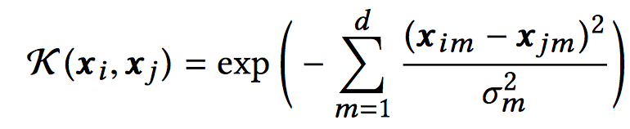


Problem Formulation
Graph Construction: Gaussian kernel is widely used for graph construction with hyperparameter. We kept using Gaussian kernel as the generating function of graph but learning the hyperparameter automatically. A more general formulation is However learning whole matrix A is too hard for high dimensionality problem. So we set A = diag(a) and learn vector a. What’s more, we also use KNN to sparsify the graph, this not only boost the performance of SSL but also reduce the runtime of our algorithm dramatically.

Slide 4



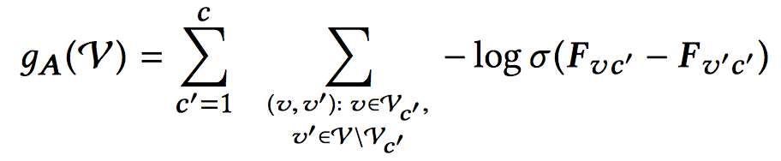
Label Inference We choose to use LGC proposed by Zhou to demonstrate our idea.
Objective function Incorporating pairwise learning-to-rank function over validation set. Idea: for any class c, we want rank sample a above sample b for any a in class c and any b not in class c.
Power Iteration Solution:

Slide 5
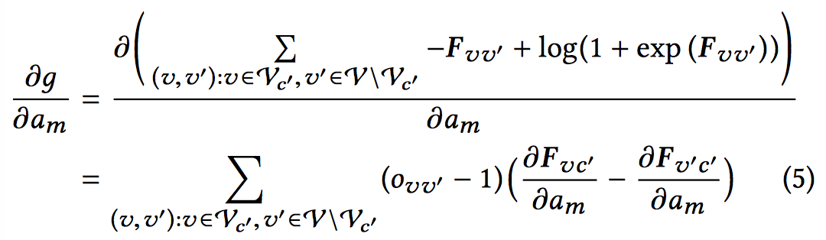
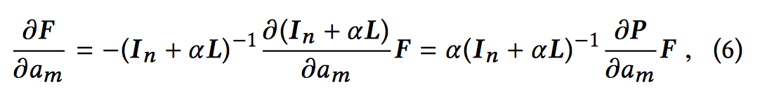
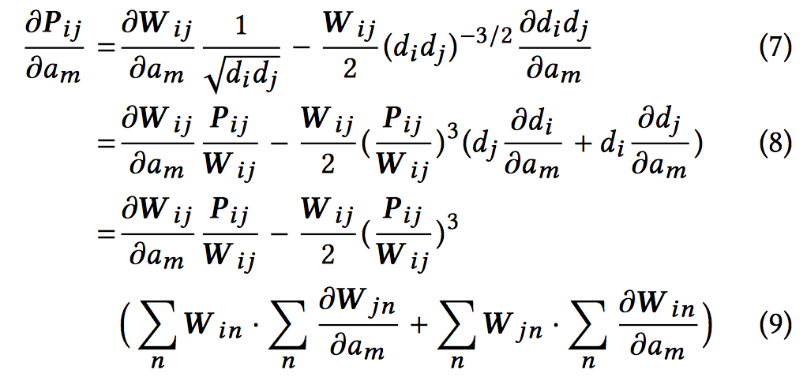
Learning Procedure
Gradient Descent

Slide 6
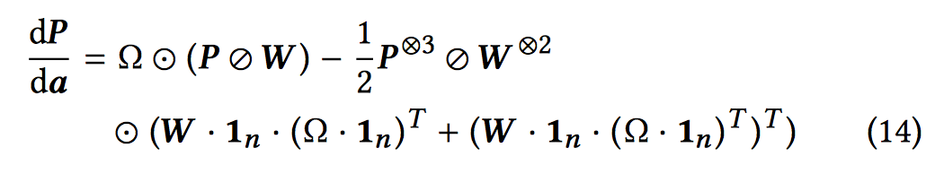
Accelerate Learning by Using Tensor and Sparsity (10x faster) - Rewrite gradient updates in tensor form: - Make use of sparsity W is KNN sparse P = D^(−1/2)WD^(−1/2) is same sparse (same non-zero elements with W) This is also true for all other tensor shown in above formula.
Accelerate by batch updating To further accelerate the implementation, we update vector a in the batch mode instead of updating all elements in each update.
Parallel Framework: Hyperband (Lisha Li et al, 2016) Although the loss function is convex, the graph construction is sparsified by KNN procedure every time. So the whole learning procedure is not convex.

Slide 7
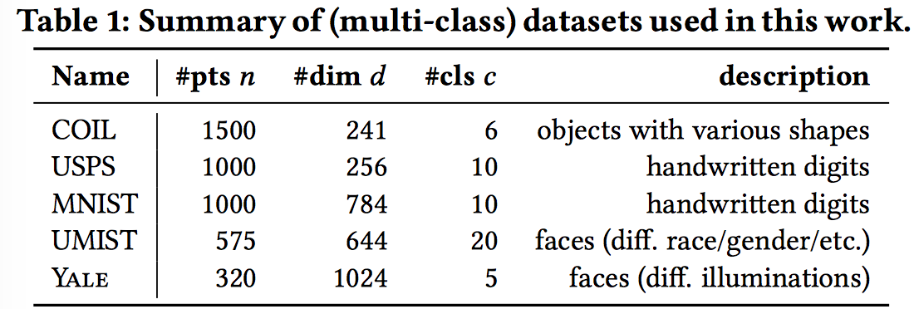
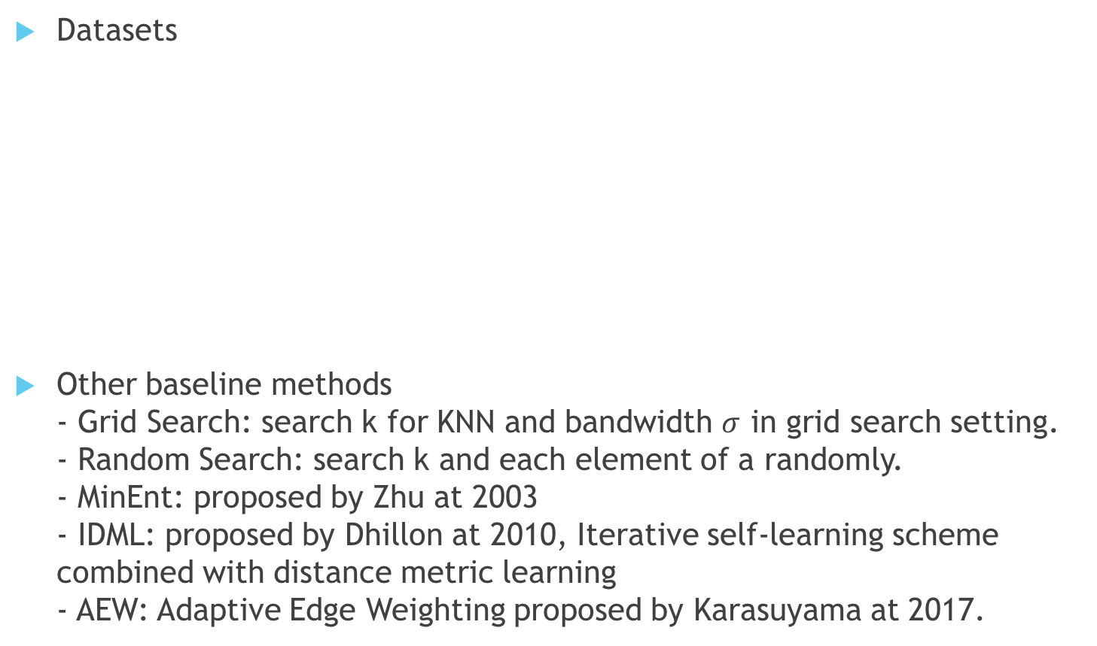
Experiment
Datasets
Other baseline methods - Grid Search: search k for KNN and bandwidth $σ$ in grid search setting. - Random Search: search k and each element of a randomly. - MinEnt: proposed by Zhu at 2003 - IDML: proposed by Dhillon at 2010, Iterative self-learning scheme combined with distance metric learning - AEW: Adaptive Edge Weighting proposed by Karasuyama at 2017.

Slide 8
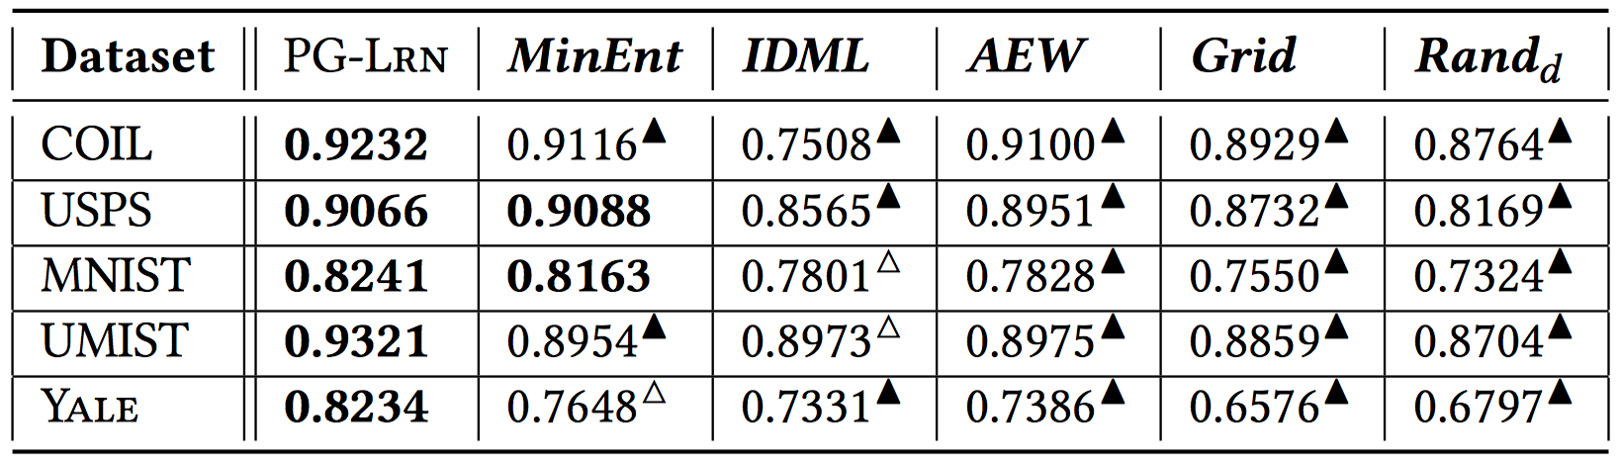
Setting1: single thread with only one random start over 5 datasets - sampling 10% randomly as training data (for our method 5% train and 5% validation) - 15 minutes limitation for each method, 10 random run over 10 partitions (split whole dataset into 10 partitions).

Slide 9
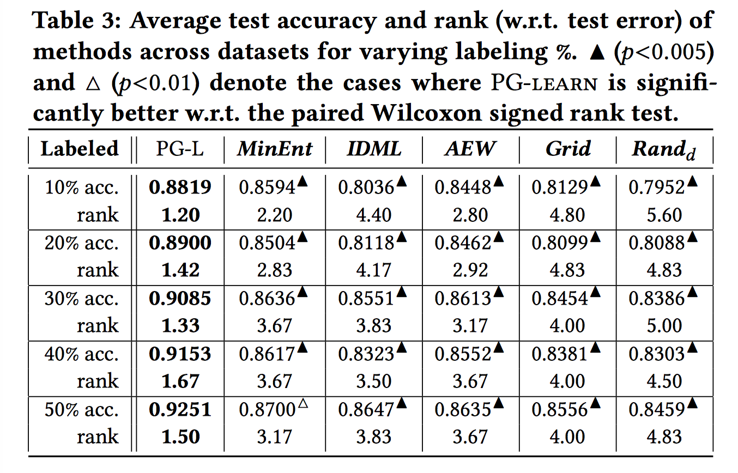

Slide 10
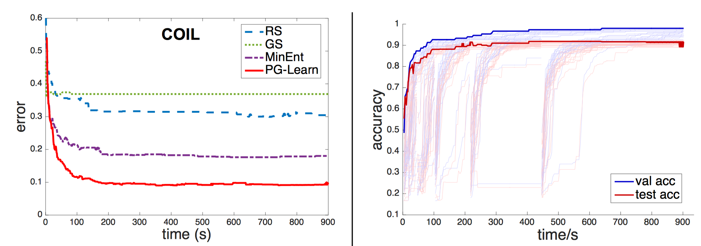
Setting2: parallel setting with noised datasets - Use parallel framework Hyperband for our method, 32 threads - 15 minutes limitation - add 100% random noise to all datasets - We drop the baseline IDML and AEW because they can’t be run for high dimensional setting (with huge memory cost)

