Slide 1
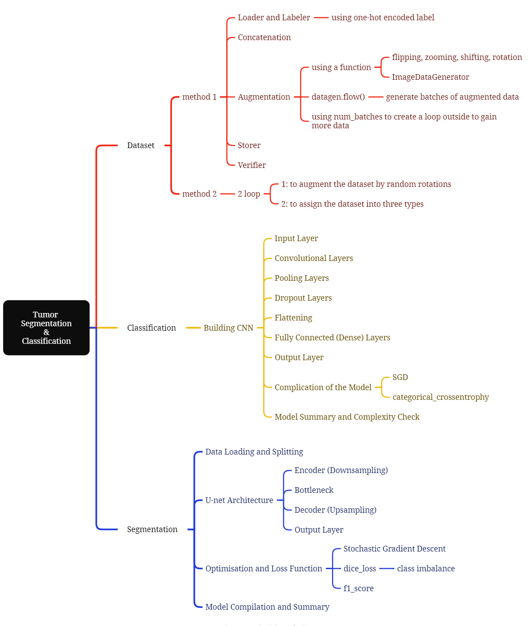
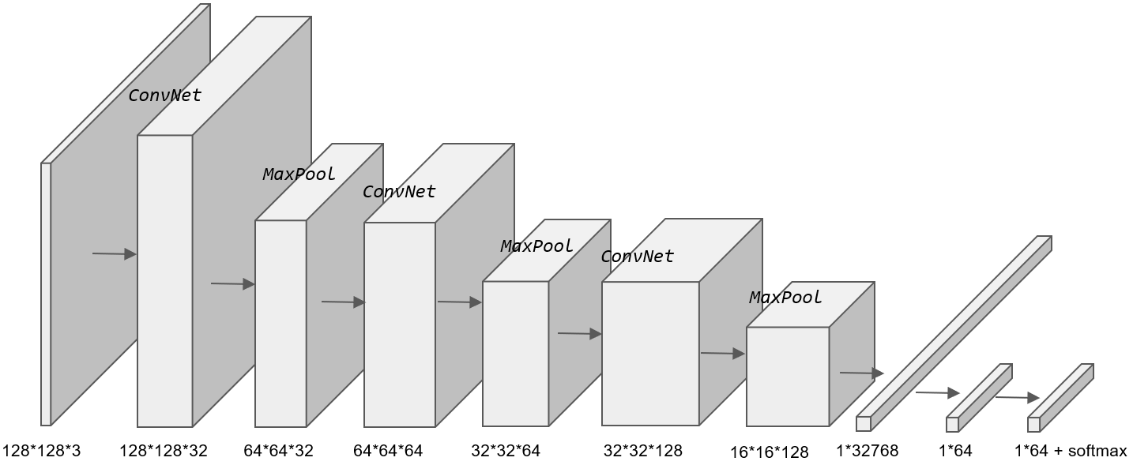
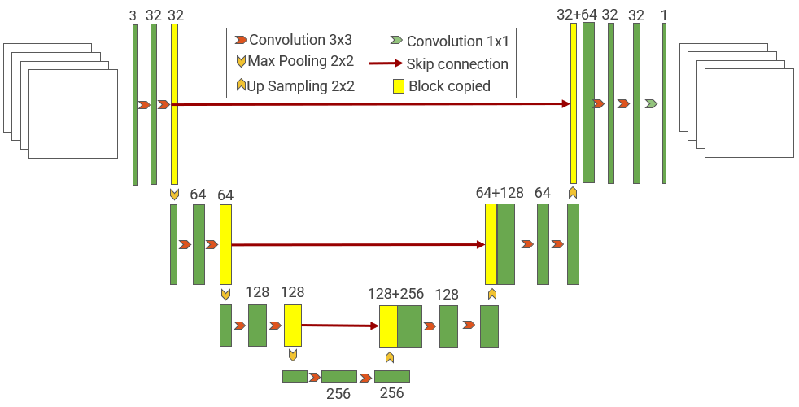
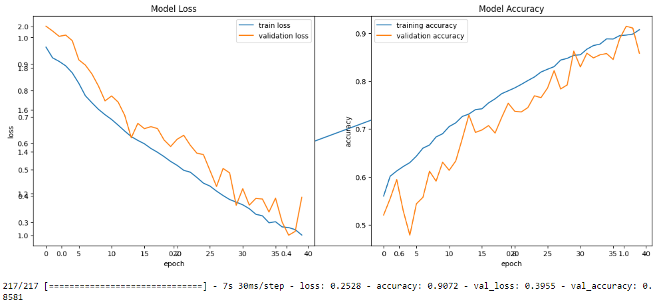
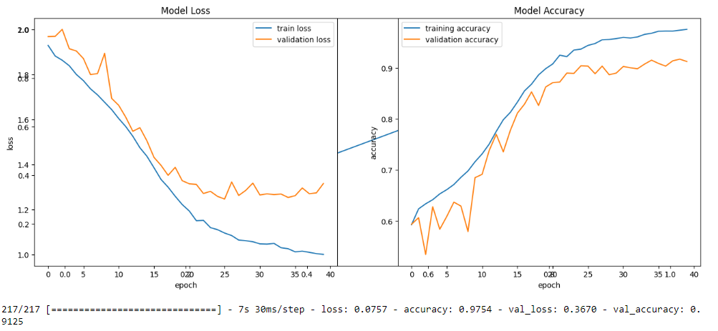
Student Name: | Lingyu Gong
Student Number: | 23337765
Lab Name: | Tumor Segmentation and Classification
Figure 1: CNN Architecture
Figure 2: U-net Architecture
 | Preprocessing | Model | Processing | Results
Tumor Detection | normalization, rotating, augmentation | CNN(2D) | 3 conv2D layers 3 maxpooling2D layers dropout 0.3 | Acc=0.91
 |  |  | 5 conv2D layers 5 maxpooling2D layers dropout 0.3 | Acc=0.86
 | resizing, flipping, rotating, augmentation | CNN(2D) | 3 conv2D layers 3 maxpooling2D layers dropout 0.3 | Acc=0.89
 |  |  | 5 conv2D layers 5 maxpooling2D layers dropout 0.3 | Acc=0.83
Tumor Segmentation | rotating, augmentation | U-net | 2 maxpooling2D layers 2 upsampling2D layers | F1 score=0.74
 |  |  | 3 maxpooling2D layers 3 upsampling2D layers | F1 score=0.89
 | resizing, flipping, rotating, augmentation | U-net | 2 maxpooling2D layers 2 upsampling2D layers | F1 score=0.62
 |  |  | 3 maxpooling2D layers 3 upsampling2D layers | F1 score=0.66
Figure 3: Comparison of classification using CNN
References:
[1] Biratu ES, Schwenker F, Ayano YM, Debelee TG. A Survey of Brain Tumor Segmentation and Classification Algorithms. Journal of Imaging. 2021; 7(9):179. https://doi.org/10.3390/jimaging7090179
[2] N. Siddique, S. Paheding, C. P. Elkin and V. Devabhaktuni, "U-Net and Its Variants for Medical Image Segmentation: A Review of Theory and Applications," in IEEE Access, vol. 9, pp. 82031-82057, 2021, doi: 10.1109/ACCESS.2021.3086020.
Table 1: Modify the comparison of different variables

