Slide 1
Background Knowledge-Resistant Traffic Padding for Preserving User Privacy in Web-Based Applications
Presenter:
Wen Ming Liu (Concordia University)
Joint work with:
Lingyu Wang (Concordia University)
Kui Ren (University at Buffalo)
Mourad Debbabi (Concordia University)
Cloudcom 2013
CIISE@CU / CSE@UB-SUNY
December 4 , 2013

Slide 2
Agenda
Overview
Motivating Example
The Model
The Algorithms
Experiment
Conclusion

Slide 3










Web-Based Applications
“Cryptography solves all security problems!”
Really?
untrusted
Internet
Client
Server
Encryption

Slide 4

Motivating Example
Internet
Patient
Website
Username/Password
Info about disease most recently associated
Fixed pattern: identified application
Diseases | Observed Directional Packet Sizes
Cancer | 801→, | ←54, | ←360, | 60→
Cervicitis | 801→, | ←54, | ←290, | 60→
Cold | 801→, | ←54, | ←290, | 60→
Cough | 801→, | ←54, | ←290, | 60→
 | b-byte |  | s-byte
Indicator of diseases

Slide 5

Side-Channel Attack on Encrypted Traffic
Network packets’ sizes and directions between user and a popular search engine
By acting as a normal user and eavesdropping traffic with sniffer pro 4.7.5.
Internet
Client
Encrypted Traffic
Server
Fixed pattern: identified input string
User Input | Observed Directional Packet Sizes
a: | 801→, | ←54, | ←509, | 60→
00: | 812→, | ←54, | ←505, | 60→,
 | 813→, | ←54, | ←507, | 60→
 | b-byte |  | s-byte
Indicator of the input itself

Slide 6

Trivial problem!
Just let every packet have the same size!

Slide 7
Don’t Forget the Cost
To make all inputs indistinguishable will result in a 21074% overhead for a well-known online tax system ¹
No guarantee of better privacy at a higher cost
Δ ↑ ⇏ privacy ↑
Δ ↑ ⇏ overhead ↑
Diseases | s Value | Rounding (Δ)
 |  | 112 | 144 | 176
Cancer | 360 | 448 | 432 | 528
Cervicitis | 290 | 336 | 432 | 352
Cold | 290 | 336 | 432 | 352
Cough | 290 | 336 | 432 | 352
Padding Overhead (%) |  | 18.4% | 40.5% | 28.8%
¹ S. Chen, R. Wang, X. Wang, and K. Zhang. Side-channel leaks in web applications: A reality today, a challenge tomorrow. In IEEE Symposium on Security and Privacy’10, pages 191–206, 2010.

Slide 8
Solution: Ceiling Padding
2-indistinguishability
Diseases | s Value | Rounding (Δ) |  |  | Ceiling Padding
 |  | 112 | 144 | 176
Cancer | 360 | 448 | 432 | 528 | 360
Cervicitis | 290 | 336 | 432 | 352 | 360
Cold | 290 | 336 | 432 | 352 | 290
Cough | 290 | 336 | 432 | 352 | 290
Padding Overhead (%) |  | 18.4% | 40.5% | 28.8% | 5.7%
Ceiling Padding: pad every packet to the maximum size in the group
Observation: a patient receives a 360-byte packet after logins
Cancer? Cervicitis? ⇒ 50% , 50%
Extra knowledge: this patient is a male
Cancer? Cervicitis? ⇒ 100% , 0%

Slide 9
One Natural Solution
Differential privacy:
No assumption about the adversaries’ background knowledge.
Suitable for statistical aggregates or their variants with
relatively small sensitivity.
Challenges:
Less suitable to traffic padding:
Sensitivity is less predictable and much large;
Packet sizes are directly observable;
Privacy budget is shared by unbounded number of users.
The selection of privacy parameter ε:
Qualitative significance of parameter ε √
Quantitative link between ε value and degree of privacy guarantee ?

Slide 10
Solution: Add Randomness
Random Ceiling Padding
Instead of deterministically forming padding groups, the server will randomly (at uniform, in this example) selects one out of the other three diseases (together with the real disease) to form a padding group in order to apply ceiling padding.
Cancerous Person
Cervicitis Patient
Diseases | s Value
Cancer | 360
Cervicitis | 290
Cold | 290
Cough | 290
Diseases | s Value
Cancer | 360
Cervicitis | 290
Cold | 290
Cough | 290
360
360
360
360
290
290
Always receive a 360-byte packet
66.7%: 290-byte packet
33.3%: 360-byte packet

Slide 11
Better Privacy Protection
Can tolerate adversaries’ extra knowledge
Suppose an adversary knows a patient is male and he saw s = 360
Patient Has | Server Selects
Cancer | Cervicitis
Cancer | Cold
Cancer | Cough
Cold | Cancer
Cough | Cancer
Diseases | s Value
Cancer | 360
Cervicitis | 290
Cold | 290
Cough | 290
The adversary now can only be 60%, instead of 100%, sure that patient has Cancer.
Cost is not necessarily worse
In this example, these two methods actually lead to exactly the same expected padding and processing costs

Slide 12
Agenda
Overview
The Model
Traffic Padding
Privacy Properties
Padding Methods
Cost Metrics
The Algorithms
Experiment
Conclusion

Slide 13

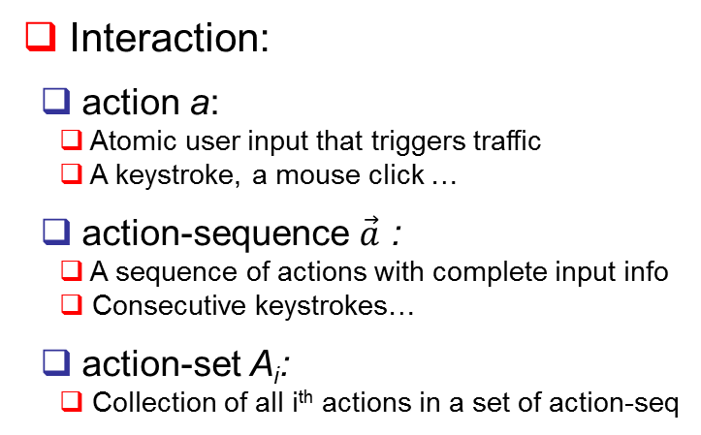
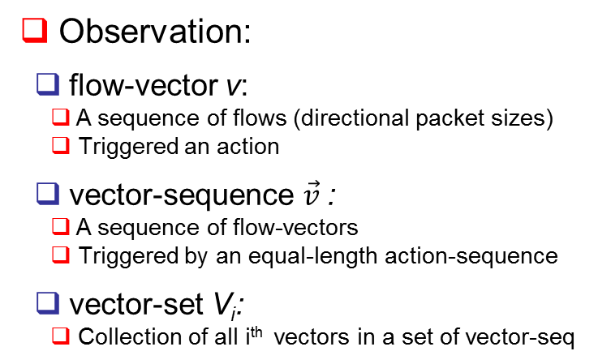
Traffic Padding Issue
Diseases | Observed Directional Packet Sizes
Cancer | 801→, | ←54, | ←360, | 60→
Cervicitis | 801→, | ←54, | ←290, | 60→
… | … | … | … | …
Internet
Interaction:
action a:
Atomic user input that triggers traffic
A keystroke, a mouse click …
action-sequence $\vec{a}$ :
A sequence of actions with complete input info
Consecutive keystrokes…
action-set A_{i}:
Collection of all i^{th} actions in a set of action-seq
Observation:
flow-vector v:
A sequence of flows (directional packet sizes)
Triggered an action
vector-sequence $\vec{v}$:
A sequence of flow-vectors
Triggered by an equal-length action-sequence
vector-set V_{i}:
Collection of all i^{th} vectors in a set of vector-seq
Vector-Action Set VA_{i}:
Pairs of i^{th} actions and corresponding i^{th} flow-vectors

Slide 14
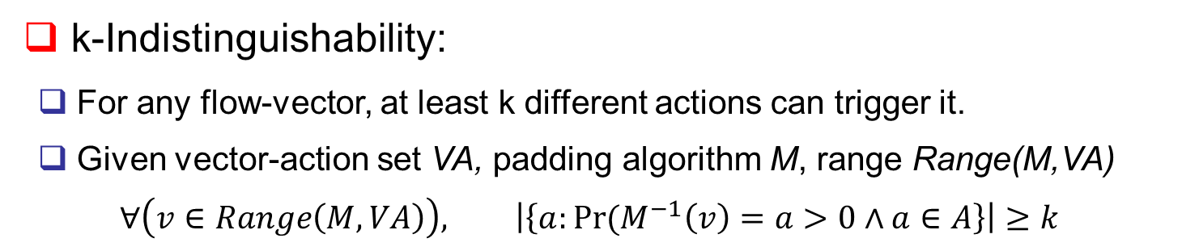
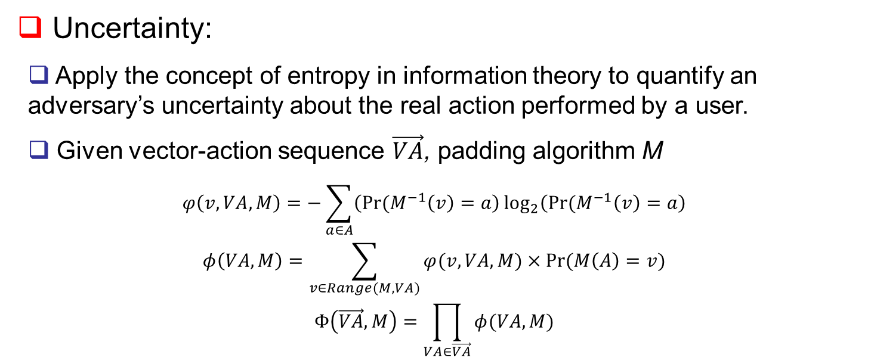
Privacy Properties
Model the privacy requirement of a traffic padding from two perspectives
k-Indistinguishability:
For any flow-vector, at least k different actions can trigger it.
Given vector-action set VA, padding algorithm M, range Range(M,VA)
$$∀\left(v∈Range\left(M,VA\right)\right), \left|\left\{a:Pr⁡(M^{−1}\left(v\right)=a>0∧a∈A\right\}\right|≥k$$
Uncertainty:
Apply the concept of entropy in information theory to quantify an adversary’s uncertainty about the real action performed by a user.
Given vector-action sequence $\vec{VA}$, padding algorithm M
$$φ\left(v,VA,M\right)=−\sum_{a∈A}{\left(Pr⁡(M^{−1}\left(v\right)=a\right)\log_{2}\left(Pr⁡(M^{−1}\left(v\right)=a\right)}$$
$$φ\left(VA,M\right)=\sum_{v∈Range(M,VA)}{φ(v,VA,M)×Pr⁡(M\left(A\right)=v)}$$
$$Φ\left(\vec{VA},M\right)=\prod_{VA∈\vec{VA}}{φ(VA,M)}$$

Slide 15
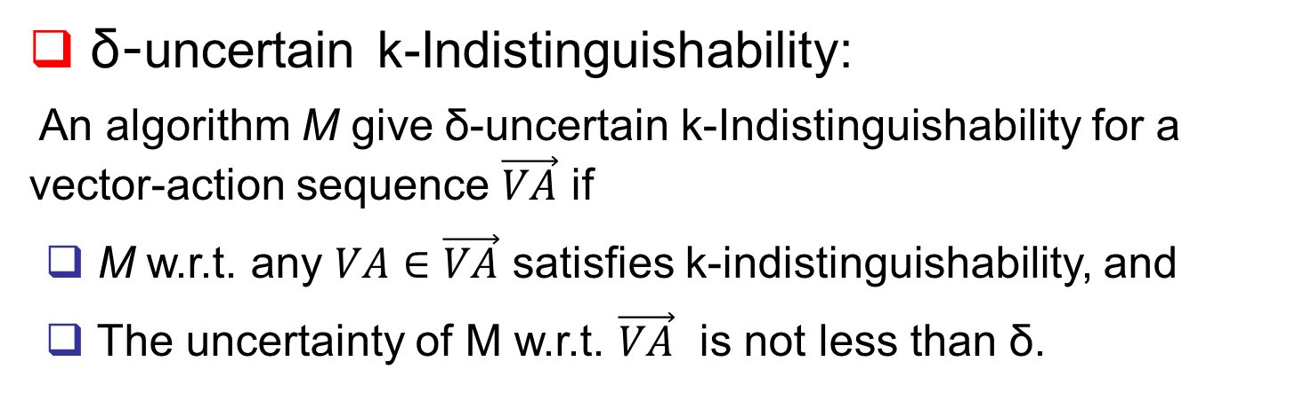
Privacy Properties (cont.)
δ-uncertain k-Indistinguishability:
An algorithm M give δ-uncertain k-Indistinguishability for a vector-action sequence $\vec{VA}$ if
M w.r.t. any $VA∈\vec{VA}$ satisfies k-indistinguishability, and
The uncertainty of M w.r.t. $\vec{VA}$ is not less than δ.

Slide 16
Padding Method
Achieves k-indistinguishability, but not sufficient if the adversary possess prior knowledge.
Ceiling padding [15][16]:
Inspired by PPDP: grouping and breaking
Dominant-vector of a padding group:
Size of each group is not less than k, and
every flow-vector in a group is padded to dominant-vector of that group.
Random ceiling padding method:
A mechanism M: when responding to an action a (per each user request),
It randomly selects k-1 other actions, and
Pads the flow-vector of action a to be dominant-vector of transient group
(those k actions).
Randomness:
Randomly selects members of transient group from certain candidates based on certain distributions.
To reduce the cost, change the probability of an action being selected as a member of transient group.

Slide 17
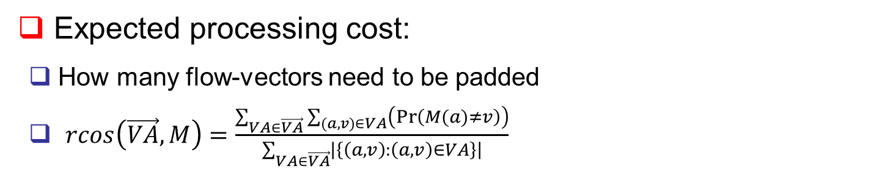
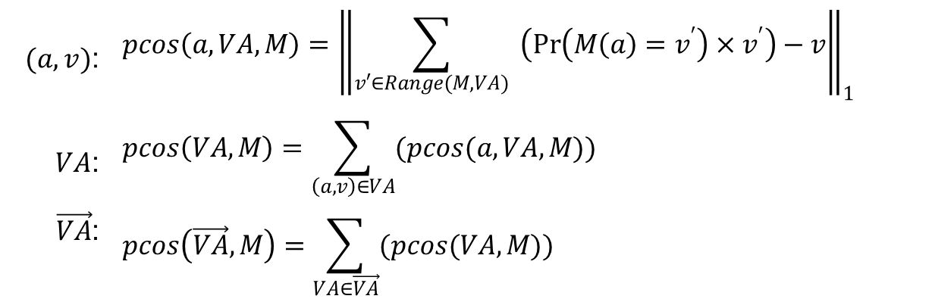
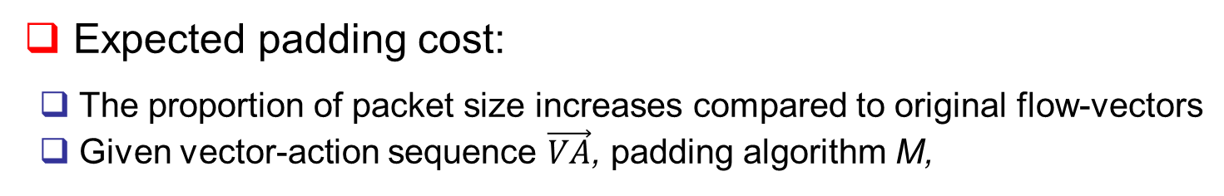
Cost Metrics
Expected padding cost:
The proportion of packet size increases compared to original flow-vectors
Given vector-action sequence $\vec{VA}$, padding algorithm M,
$(a,v)$: | $$pcos\left(a,VA,M\right)={\left\|\sum_{v′∈Range(M,VA)}{ \left(\operatorname{Pr}\left(M\left(a\right)=v^{′}\right)×v^{′}\right)−v}\right\|}_{1}$$
$VA$: | $$pcos\left(VA,M\right)=\sum_{\left(a,v\right)∈VA}{(pcos(a,VA,M))}$$
$\vec{VA}$: | $$pcos\left(\vec{VA},M\right)=\sum_{VA∈\vec{VA}}{(pcos(VA,M))}$$
Expected processing cost:
How many flow-vectors need to be padded
$rcos\left(\vec{VA},M\right)=\frac{\sum_{VA∈\vec{VA}}{\sum_{(a,v)∈VA}{\left(Pr⁡\left(M(a)≠v\right)\right)}}}{\sum_{VA∈\vec{VA}}{\left|\left\{\left(a,v\right):\left(a,v\right)∈VA\right\}\right|}}$

Slide 18
Agenda
Overview
The Model
The Algorithms
Scheme
Instantiations
Experiment
Conclusion

Slide 19
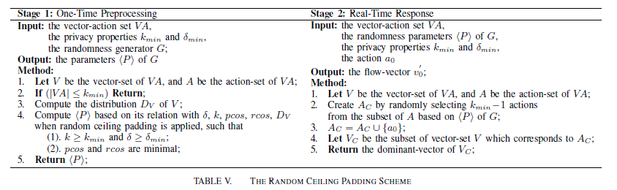
Overview of Scheme
Main idea:
To response a user input, server randomly selects members to form the group.
Different choices of random distribution lead to different algorithms.
Goal:
The privacy properties need to be ensured.
The costs of achieving such privacy protection should be minimized.
Two stage scheme:
Stage 1: derive randomness parameters, one-time, optimization problem;
Stage 2: form transient group, real-time.

Slide 20
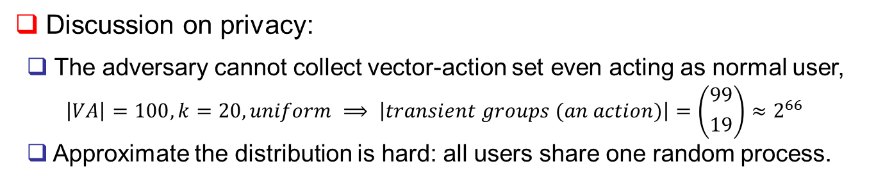
Scheme (cont.)
Computational complexity: O(k)
Stage 1: pre-calculated only once
Stage 2: select k-1 random actions without duplicate, O(k).
Discussion on privacy:
The adversary cannot collect vector-action set even acting as normal user,
$$\left|VA\right|=100, k=20, uniform ⟹ \left|transient groups (an action)\right|=\left({99 \atop 19}\right)≈2^{66}$$
Approximate the distribution is hard: all users share one random process.
Discussion on costs:
Deterministically incomparable with those of ceiling padding.

Slide 21
Instantiations of Scheme
Scheme can be realized in many different ways.
Choose group members from different subsets of candidates and based on different distributions, in order to reduce costs.
Bounded uniform distribution:
c_{t}: cardinality of candidate actions
c_{l}: number of larger candidates
Normal distribution:
μ: mean
σ: standard deviation
probability
c_{t}
largest
smallest
largest
smallest
0
n
0
n
c_{l}
i
action
i
action
[max(0,min(i-c_{l}, |VA|-c_{t})), min(max(0,min(i-c_{l}, |VA|-c_{t}))+c_{t}, |VA|)]

Slide 22
Agenda
Overview
The Model
The Algorithms
Experiment
Conclusion

Slide 23
Experiment Settings
Collect testing vector-action sets from two real-world web applications:
A popular search engine (where users’ search keyword needs to be protected)
Collect flow-vectors for query suggestion widget by crafting requests to simulate the normal AJAX connection request.
An authoritative drug information system (user’s possible health information)
Collect vector-action set for all the drug information by mouse-selecting following the application’s tree-hierarchical navigation.
The flows of drug are more diverse, large, and disparate than those of engine.
Compare our solutions (TUNI option, Norm option) with the svmdGreedy (SVMD) [16] on four-letter combinations in Engine and last-level data in Drug.

Slide 24
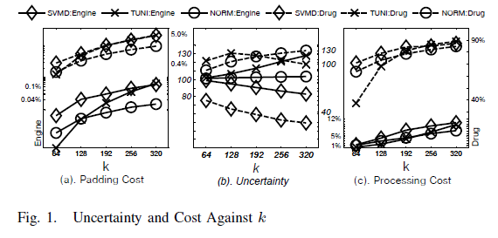
Uncertainty and Costs v.s. k
The padding and processing costs of all algorithms increase with k, while TUNI and NORM have less than those of SVMD.
Our algorithms have much larger uncertainty for Drug and slightly larger for Engine.

Slide 25
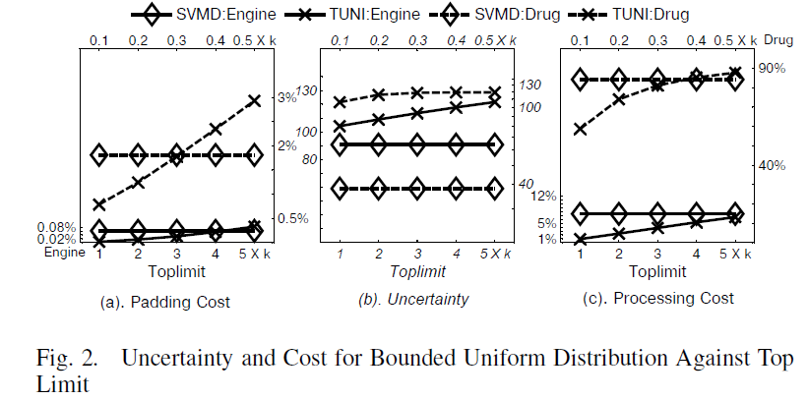
Randomness Drawn From Bounded Uniform Distribution (c_{l})
Both costs increase slowly with c_{l} for TUNI: more chances to select larger actions for transient group.
TUNI has less costs yet higher uncertainty than SVMD.

Slide 26
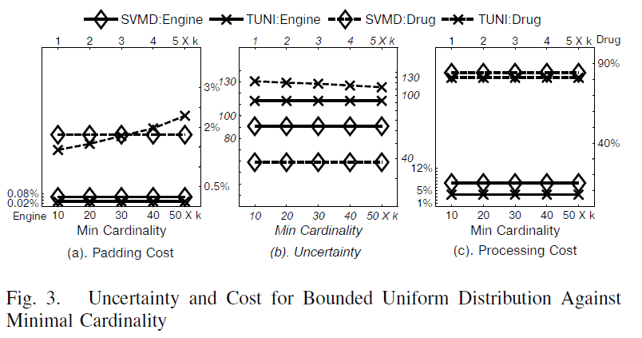
Randomness Drawn From Bounded Uniform Distribution (c_{t})
For engine: same regardless of c_{t} value.
For drug: costs (uncertainty) increase (decreases) slowly.
TUNI has less costs yet higher uncertainty than SVMD.

Slide 27
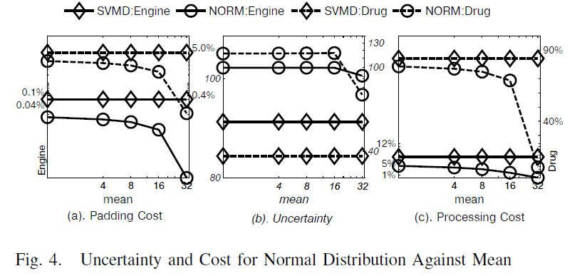
Randomness Drawn From Normal Distribution (μ)
Costs decrease almost linearly with μ from 0 to 16, and rapidly as μ grows to 32.
Uncertainty slightly changes with μ from 0 to 16, and decreases rapidly when μ grows to 32 .
NORM has less costs yet higher uncertainty than SVMD.

Slide 28
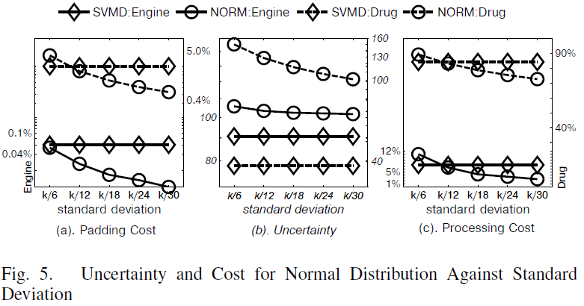
Randomness Drawn From Normal Distribution (σ)
All the three measurements decreases with the decrease of σ.
Compared with SVMD, the less the σ, NORM exhibits better.

Slide 29
Agenda
Overview
The Model
The Algorithms
Experiment
Conclusion

Slide 30
Conclusion and Future Work
Propose a solution to reduce the impact of adversaries’ background knowledge in privacy-preserving traffic padding.
Propose a formal model for quantifying the amount of privacy protection provided by traffic padding solutions;
Instantiate two algorithms;
Confirm the performance of our solutions in terms of both privacy and overhead through experiment with real-world applications.
Future work:
Apply the proposed approach to privacy-preserving data publishing.

Slide 31
Thank you!

