Slide 1
Privacy Streamliner: A Two-Stage Approach to Improving
Algorithm Efficiency
Wen Ming Liu and Lingyu Wang
Concordia University
CODASPY 2012
Computer Security Laboratory / Concordia Institute for Information Systems Engineering
Feb 08 , 2012

Slide 2
Agenda
Introduction
Model
Algorithms
Experimental Results
Conclusion

Slide 3
Agenda
Introduction
  When the Algorithm is Publicly Known
  Approach Overview
Model
Algorithms
Experimental Results
Conclusion

Slide 4
When the Algorithm is Publicly Known
Name | DoB | Condition
Ada | 1990 | ???
Bob | 1985 | ???
Coy | 1974 | ???
Dan | 1962 | ???
Eve | 1953 | ???
Fen | 1941 | ???
Unknown Micro-Data Table t₀
DoB | Condition
1980~1999 | ???
 | ???
1960~1979 | ???
 | ???
1940~1959 | ???
 | ???
Checked but unused Generalization g₁(t₀)
DoB | Condition
1970~1999 | flu
 | cold
 | cancer
1940~1969 | cancer
 | headache
 | toothache
Released Generalization g₂(t₀)
Traditional generalization algorithm:
  Evaluate generalization functions in a predetermined order and then release data using the first function satisfying the privacy property .
Adversaries’ view when knowing the algorithm:
  The adversaries may further refine their mental image about the original data by eliminating invalid guesses from the mental image in terms of the disclosed data.
  The refined image may violate the privacy even if the disclosed data does not.
Natural solution:
  First simulate such reasoning to obtain the refined mental image, and then enforce the privacy property on such image instead of the disclosed data.
  Such solution is inherently recursive and incur a high complexity.
  [Zhang et al., CCS’07 and Liu et al., ICDT’10]

Slide 5
Agenda
Introduction
  When the Algorithm is Publicly Known
  Approach Overview
Model
Algorithms
Experimental Results
Conclusion

Slide 6
Approach Overview
Key observation
  The above strategy attempts to achieve safety (i.e., satisfaction of privacy property) and optimal data utility at the same time, when checking each candidate generalization
Propose a new strategy
  Decouple ‘safety’ from ‘utility optimization’
  Which (as we shall see) may lead to efficient algorithms that remain safe even when publicized
Identifier partition vs. table generalization
  The former is the ‘ID portion’ of the latter
  An adversary may know an identifier partition to be safe / unsafe without seeing corresponding table generalization

Slide 7
Approach Overview (Cont.)
Decouple the process of privacy preservation from that of utility optimization to avoid the expensive recursive task of simulating the adversarial reasoning.
  Start with the set of generalization function that can satisfy the privacy property for the given micro-data;
  Identify a subset of such functions satisfying that knowledge about this subset will not assist the adversaries in violating the privacy property.
  Optimize data utility within this subset of functions.
privacy preservation
utility optimization

Slide 8
Example – LSS
Start with locally safe set (LSS)
  The set of identifier partitions that can satisfy the privacy property.
  LSS=
{
P1 = {{Ada, Coy}, {Bob, Dan, Eve}},
P2 = {{Ada, Dan}, {Bob, Coy, Eve}},
P3 = {{Ada, Eve}, {Bob, Coy, Dan}},
P4 = {{Bob, Coy}, {Ada, Dan, Eve}},
P5 = {{Bob, Dan}, {Ada, Coy, Eve}},
P6 = {{Bob, Eve}, {Ada, Coy, Dan}},
P7 = {{Coy, Eve}, {Ada, Bob, Dan}},
P8 = {{Dan, Eve}, {Ada, Bob, Coy}},
P9 = {{Ada, Bob, Coy, Dan, Eve}}
}
  P10={{Ada, Bob}, {Coy, Dan, Eve}}
  P11={{Coy, Dan}, {Ada, Bob, Eve}}
Name | DoB | Condition
Ada | 1985 | flu
Bob | 1980 | flu
Coy | 1975 | cold
Dan | 1970 | cold
Eve | 1965 | HIV
Micro-Data Table t₀
Name: identifier.
DoB: quasi-identifier.
Condition: sensitive attribute.
the privacy property:
  highest ratio of a sensitive value in a group must be no greater than 2/3.

Slide 9
Example (cont.) – LSS (cont.)
l-diversity:
≤ 2/3
Name | DoB | Condition
Ada | 1985 | ???
Bob | 1980 | ???
Coy | 1975 | ???
Dan | 1970 | ???
Eve | 1965 | ???
Public Knowledge
  LSS = {
P1 = {{Ada, Coy}, {Bob, Dan, Eve}},
P2 = {{Ada, Dan}, {Bob, Coy, Eve}},
P3 = {{Ada, Eve}, {Bob, Coy, Dan}},
P4 = {{Bob, Coy}, {Ada, Dan, Eve}},
P5 = {{Bob, Dan}, {Ada, Coy, Eve}},
P6 = {{Bob, Eve}, {Ada, Coy, Dan}},
P7 = {{Coy, Eve}, {Ada, Bob, Dan}},
P8 = {{Dan, Eve}, {Ada, Bob, Coy}},
P9 = {{Ada, Bob, Coy, Dan, Eve}} }
Initial Knowledge
Name | DoB | t₀₁ | t₀₂
Ada | 1985 | flu | cold
Bob | 1980 | flu | cold
Coy | 1975 | cold | flu
Dan | 1970 | cold | flu
Eve | 1965 | HIV | HIV
Violated!
Mental image
LSS may contain too much information to be assumed as public knowledge.

Slide 10
Example (cont.) – GSS
l-diversity:
≤ 2/3
Name | DoB | Condition
Ada | 1985 | ???
Bob | 1980 | ???
Coy | 1975 | ???
Dan | 1970 | ???
Eve | 1965 | ???
Public Knowledge
  GSS = {
P1 = {{Ada, Coy}, {Bob, Dan, Eve}},
P2 = {{Ada, Dan}, {Bob, Coy, Eve}},
P3 = {{Ada, Eve}, {Bob, Coy, Dan}},
P4 = {{Bob, Coy}, {Ada, Dan, Eve}},
P5 = {{Bob, Dan}, {Ada, Coy, Eve}},
P6 = {{Bob, Eve}, {Ada, Coy, Dan}},
P7 = {{Coy, Eve}, {Ada, Bob, Dan}},
P8 = {{Dan, Eve}, {Ada, Bob, Coy}},
P9 = {{Ada, Bob, Coy, Dan, Eve}} }
Initial Knowledge
Name | t₀₁ | t₀₂ | t₀₃ | t₀₄
Ada | flu | cold | flu | cold
Bob | flu | cold | flu | cold
Coy | cold | flu | cold | flu
Dan | cold | flu | HIV | HIV
Eve | HIV | HIV | cold | flu
This would be the adversary’s best guesses of the micro-data table in terms of the GSS, However …
However:
The information disclosed by the GSS and that by the released data may be different, and by intersecting the two, adversaries may further refine their mental image.
Mental image

Slide 11
Example (cont.) – GSS (cont.)
l-diversity:
≤ 2/3
Name | DoB | Condition
Ada | 1985 | ???
Bob | 1980 | ???
Coy | 1975 | ???
Dan | 1970 | ???
Eve | 1965 | ???
Public Knowledge
  GSS = {
P1 = {{Ada, Coy}, {Bob, Dan, Eve}},
P2 = {{Ada, Dan}, {Bob, Coy, Eve}},
P3 = {{Ada, Eve}, {Bob, Coy, Dan}},
P4 = {{Bob, Coy}, {Ada, Dan, Eve}},
P5 = {{Bob, Dan}, {Ada, Coy, Eve}},
P6 = {{Bob, Eve}, {Ada, Coy, Dan}},
P7 = {{Coy, Eve}, {Ada, Bob, Dan}},
P8 = {{Dan, Eve}, {Ada, Bob, Coy}},
P9 = {{Ada, Bob, Coy, Dan, Eve}} }
Initial Knowledge
Suppose utility optimization selects P3
Name | t₀₁ | t₀₂ | t₀₃ | t₀₄
Ada | flu | cold | flu | cold
Bob | flu | cold | flu | cold
Coy | cold | flu | cold | flu
Dan | cold | flu | HIV | HIV
Eve | HIV | HIV | cold | flu
Name | t₁₁ | t₁₂ | t₁₃ | t₁₄ | t₁₅ | t₁₆
Ada | flu | flu | flu | HIV | HIV | HIV
Bob | flu | cold | cold | flu | cold | cold
Coy | cold | flu | cold | cold | flu | cold
Dan | cold | cold | flu | cold | cold | flu
Eve | HIV | HIV | HIV | flu | flu | flu
Mental image
∩
In terms of disclosed P3
In terms of GSS

Slide 12
Example (cont.) – SGSS
l-diversity:
≤ 2/3
Name | DoB | Condition
Ada | 1985 | ???
Bob | 1980 | ???
Coy | 1975 | ???
Dan | 1970 | ???
Eve | 1965 | ???
Public Knowledge
  SGSS = {
P1 = {{Ada, Coy}, {Bob, Dan, Eve}},
P2 = {{Ada, Dan}, {Bob, Coy, Eve}},
P3 = {{Ada, Eve}, {Bob, Coy, Dan}},
P4 = {{Bob, Coy}, {Ada, Dan, Eve}},
P5 = {{Bob, Dan}, {Ada, Coy, Eve}},
P6 = {{Bob, Eve}, {Ada, Coy, Dan}},
P7 = {{Coy, Eve}, {Ada, Bob, Dan}},
P8 = {{Dan, Eve}, {Ada, Bob, Coy}},
P9 = {{Ada, Bob, Coy, Dan, Eve}} }
Initial Knowledge
Suppose utility optimization selects P1
Now the privacy property will always be satisfied regardless of which partition is selected during utility optimization.
Name | t₀₁ | t₀₂ | t₀₃ | t₀₄ | t₀₅ | t₀₆ | t₀₇ | t₀₈ | t₀₉ | t₁₀
Ada | flu | cold | flu | cold | flu | cold | flu | cold | HIV | HIV
Bob | flu | cold | flu | cold | HIV | HIV | flu | cold | flu | cold
Coy | cold | flu | cold | flu | cold | flu | HIV | HIV | cold | flu
Dan | cold | flu | HIV | HIV | cold | flu | cold | flu | cold | flu
Eve | HIV | HIV | cold | flu | flu | cold | cold | flu | flu | cold
Name
Ada | flu
Coy | cold
Bob | flu
Dan | cold
Eve | HIV
Mental image
∩

Slide 13
In Summary
Sets of Identifier Partitions
All Possible
Identifier
Partitions
The SGSS allow us to optimize utility without worrying about violating the privacy property.
LSS
Question remainder: How to compute a SGSS?
GSS₂
Naïve solution: LSS → GSS → SGSS ($\left|LSS\right|∝\frac{n!}{{\left(l!\right)}^{n/l}}, \left|GSS\right|∝2^{\left|LSS\right|},|SGSS|∝2^{\left|GSS\right|}$)
Directly construct SGSS.
SGSS₂
GSS₁
SGSS₁₁
SGSS₁₂

Slide 14
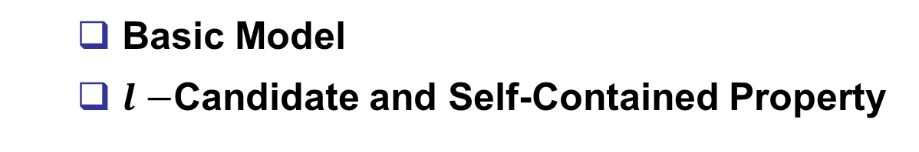
Agenda
Introduction
Model
  Basic Model
  $l−$Candidate and Self-Contained Property
Algorithms
Experimental Results
Conclusion

Slide 15
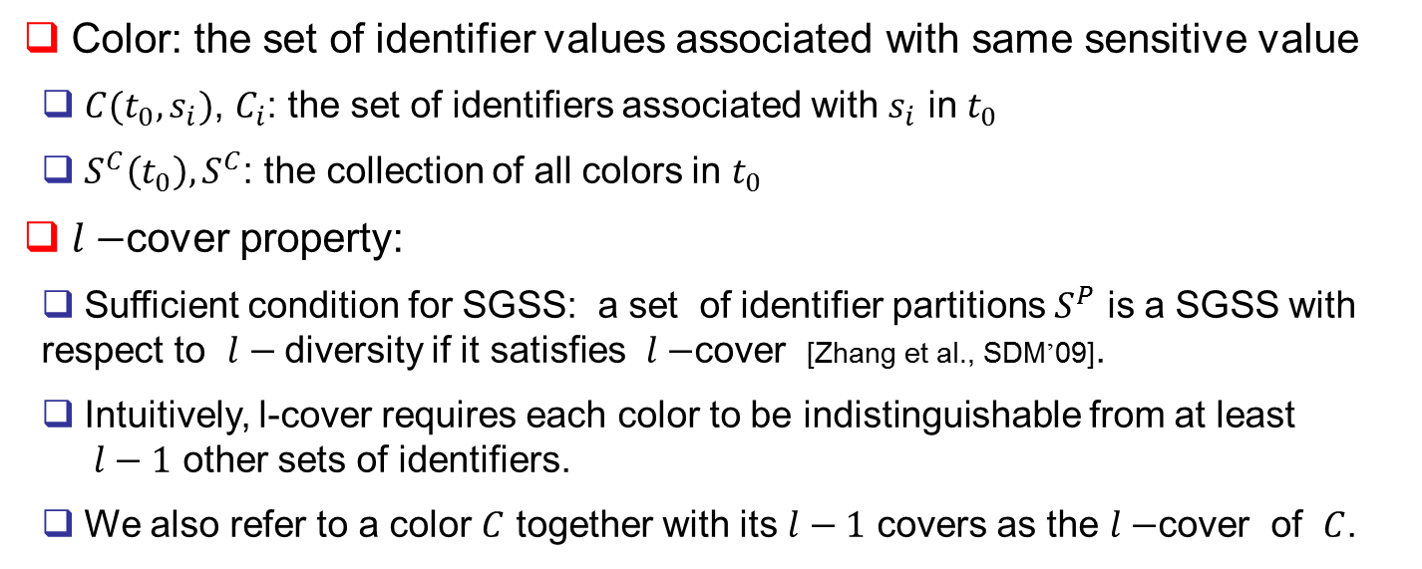
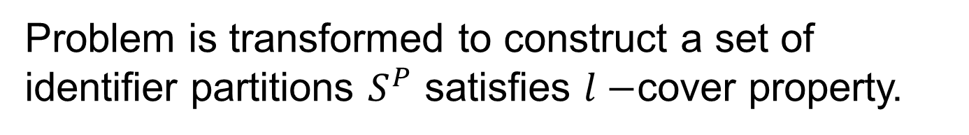
Basic Model
Color: the set of identifier values associated with same sensitive value
  $C(t_{0}, s_{i})$, $C_{i}$: the set of identifiers associated with $s_{i}$ in $t_{0}$
  $S^{C}\left(t_{0}\right), S^{C}$: the collection of all colors in $t_{0}$
$l−$cover property:
  Sufficient condition for SGSS: a set of identifier partitions $S^{P}$ is a SGSS with respect to $l−$diversity if it satisfies $l−$cover [Zhang et al., SDM’09].
  Intuitively, l-cover requires each color to be indistinguishable from at least
  $l−1$ other sets of identifiers.
  We also refer to a color $C$ together with its $l−1$ covers as the $l−$cover of $C$.
Problem is transformed to construct a set of identifier partitions $S^{P}$ satisfies $l−$cover property.

Slide 16



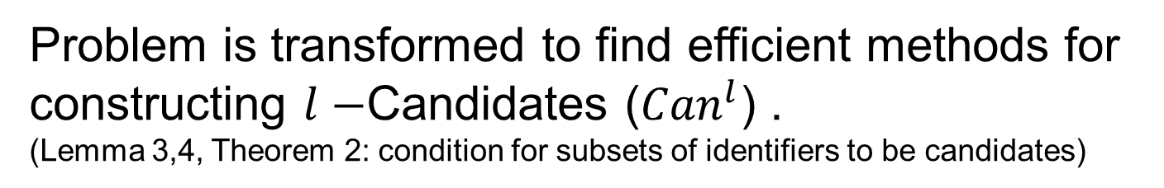
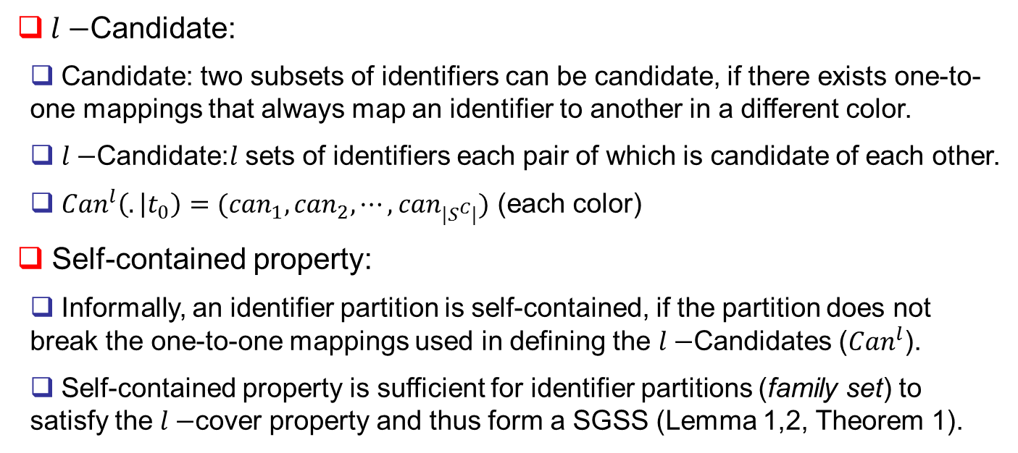
$l−$Candidate and Self-Contained Property
$l−$Candidate:
  Candidate: two subsets of identifiers can be candidate, if there exists one-to-one mappings that always map an identifier to another in a different color.
  $l−$Candidate:$l$ sets of identifiers each pair of which is candidate of each other.
  ${Can}^{l}\left(. | t_{0}\right)=({can}_{1},{can}_{2},⋯,{can}_{|S^{C}|})$ (each color)
Self-contained property:
  Informally, an identifier partition is self-contained, if the partition does not break the one-to-one mappings used in defining the $l−$Candidates (${Can}^{l}$).
  Self-contained property is sufficient for identifier partitions (family set) to satisfy the $l−$cover property and thus form a SGSS (Lemma 1,2, Theorem 1).
Problem is transformed to find efficient methods for constructing $l−$Candidates (${Can}^{l}$) .
(Lemma 3,4, Theorem 2: condition for subsets of identifiers to be candidates)
$l−$Candidates (${Can}^{l}$)
$$\underset{→}{self−contained property}$$
$l−$Cover property

Slide 17
Agenda
Introduction
Model
Algorithms
Experimental Results
Conclusion

Slide 18
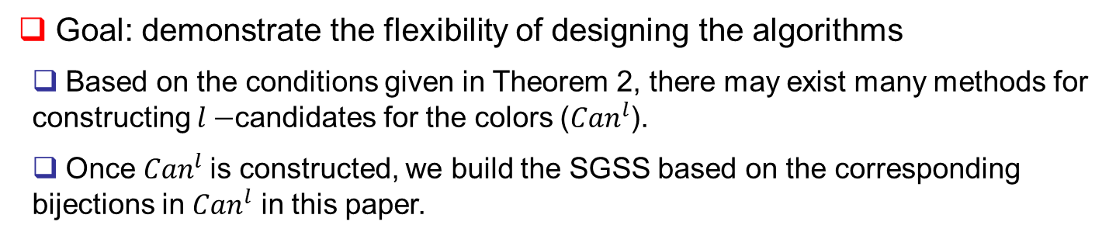
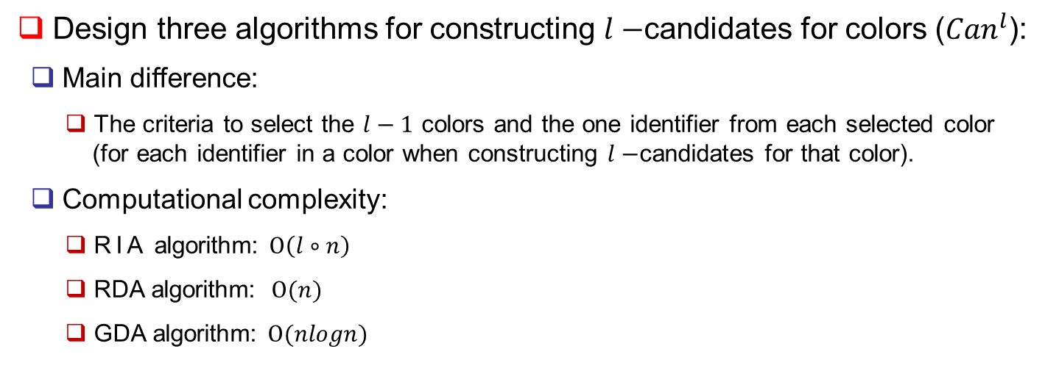
Overview of Algorithms
Goal: demonstrate the flexibility of designing the algorithms
  Based on the conditions given in Theorem 2, there may exist many methods for constructing $l−$candidates for the colors (${Can}^{l}$).
  Once ${Can}^{l}$is constructed, we build the SGSS based on the corresponding bijections in ${Can}^{l}$ in this paper.
Design three algorithms for constructing $l−$candidates for colors (${Can}^{l}$):
  Main difference:
  The criteria to select the $l−1$ colors and the one identifier from each selected color
  (for each identifier in a color when constructing $l−$candidates for that color).
  Computational complexity:
  RIA algorithm: $Ο\left(l∘n\right)$
  RDA algorithm: $Ο(n)$
  GDA algorithm: $Ο(nlogn)$

Slide 19
Agenda
Introduction
Model
Algorithms
Experimental Results
Conclusion

Slide 20
Experiment Settings
Real-world census datasets (http://ipums.org)
  600K tuples and 6 attributes:
  Age(79), Gender(2), Education(17), Birthplace(57), Occupation(50), Income(50).
  Two extracted data:
  OCC: Occupation
  SAL: Income
MBR (minimum bounding rectangle) function is adopted to generalize QI-values within same anonymized group once identifier partition is obtained.
Our experimental setting is similar to Xiao et al., TODS 10 [28], to compare our results to those reported there.

Slide 21
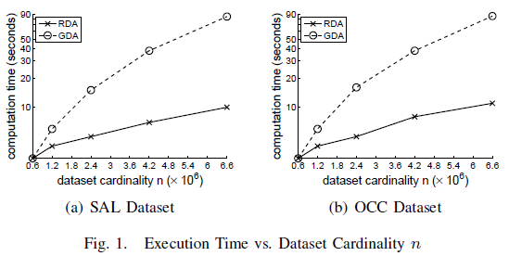
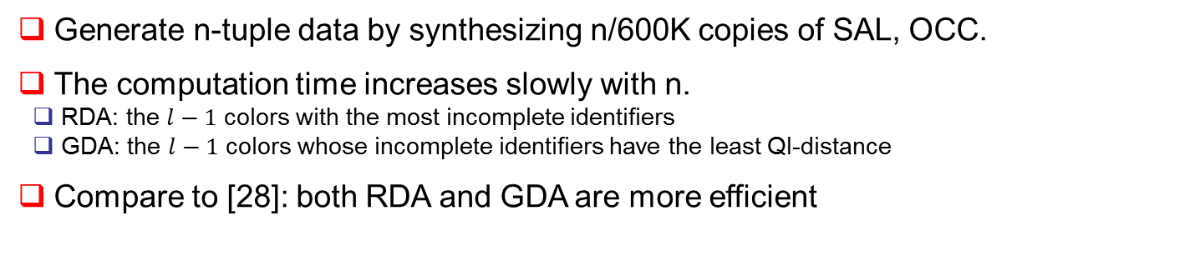
Execution Time
Generate n-tuple data by synthesizing n/600K copies of SAL, OCC.
The computation time increases slowly with n.
  RDA: the $l−1$ colors with the most incomplete identifiers
  GDA: the $l−1$ colors whose incomplete identifiers have the least QI-distance
Compare to [28]: both RDA and GDA are more efficient

Slide 22
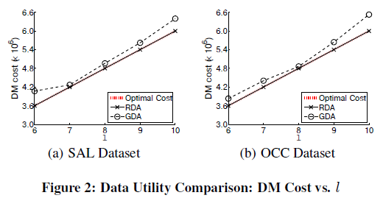
Data Utility – DM metric
DM metric - discernibility metric: each generalized tuple is assigned a cost (the number of tuples with identical quasi-identifier.
DM cost of RDA and GDA.
  RDA: very close to the optimal cost (RDA aims to minimize the size of each anonymized group)
  GDA: slightly higher than the optimal one (GDA attempt to minimize the QI-distance)
Compare to [28]: no result based on DM was reported in [28].

Slide 23
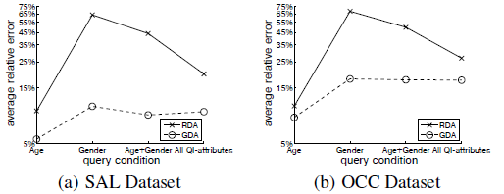
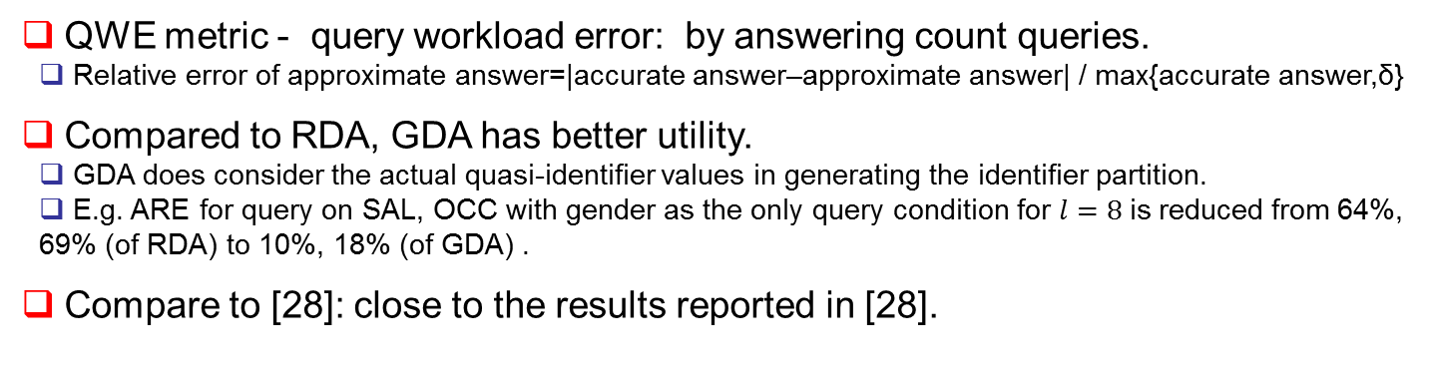
Data Utility – QWE
Figure 5: Data Utility Comparison: Query Accuracy vs. Query Condition (l=8)
QWE metric - query workload error: by answering count queries.
  Relative error of approximate answer=|accurate answer–approximate answer| / max{accurate answer,δ}
Compared to RDA, GDA has better utility.
  GDA does consider the actual quasi-identifier values in generating the identifier partition.
  E.g. ARE for query on SAL, OCC with gender as the only query condition for $l=8$is reduced from 64%, 69% (of RDA) to 10%, 18% (of GDA) .
Compare to [28]: close to the results reported in [28].

Slide 24
Agenda
Introduction
Model
Algorithms
Experimental Results
Conclusion

Slide 25
Conclusion
We have proposed a privacy streamliner approach for privacy-preserving applications.
  Instantiate this approach in the context of privacy-preserving micro-data release using public algorithms.
  Design three such algorithms
  Yield practical solutions by themselves;
  Reveal the possibilities for a large number of algorithms that can be designed for specific utility metrics and applications
  Our experiments with real datasets have proved our algorithms to be practical in terms of both efficiency and data utility.

Slide 26
Discussion and Future Work
Future Work:
Apply the proposed approach to other privacy properties and privacy-preserving applications.
Possible extensions:
  Focus on applying self-contained property on l-candidates to build sets of identifier partitions satisfying l-cover property, and hence to construct the SGSS.
  However, there may exist many other methods to construct SGSS …
The focus on syntactic privacy principles:
  The general approach of two-stage is not necessarily limited to such scope.

Slide 27
Q & A
Thank you!
Lingyu Wang and Wen Ming Liu (wang,l_wenmin@ciise.concordia.ca)

