Slide 1


Modeling Network Diversity for Evaluating the Robustness of Networks against Zero-Day Attacks
Lingyu Wang¹
Mengyuan Zhang¹, Sushil Jajodia², Anoop Singhal³, and Massimiliano Albanese²
¹ Concordia University, Canada
² George Mason University, USA
³ National Institute of Standards and Technology, USA
ESORICS 2014

Slide 2
Outline
Introduction
Modeling Network Diversity
  Biodiversity-Inspired Metric
  Least Attacking Effort-Based Metric
  Probabilistic Metric
Simulation
Conclusion
Notes:
I’ll first motivate our study, and summarize the limitations of related work.
I’ll then introduce some basic concepts such as attack graph.
I’ll describe our model in three stages: how to assign individual values using CVSS, how to compose them in a static case, how to compose them in dynamic case
I’ll discuss two case studies.

Slide 3
Outline
Introduction
Network Diversity Metrics
  Biodiversity-Inspired Metric
  Least Attacking Effort-Based Metric
  Probabilistic Metric
Simulation
Conclusion
Notes:
I’ll first motivate our study, and summarize the limitations of related work.
I’ll then introduce some basic concepts such as attack graph.
I’ll describe our model in three stages: how to assign individual values using CVSS, how to compose them in a static case, how to compose them in dynamic case
I’ll discuss two case studies.

Slide 4
Why Worry about Zero-Day Attacks?
A real threat to mission critical networks
Governments and cybercriminals alike are stockpiling zero-day bugs¹
  The NSA spent more than $25 million a year to acquire software vulnerabilities - Edward Snowden
  Private vendors provide at least 85 zero-day exploits on any given day of the year - Stefan Frei
  E.g., Stuxnet exploits 4 different/complementary zero day vulnerabilities to infiltrate a SCADA network
But what can we do about unknown attacks?
¹http://krebsonsecurity.com/2013/12/how-many-zero-days-hit-you-today/
Notes:
stockpiling: building a reserve of

Slide 5
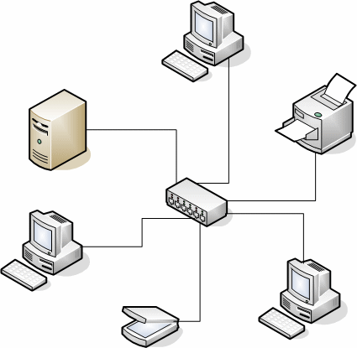







How Could Diversity Help?
Stuxnet’s attack strategy
  3rd party (e.g., contractor) → organization’s network → machine with Siemens Step 7 → PLC
The degree of software diversity along potential attack paths can be considered a good metric for the network’s capability of resisting Stuxnet
Notes:
Networks may contain residue vulnerabilities, the reason is as the following…
To deal with such residue vulnerabilities, there exist qualitative solutions, such as…

Slide 6
Existing Work on Diversity
Software diversity has long been regarded as a security mechanism for improving robustness
Tolerating attacks as Byzantine faults by comparing outputs or behaviors of diverse variants
Opportunistic or automatically generated diversity (e.g., via randomization) improves the practicality
Many new applications for diversity
  Moving target defense (MTD)
  Resisting worms in sensor networks
  Improving robustness of network routing
Notes:
Networks may contain residue vulnerabilities, the reason is as the following…
To deal with such residue vulnerabilities, there exist qualitative solutions, such as…

Slide 7
So Why Another Paper?
At a higher abstraction level, as a global property of an entire network, network diversity and its impact on security has not been formally modeled
  How to define the diversity metric function? count? how to count?
  How to apply the metric function? on the network as a multiset of resources? what about “paths”?
  On which path? On one or more paths?
It depends on the use cases...

Slide 8
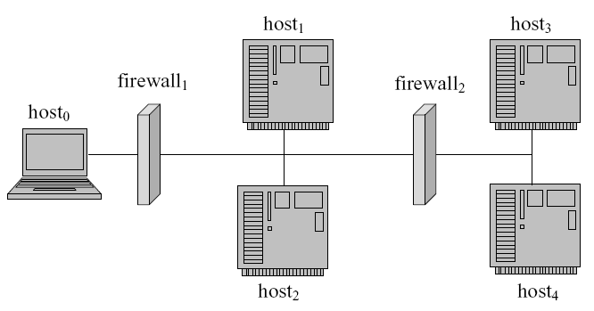




Example Use Cases
Intuitive notion of diversity can be misleading. A formal model is needed.
Different diversity metrics may be needed for different purposes.
Worm propagation
  Count might be sufficient
Targeted attack (e.g., on host₄)
  Least attack effort may not be sufficient
MTD
  The layers do not “combine” to increase attack effort

Slide 9
Our Contribution
We take the first step towards formally modeling network diversity as a security metric
  We propose a network diversity function based on well known mathematical models of biodiversity in ecology
  We design a network diversity metric based on the least attacking effort
  We design a probabilistic network diversity metric to reflect the average attacking effort
  We evaluate the metrics and algorithms through simulation
The modeling effort helps understanding diversity and enables quantitative hardening approaches
Notes:
CVSS measures the exploitability, with its temporal factors, of a vulnerability.
The interplay between vulnerabilities in a given network is not taken into account in CVSS.
The impact means the impact of an individual vulnerability, without considering the context.

Slide 10
Outline
Introduction
Network Diversity Metrics
  Biodiversity-Inspired Metric
  Least Attacking Effort-Based Metric
  Probabilistic Metric
Simulation
Conclusion
Notes:
I’ll first motivate our study, and summarize the limitations of related work.
I’ll then introduce some basic concepts such as attack graph.
I’ll describe our model in three stages: how to assign individual values using CVSS, how to compose them in a static case, how to compose them in dynamic case
I’ll discuss two case studies.

Slide 11
Bio-Diversity and Richness of Species
A rich literature exists on biodiversity
  Both theoretical studies and experiments confirm a positive relationship between biodiversity and the ecosystem’s resistance to invasion and diseases
  Many lessons may be borrowed, but we focus on metric functions and how they are applied
Richness of species
  The number of different species in an ecosystem
  Problem: It ignores the relative abundance of each species
Notes:
NIST has several efforts on security metric…
Dacier and others proposed to use Markov model and mean time to failure (MTTF) to measure security, but they do not consider realistic cases modeled by attack graphs.
Several previous approaches measure security using the minimum-efforts required by attackers, we have shown in last year’s QoP workshop that those approaches have their limitations.
Attack surface is for software security.
Pagerank assumes attacker moves in a random way, which is not necessarily the case.

Slide 12
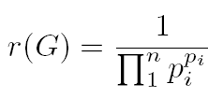
Effective Richness of Resources
Effective number¹
  Shannon-Wiener index (Shannon entropy using natural logarithm) groups systems with same levels of diversity
  The effective number, the exponential of this index, measures the number of equally-common species, even if in reality all species are not equally common.
  We define the effective richness of resources as:
    (p_{i} is the relative frequency of resource i)
  Problem: Assuming all resources are equally different
¹M.O. Hill. Diversity and evenness: a unifying notation and its consequences. Ecology, 54(2):427–432, 1973.
Notes:
1/((1/3)^(2/3)*(2/3)^(2/3)) = 2.72568088925

Slide 13


Similarity-Sensitive Effective Richness
Similarity-Sensitive Richness¹
  Given a resource similarity function z(.): [1;m] × [1;m] → [0; 1] (with z(i,i) = 1), we define the effective richness of resources as:
We can simply talk about “the number of distinct resource types” from now on, as if all resources are equally common and equally different
(
)
¹T. Leinster and C.A Cobbold. Measuring diversity: the importance of species similarity. Ecology, 93(3):477–489, 2012.
Notes:
1/((1/3)^(2/3)*(2/3)^(2/3)) = 2.72568088925

Slide 14
Outline
Introduction
Network Diversity Metrics
  Biodiversity-Inspired Metric
  Least Attacking Effort-Based Metric
  Probabilistic Metric
Simulation
Conclusion
Notes:
I’ll first motivate our study, and summarize the limitations of related work.
I’ll then introduce some basic concepts such as attack graph.
I’ll describe our model in three stages: how to assign individual values using CVSS, how to compose them in a static case, how to compose them in dynamic case
I’ll discuss two case studies.

Slide 15
From Food Web to Resource Graph
The second lesson from biodiversity
  The effect of biodiversity on stability of an ecosystem critically depends on the interaction of different species inside a food web¹
    For food web, it is the feeding relationship (e.g., disease in one species affect those who feed on it)
    For networks, it is the causal relationships (e.g., hacking one service may lead to accesses to others)
  Resource graph
    Syntactically equivalent to attack graph
    Models causal relationships between network resources (instead of known vulnerabilities)
¹K.S. McCann. The diversity-stability debate. Nature, 405:228–233, 2000.
Notes:
NIST has several efforts on security metric…
Dacier and others proposed to use Markov model and mean time to failure (MTTF) to measure security, but they do not consider realistic cases modeled by attack graphs.
Several previous approaches measure security using the minimum-efforts required by attackers, we have shown in last year’s QoP workshop that those approaches have their limitations.
Attack surface is for software security.
Pagerank assumes attacker moves in a random way, which is not necessarily the case.

Slide 16
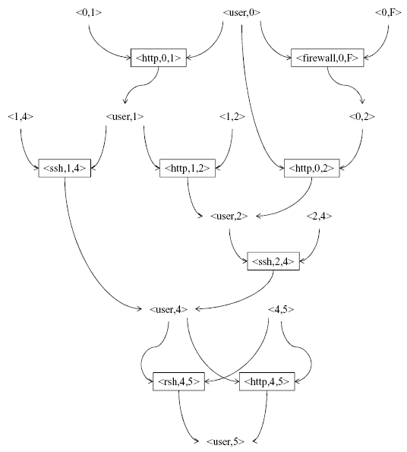
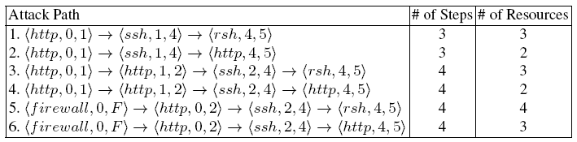
Resource Graph
Vertices: zero day exploits of resources, their pre- and post-conditions
Edges: AND between pre-conditions, OR between exploits
  On which path should we apply the diversity metric function (i.e., the number of distinct resource types)?
Notes:
NIST has several efforts on security metric…
Dacier and others proposed to use Markov model and mean time to failure (MTTF) to measure security, but they do not consider realistic cases modeled by attack graphs.
Several previous approaches measure security using the minimum-efforts required by attackers, we have shown in last year’s QoP workshop that those approaches have their limitations.
Attack surface is for software security.
Pagerank assumes attacker moves in a random way, which is not necessarily the case.

Slide 17
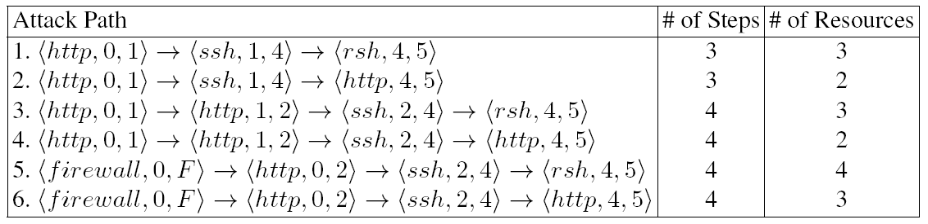
Selecting the Right Path(s)
Intuitively, it should be the “shortest” path
  1 or 2, minimum # of steps? But 4 may take less effort than 1!
  2 or 4, minimum # of resources? But they both have 2 resources, so which one to choose, 2 or 4?
  4, minimizing (#steps/#of resources)? But what if there’s a path with 9 steps and 3 resources? 1/3<2/4, but it clearly does not represent the least attack effort!
Notes:
NIST has several efforts on security metric…
Dacier and others proposed to use Markov model and mean time to failure (MTTF) to measure security, but they do not consider realistic cases modeled by attack graphs.
Several previous approaches measure security using the minimum-efforts required by attackers, we have shown in last year’s QoP workshop that those approaches have their limitations.
Attack surface is for software security.
Pagerank assumes attacker moves in a random way, which is not necessarily the case.

Slide 18
Network Diversity in Least Attack Effort
We define network diversity as:
  (minimum # of resources on any path)/(minimum # of steps on any path)
  Note: These may or may not be the same path! e.g., in this case: = 2 (path 2, 4) / 3 (path 1, 2)
  The numerator 2 denotes the network’s current level of diversity and the denominator 3 maximum potential (# of resources can never be greater than # of steps)
Notes:
NIST has several efforts on security metric…
Dacier and others proposed to use Markov model and mean time to failure (MTTF) to measure security, but they do not consider realistic cases modeled by attack graphs.
Several previous approaches measure security using the minimum-efforts required by attackers, we have shown in last year’s QoP workshop that those approaches have their limitations.
Attack surface is for software security.
Pagerank assumes attacker moves in a random way, which is not necessarily the case.

Slide 19
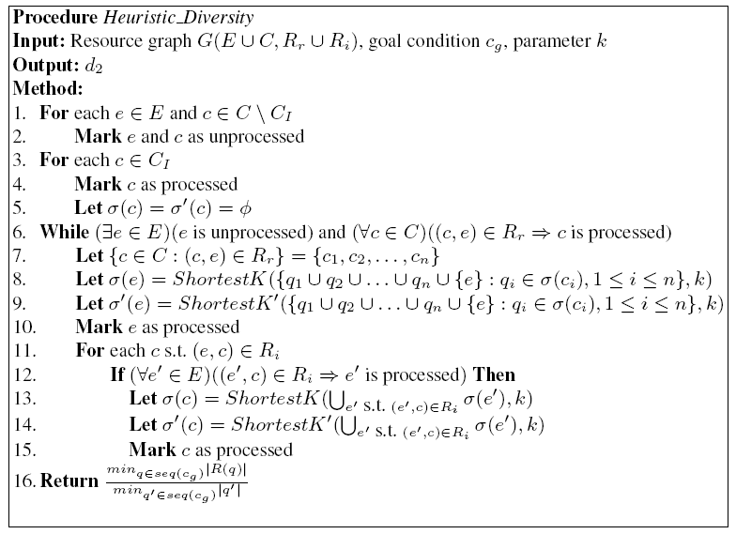
Complexity and Heuristic Algorithm
Determining the network diversity is NP-hard
Heuristic algorithm
  Only keep a
  limited number
  of local optima
  at each step
Notes:
NIST has several efforts on security metric…
Dacier and others proposed to use Markov model and mean time to failure (MTTF) to measure security, but they do not consider realistic cases modeled by attack graphs.
Several previous approaches measure security using the minimum-efforts required by attackers, we have shown in last year’s QoP workshop that those approaches have their limitations.
Attack surface is for software security.
Pagerank assumes attacker moves in a random way, which is not necessarily the case.

Slide 20
Outline
Introduction
Network Diversity Metrics
  Biodiversity-Inspired Metric
  Least Attacking Effort-Based Metric
  Probabilistic Metric
Simulation
Conclusion
Notes:
I’ll first motivate our study, and summarize the limitations of related work.
I’ll then introduce some basic concepts such as attack graph.
I’ll describe our model in three stages: how to assign individual values using CVSS, how to compose them in a static case, how to compose them in dynamic case
I’ll discuss two case studies.

Slide 21
Network Diversity in Average Effort
The least attacking effort-based metric only provides a partial picture of the threat
We now define a probabilistic network diversity metric based on the average attacking effort
Informally, as p₁/p₂, where
  p₁ is the probability an attacker can compromise the given asset now, and
  p₂ the probability he/she can still compromise it if all the resources were to be made different (i.e., every resource type would appear at most once)
Notes:
NIST has several efforts on security metric…
Dacier and others proposed to use Markov model and mean time to failure (MTTF) to measure security, but they do not consider realistic cases modeled by attack graphs.
Several previous approaches measure security using the minimum-efforts required by attackers, we have shown in last year’s QoP workshop that those approaches have their limitations.
Attack surface is for software security.
Pagerank assumes attacker moves in a random way, which is not necessarily the case.

Slide 22
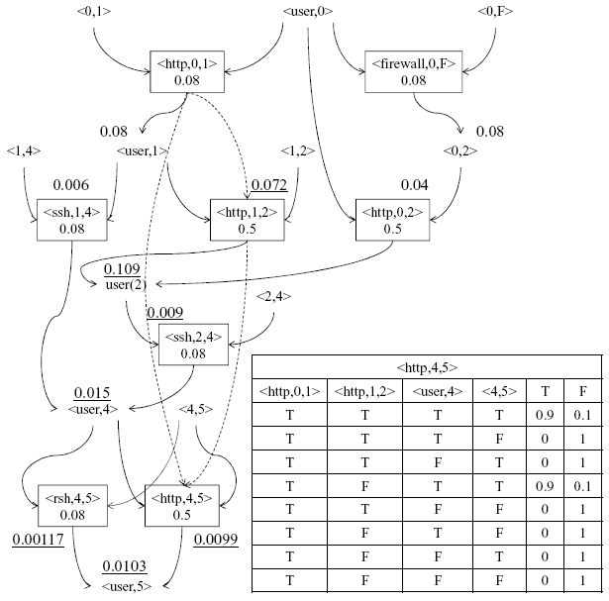
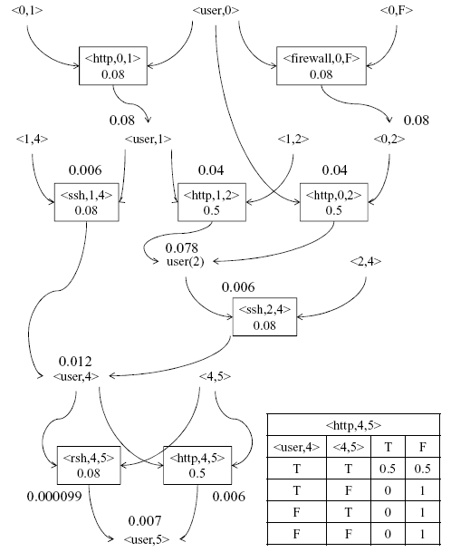
An Example
Number in smaller font: probability of an exploit given all pre-conditions are true
Number in larger font: probability of reaching this node
Dotted lines/ underlined numbers: given probabilities of reusing an exploit
Network diversity = 0.007/0.0103
Notes:
E union C are the nodes, Rr union Ri are the edges.
Vul is vulnerability name, source and dest are two hosts.
Rr and Ri are two relations that comprise the edges of attack graphs.

Slide 23
Outline
Introduction
Network Diversity Metrics
  Biodiversity-Inspired Metric
  Least Attacking Effort-Based Metric
  Probabilistic Metric
Simulation
Conclusion
Notes:
I’ll first motivate our study, and summarize the limitations of related work.
I’ll then introduce some basic concepts such as attack graph.
I’ll describe our model in three stages: how to assign individual values using CVSS, how to compose them in a static case, how to compose them in dynamic case
I’ll discuss two case studies.

Slide 24
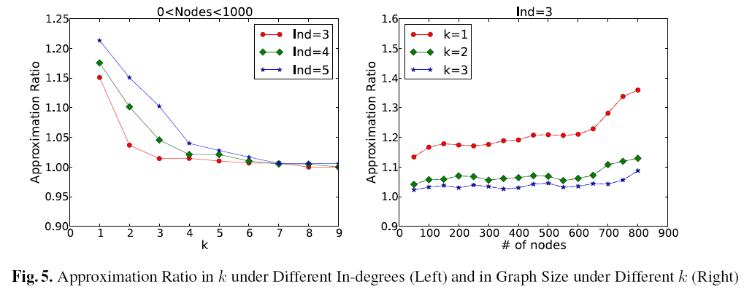
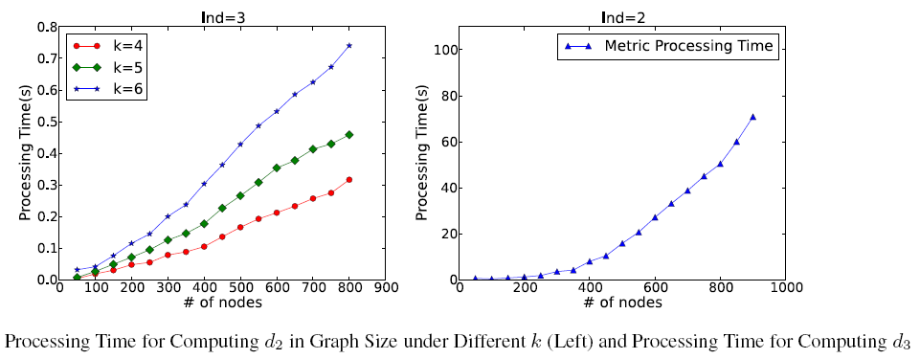
Simulation Results
Accuracy/performance of the heuristic algorithm

Slide 25
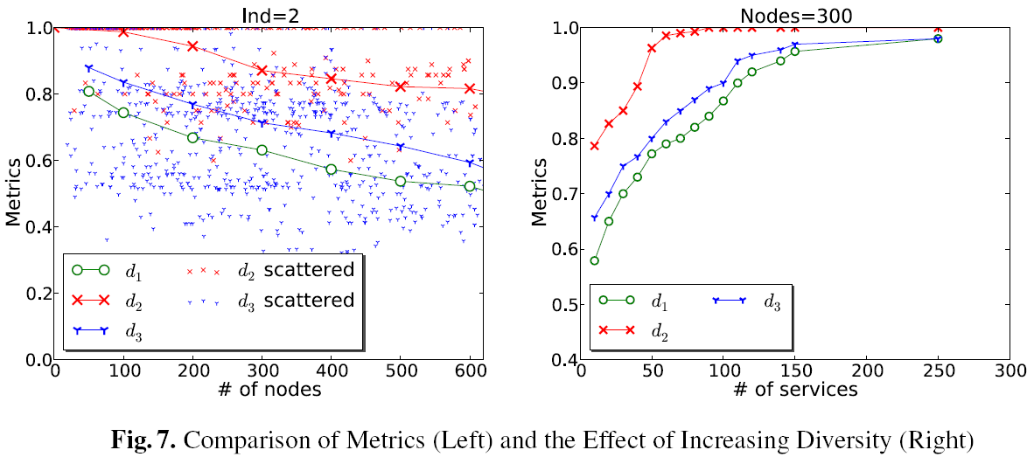
Simulation Results Cont’d
Comparison of the metrics

Slide 26
Outline
Introduction
Network Diversity Metrics
  Biodiversity-Inspired Metric
  Least Attacking Effort-Based Metric
  Probabilistic Metric
Simulation
Conclusion
Notes:
I’ll first motivate our study, and summarize the limitations of related work.
I’ll then introduce some basic concepts such as attack graph.
I’ll describe our model in three stages: how to assign individual values using CVSS, how to compose them in a static case, how to compose them in dynamic case
I’ll discuss two case studies.

Slide 27
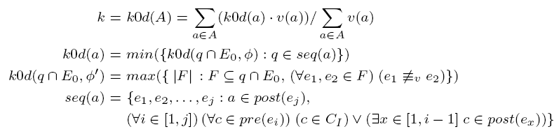
Conclusion
We have taken a first step towards modeling network diversity, by proposing
  a biodiversity-inspired metric
  a least attacking effort-based metric
  a probabilistic metric
Limitations and future work
  Depending on the availability and accuracy of inputs, e.g., resources, their relationships, and similarity
  Simulations are based on random inputs
  Not considering the cost and impact of diversity
  Not considering the likelihood of attacks on resources
  Future work will also apply other biodiversity results
We can unfold k based on the model
Notes:
NIST has several efforts on security metric…
Dacier and others proposed to use Markov model and mean time to failure (MTTF) to measure security, but they do not consider realistic cases modeled by attack graphs.
Several previous approaches measure security using the minimum-efforts required by attackers, we have shown in last year’s QoP workshop that those approaches have their limitations.
Attack surface is for software security.
Pagerank assumes attacker moves in a random way, which is not necessarily the case.

Slide 28
Q & A
Thank You!
Contact Author: Lingyu Wang (wang@ciise.concordia.ca)

