Slide 1
k-Indistinguishable Traffic Padding in Web-Based Applications
Presenter:
Wen Ming Liu (Concordia University)
Joint work with:
Lingyu Wang (Concordia University)
Kui Ren (Illinois Institute of Technology)
Pengsu Cheng (Concordia University)
Mourad Debbabi (Concordia University)
PETS 2012
CIISE@CU / ECE@IIT
July 12 , 2012

Slide 2
Agenda
Overview
The Model
PPTP Problems
The Algorithms
Evaluation
Extension
Conclusion

Slide 3
Agenda
Overview
  Web-based Application
  Side-Channel Attack
  Mapping: PPTP & PPDP
The Model
PPTP Problems
The Algorithms
Evaluation
Extension
Conclusion

Slide 4



Web-based Application
Internet
Client
Server
Encrypted Traffic
Advantages:
  Less client-side resources
  Easier to deliver and maintain
Characteristics:
  Low entropy inputs
  Rich & diverse resource objects
  Stateful communications

Slide 5

Side-Channel Attack
Example:
Internet
Size and directions of packets between users and search engine
Client
Encrypted Traffic
Server
Fixed pattern: identified input string
User Input | Observed Directional Packet Sizes
a: | 801→, | ←54, | ←509, | 60→
00: | 812→, | ←54, | ←505, | 60→,
 | 813→, | ←54, | ←507, | 60→
 | b-byte |  | s-byte
Indicator of input itself

Slide 6
Example (cont.) – Search Engine
S value for each character entered as:
  First keystroke:
  Second keystroke:
a | b | c | d | e | f | g
509 | 504 | 502 | 516 | 499 | 504 | 502
h | i | j | k | l | m | n
509 | 492 | 517 | 499 | 501 | 503 | 488
o | p | q | r | s | t
509 | 525 | 494 | 498 | 488 | 494
u | v | w | x | y | z
503 | 522 | 516 | 491 | 502 | 501
First Keystroke |  | Second Keystroke
 |  | a | b | c | d
a | 509 | 487 | 493 | 501 | 497
b | 504 | 516 | 488 | 482 | 481
c | 502 | 501 | 488 | 473 | 477
d | 516 | 543 | 478 | 509 | 499
In reality, it may take more than two keystrokes to uniquely identify an input string.
Unique s value
  16 out of 16
  12 out of 16
  Leak out users’ private information: the input string

Slide 7
Two Conflicting Goals
To prevent such side-channel attack, we face two seemingly conflicting goals,
  Privacy protection:
  Remove the difference of packet sizes
  Cost:
  Minimize the cost or overhead (padding, processing…)
  Trade-off:
  Between two objectives

Slide 8
Mapping PPTP to PPDP
S Value | Padding |  | (Prefix) char
 | Option 1 | Option 2
PPDP:
anonymized group
473 | 477 | 478 | (c) c
477 | 477 | 478 | (c) d
478 | 499 | 478 | (d) b
499 | 499 | 509 | (d) d
501 | 509 | 509 | (c) a
509 | 509 | 509 | (d) c
  Similarity:
PPTP goals:
  Privacy
  Cost
PPDP goals:
  Privacy
  Data utility
PPTP:
Padding group
Quasi-ID | Function 1 | Function 2 | Sensitive Attribute
 | Generalization
  Differences:
Data utility measures & padding cost
Effect of combing both keystrokes
  Equivalent to releasing multiple inter-dependent tables

Slide 9
Agenda
Overview
The Model
  Basic Model
  Privacy And Cost Model
  The SVMD and MVMD Cases
PPTP Problems
The Algorithms
Evaluation
Extension
Conclusion

Slide 10

PPTP Components - Interaction
User Input | Observed Directional Packet Sizes
a: | 801→, | ←54, | ←509, | 60→
00: | 812→, | ←54, | ←505, | 60→,
 | 813→, | ←54, | ←507, | 60→
Internet
Interaction:
  action a:
  Atomic user input that triggers traffic
  A keystroke, a mouse click …
  action-sequence a:
  A sequence of actions with known relationship
  Consecutive keystrokes, a serial of mouse clicks
  action-set A_{i}:
  A collection of all i^{th} action in a set of action-seq
Example 1:
  Three actions:
  a₁ = input ‘a’
  a₂ = input first ‘0’
  a₃ = input second ‘0’
  Two action-sequences:
  a₁ = (a)
  a₂ = (0,0)
  Two action-sets:
  A₁ = {a,0} (0 as first keystroke)
  A₂ = {0} (0 as second keystroke)

Slide 11
PPTP Components - Observation
User Input | Observed Directional Packet Sizes
a: | 801→, | ←54, | ←509, | 60→
00: | 812→, | ←54, | ←505, | 60→,
 | 813→, | ←54, | ←507, | 60→
Internet
Observation:
  flow-vector v:
  A sequence of flows (flow: a directional packet size)
  Correspond to an action
  vector-sequence v:
  A sequence of flow-vectors
  Correspond to an equal-length action-sequence
  vector-set V_{i}:
  A collection of all i^{th} flow-vectors in a set of vector-seq
  Correspond to an action-set
Example 2:
  Three flow-vectors:
  v₁ = (509)
  v₂ = (505)
  v₃ = (507)
  Two vector-sequences:
  v₁ = (v₁)
  v₂ = (v₂, v₃)
  Two vector-sets:
  V₁ = {(509),(505)}
  V₂ = {(507)}

Slide 12
PPTP Components - Joint Information
User Input | Observed Directional Packet Sizes
a: | 801→, | ←54, | ←509, | 60→
00: | 812→, | ←54, | ←505, | 60→,
 | 813→, | ←54, | ←507, | 60→
Internet
Interaction:
  action-set A_{i}:
  A₁={a,0} (0 as first keystroke)
Observation:
  vector-set V_{i}:
  V₁={509,505}
Vector-Action Set VA_{i}:
  Given action-set A_{i} and corresponding vector-set V_{i,} a vector-action set VA_{i} as the set {(v,a):v ∈ V_{i} ∧ a ∈ A_{i} }
  VA₁={(509,a),(505,0)} (0 as first keystroke)

Slide 13
Agenda
Overview
The Model
  Basic Model
  Privacy And Cost Model
  The SVMD and MVMD Cases
PPTP Problems
The Algorithms
Evaluation
Extension
Conclusion

Slide 14
Privacy and Cost
SVSD case (Single-Vector Single-Dimension):
  Every action-sequence and flow-vector are of length one.
  Assume: all actions are independent and each action triggers only a single packet used to identify the action.
Goal of privacy protection:
  Upon observing any flow-vector in the traffic, the eavesdropper cannot determine which action in the table (vector-action set) has triggered this flow-vector.
Flow-Vector v (Flow s) | Action a
s₁ | a₁
s₂ | a₂
… | …
s_{n} | a_{n}
Quasi-ID | Sensitive Attribute
k-indistinguishability: Given a vector-action set VA
  Padding group :
  any S⊆VA satisfying all the pairs in S have identical flow-vectors and no S’ ⊃S can satisfy this property
  We say VA satisfies k-indistinguishability (k is an integer) if the cardinality of every padding group is no less than k
  The sensitive values (actions) are always unique: l-diversity in the simplest form
  General form of l-diversity; differential privacy

Slide 15
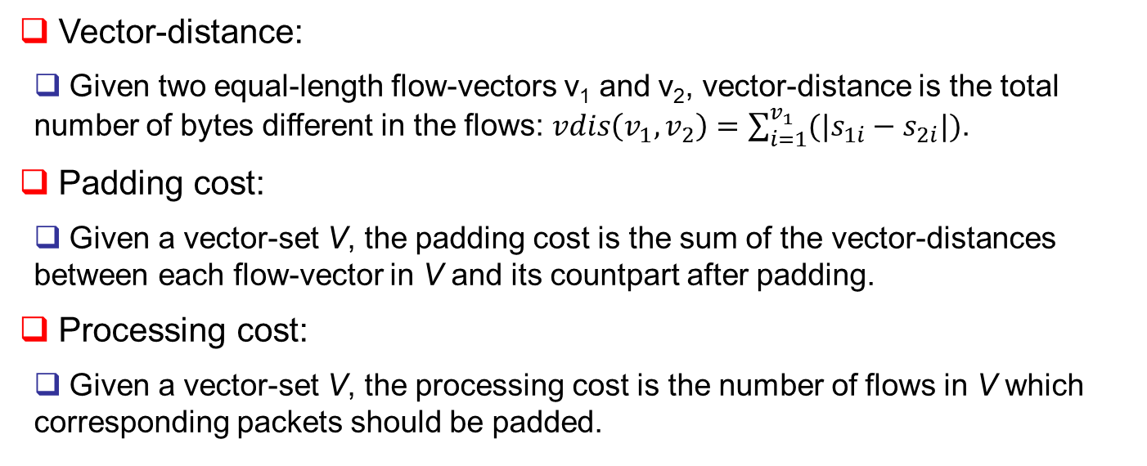
Privacy and Cost
Vector-distance:
  Given two equal-length flow-vectors v₁ and v₂, vector-distance is the total number of bytes different in the flows: $vdis\left(v_{1},v_{2}\right)=\sum_{i=1}^{v_{1}}{({|s}_{1i}−s_{2i}|)}$.
Padding cost:
  Given a vector-set V, the padding cost is the sum of the vector-distances between each flow-vector in V and its countpart after padding.
Processing cost:
  Given a vector-set V, the processing cost is the number of flows in V which corresponding packets should be padded.

Slide 16
Agenda
Overview
The Model
  Basic Model
  Privacy And Cost Model
  The SVMD and MVMD Cases
PPTP Problems
The Algorithms
Evaluation
Extension
Conclusion

Slide 17
SVMD Case
Single-Vector Multi-Dimension (SVMD):
  Each flow-vector includes more than one flows;
  Each action-sequence is still composed of a single action.
  The vector-action set is mapped to a relational table with multiple quasi-identifier attributes.
Note:
  Flow-vectors can form a padding group only if they are identical with respect to each flow inside the vectors.
  The model of vector-action set requires all the flow-vectors to have the same number of flows.
Flow-Vector v | Action a
v₁=s₁₁, s₁₂,…,s_{1n} | a₁
v₂=s₂₁, s₂₂,…,s_{2n} | a₂
… | …
v_{m}=s_{m1}, s_{m2},…,s_{mn} | a_{m}
Quasi-IDs | Sensitive Attribute

Slide 18
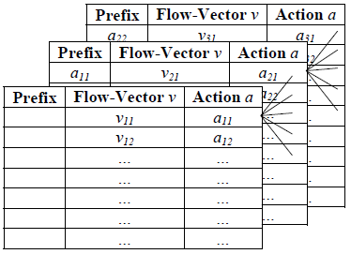
MVMD Case
Multi-Vector Multi-Dimension (MVMD):
  Each flow-vector includes more than one flows;
  Each action-sequence is composed of more than one actions.
Note:
  Multiple actions are related to each other and such relationship may help an eavesdropper to combine multiple observations.
Relationship between actions in an action-sequence
  i-prefix of action-sequence:
  The i-prefix of an action-sequence a=(a₁, a₂,…, a_{t}) is the sequence (a₁, a₂,…, a_{i}) (i ∈ [1,t])
  a_{i-1} is the adjacent-prefix (prefix) of a_{i} (i ∈ [2,t])
  i-prefix of vector-sequence:
  The i-prefix of an vector-sequence v=(v₁, v₂,…, v_{t}) is the sequence (v₁, v₂,…, v_{i}) (i ∈ [1,t])
  v_{i-1} is the adjacent-prefix (prefix) of v_{i} (i ∈ [2,t])

Slide 19
MVMD Case (cont.)
Vector-action set (MVMD case):
  Given n action-sets {A_{i}:1 ≤ i ≤n} and the corresponding vector-sets {V_{i}:1≤ i ≤n}, the vector-action set VA is the collection of sets :
  {{(v , a) : v ∈ V_{i} ˄ a ∈ A_{i} }: 1≤ i ≤n}
Note:
  The vector-action set is mapped to a sequence of relational tables in which the i^{th} table corresponds to the action-set A_{i} and the i^{th} vector-set V_{i} .
  Then each (V_{i} , A_{i}) pair is mapped to the corresponding table in the similar way as shown in SVMD case.

Slide 20
Agenda
Overview
The Model
PPTP Problems
  Padding Method
  The SVSD and SVMD Cases
  MVMD Problem
The Algorithms
Evaluation
Extension
Conclusion

Slide 21
Ceiling Padding
In formulating PPTP problems, we need to address two aspects:
  Protect user’s privacy by forming padding groups to satisfy k-indistinguishability;
  Minimize padding cost in achieving such privacy protection.
A large rounding size does not necessarily lead to more privacy.
  Example:
  ∆=128: 5-anonymity;
  ∆=512: 5-anonymity;
  ∆=520: 2-anonymity.
a | b | c | d | e | f | g
509 | 504 | 502 | 516 | 499 | 504 | 502
h | i | j | k | l | m | n
509 | 492 | 517 | 499 | 501 | 503 | 488
o | p | q | r | s | t
509 | 525 | 494 | 498 | 488 | 494
u | v | w | x | y | z
503 | 522 | 516 | 491 | 502 | 501

Slide 22
Ceiling Padding (cont.)
PPDP techniques can potentially applied to PPTP problems due to the mapping established.
Generalization.
  Grouping and breaking:
  Unique aspect:
  Padding can only increase packet size but cannot
  decrease it or replace it with a range of values.
Dominant-vector:
  Given a vector-set V, the dominant-vector is the flow-vector in which every flow is no smaller than the corresponding flow of any vector in V .
Ceiling padding:
  Given a vector-set V, a ceiling-padded group in V is a padding group which each flow-vector is padded to the dominant-vector.
  V is ceiling-padded if all the padding groups are ceiling padded.
Ceiling Padding:
Partition a vector-action set into padding groups, and then pad the flow-vectors to the dominant value to render them indistinguishable.

Slide 23
Agenda
Overview
The Model
PPTP Problems
  Padding Method
  The SVSD and SVMD Cases
  MVMD Problem
The Algorithms
Evaluation
Extension
Conclusion

Slide 24
The SVSD and SVMD Cases
SVSD problem:
Given a vector-action set VA and the corresponding vector set V and action set A, the privacy property k≤|V|, find a partition P^{VA} on VA such that the corresponding partition on V, denoted as P^{V} = {P1, P2, …, Pm}, satisfies:
- ∀ (i∈[1,m]), |P_{i}| ≥ k;
- ∑(dom(P_{i}) ᵡ|P_{i}|) is minimal.
SVMD problem:
  P^{V} = {P1, P2, …, Pm}, satisfies:
  - ∀ (i∈[1,m]), |P_{i}| ≥ k;
  - ∑_{i∈[1,m]} ( ∑_{j∈[1,np]} (dom(P_{i})[j]) ᵡ|P_{i}|) is minimal.
  Theorem shows that SVMD problem is intractable (reduction to EPIT).
  SVMD problem is NP-complete when k=3 and the flow-vectors are from any binary alphabet.
  SMVD vs. k-means clustering

Slide 25
Agenda
Overview
The Model
PPTP Problems
  Padding Method
  The SVSD and SVMD Cases
  MVMD Problem
The Algorithms
Evaluation
Extension
Conclusion

Slide 26
The MVMD Problem
The challenges when correlating flow-vectors in vector-sequence:
  Example:
First Keystroke |  | Second Keystroke
 |  | c₁ | c₂ | c₃ | c₄
c₁ |  | 10 | 20 | 80 | 50
c₂ |  | 40 | 70 | 30 | 60
c₃ |  | 65 | 15 | 45 | 75
c₄ |  | 35 | 55 | 85 | 25
First Keystroke |  | Second Keystroke
 |  | c₁ | c₂ | c₃ | c₄
c₁ |  | 10 | 20 | 80 | 50
c₂ |  | 40 | 70 | 30 | 60
c₃ |  | 65 | 15 | 45 | 75
c₄ |  | 35 | 55 | 85 | 25
First Keystroke |  | Second Keystroke
 |  | c₁ | c₂ | c₃ | c₄
c₁ |  | 15 | 25 | 85 | 55
c₂ |  | 45 | 75 | 35 | 65
c₃ |  | 65 | 15 | 45 | 75
c₄ |  | 35 | 55 | 85 | 25
First Keystroke |  | Second Keystroke
 |  | c₁ | c₂ | c₃ | c₄
c₁ | 5 | 15 | 25 | 85 | 55
c₂ | 10 | 45 | 75 | 35 | 65
c₃ | 15 | 65 | 15 | 45 | 75
c₄ | 20 | 35 | 55 | 85 | 25
First Keystroke |  | Second Keystroke
 |  | c₁ | c₂ | c₃ | c₄
c₁ | 10 | 15 | 25 | 85 | 55
c₂ | 10 | 45 | 75 | 35 | 65
c₃ | 20 | 65 | 15 | 45 | 75
c₄ | 20 | 35 | 55 | 85 | 25
strings | S₁ (1st) | S₁ (2nd)
c₁c₂ | 5 | 20
c₂c₃ | 10 | 30
c₁c₃ | 5 | 80
c₃c₄ | 15 | 75
… | … | …
  One seemingly valid solution:
  Pad the flow-vector for each keystroke so that 2-indistinguishability is satisfied separately for each keystroke.
  Another seemingly valid solution:
First collect all vector-sequences for the sequence of keystrokes and then pad them such that the input string as a whole cannot be distinguished from at least k -1 others.

Slide 27
The MVMD Problem (cont.)
Main reason: pad vector-sets independently.
Our approach:
  Oriented-forest partition: the padding of different vector-sets is correlated based on the following two conditions:
  Given two t-sized vector-sequences v1 and v2, any prefix pre(v1, i) and pre(v2, i)(i ∈[2,t]), can be padded together only if ∀(j < i), pre(v1, j) and pre(v2, j) are padded together.
  For any two t-sized action-sequences a1 and a2, and corresponding vector-sequences v1 and v2, if pre(a1, i)= pre(a2, i)(i ∈[1,t]), then pre(v1, j) and pre(v2, j) must be padded together.
MVMD problem:
Given VA=(VA1,VA2,…, VAt) where VAi=(Vi,Ai), the privacy property k≤|Vt|, find a partition P^{VAi} on VAi such that P^{Vi} = {P^{i}1, P^{i}2, …, P^{i}mi}, satisfies:
∀ (j∈[1,mi]), |P^{i}_{j}| ≥ k;
The sequence of P^{Vi} is an oriented-forest partition;
The total padding cost is minimal.

Slide 28
Agenda
Overview
The Model
PPTP Problems
The Algorithms
  The svsdSimple Algorithm
  The svmdGreedy Algorithm
  The mvmdGreedy Algorithm
Evaluation
Extension
Conclusion

Slide 29
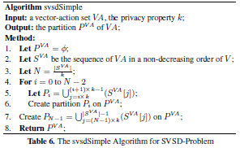
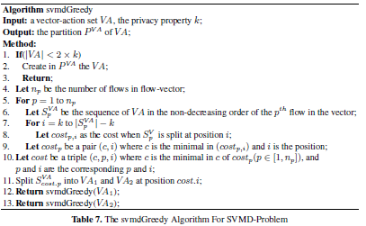
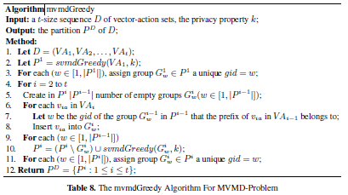
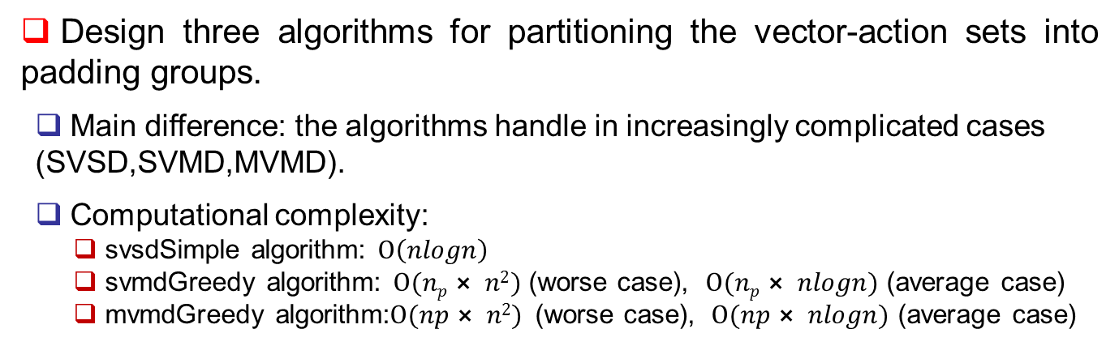
Overview of Algorithms
Intention:
  To demonstrate the existence of abundant possibilities in approaching PPTP issue, and not to design an exhaustive list of solutions.
Design three algorithms for partitioning the vector-action sets into padding groups.
  Main difference: the algorithms handle in increasingly complicated cases (SVSD,SVMD,MVMD).
  Computational complexity:
  svsdSimple algorithm: $Ο\left(nlogn\right)$
  svmdGreedy algorithm: $Ο(np⨯ n2)$ (worse case), $Ο(np⨯ nlogn)$ (average case)
  mvmdGreedy algorithm:$Ο(np⨯ n2)$ (worse case), $Ο(np⨯ nlogn)$ (average case)

Slide 30
Agenda
Overview
The Model
PPTP Problems
The Algorithms
Evaluation
Extension
Conclusion

Slide 31
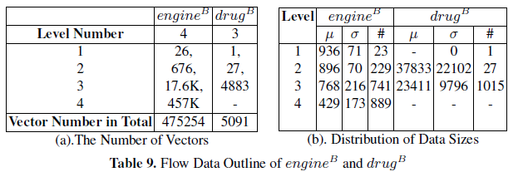
Experiment Settings
Collect testing vector-action sets from two real-world web applications:
  A popular search engine (where users’ search keyword needs to be protected)
  Collect flow-vectors for query suggestion widget for all possible combinations of four letters by crafting requests to simulate the normal AJAX connection request.
  An authoritative drug information system (user’s possible health information)
  Collect vector-action set for all the drug information by mouse-selecting following the application’s three-level tree-hierarchical navigation.
Note that the size information collected may have integrally shifted from the original one. However, such information is sufficient and reasonable for our experimental evaluation.
The flows of drug^{B} are more diverse, large, and disparate than those of engine^{B}.

Slide 32
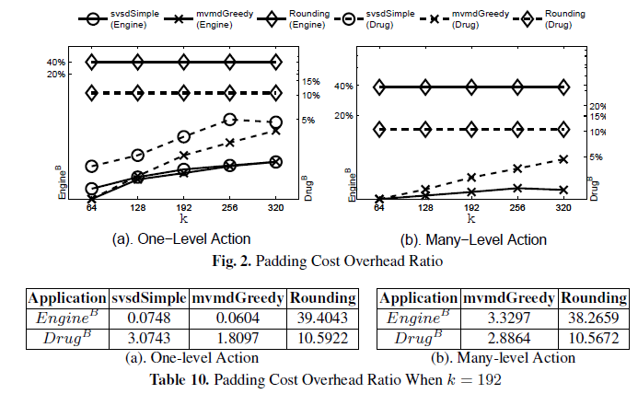
Overhead - Padding Cost
The padding cost against k:
  To compare to rounding, Δ=512 (engine^{B}) and Δ=5120 (drug^{B}) which achieves only 5-indistinguishility.
  Our algorithms have less padding cost in both cases, while incur significantly less in one-level case.
  Observe that our algorithms are superior specially when the number of flow-vectors is larger.
MvmdGreedy one-level vs. many-level:
  In many-level case, it first partitions VAs based on the prefix of actions and regardless of the values of the flow-vectors.

Slide 33
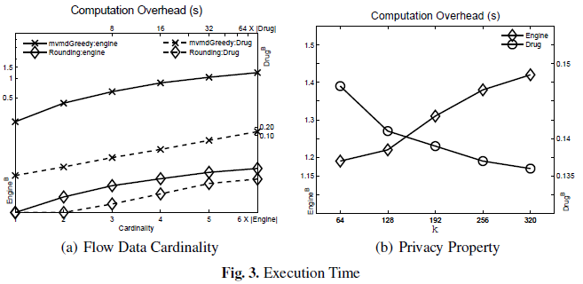
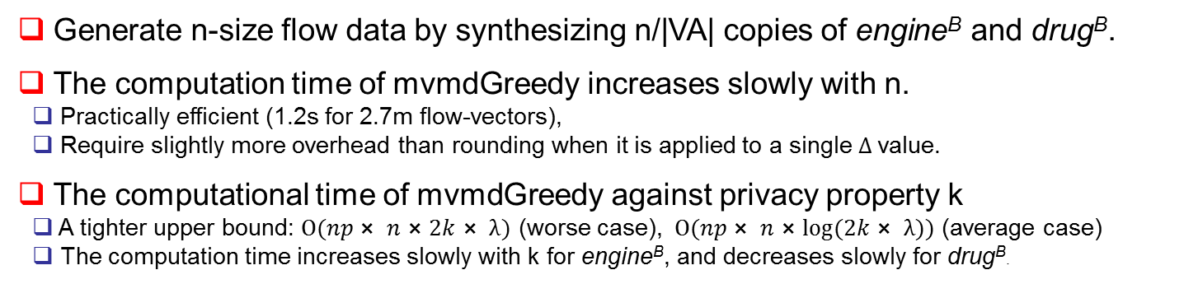
Overhead – Execution Time
Generate n-size flow data by synthesizing n/|VA| copies of engine^{B} and drug^{B}.
The computation time of mvmdGreedy increases slowly with n.
  Practically efficient (1.2s for 2.7m flow-vectors),
  Require slightly more overhead than rounding when it is applied to a single Δ value.
The computational time of mvmdGreedy against privacy property k
  A tighter upper bound: $Ο(np⨯ n⨯2k⨯ λ)$ (worse case), $Ο(np⨯ n⨯log⁡(2k⨯ λ))$ (average case)
  The computation time increases slowly with k for engine^{B}, and decreases slowly for drug^{B}.

Slide 34
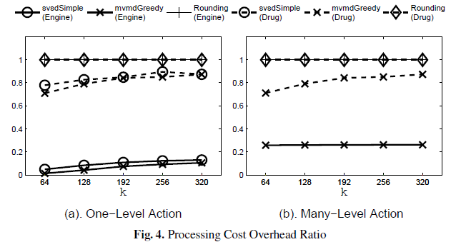
Overhead – Processing Cost
An application can choose to incorporate the padding at different stage of processing a request, however, we must minimize the number of packets to be padded.
  Pad the flow-vectors on the fly,
  Modify the original data beforehand.
The processing cost against k:
  Rounding must pad each flow-vector regardless of the k’s and the applications, while our algorithms have much less cost for engine^{B} and slightly less for drug^{B}.

Slide 35
Agenda
Overview
The Model
PPTP Problems
The Algorithms
Evaluation
Extension
Conclusion

Slide 36
Extension and Discussion
Adapt l-diversity to address cases that no all actions should be treated equally in padding:
  Assign an integer weight to each action to represent the possibility it will be performed.
  Apply l-diversity to quantify the privacy:
  For each padding group, the summation of weights corresponding to the actions in the group should be at least l times of the maximum weight value in that group.
  Reformulate the PPTP MVMD problem to satisfy l-diversity instead:
  Diversity problem is at least as hard as k-indistinguishable MVMD problem.
  Different from l-diversity in PPDP:
  In PPDP, many tuples may have same sensitive values,
  In PPTP, action is unique and a weight is assigned for each action to distinguish its possibility to be performed from others.

Slide 37
Extension and Discussion
Three steps to incorporate our techniques into Web applications:
  Gather information: action-sequences and corresponding vector-sequences;
  Feed the vector-action sets into our algorithms to calculate the paddings;
  Implement the padding according to the calculated sizes.
It is practical to gather information about action-sequences:
  The aforementioned side-channel attack typically arises due to highly interactive features of web applications. The application designer should have already profiled the domain of possible inputs.
  Even an application may take infinite number of inputs, this does not necessarily mean there would be infinite action-sequences.
  All the three steps are part of the off-line processing.

Slide 38
Agenda
Overview
The Model
PPTP Problems
The Algorithms
Evaluation
Extension
Conclusion

Slide 39
Conclusion and Future Work
We have established an interesting connection between the privacy-preserving traffic padding (PPTP) issue of web applications and the well-studied issue of privacy-preserving data publishing (PPDP).
  Propose a formal model for quantifying the amount of privacy protection provided by traffic padding solutions.
  Formulate the problems under different scenarios;
  Design three efficient heuristic algorithms;
  Confirm the performance of our solutions to be superior to existing solutions through experiment with real-world applications.
Future work:
  Apply different privacy model: such as, differential privacy.
  Investigate padding approaches for frequently updated vector-action sets.

Slide 40
Thank you!

Slide 41
Confidentiality V.S. Privacy
Encryption is to hide 'what it is', while padding hides 'which it is'. Padding does not replace encryption; padding works only when encryption does not. In web applications, there are situations where encryption cannot hide users' inputs, e.g., when attackers already know the user has selected one of several menu items. In this case, we cannot hide 'what it is' because attackers already know it; however, we can still hide 'which it is' by padding.

