Slide 1
Aggregating CVSS Base Scores for
Semantics-Rich Network Security Metrics
Lingyu Wang¹
Pengsu Cheng¹, Sushil Jajodia², Anoop Singhal³
¹ Concordia University
² George Mason University
³ National Institute of Standards and Technology
SRDS 2012

Slide 2
Outline
Introduction
Related Work
Base Metric-Level Aggregation
Three Aspects of CVSS Scores
Simulation
Conclusion
Notes:
I’ll first motivate our study, and summarize the limitations of related work.
I’ll then introduce some basic concepts such as attack graph.
I’ll describe our model in three stages: how to assign individual values using CVSS, how to compose them in a static case, how to compose them in dynamic case
I’ll discuss two case studies.

Slide 3
Outline
Introduction
Related Work
Base Metric-Level Aggregation
Three Aspects of CVSS Scores
Simulation
Conclusion
Notes:
I’ll first motivate our study, and summarize the limitations of related work.
I’ll then introduce some basic concepts such as attack graph.
I’ll describe our model in three stages: how to assign individual values using CVSS, how to compose them in a static case, how to compose them in dynamic case
I’ll discuss two case studies.

Slide 4
The Need for Security Metric
… …
Boss, we really need this new
firewall, it will make our network
much more secure!
“Much more secure”?
How much more?
“You cannot improve what you cannot measure”
  To justify the cost of a security solution, we need to know how much more security can be brought by that solution
  A security metric will allow for a direct measurement of security before, and after deploying the solution
  Such a capability will make network hardening a science rather than an art
Notes:
Networks may contain residue vulnerabilities, the reason is as the following…
To deal with such residue vulnerabilities, there exist qualitative solutions, such as…

Slide 5
Can Security Be Measured?
We take a vulnerability-centric approach
The Common Vulnerability Scoring System (CVSS)¹
  Numerical scores measuring the relative exploitability, likelihood, and impact of vulnerabilities
  A widely adopted standard with readily available scores in public vulnerability databases (e.g., NVD²)
  Provides a practical foundation for security metrics
However, CVSS measures individual vulnerabilities
  How do we aggregate different CVSS scores in a given network in order to measure its overall security?
¹ Common Vulnerability Scoring System (CVSS-SIG) v2, http://www.first.org/cvss/
² National vulnerability database, http://www.nvd.org

Slide 6

Aggregating CVSS Scores
user(0)
user(0)
ftp_rhosts(0,1)
ftp_rhosts(0,1)
0.8
trust(0,1)
trust(0,1)
sshd_bof
sshd_bof(0,1)
sshd_bof(0,1)
0.1
rsh(0,1)
rsh(0,1)
0.9
user(1)
user(1)
ftp_rhost
ftp_rhosts(0,2)
ftp_rhosts(1,2)
ftp_rhosts(0,2)
0.8
ftp_rhosts(1,2)
0.8
trust(0,2)
trust(1,2)
rsh
trust(0,2)
trust(1,2)
rsh(0,2)
rsh(1,2)
rsh(0,2)
0.9
rsh(1,2)
0.9
local_bof
user(2)
user(2)
local_bof(2,2)
local_bof(2,2)
0.1
0.78
root(2)
root(2)

Slide 7
Our Contributions
Existing approaches cause the loss of useful semantics during the aggregation
  Vulnerabilities’ dependency relationship is either ignored or handled in an arbitrary way
  Only consider one semantics aspect, attack probability
We propose solutions to remove those limitations
  We aggregate CVSS scores with which the dependency relationship has a clear semantics
  We consider one aspects, probability, effort, and skill, and show how the aggregation works under each
  We show simulation results
base metrics
three

Slide 8
Outline
Introduction
Related Work
Base Metric-Level Aggregation
Three Aspects of CVSS Scores
Simulation
Conclusion
Notes:
I’ll first motivate our study, and summarize the limitations of related work.
I’ll then introduce some basic concepts such as attack graph.
I’ll describe our model in three stages: how to assign individual values using CVSS, how to compose them in a static case, how to compose them in dynamic case
I’ll discuss two case studies.

Slide 9
Related Work
Efforts on standardizing security metric
  CVSS by NIST
  CWSS by MITRE
Efforts on measuring vulnerabilities
  Minimum-effort approaches (Balzarotti et al., QoP’05 and Pamula et al., QoP’06)
  PageRank approach (Mehta et al., RAID’06)
  MTTF-based approach (Leversage et al., SP’08)
  Attack surface (Manadhata et al., TSE’11)
  Our previous work (DBSec’07-08, QoP’07-08, ESORICS’10)
Notes:
NIST has several efforts on security metric…
Dacier and others proposed to use Markov model and mean time to failure (MTTF) to measure security, but they do not consider realistic cases modeled by attack graphs.
Several previous approaches measure security using the minimum-efforts required by attackers, we have shown in last year’s QoP workshop that those approaches have their limitations.
Attack surface is for software security.
Pagerank assumes attacker moves in a random way, which is not necessarily the case.

Slide 10
Outline
Introduction
Related Work
Base Metric-Level Aggregation
Three Aspects of CVSS Scores
Simulation
Conclusion
Notes:
I’ll first motivate our study, and summarize the limitations of related work.
I’ll then introduce some basic concepts such as attack graph.
I’ll describe our model in three stages: how to assign individual values using CVSS, how to compose them in a static case, how to compose them in dynamic case
I’ll discuss two case studies.

Slide 11

CVSS Base Score and Base Metrics
Each vulnerability is assigned a base score between 0 and 10
Based on two groups (Exploitability and Impact) of totally six base metrics
(The base score can optionally be further adjusted using temporal and environmental scores)
Base Metrics
Quantifies intrinsic and fundamental properties that are constant over time
Access Vector (AV): Local (0.395), Adjacent (0.646), Network (1.0)
Access Complexity (AC): High(0.35), Medium (0.61), Low (0.71)
Authentication (Au): Multiple (0.45), Single (0.56), No (0.704)
Confidentiality (C): None (0.0), Partial (0.275), Complete (0.660)
Integrity (I): None (0.0), Partial (0.275), Complete (0.660)
Availability (A): None (0.0), Partial (0.275), Complete (0.660)
Base Score (BS)
BS= round_to_1_decimal((0.6*Impact)+(0.4*Exploitability-1.5)*f(impact)
Impact=10.41*(1-(1-ConfImpact)*(1-(IntegImpact)*(1-AvailImpact)
Exploitability=20*AccessVector*AccessComplexity*Authentication
f(impact)=0 if Impact=0, 1.176 otherwise
Notes:
In this slide is a very brief summary of CVSS.
CVSS is an open framework .
Note that Formulas exist to compute the BS and TS for individual vulnerabilities only. They do not provide a network administrator to make an assessment about how all of the vulnerabilities may interrelate and allow an attacker to compromise a critical resource.

Slide 12
An Example
firewall
firewall
host 0
host 1
host 2
Case 1: UNIX+v_{telnet}
Case 2: WinXP+v_{UPnP}
Case 1: WinXP+v_{UPnP}
Case 2 : UNIX+v_{telnet}
v_{telnet}(CVE-2007-0956) allows attackers to bypass authentication and gain system accesses via providing special usernames to the telnetd service
v_{UPnP}(CVE-2007-1204) stack overflow vulnerabilityallows attackers on the same subnet to execute arbitrary codes via sending specially crafted requests.
Metric Group | Metric | v_{telnet} | v_{UPnP}
Exploitability | Access Vector Access Complexity Authentication | Network(1.00) High(0.35) None(0.704) | Adjacent Network(0.646) High(0.35) None(0.704)
Impact | Confidentiality Integrity Availability | Complete(0.660) Complete(0.660) Complete(0.660) | Complete(0.660) Complete(0.660) Complete(0.660)
Base Score |  | 7.6 | 6.8

Slide 13
Limitations: Average and Maximum
firewall
firewall
host 0
host 1
host 2
 | Average | Maximum
Case 1 | 7.2 | 7.6
Case 2 | 7.2 | 7.6
Case 1: UNIX+v_{telnet}
Case 2: WinXP+v_{UPnP}
Case 1: WinXP+v_{UPnP}
Case 2 : UNIX+v_{telnet}
Suppose the UNIX server is the most valuable asset
Aggregation by average or maximum will each yield the same score (meaning the same overall security) in both cases
However, we know this result is not reasonable:
  Case 1: The attacker can directly attack the UNIX server on host 1
  Case 2: The attacker must first compromise the Windows server on host 1 and use it as a stepping stone before attacking host 2

Slide 14
Limitations: Attack Graph-Based¹
Case 1:
⟨v_{telnet},0,1⟩
⟨root,1⟩
⟨v_{UPnP},1,2⟩
⟨root,2⟩
Case 2:
⟨v_{UPnP},0,1⟩
⟨root,1⟩
⟨v_{telnet},1,2⟩
⟨root,2⟩
Aggregating CVSS scores as attack probabilities
Can address the limitations of average and maximum
  Will yield 0.76 for case 1 and 0.76 x 0.68 = 0.52 for case 2
Now, suppose root privilege on host 2 is the valuable asset
    0.52 in both cases, seemingly reasonable (same two vulnerabilities)
However, not reasonable upon a more careful look
  v_{UPnP}(CVE-2007-1204) requires the attacker to be within the same subnet as the victim host
  In case 1, exploiting v_{telnet} on host 1 helps the attacker to gain accesses to local network, and hence makes it easier to exploit host 2
1. L. Wang, T. Islam, T. Long, A. Singhal, and S. Jajodia. An attack graph-based probabilistic security metric. In Proceedings of the ^{22nd IFIP DBSec, 2008.}

Slide 15
Limitations: Bayesian Network-Based¹
v_{telnet}
0.76
V_{telnet}
T | F
0.76 | 0.24
v_{UPnP}
v_{telnet} | T | F
T | 0.8 | 0.2
F | 0 | 1
v_{UPnP}
0.68
P_{goal}=0.61
Goal State
v_{UPnP}
0.68
V_{UPnP}
T | F
0.68 | 0.32
V_{telnet}
v_{UPnp} | T | F
T | 0.76 | 0.24
F | 0 | 1
v_{telnet}
0.72
P_{goal}=0.52
Goal State
Addresses the limitation of the previous approach
  P(v_{pnp}|v_{telnet}) is assigned a higher value, say, 0.8 (than 0.68 derived from CVSS scores) to reflect the dependency relationship (i.e., v_{telnet} makes u_{pnp} easier)
  However, why 0.8?
  Can we find such an adjusted value with well-defined semantics?
M. Frigault, L. Wang, A. Singhal, and S. Jajodia. Measuring network security using dynamic bayesian network. In Proceedings ^{of 4th ACM QoP, 2008.}

Slide 16
Our Approach
Case 1:
⟨v_{telnet},0,1⟩
⟨root,1⟩
⟨v_{UPnP},1,2⟩
⟨root,2⟩
Case 2:
⟨v_{UPnP},0,1⟩
⟨root,1⟩
⟨v_{telnet},1,2⟩
⟨root,2⟩
Case 1:
Metric Group | Metric | v_{telnet} | v_{UPnP}
Exploitability | Access Vector Access Complexity Authentication | Network(1.00) High(0.35) None(0.704) | Adjacent Network(0.646) High(0.35) None(0.704)
Impact | Confidentiality Integrity Availability | Complete(0.660) Complete(0.660) Complete(0.660) | Complete(0.660) Complete(0.660) Complete(0.660)
Base Score |  | 7.6 | 6.8
Metric Group | Metric | v_{telnet} | v_{UPnP}
Exploitability | Access Vector Access Complexity Authentication | Network(1.00) High(0.35) None(0.704) | Network(1.00) High(0.35) None(0.704)
Impact | Confidentiality Integrity Availability | Complete(0.660) Complete(0.660) Complete(0.660) | Complete(0.660) Complete(0.660) Complete(0.660)
Base Score |  | 7.6 | 7.6

Slide 17


Our Approach
v_{telnet}
0.76
V_{telnet}
T | F
0.76 | 0.24
v_{UPnP}
v_{telnet} | T | F
T | 0.76 | 0.24
F | 0 | 1
Case 1:
v_{UPnP}
0.76
Goal State
v_{UPnP}
0.68
V_{UPnP}
T | F
0.68 | 0.32
V_{telnet}
v_{UPnp} | T | F
T | 0.76 | 0.24
F | 0 | 1
Case 2:
v_{telnet}
0.72
Goal State
Case 1:
Case 2:

Slide 18
Comparison of different approaches
Approaches | Case 1 | Case 2 | Summary
Average | 7.2 | 7.2 | Ignoring causal relationships (exploiting one vulnerability enables the orther)
Maximum | 7.6 | 7.6
Attack graph-based | 0.52 | 0.52 | Ignoring dependency relationships (exploiting one vulnerability makes the orhter easier)
BN-Based | 0.61 | 0.52 | Arbitrary adjustment for dependency relationships
Our approach | 0.58 | 0.52 | Adjustment with well-defined semantic

Slide 19
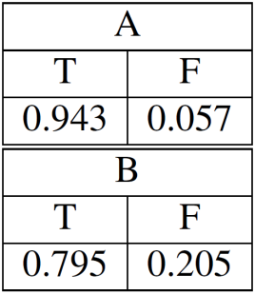
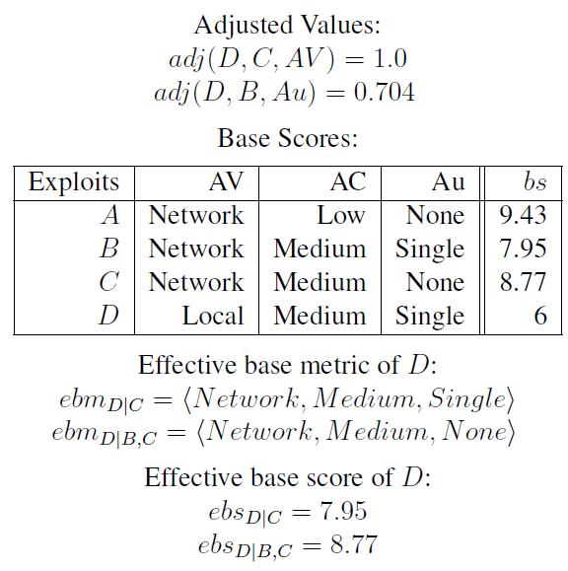
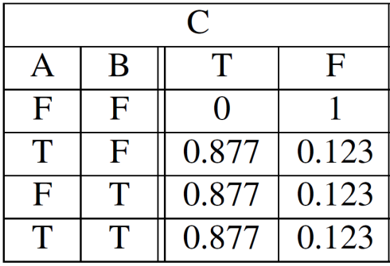
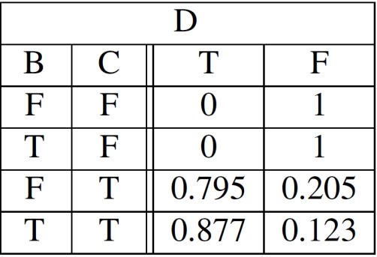

A More Elaborated Example
c_{i1}
c_{i2}
c_{i3}
A
B
c₀
C
c_{i4}
c₁
D
c_{goal}
Formal model omitted
(can be found in the paper)

Slide 20
Outline
Introduction
Related Work
Base Metric-Level Aggregation
Three Aspects of CVSS Scores
Simulation
Conclusion
Notes:
I’ll first motivate our study, and summarize the limitations of related work.
I’ll then introduce some basic concepts such as attack graph.
I’ll describe our model in three stages: how to assign individual values using CVSS, how to compose them in a static case, how to compose them in dynamic case
I’ll discuss two case studies.

Slide 21
The Three Aspects
The CVSS base metrics and scores can be interpreted in different ways
Attack probability
  E.g., AccessVector: Local vs. Network
  Aggregated as before
Time/Effort
  E.g., Authentication: Multiple vs. None
  Aggregation = addition
Least skills
  E.g., AccessComplexity: High vs. Low
  Aggregation = maximum
Notes:
NIST has several efforts on security metric…
Dacier and others proposed to use Markov model and mean time to failure (MTTF) to measure security, but they do not consider realistic cases modeled by attack graphs.
Several previous approaches measure security using the minimum-efforts required by attackers, we have shown in last year’s QoP workshop that those approaches have their limitations.
Attack surface is for software security.
Pagerank assumes attacker moves in a random way, which is not necessarily the case.

Slide 22
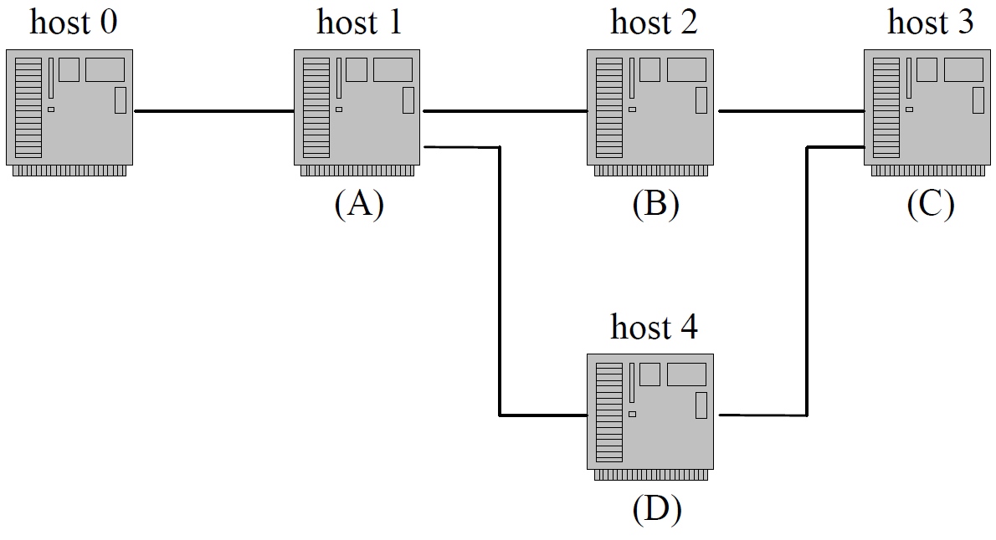
Different Aspects, Different Aggregation
Assume:
BS_{B} > BS_{A} > BS_{C}
BS_{B} > BS_{D}
host 3 is the asset
Attack Probability
Required Effort
Minimum Skill
Initially:
P1=P_{A}*(P_{B}*P_{D}/(P_{B}+P_{D}))*P_{c}
After removing host 4:
P2=P_{A}*P_{B}*P_{c} < P1
Further removing host 2:
P3=P_{A}*P_{c} > P2
Initially:
F1=F_{A}+F_{B}+F_{C} (note BS_{B} > BS_{D} )
After removing host 4:
F2=F_{A}+F_{B}+F_{C} (no change)
Further removing host 2:
F3=F_{A}+F_{C} < F2
Initially:
S1=S_{C}
After removing host 4:
S1=S_{C} (no change)
Further removing host 2:
S1=S_{C} (no change)

Slide 23
Aggregating Effort/Skill Scores
c_{i1}
 | AV | AC | Au | es,ss
v_{A} | Network | Low | None | 1
v_{B} | Network | Medium | None | 1.21
v_{C} | Local | Low | None | 1 (w.r.t q₁)
v_{D} | Local | Medium | None | 3.49
v_{E} | Network | Medium | Single | 1.59
v_{F} | Network | Medium | Single | 1.59 (w.r.t q₁) And 1.21 (w.r.t. q₂)
A
c₀
B
E
c₁
c₂
C
D
c₃
c₄
F
Attack Sequence | Effort F(F) | Skill S(F)
q₁: A -> B -> C -> F | 4.8 | 1.59
q₂: A -> B -> D -> E -> F | 8.5 | 3.49
c_{goal}

Slide 24
Outline
Introduction
Related Work
Base Metric-Level Aggregation
Three Aspects of CVSS Scores
Simulation
Conclusion
Notes:
I’ll first motivate our study, and summarize the limitations of related work.
I’ll then introduce some basic concepts such as attack graph.
I’ll describe our model in three stages: how to assign individual values using CVSS, how to compose them in a static case, how to compose them in dynamic case
I’ll discuss two case studies.

Slide 25
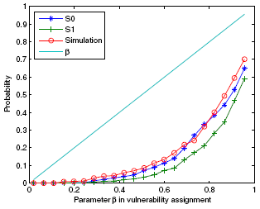
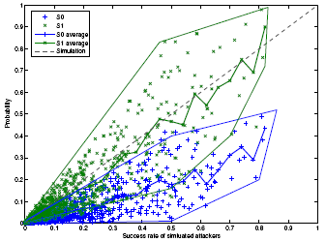
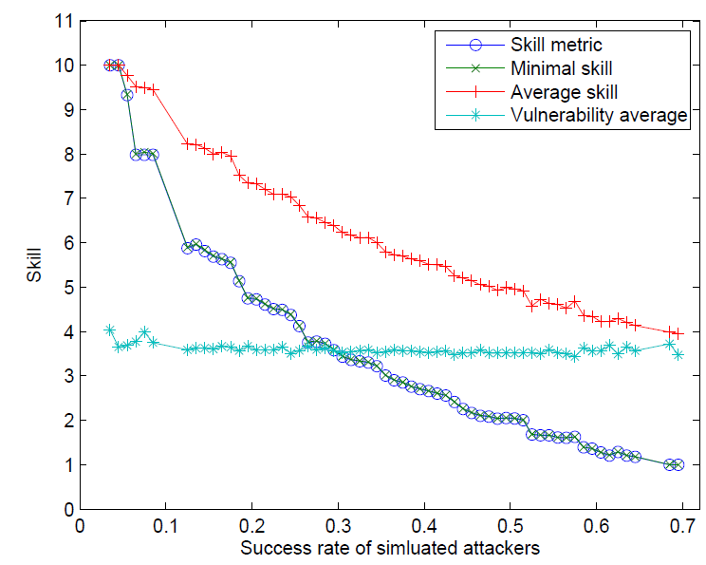
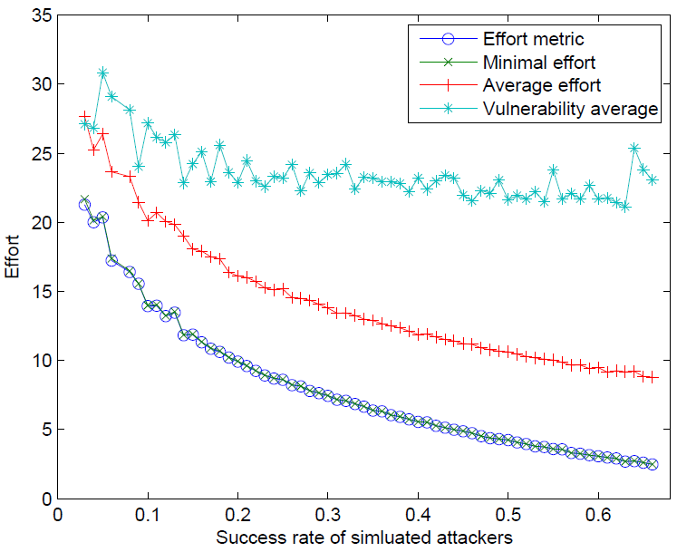
Simulation Results
Notes:
I’ll first motivate our study, and summarize the limitations of related work.
I’ll then introduce some basic concepts such as attack graph.
I’ll describe our model in three stages: how to assign individual values using CVSS, how to compose them in a static case, how to compose them in dynamic case
I’ll discuss two case studies.

Slide 26
Outline
Introduction
Related Work
Base Metric-Level Aggregation
Three Aspects of CVSS Scores
Simulation
Conclusion
Notes:
I’ll first motivate our study, and summarize the limitations of related work.
I’ll then introduce some basic concepts such as attack graph.
I’ll describe our model in three stages: how to assign individual values using CVSS, how to compose them in a static case, how to compose them in dynamic case
I’ll discuss two case studies.

Slide 27
Conclusion
We have identified two important limitations of existing approaches to aggregating CVSS scores
  Lack of support for dependency
  Lack of consideration for different aspects
  Both of which may lead to the loss of useful semantics
We proposed
  Base-metric level aggregation to handle dependency relationships with well-defined semantics
  Three aggregation methods for preserving different aspects of the semantics of CVSS scores
Future work will be directed to incorporating the temporal and environmental scores, considering other aspects, and more realistic experimental settings
Notes:
I’ll first motivate our study, and summarize the limitations of related work.
I’ll then introduce some basic concepts such as attack graph.
I’ll describe our model in three stages: how to assign individual values using CVSS, how to compose them in a static case, how to compose them in dynamic case
I’ll discuss two case studies.

