Slide 1
A Unified Framework for Measuring a Network’s
Mean Time-to-Compromise
Anoop Singhal¹
William Nzoukou², Lingyu Wang², Sushil Jajodia³
¹ National Institute of Standards and Technology
² Concordia University
³ George Mason University
SRDS 2013

Slide 2
Outline
Introduction
Motivating Example
The MTTC metric models
Simulation
Conclusion

Slide 3
Outline
Introduction
Motivating Example
The MTTC metric models
Simulation
Conclusion

Slide 4
The Need for Security Metric
Some simple questions difficult to answer:
  Are we more secure than that company?
  Are we secure enough?
  How much additional security will be provided by that firewall?
“You cannot improve what you cannot measure”
  A security metric will allow for a direct measurement of security before, and after deploying the solution
  Such a capability will make network hardening a science rather than an art

Slide 5
Existing Work
Efforts on standardizing security metric
  CVSS by NIST
  CWSS by MITRE
Efforts on measuring vulnerabilities
  Minimum-effort approaches (Balzarotti et al., QoP’05 and Pamula et al., QoP’06)
  PageRank approach (Mehta et al., RAID’06)
  Attack surface (Manadhata et al., TSE’11)
  MTTC-based approach (Leversage et al., SP’08)
  Our previous work (DBSec’07-08, QoP’07-08, ESORICS’10, SRDS’12)
Notes:
Note the MTTC-based approach (Leversage et al., SP’08) is closest to our work. but our work improves the model by introducing attack graph and CVSS scores.

Slide 6
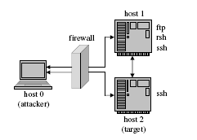
An Example Metric for Known Vulnerabilities
user(0)
user(0)
Attack probability (DBSec’08)
  E.g., probability of exploiting ftp_rhosts is 0.8
  E.g., probability of reaching root(2) is 0.087
ftp_rhosts(0,1)
ftp_rhosts(0,1)
0.8
0.8
trust(0,1)
trust(0,1)
0.1
sshd_bof(0,1)
0.72
sshd_bof(0,1)
0.1
rsh(0,1)
rsh(0,1)
0.9
user(1)
user(1)
ftp_rhosts(0,2)
ftp_rhosts(1,2)
ftp_rhosts(0,2)
0.8
ftp_rhosts(1,2)
0.8
0.6
trust(0,2)
trust(1,2)
trust(0,2)
trust(1,2)
0.72
0.54
rsh(0,2)
rsh(1,2)
rsh(0,2)
0.9
rsh(1,2)
0.9
user(2)
user(2)
0.087
local_bof(2,2)
local_bof(2,2)
0.1
root(2)
root(2)
Notes:
Here is one example of existing metrics for known vulnerabilities (based on our DBSec’08 paper). No need to explain in details.
Just say the metric assigns probability to individual vulnerability based on CVSS (e.g., 0.8 for ftp_rhosts(0,1)), and calculating probability for reaching the goal based on probability theory (e.g., 0.087 for eaching root(2)).

Slide 7
An Example Metric for Zero-Day Attacks
k-zero day safety (ESORICS’10)
  k: the minimum number of distinct zero-day vulnerabilities required for attack
  Larger k means safer networks
  E.g., assuming no known vulnerability here, then k=1, if ssh has no known vulnerability; k=0, otherwise
Notes:
Here is one example of existing metrics for zero day attacks (based on our ESORICS’10 paper). No need to explain in details.
Suppose host 2 is the target. If no service has any known vulnerability, then attacker will require at least one zero day vulnerability (in ssh) to attack host 2.

Slide 8
How to Measure Both?
A natural next step is to develop metrics that are capable of handling the threats of both known vulnerabilities and zero day attacks

Slide 9
Outline
Introduction
Motivating Example
The MTTC metric models
Simulation
Conclusion
Notes:
I’ll first motivate our study, and summarize the limitations of related work.
I’ll then introduce some basic concepts such as attack graph.
I’ll describe our model in three stages: how to assign individual values using CVSS, how to compose them in a static case, how to compose them in dynamic case
I’ll discuss two case studies.

Slide 10
How to Measure Both?
A viable approach is to combine those two types of metrics,
  Known vulnerabilities
  Zero day vulnerabilities
through, for example, a weighted sum
  E.g., we assign a score s (0 <= s < 1) to known vulnerability, and 1 to zero day vulnerability
However, such a naïve approach may lead to misleading results
Notes:
One way to measure both is to combine existing metrics for known, and zero day vulnerabilities
For example, a naïve solution is to use weighted sum, to assign a smaller than 1 score to known vulnerability and 1 to zero day vulnerability (since known vulnerability is considered easier than zero day ones)

Slide 11
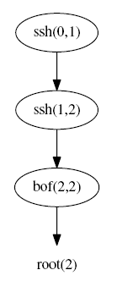
Issues with Such a Naïve Solution
Consider this sequence
  Initially, s_{ssh}+s_{ssh}+s_{bof}
  If we patch one of the ssh services, s_{ssh}+1+s_{bof}
  If we path both ssh, 1+s_{bof}
  Patching both is less secure than patching only one – difficult to explain
Adding the two metrics together makes little sense, when they have different semantics
Notes:
The problem with this naïve solution (of adding the two together) is that it makes little sense, because the two metrics measure different things (one for difficulty of exploiting a known vulnerability, one for the likelihood of having a zero day vulnerability).
Explaining this example is optional.

Slide 12
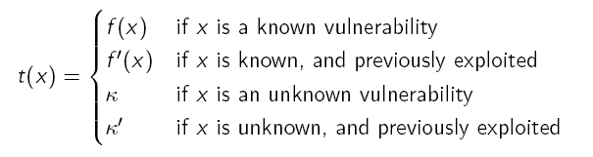
Our Solution: Using Time to Combine Different Metrics
Define the MTTC t of a vulnerability x
  Initially, t₁ ₌ f(ssh)+f’(ssh)+f(bot)
  Patch one ssh, t₂ ₌ k+min(f(ssh),k’)+f(bot)
  Patch both ssh, k+k’+f(bot)
  Which case more secure will depend on how you define f and k. What is important is the model still applies.
Notes:
No need to explain the formulas in details (say explanations are in paper).
The key point is, we combine the two types of metrics using time, so there is a clear and coherent semantics, and no matter how you define f(x) and k, the model still applies.

Slide 13
Contribution
Among the first security metrics capable of handling both known vulnerabilities and zero day attacks under the same model with coherent semantics
The proposed metric provides more intuitive and easy-to-understand score (time) than previous work based on abstract value-based metrics
We take a layered approach such that the high level metric model remains valid regardless of specific low level inputs

Slide 14
Outline
Introduction
Motivating Example
The MTTC metric models
Simulation
Conclusion

Slide 15

Mean Time-to-Compromise (MTTC)
Given an attack graph and goal, the MTTC of a condition c in an attack graph is defined as the average time spent by an attacker in reaching the goal
  MTTC(e) is the average time required for the exploit e
  Pr(e∧c) represents the conditional probability that a successful attacker actually chooses to exploit e
  P(c) represents the probability of an attacker being successful (i.e., s/he can reach the goal condition c)
  (Note that ‘chooses to exploit’ and ‘can exploit’ are two different things)
Notes:
Intuitively speaking, the dividend is the total time used by all successful attackers in reaching the goal condition c. the divisor is the number of successful attackers. So by diving the two, we have the average time used by each attacker, e.g., if among 100 attackers, 50 can reach the goal, and those 50 attacker use 36 hours in total, then 36/50 = 0.72hour is the MTTC.

Slide 16
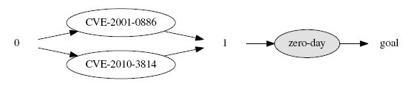
An Example
To determine MTTC(goal)
  We need to find the probabilities P(goal) and Pr(e∧goal) for each e (we will do this in three steps)
  We need to estimate MTTC(e) for each e

Slide 17


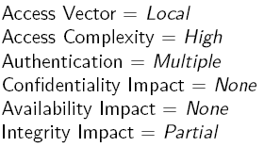
Step 1: Probability of Being Able to Exploit e When Its Pre-Conditions Are Satisfied
For known vulnerabilities, we assign the probability based on CVSS scores
For zero day vulnerabilities, we assign a fixed nominal 0.08 based on following assumptions:
Notes:
This is the probability of an attacker being able to exploit e.
For known vulnerability, just use CVSS score
For zero day, we make some assumptions about their CVSS base metrics, as stated here on the slides, and then calculate a nominal score as 0.08.

Slide 18
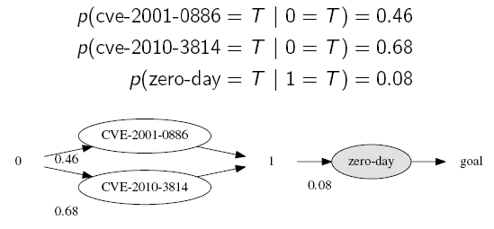
An Example
Apply this to our example:
Notes:
Here we just assign probabilities to each exploit, either based on CVSS (first two cases), or as a nominal value (last one)

Slide 19
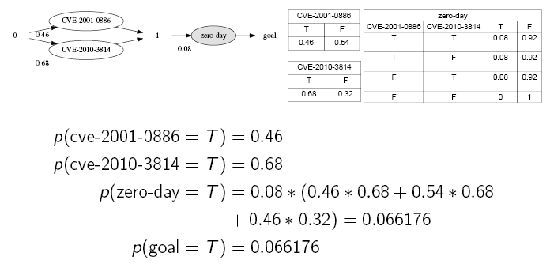
Step 2: Probability of Being Able to Exploit e
Construct a Bayesian network based on the attack graph
Calculate the probability that an attacker can reach the goal
Notes:
This is to follow the previous probability assignment.
No need to explain. Details are in paper.

Slide 20
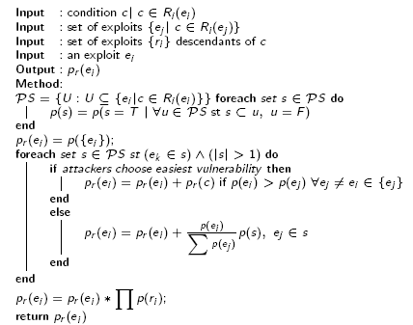
Step 3: Probability of Attacker Choosing Exploit e
Here we can make different assumptions, e.g.,
  An attacker may always choose the easiest exploit s/he is able to
  An attacker may still choose harder exploits, the likelihood of which are proportional to their relative difficulties
The procedure calculates pr(e) based on those two assumptions
Notes:
Even though an attacker can exploit e, s/he may or may not choose to do so, because s/he usually have more than one choices.
Don’t explain the algorithm. It calculates the probability that an attacker chooses e, based on the two assumptions.

Slide 21
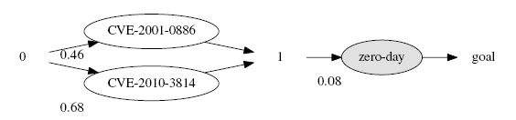
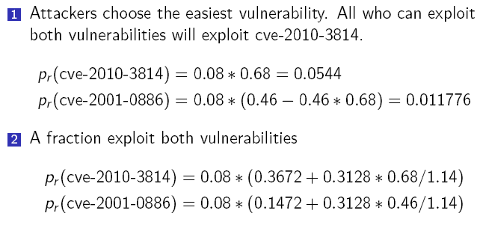

An Example
Apply this to our example:
Notes:
Here we just assign probabilities to each exploit, either based on CVSS (first two cases), or as a nominal value (last one)

Slide 22


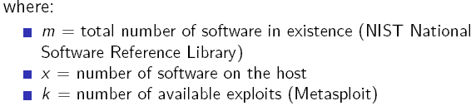


Estimating MTTC(e) – Known Vulnerabilities
To estimate MTTC(e), we average the two complementary cases:
  Exploit code already exists, e.g.,
  Exploit code does not exist, e.g.,
  Note those only represent one (rough) way of estimating MTTC(e)
Notes:
No need to explain. You can say the results are based on search theory and the previous MTTC work (Leversage et al., SP’08). Especially, the ‘5.8 days’ comes from Leversage et al., SP’08.

Slide 23
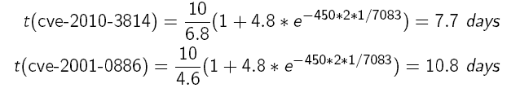
An Example
Apply this to our example:
Notes:
Here we just assign probabilities to each exploit, either based on CVSS (first two cases), or as a nominal value (last one)

Slide 24
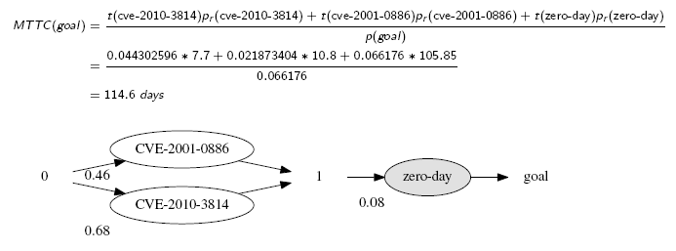
An Example
The final result of our example:
Notes:
Here we just assign probabilities to each exploit, either based on CVSS (first two cases), or as a nominal value (last one)

Slide 25
Outline
Introduction
Motivating Example
The MTTC metric models
Simulation
Conclusion

Slide 26
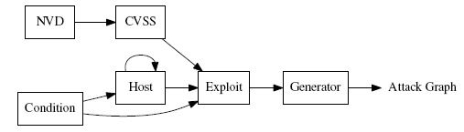

Simulation
The algorithms are implemented using Python and libraries including the Networkx, OpenBayes, Pygraphviz[33] and Matplotlib. To render the graphs, we use GraphViz
The experiments were performed inside an Intel Core I7 computer with 8Gb of RAM. The computer is running Ubuntu 12.04 LTS
Notes:
If they ask why not do experiments, say there do not exist any publicly available datasets of attack graphs.
We generate random attack graphs by growing from a seed graph, which is based on real world networks.

Slide 27
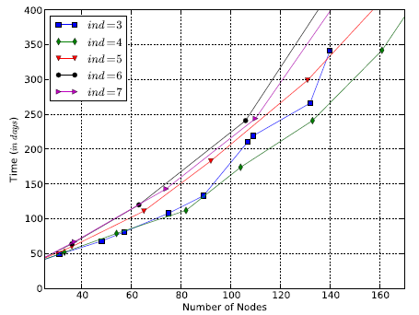
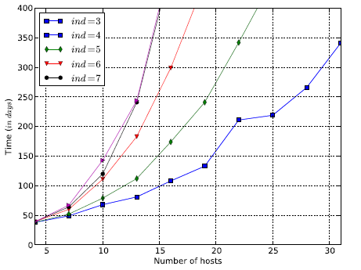
Simulation: MTTC vs Network Size
Notes:
Those results show how the MTTC grows in the size of attack graph (# of nodes) or that of networks (# of hosts). In the figure, ind represents the maximum number of pre-conditions of each exploit.

Slide 28
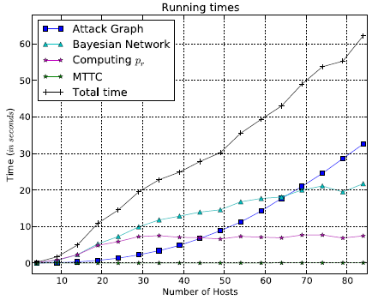
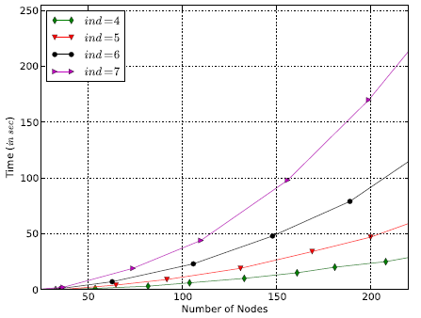
Simulation: Running Time vs Network Size
Notes:
Those results show how the running time grows in the size of networks. We can see that the running time is dominated by the generation of attack graphs and Bayesian networks (so that our algorithms do not cost that much time).

Slide 29
Outline
Introduction
Motivating Example
The MTTC metric models
Simulation
Conclusion

Slide 30
Conclusion
We have proposed a MTTC framework for developing metrics in order to measure both known and zero day vulnerabilities
We have defined our MTTC model, and provided examples of concrete methods for estimating inputs to the model
Future work will be directed to developing more refined estimation methods, applying the metrics to network hardening, and conducting more realistic experiments

