Slide 1
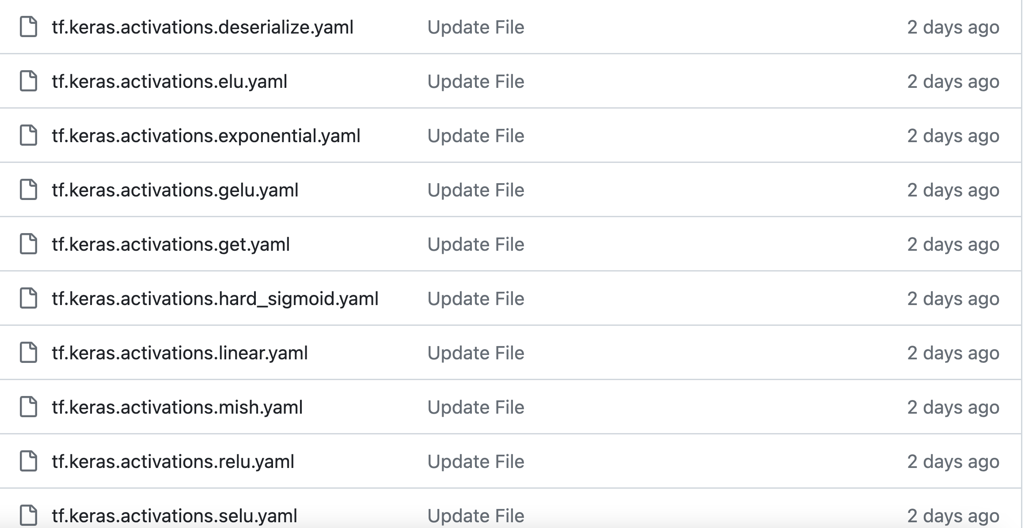
上周工作
TensorFlow数据收集（information/tf/layer_info）
同框架相似度计算（information/tf/api_similarity）
跨框架相似度计算（information/api_info）
Step 1. API名称相同
Step 2. API名称相似
Step 3. API定义相似
Step 4. API上下文相似

Slide 2
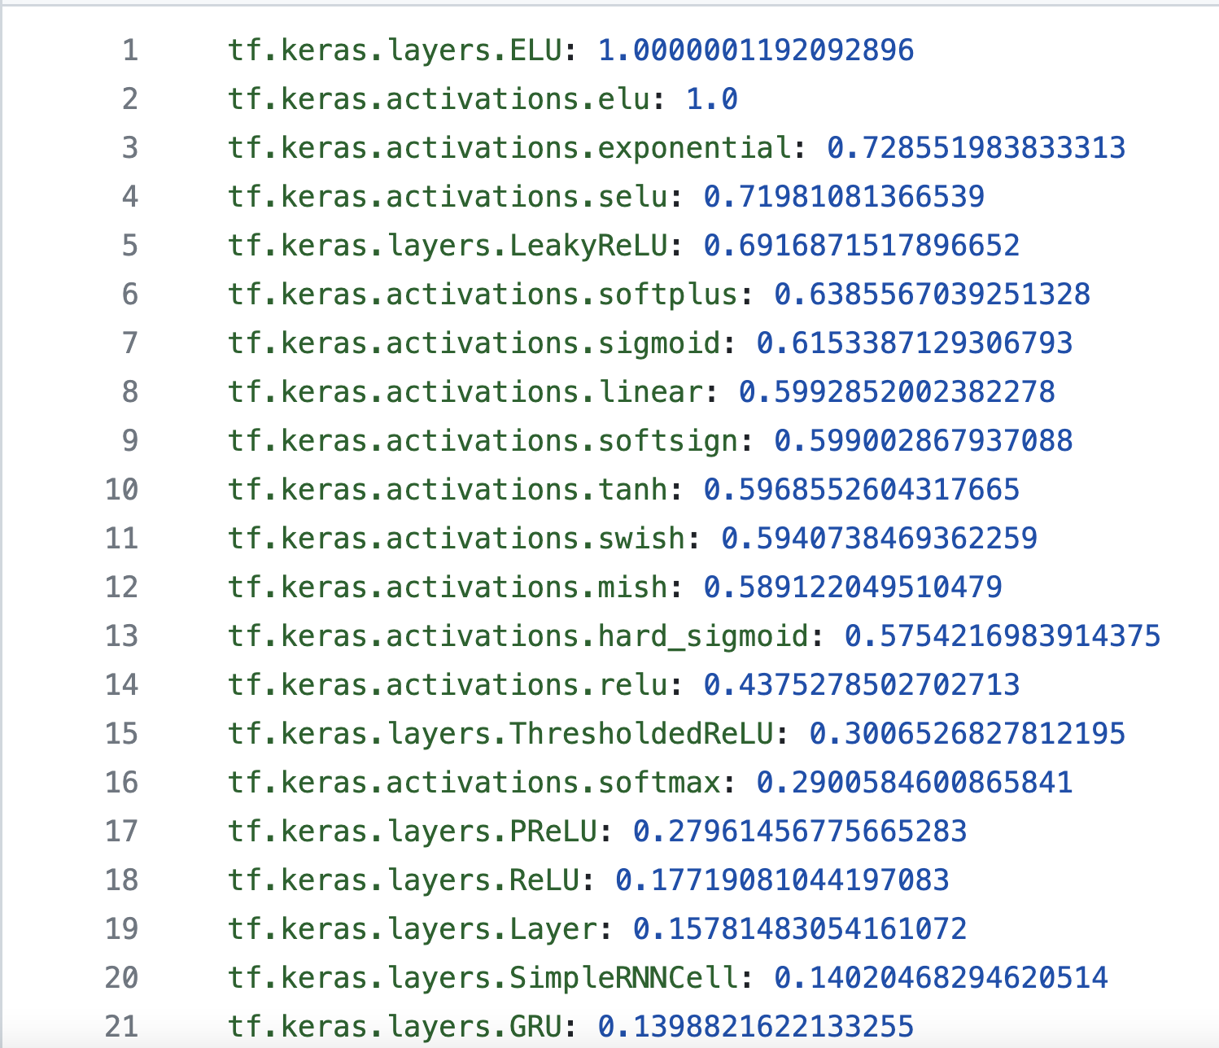
上周工作
TensorFlow数据收集（information/tf/layer_info）
同框架相似度计算（information/tf/api_similarity）
跨框架相似度计算（information/api_info）
Step 1. API名称相同
Step 2. API名称相似
Step 3. API定义相似
Step 4. API上下文相似

Slide 3
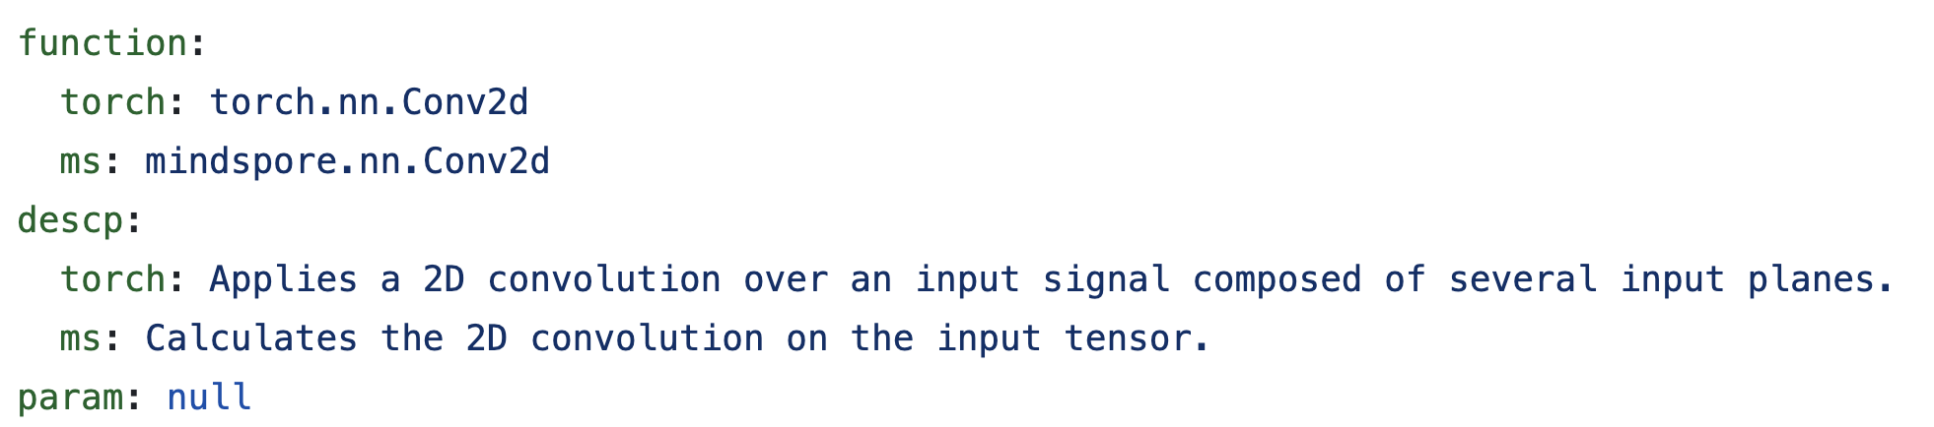
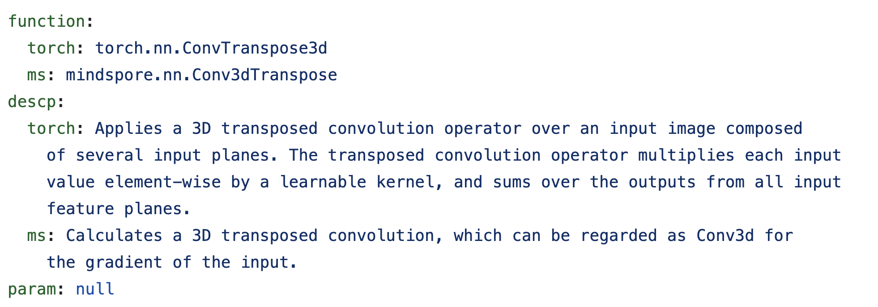
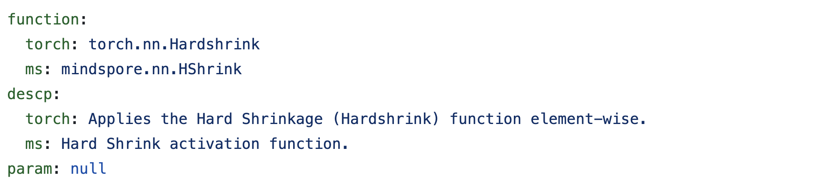
上周工作
TensorFlow数据收集（information/tf/layer_info）
同框架相似度计算（information/tf/api_similarity）
跨框架相似度计算（information/api_info）
Step 1. API名称相同
Step 2. API名称相似
Step 3. API定义相似
Step 4. API上下文相似

Slide 4
 | abs_function | torch | ms | paddle | tf | jittor
1 | conv1d | torch.nn.Conv1d | mindspore.nn.Conv1d | paddle.nn.Conv1D | tf.keras.layers.Conv1D | jittor.nn.Conv1d
2 | conv2d | torch.nn.Conv2d | mindspore.nn.Conv2d | paddle.nn.Conv2D | tf.keras.layers.Conv2D | jittor.nn.Conv2d
3 | conv3d | torch.nn.Conv3d | mindspore.nn.Conv3d | paddle.nn.Conv3D | tf.keras.layers.Conv3D | jittor.nn.Conv3d
4 | convtranspose1d | torch.nn.ConvTranspose1d | mindspore.nn.Conv1dTranspose | paddle.nn.Conv1DTranspose | tf.keras.layers.Conv1DTranspose
5 | convtranspose2d | torch.nn.ConvTranspose2d | mindspore.nn.Conv2dTranspose | paddle.nn.Conv2DTranspose | tf.keras.layers.Conv2DTranspose | jittor.nn.ConvTranspose2d
6 | convtranspose3d | torch.nn.ConvTranspose3d | mindspore.nn.Conv3dTranspose | paddle.nn.Conv3DTranspose | tf.keras.layers.Conv3DTranspose | jittor.nn.ConvTranspose3d
7 | maxpool2d | torch.nn.MaxPool2d | mindspore.nn.MaxPool2d | paddle.nn.MaxPool2D | tf.keras.layers.MaxPooling2D | jittor.nn.MaxPool2d
8 | maxpool3d | torch.nn.MaxPool3d | mindspore.nn.MaxPool3d | paddle.nn.MaxPool3D | tf.keras.layers.MaxPooling3D | jittor.nn.MaxPool3d
… | … | … | … | … | … | …

Slide 5
API Mutate
为了保证语义一致性，API Mutate的函数选择过程在抽象层进行，就要计算抽象函数conv2d在所有框架下可以突变为的抽象层函数。
抽象层
- layer: conv2d
params:
in_channels: 1
kernel_size: 5
out_channels: 6
in: x
out: x
- layer: relu
params: {}
in: x
out: x
- layer: maxpool2d
params:
kernel_size: 2
stride: 2
in: x
out: x
（information/tf/layer_info）
（information/tf/api_similarity）
（information/api_info）
？
conv2d(抽象层函数)
 | abs_function | torch | ms | paddle | tf | jittor
1 | conv1d | torch.nn.Conv1d | mindspore.nn.Conv1d | paddle.nn.Conv1D | tf.keras.layers.Conv1D | jittor.nn.Conv1d
2 | conv2d | torch.nn.Conv2d | mindspore.nn.Conv2d | paddle.nn.Conv2D | tf.keras.layers.Conv2D | jittor.nn.Conv2d
3 | conv3d | torch.nn.Conv3d | mindspore.nn.Conv3d | paddle.nn.Conv3D | tf.keras.layers.Conv3D | jittor.nn.Conv3d
4 | convtranspose1d | torch.nn.ConvTranspose1d | mindspore.nn.Conv1dTranspose | paddle.nn.Conv1DTranspose | tf.keras.layers.Conv1DTranspose
5 | convtranspose2d | torch.nn.ConvTranspose2d | mindspore.nn.Conv2dTranspose | paddle.nn.Conv2DTranspose | tf.keras.layers.Conv2DTranspose | jittor.nn.ConvTranspose2d
6 | convtranspose3d | torch.nn.ConvTranspose3d | mindspore.nn.Conv3dTranspose | paddle.nn.Conv3DTranspose | tf.keras.layers.Conv3DTranspose | jittor.nn.ConvTranspose3d
7 | maxpool2d | torch.nn.MaxPool2d | mindspore.nn.MaxPool2d | paddle.nn.MaxPool2D | tf.keras.layers.MaxPooling2D | jittor.nn.MaxPool2d
8 | maxpool3d | torch.nn.MaxPool3d | mindspore.nn.MaxPool3d | paddle.nn.MaxPool3D | tf.keras.layers.MaxPooling3D | jittor.nn.MaxPool3d
… | … | … | … | … | … | …

Slide 6
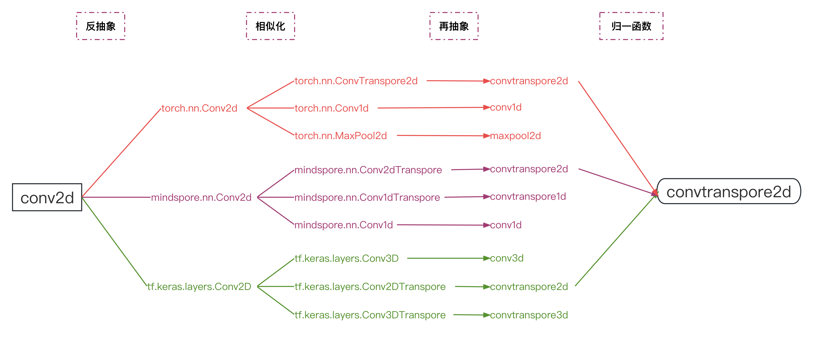
API Mutate
（information/framework/api_similarity）
（information/api_info）
（information/api_info）
……

Slide 7


基于语义一致性的API翻译过程
具体层
class Demo(torch.nn.Module):
def __init__(self):
super(Demo, self).__init__()
self.convtranspore2d_1 = torch.nn.ConvTranspore2D(in_channels=1, kernel_size=5, out_channels=6)
def forward(self, x):
# 1st block
x = self.convtranspore2d_1(x)
return x
抽象层
- layer: conv2d
params:
in_channels: 1
kernel_size: 5
out_channels: 6
in: x
out: x
API Mutate
- layer: convtranspore2d
params:
in_channels: 1
kernel_size: 5
out_channels: 6
in: x
out: x
def Demo(label_num=10, input_shape=(28, 28, 1)):
input_tensor = tf.keras.Input(shape=input_shape)
# 1st block
x = tf.keras.layers.Conv2DTranspore(filters=6, kernel_size=5)
return x

Slide 8
本周工作
收集基于不同框架实现的神经网络（CNN/RNN）各100个。
(C)对收集到的网络进行裁剪
(W)利用收集到的神经网络计算APIStep 4. 上下文相似度。
(Y)用abs_function表以及相关数据完成API Mutate的原型设计。

