Slide 1
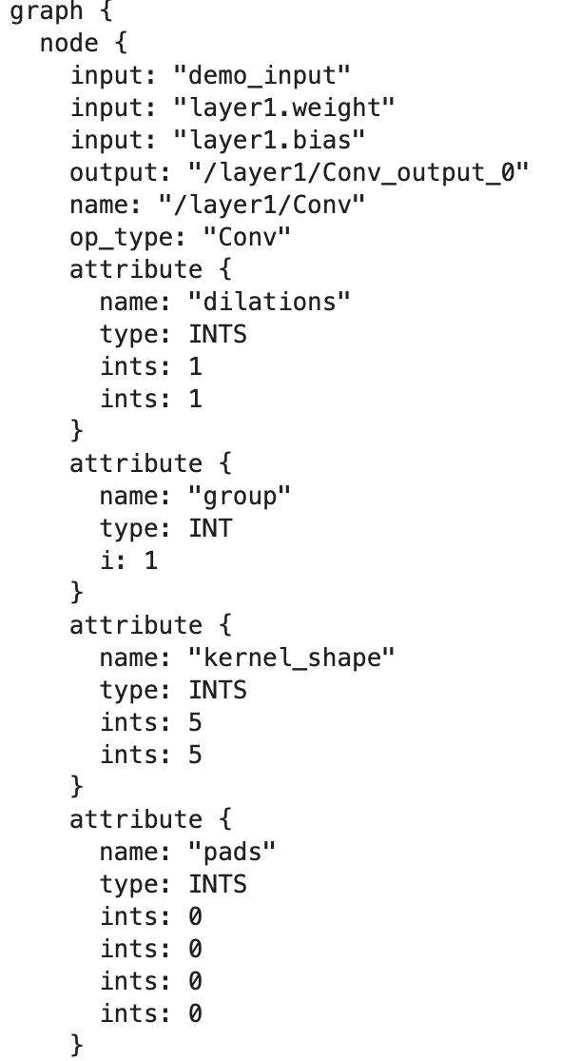
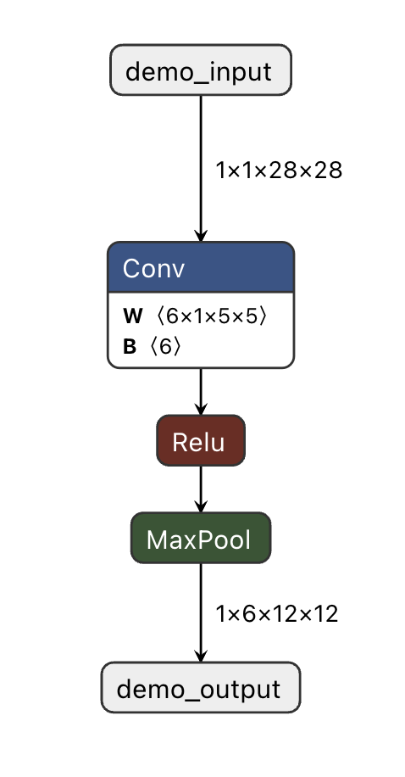
ONNX
Pytorch->ONNX
model
torch.onnx.export
model.onnx
NETRON
可视化
# model pytorch implementation
class Demo(nn.Module):
def __init__(self):
super(Demo, self).__init__()
self.layer1 = torch.nn.Conv2d(in_channels=1,
kernel_size=5, out_channels=6)
self.layer2 = torch.nn.ReLU()
self.layer3 = torch.nn.MaxPool2d(
kernel_size=2, stride=2)
def forward(self, x):
x = self.layer1(x)
x = self.layer2(x)
x = self.layer3(x)
return x
dim = len(IR_node.get_attr('strides')) - 2

Slide 2
ONNX
PROTOBUF
|__input(input_tensor)
| |__name
| |__type
| | |__tensor_type
| | | |__elem_type
| | | |__shape
| | | | |__dim
| | | | |__dim_value
| | | | |__dim
| | | | |__dim_value
| | | | |__dim
| | | | |__dim_value
| | | | |__dim
| | | | |__dim_value
| | | | |__...
|__output(output_tensor,同上)
graph
|__node
| |__input
| |__output
| |__name
| |__op_type
| |__domain
| |__attribute
| | |__name
| | |__type
| | |__ints(when type is INTS)
| | |__f(when type is FLOAT)
| | |__i(when type is INT)
|__initializer(weight/bias初始化数值)

Slide 3
ONNX
可变范围
参数 | 原工具 | TensorScope | 希望实现
node.op_type | 1 | 0 | 1
nodel.attribute | 1 | 1 | 1

Slide 4
ONNX
获取抽象信息
@_onnx_symbolic("aten::conv2d")
@symbolic_helper.parse_args("v", "v", "v", "is", "v", "is", "i")
@_beartype.beartype
def conv2d(...):
str_padding = symbolic_helper._parse_arg(padding, "s")
if str_padding in ["valid", "same"]:
return _convolution_mode(...)
else:
padding = symbolic_helper._parse_arg(padding, "is")
return _convolution(...)
def _convolution():
...
n = g.op("ConvTranspose" if transposed else "Conv", *args, **kwargs)
...
def _convolution_mode():
...
n = g.op("Conv", *args, **kwargs)
...

Slide 5
ONNX
获取抽象信息
dim = len(IR_node.get_attr('strides')) - 2
node.op_type | pytorch | tenserflow
AveragePool | torch.nn.AvgPool{dim}d | tf.keras.layers.AveragePooling{dim}D tf.keras.layers.AveragePool{dim}D
BatchNormalization | torch.nn.BatchNorm{dim}d | tf.keras.layers.BatchNormalization
Conv | torch.nn.Conv{dim}d | tf.keras.layers.Conv{dim}D
ConvTranspose | torch.nn.ConvTranspose{dim}d | tf.keras.layers.Conv{dim}DTranspose
Flatten | torch.nn.Flatten | tf.keras.layers.Flatten
GlobalAveragePool | torch.nn.AdaptiveAvgPool{dim}d | GlobalAveragePooling{dim}D
Relu | torch.nn.Relu | tf.nn.relu tf.keras.layers.ReLU tf.keras.activations.relu

Slide 6
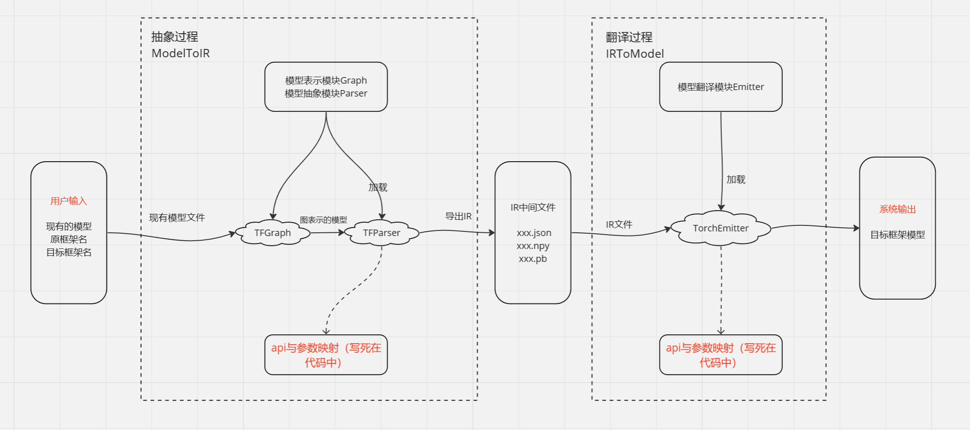
MMDNN
Convert流程
Mmdnn工具可以实现模型的跨框架转化

Slide 7
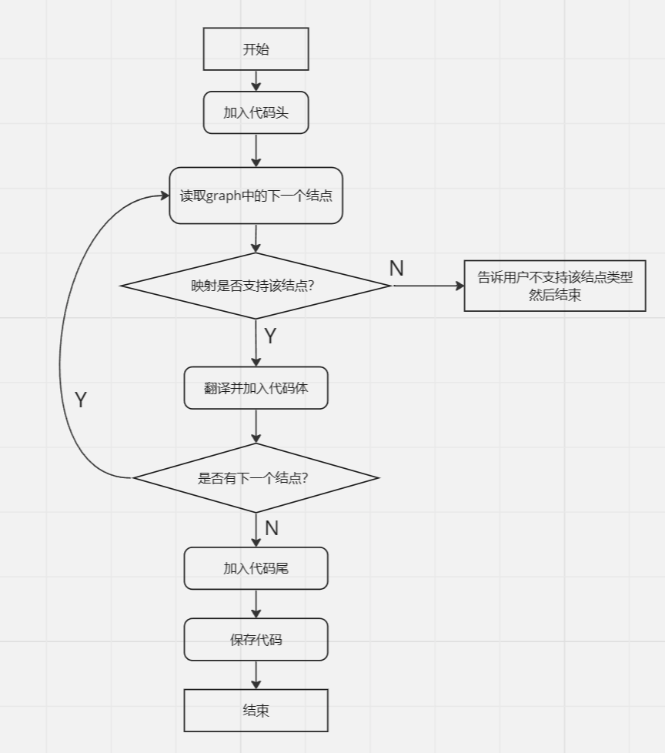
MMDNN
映射原理
在模型转换的部分，
Mmdnn采用固定逻辑的方式，将映射逻辑写入代码中进行映射。
MoCo采用外置数据的方式，将逻辑写入表中，并动态读取。
1.Mmdnn可维护性差，不支持动态添加框架新增的方法。
MoCo中新增映射，只需要在表中加入新条目，运算时会自动读取，便于扩展。
2.Mmdnn版本较老，在今天的主流新版本深度学习系统中已经无法运行（如mmdnn支持的pytorch版本只到1.5.1）
MoCo使用的都是各框架最新版本。

