Slide 1
SUSTAINSCOPE
YOUR LENS TO GAUGE A COMPANY’S SUSTAINABILITY PULSE

Slide 2

PROBLEM

Slide 3
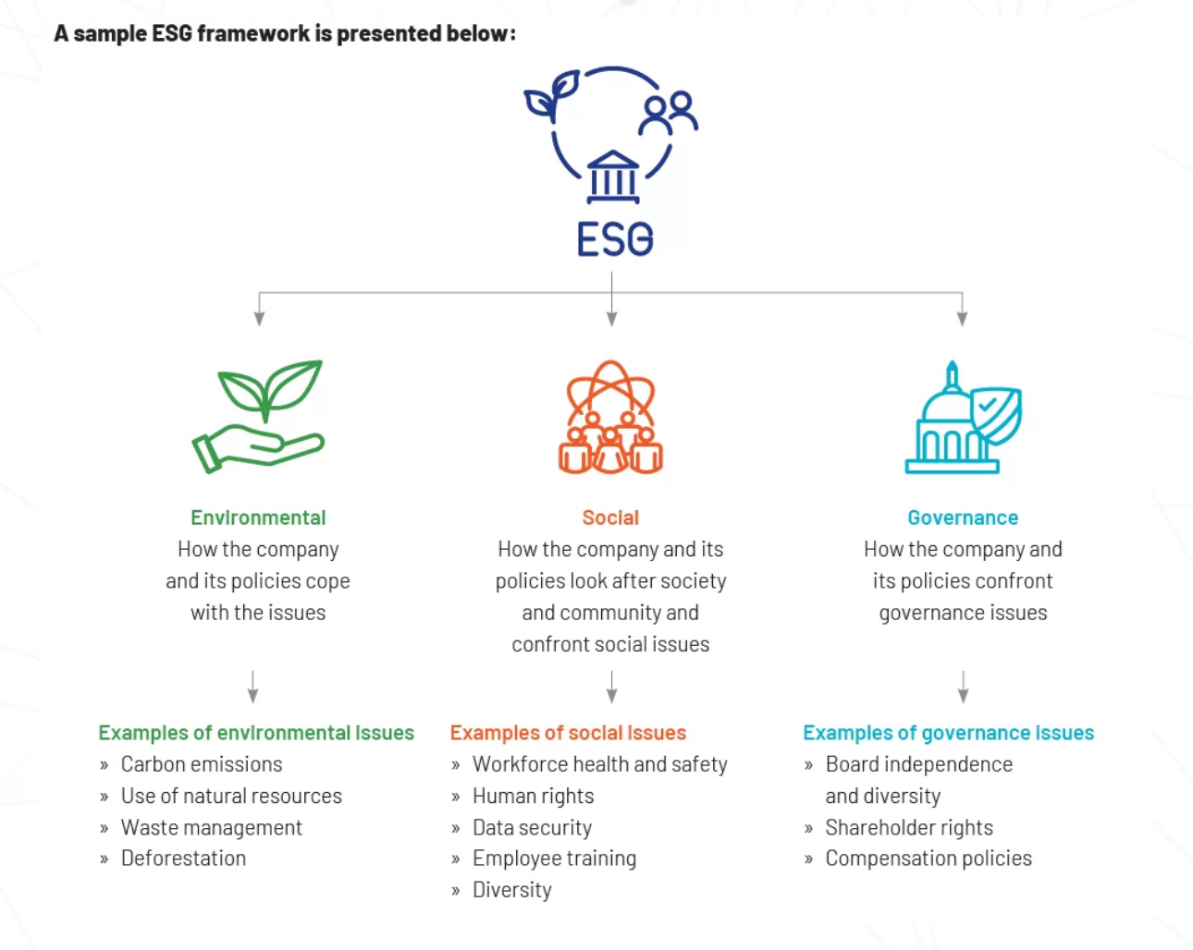
Problem

Slide 4
SOLUTION
A Generative AI Web Application that leverages Azure AI Search, OpenAI and Langchain framework to employ Retrieval-Augmentation-Generation Techniques for sustainability analysis.
KEY FEATURES:
Sentiment Analysis: Uses OpenAI to analyze news sentiment about companies' ESG efforts.
Comparative Analysis: Compares public sentiment and media coverage with the company's stated ESG objectives.
Analysis of Sustainability Reports Via OpenAI ChatBot
User-Friendly Interface: Simplifies navigation and data interpretation through an intuitive design built with Streamlit

Slide 5
END-USERS
Investors
Sustainability Activists
Company Sustainability Analyst

Slide 6
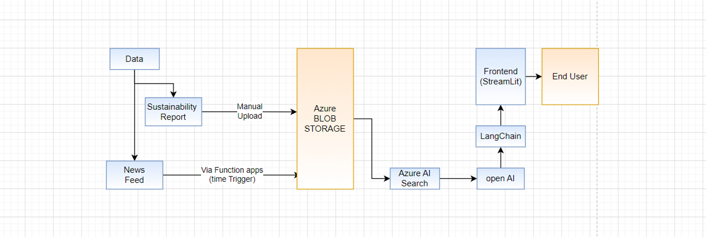
SOLUTION ARCHITECTURE

Slide 7
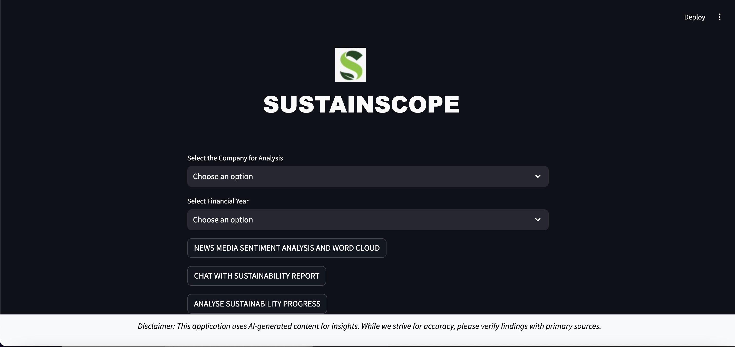
SOLUTION SHOWCASE

Slide 8
THANK YOU

