Slide 1
Data Input
Target and Feature Extraction
UK Biobank (UKB)
NOVELTY Filter: Literature Search
Literature Co-occurrence
PubMed
Features
Language Model (LLM) annotations for all criteria
Novelty
Plausability
Utility
UTILITY Filter:
Statistical and Model-based Feature Selection
Interesting?
NOVELTY Filter: Knowledge Graph (KG)
Named Entity Linking of features to entities in KG
Remove features with strong target KG links
Output
Ranked features list, annotations and explanations

Slide 2
Data Input: UK Biobank (UKB)
Target Definition, Inverse Probability Weighting (IPW), Feature Extraction
Removal Known Candidates:
Literature Co-occurance
(PubMed)
Filter:
Statistical Feature Selection:
Candidate Generation: UTILITY
Candidate Features
Large Language Model (LLM) &
Retrieval-Augmented Generation (RAG) annotation
Named Entity Linking:
Unified Medical Language System (UMLS)
Output: Ranked features, labels and Explanations
Removal Known Candidates:
Knowledge Graph
Semantic MEDLINE Database (SemMed)
Manual Review:
Assessment Including False Positives

Slide 3
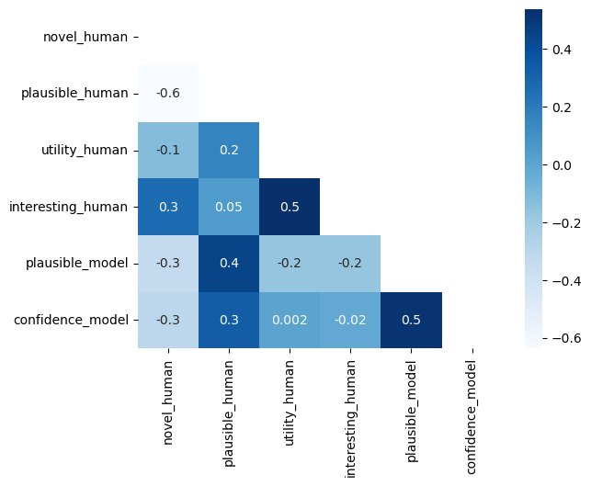
Add some frame and improve the visualization

Slide 4
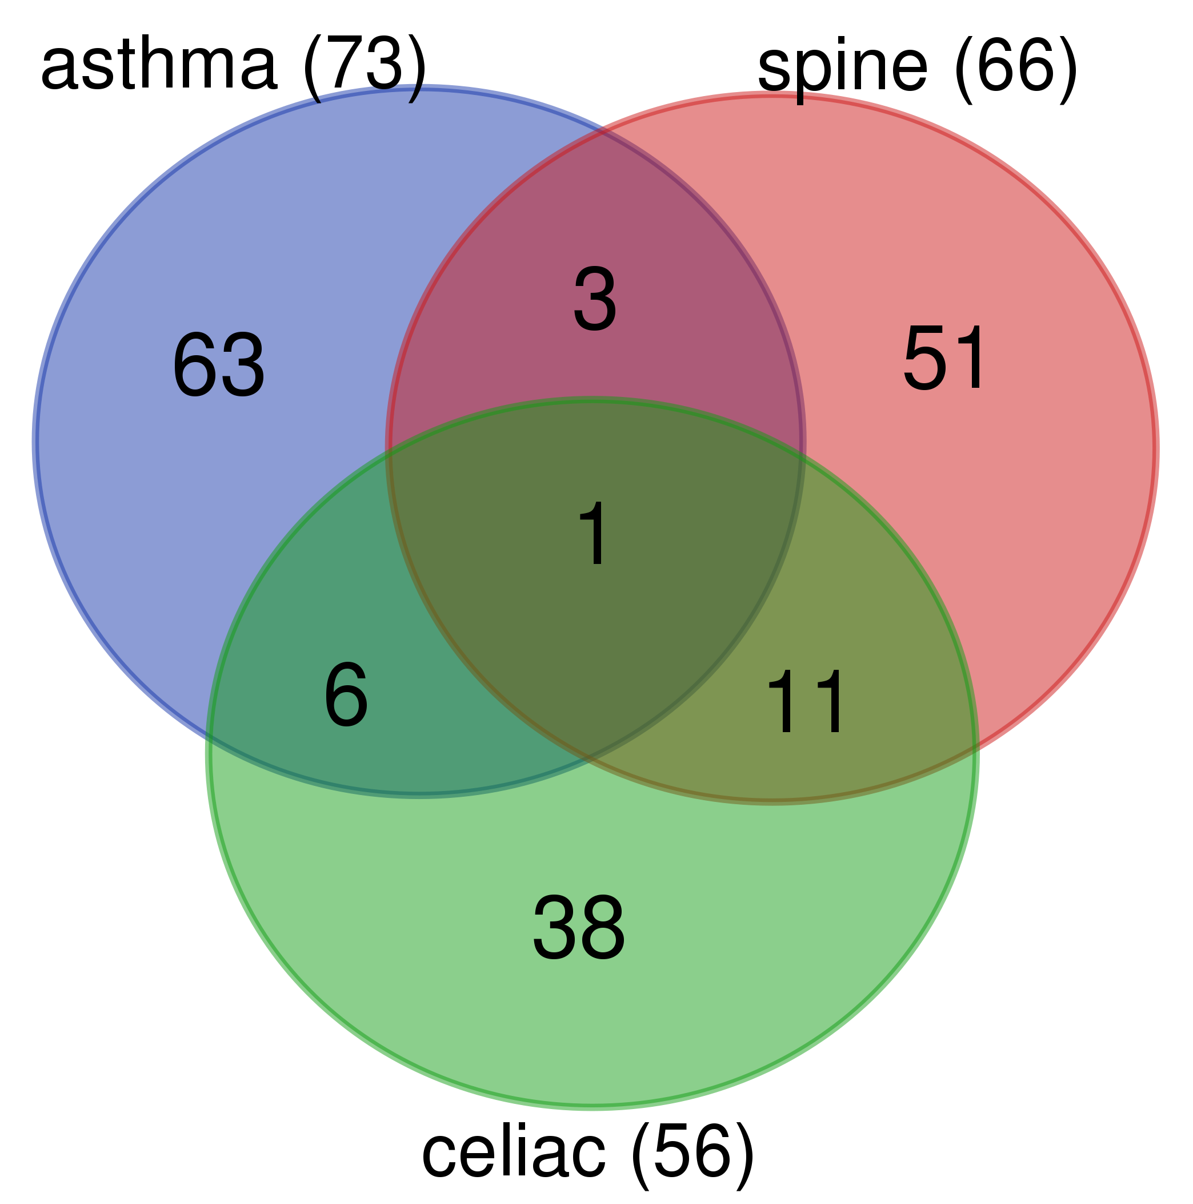
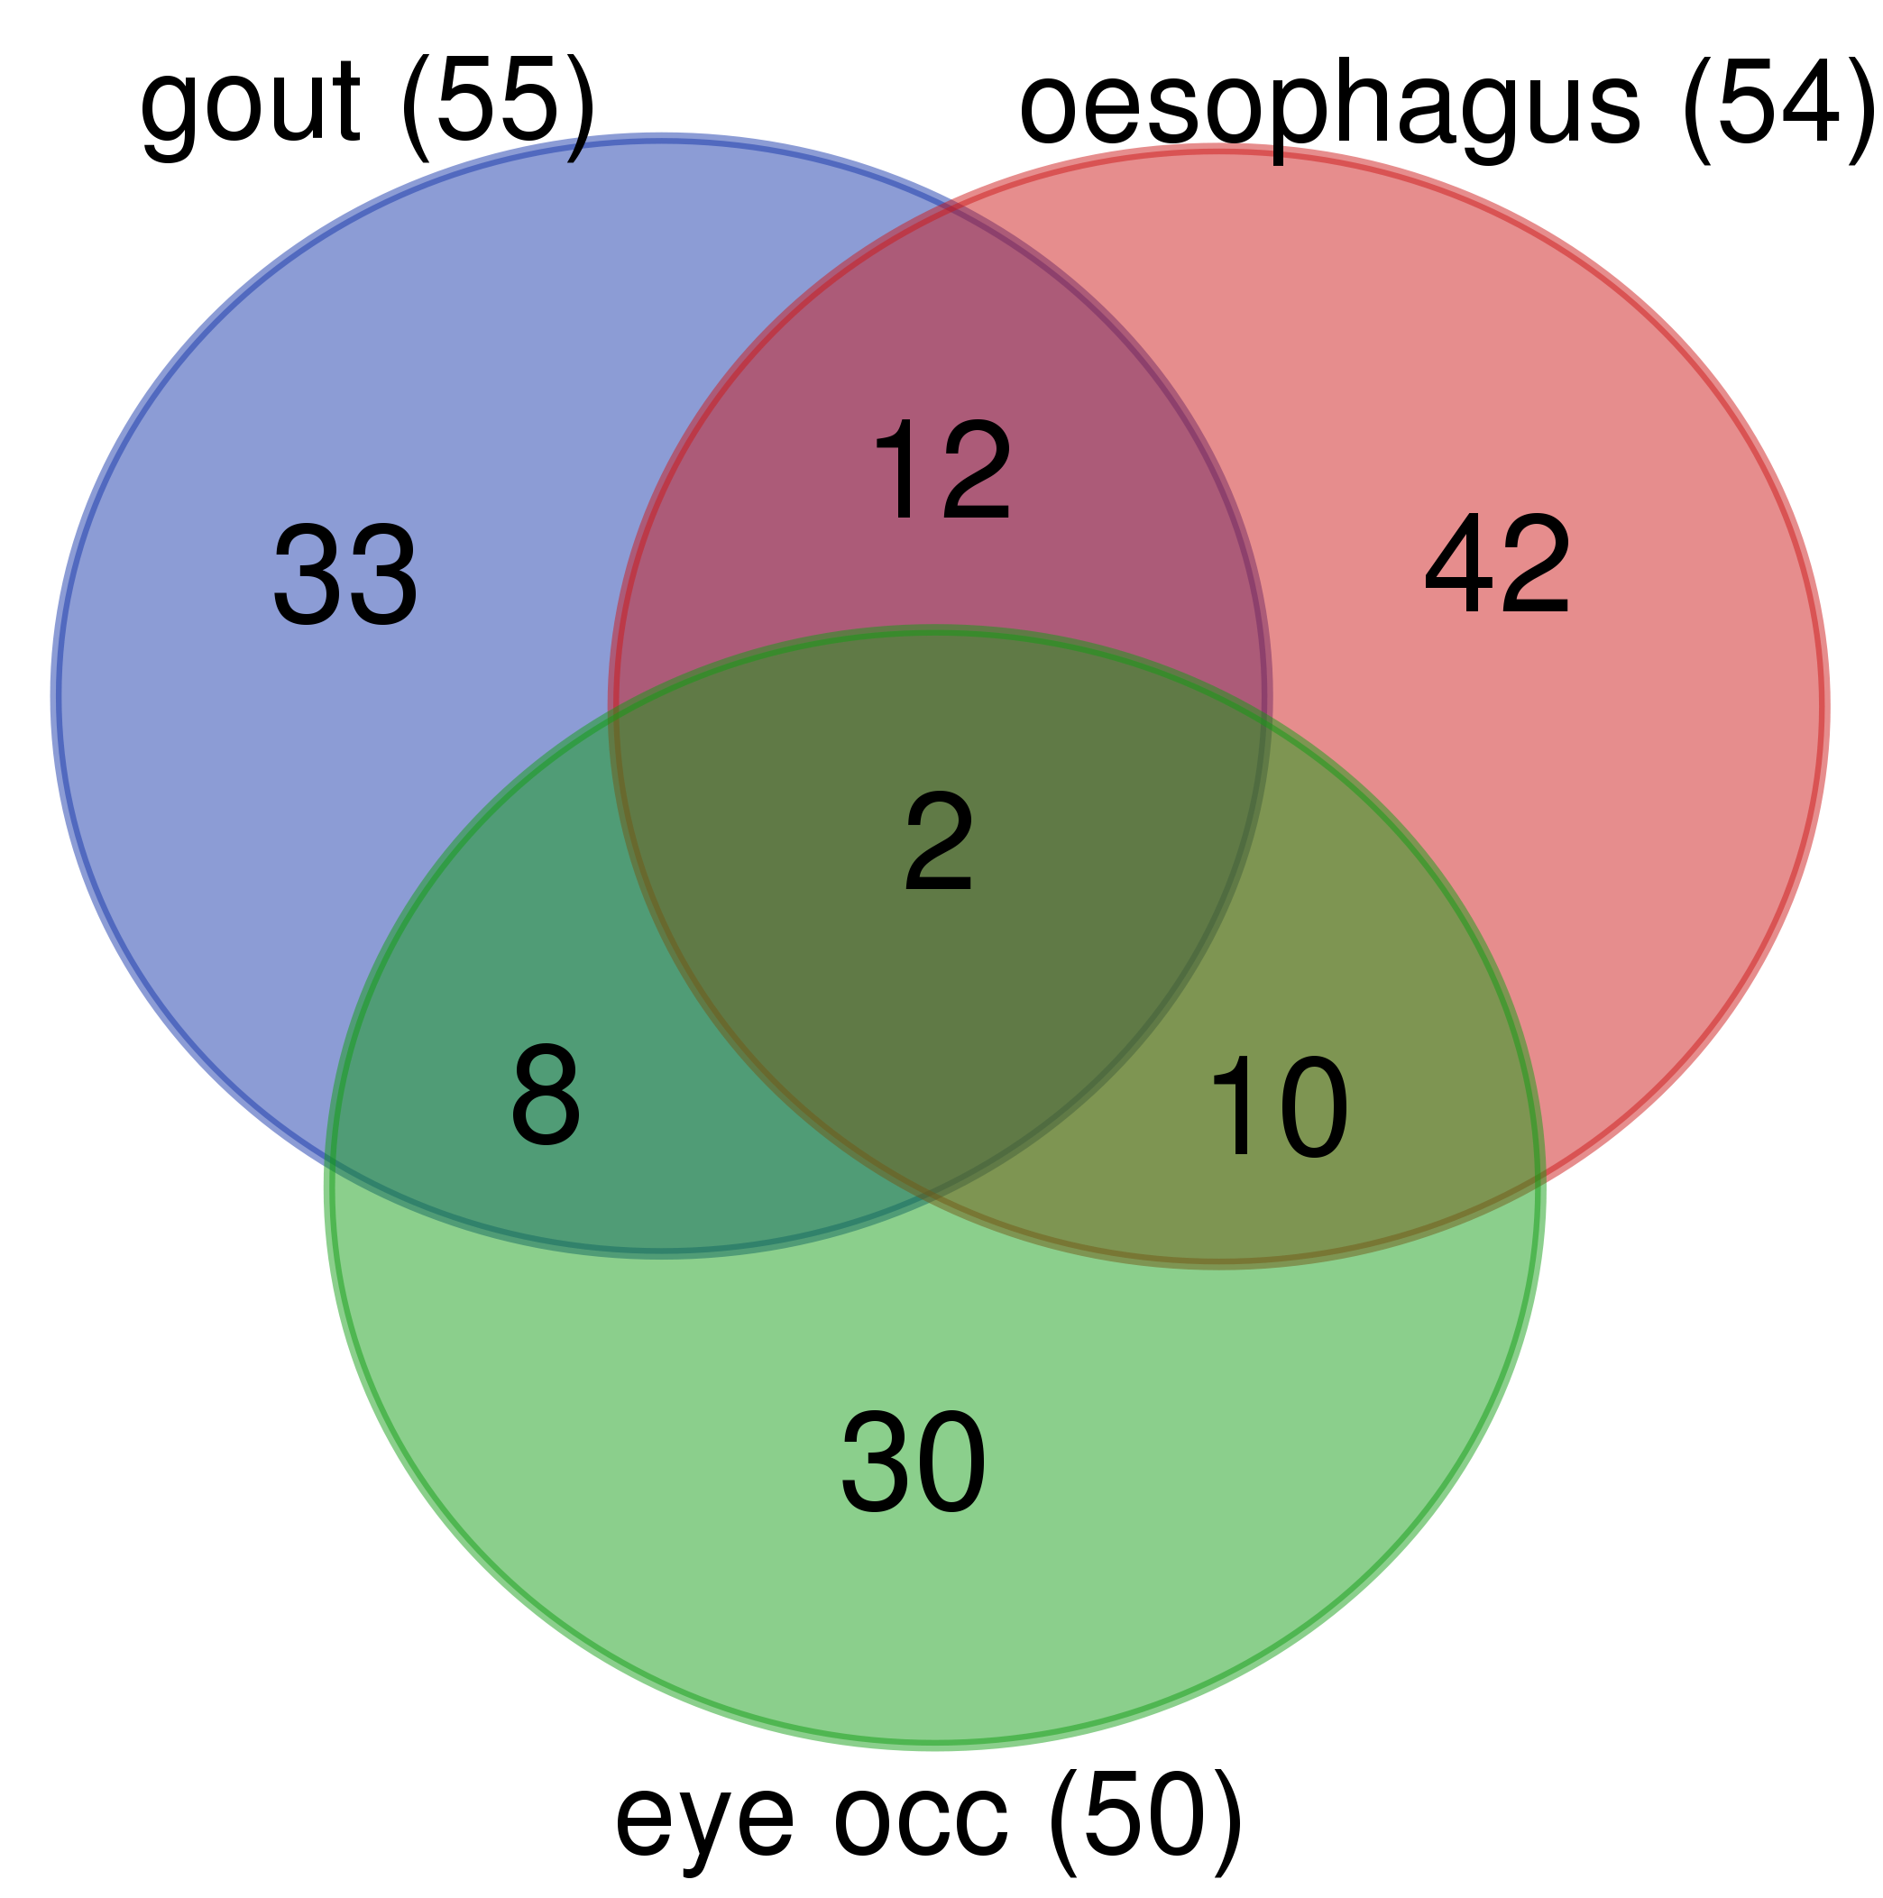
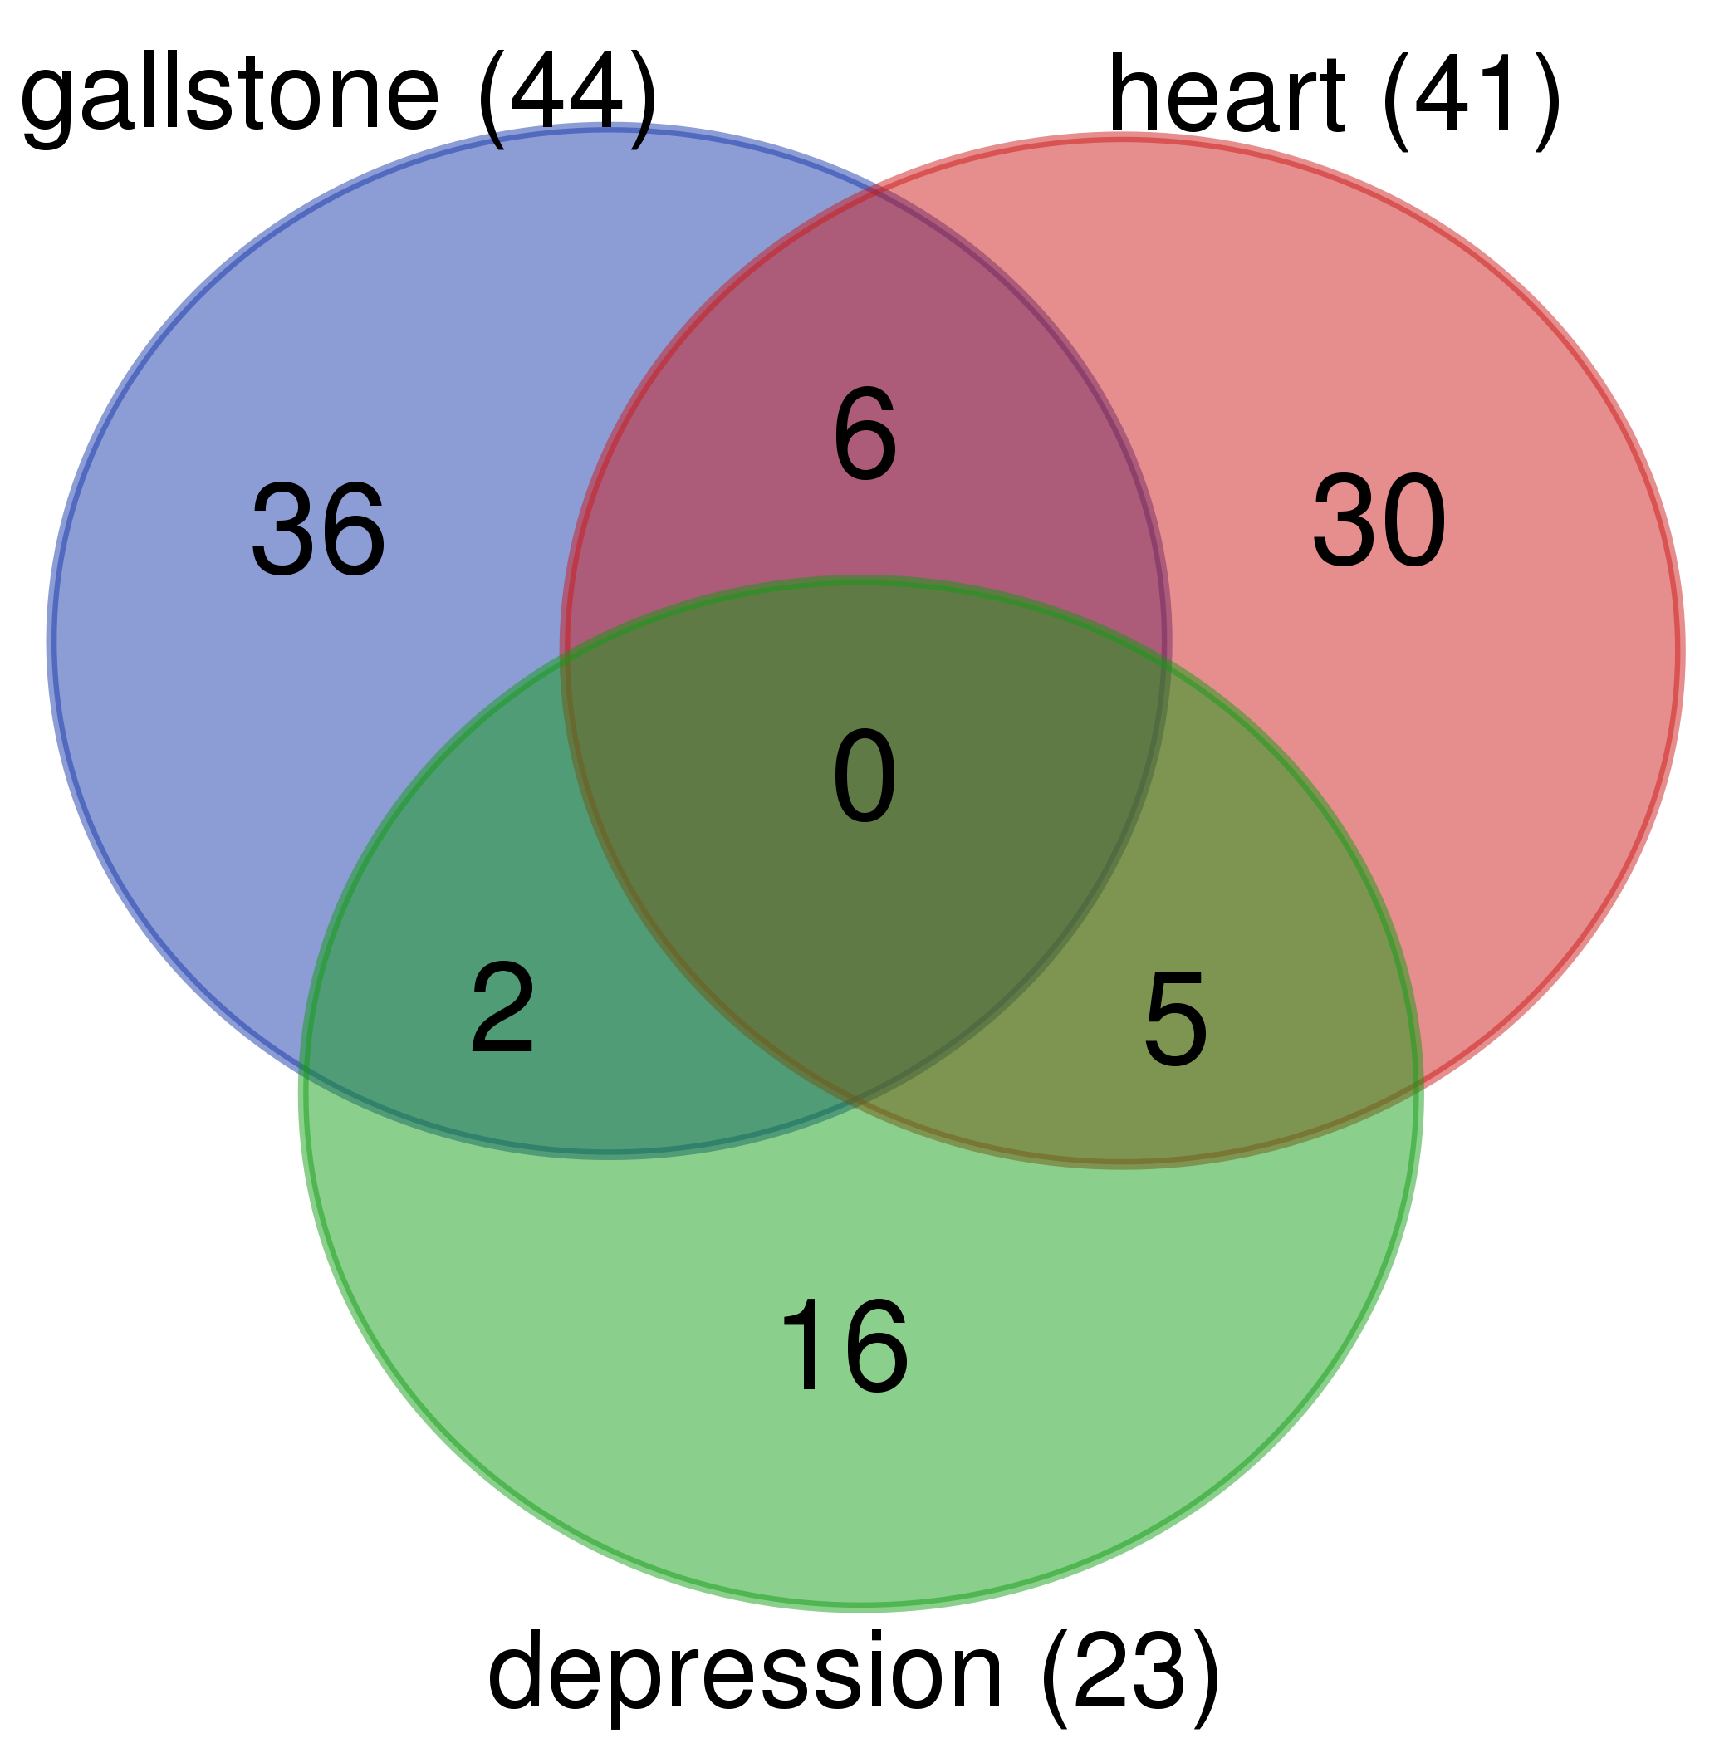
This is example of the features that are OVERLAPPED (just sample
I belive that these are important (I said it 100s times)
Do as you think as I refuse to keep arguing about the content.
As I said I think the insights from the process are far more interesting than the ‘result’ of this is indeed interesting that a random clinical doctor shared with us.

