Slide 1














OTRec Two‑Tower Architecture
Disease–Target Recommendation
Disease Inputs
Target Inputs
Name & description
Gene symbol & description
Exact synonyms
GO terms (MF/BP)
Ontology parents (EFO)
Pathway annotations
ID embedding (64‑dim)
Tractability buckets
Feature Encoding
Feature Encoding
Text vectorisation & counts
Text vectorisation & counts
Concatenate Disease ID embedding
Tower (Wide & Deep)
Dot Product
(Cosine similarity)
Tower (Wide & Deep)
Wide: Dense 384 (Linear)
Wide: Dense 384 (Linear)
Deep: 384→LayerNorm→Dropout→64→ Dropout →384
Deep: 384→LayerNorm→Dropout→64→ Dropout →384
Residual Add → 384‑dim embedding
Residual Add → 384‑dim embedding
Predicted Clinical Association
Sigmoid → Probability of clinical trial entry (0-1)
Linear → Open targets evidence score (auxiliary target)

Slide 2
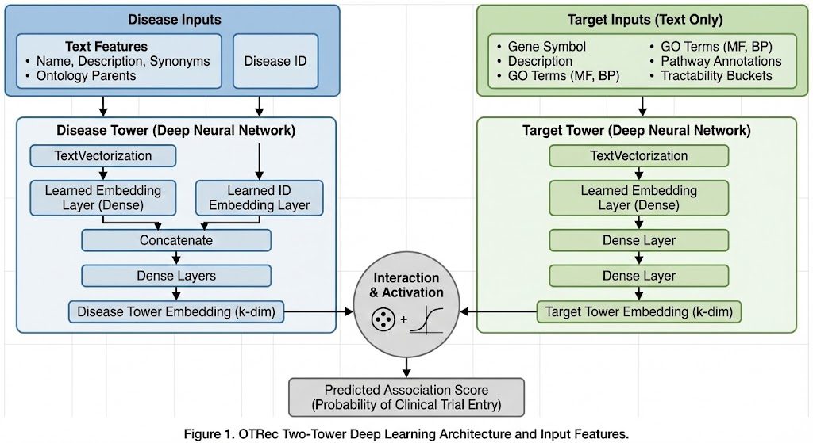
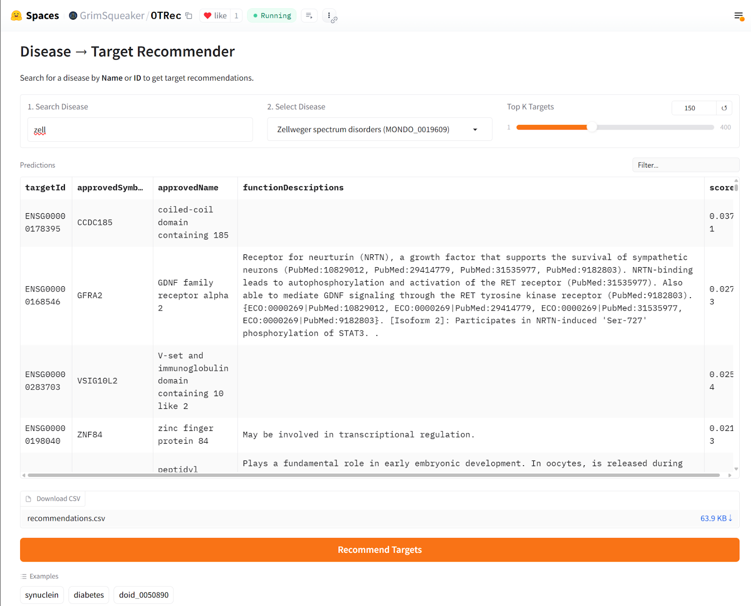
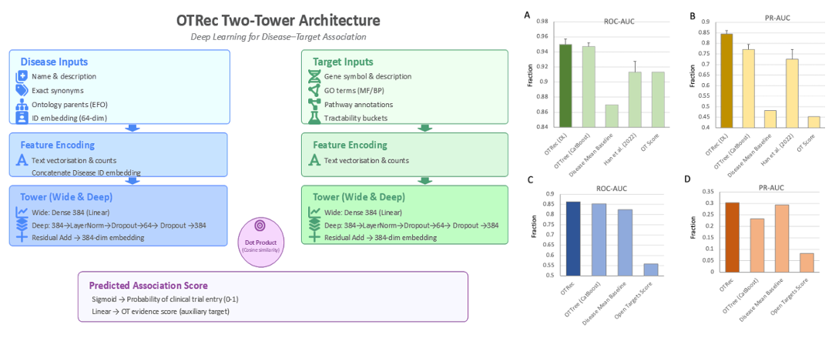

Slide 3
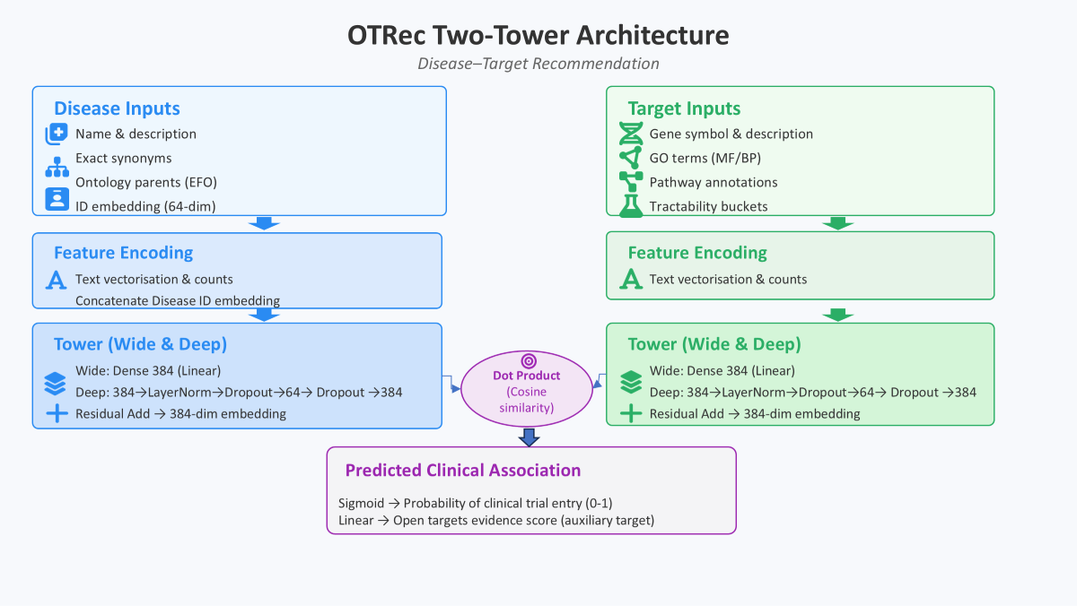

Slide 4
A
B
Fraction
Fraction
C
D
Fraction
Fraction

