Slide 1






Skills & WebGames
Liang Jiaxi 2530031163

Slide 2
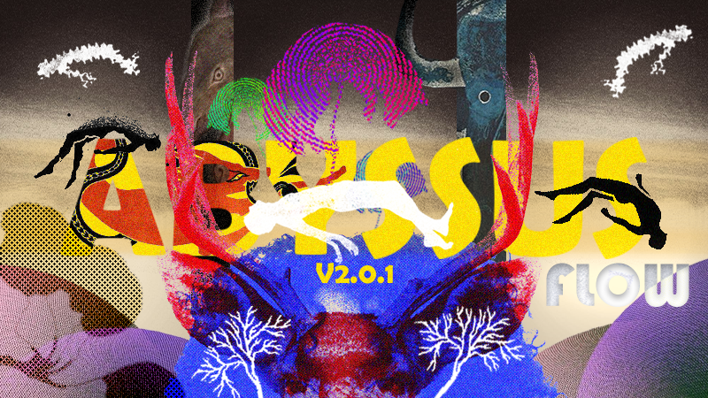
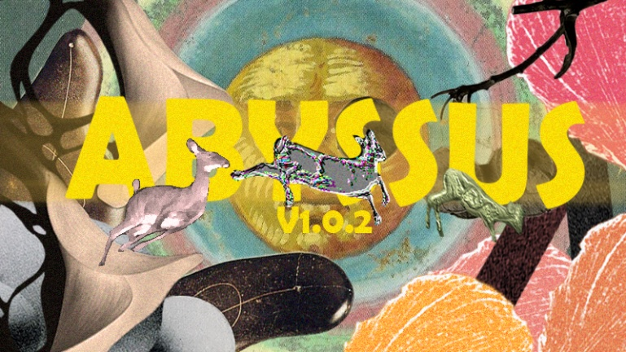
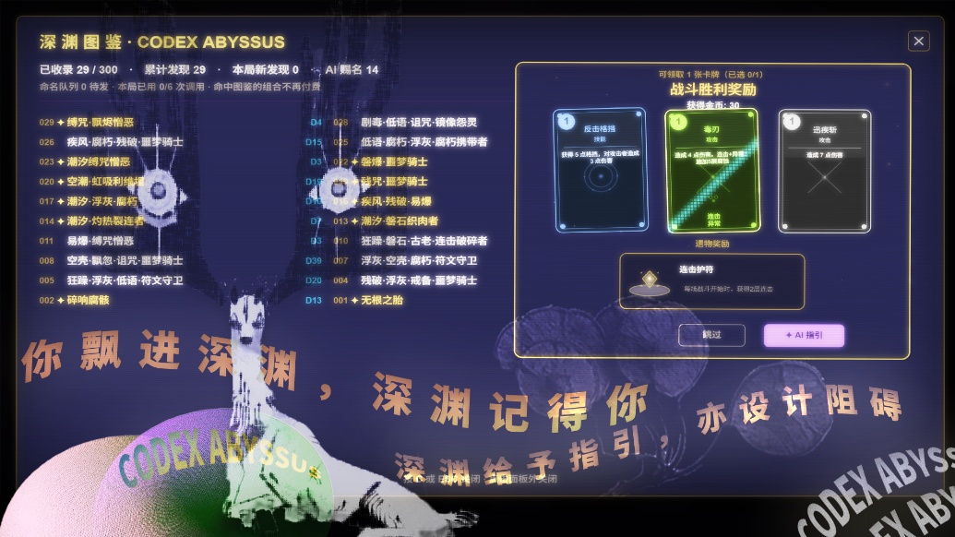

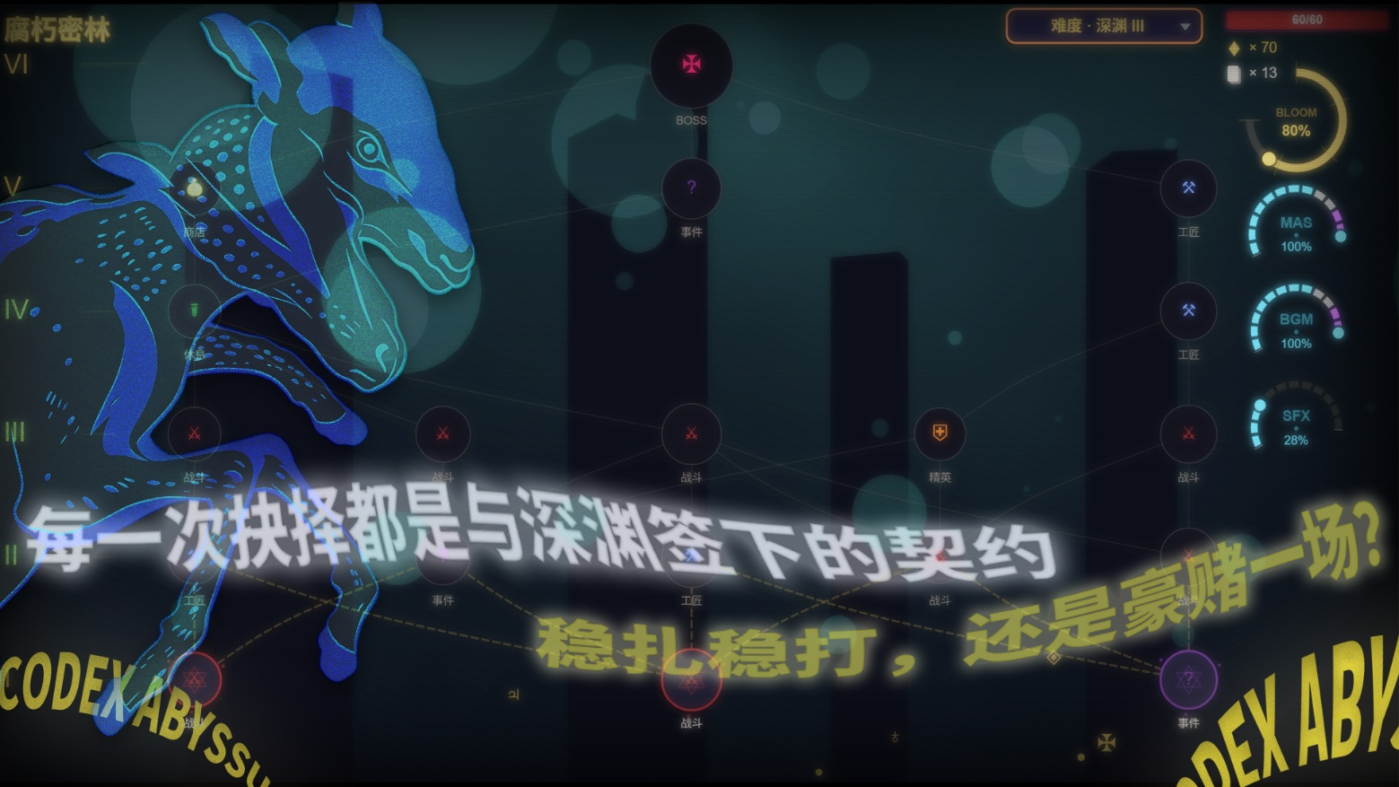
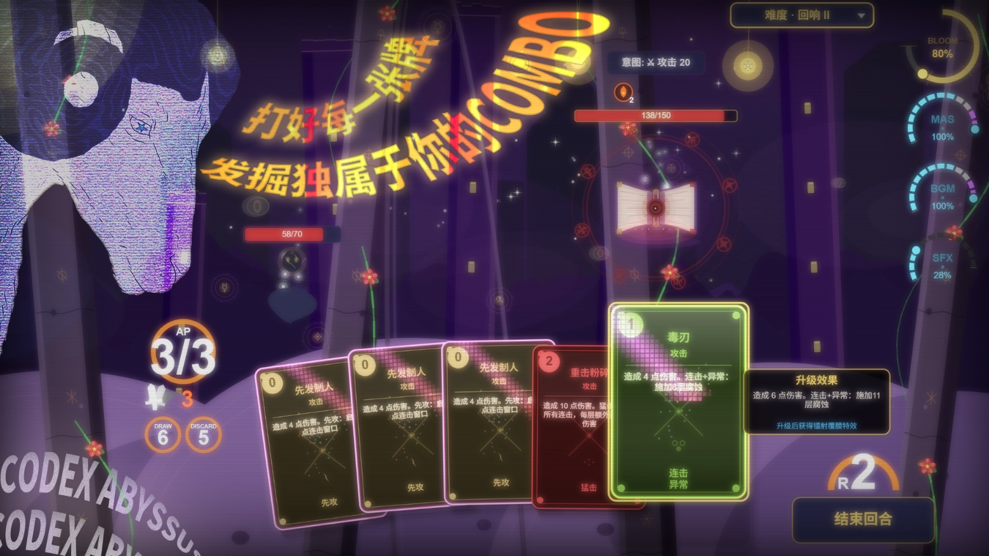
WebGame Example
https://game.virtualoverapp.com/game/3730
ABYSSUSFLOW
Cards
Rougelike

Slide 3
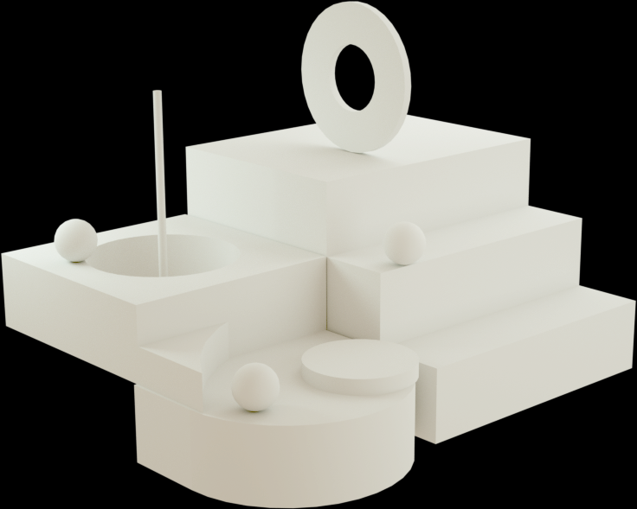
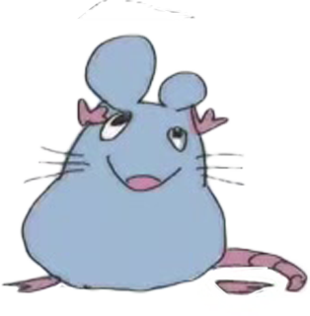
SKILLS
Extraction and Replication of a Common Design Language
Cool card motion effect

Slide 4
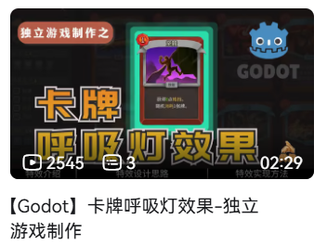
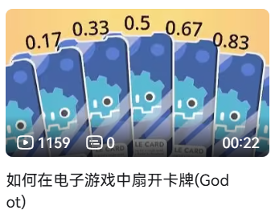

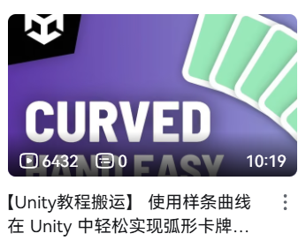
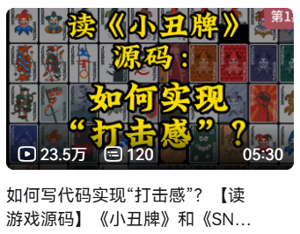

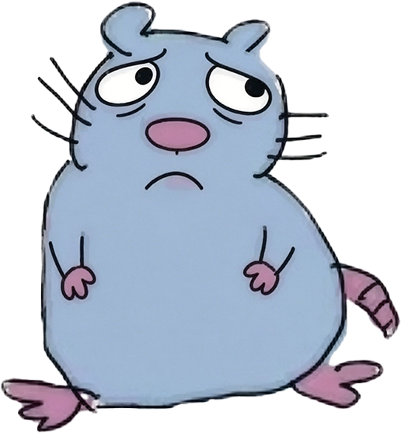
DO NOT REINVENT THE WHEELS
You may have seen...
Multiple videos focus on how to build great card effects, but they are based on unity/godot, are they really useful for me who want to build theses based on P5JS?
Of course Yes

Slide 5

DESIGN
LANGUAGE
What should a great effect have
Implementation mechanism
&
How to make
Great effects
Replication is like Language translation
Code to Effect to Code
C#/gdscript
javascript

Slide 6
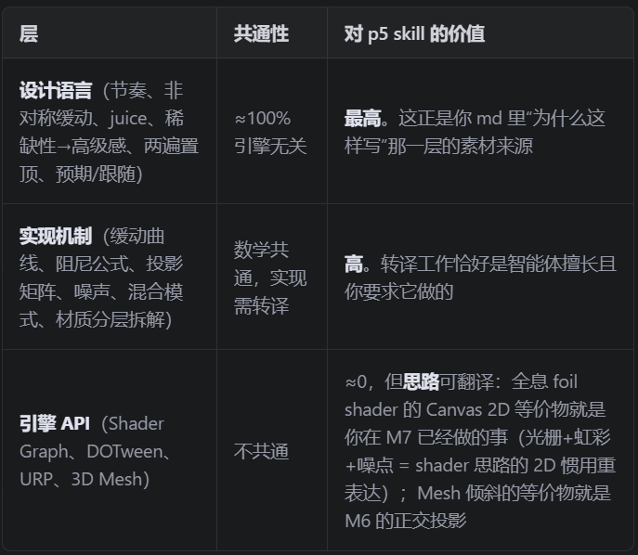




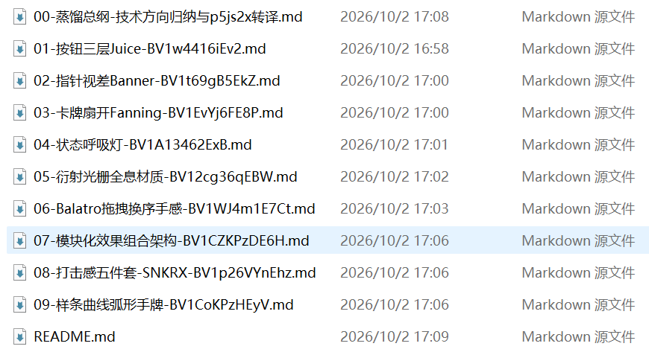



Video To Skill To Code Workflow
Detailed MD File
2
Able to grasp all the subtitles & comments
Define what kind of information in the video should be Distilled
Create a mcp/download videos
To let AI read and fully understand their content
How should AI translate them into Specific Code
1
Final Skill
Start working and produce MDs(With Codes)
Generate the most important reference
3
4
Modify according to the actual project background and requirements
“Personalize”

Slide 7
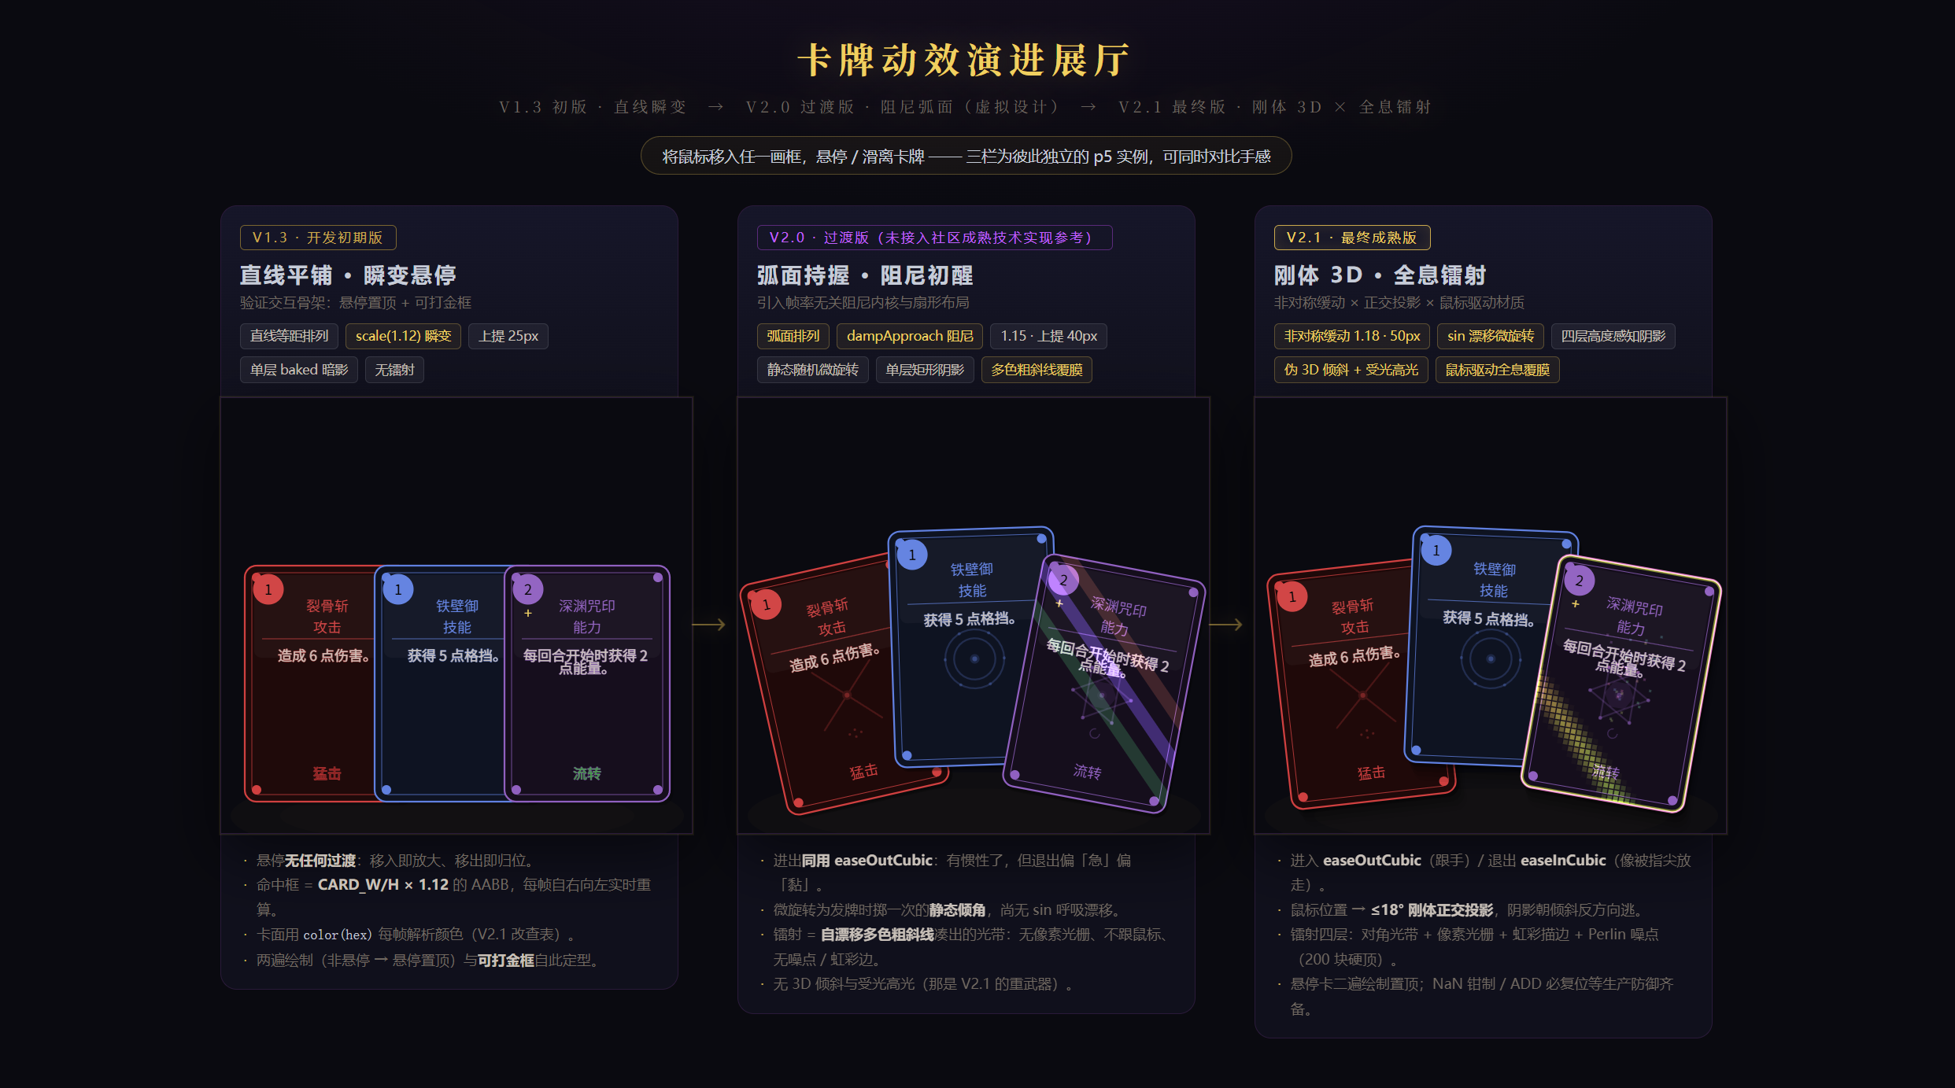
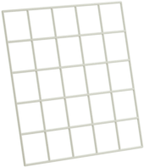
Visualization

Slide 8

How to build “huge” Web Game
Suggestions about AI Workflow

Slide 9
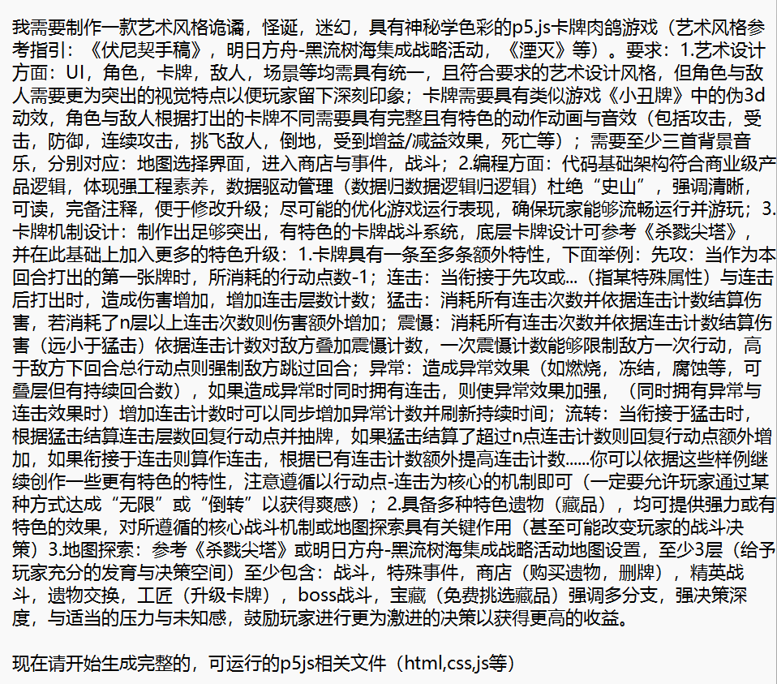
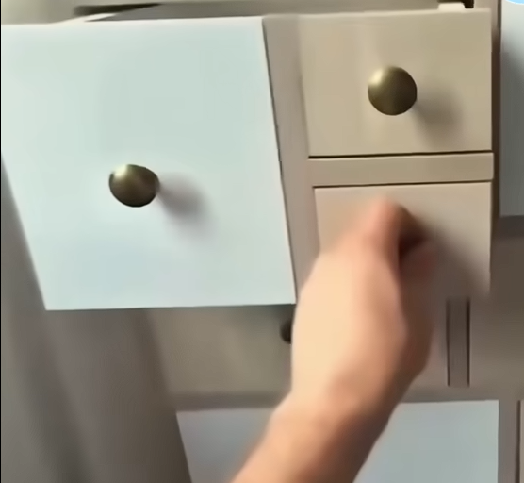


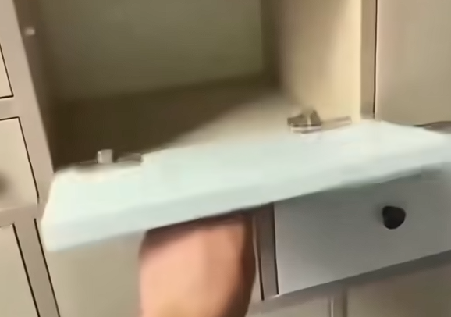

Demo != Publish Games
One sentence prompt to create the whole game......or
Structure suitable for long-term update
Should be built based on Substructure
The first/most important task you & your AI
Need to highly focus on
Data
Basically test your thoughts/for immediately play or test
Most of them Not for long-term update (if rich enough no need to care about this)
logic
Modularity and Low Coupling

Slide 10
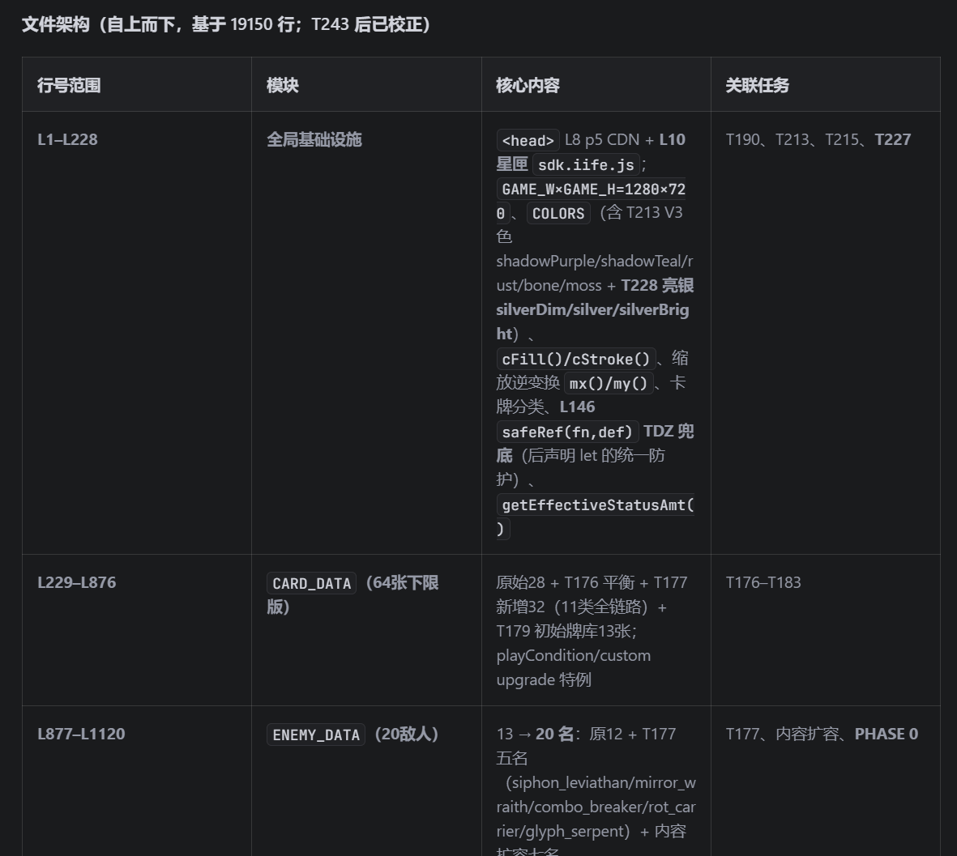
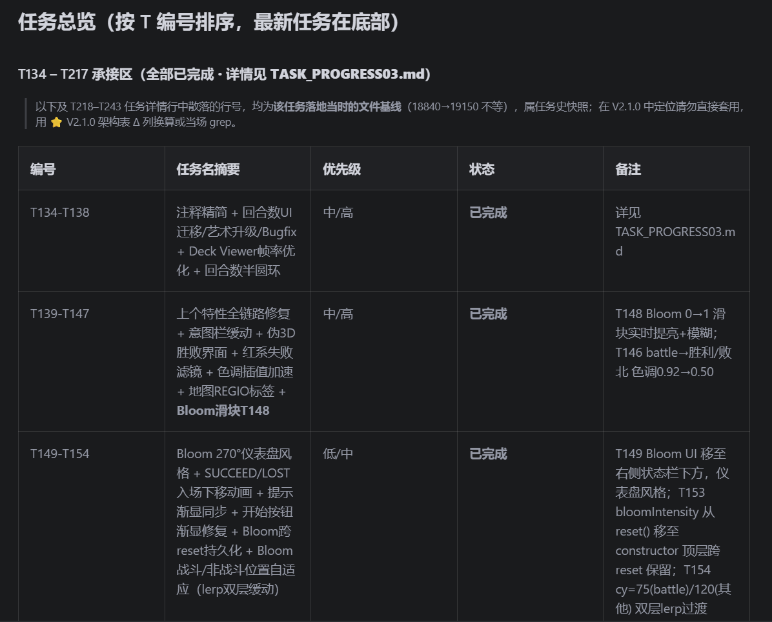
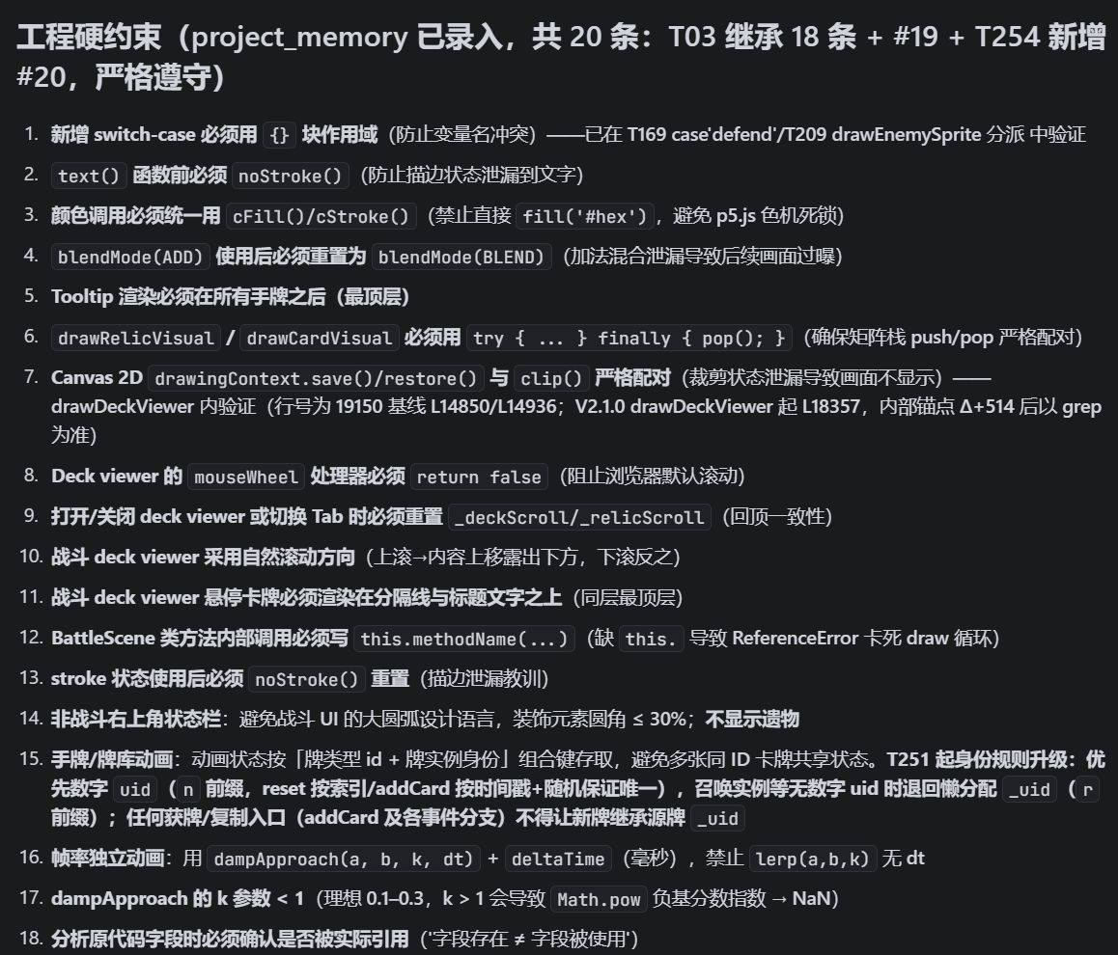
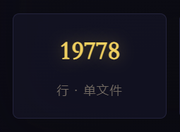
Suggestions for AI Workflow
Reference for higher Speed & Precision
Changelog for memorize bug/solutions
Constraint for More stable output quality
Need to be changed after every update
Gain these from multiple updates
(For may meet many new bugs)
You can create a skill to help update these
TASKPROGRESS.md

Slide 11
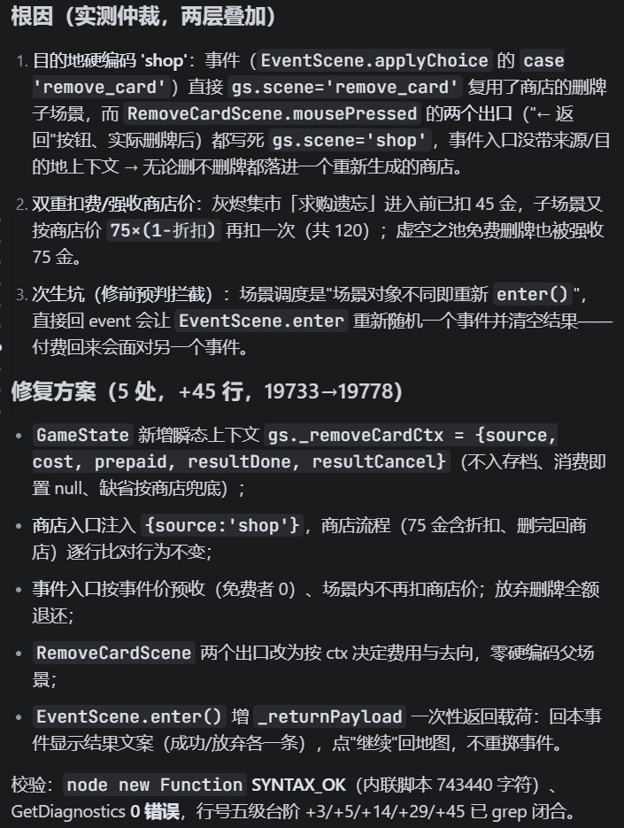
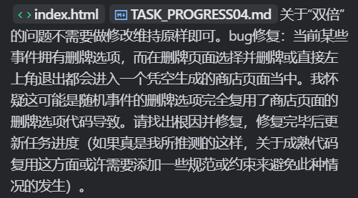
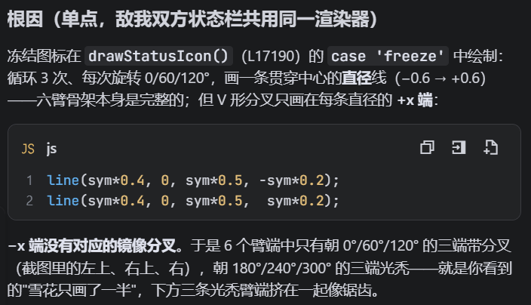
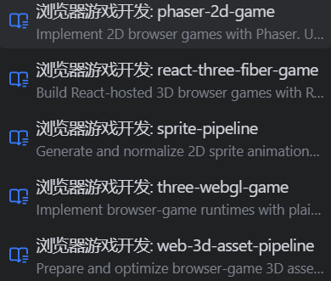
Debug & Incremental update
Identify the root cause &
Minimize modifications
The Card motion effect as example
Clarify your thoughts
Find Existing“wheels”
Distilled them into a skill which Dedicated to serving such updates
Do not change too much or something unknown will happen
cook03
cook02
cook01

Slide 12

Thank You
Liang Jiaxi 2530031163
Such simple game I can definitely do a better job than

