Slide 1
Integrated AP Computer Science
Learning and Practice Platform
Proudly Presented by Lloyd & Link

Slide 2
Objectives
Difficultly for getting review and practice resource ( bad CB )
Hard to do review & practice & writing & checking answer together
Learn more java : prepare for Advanced CS

Slide 3



Workflow Introduction
Cross-Platforms ----- Java
Desktop Graphics Application ----- JavaFX
General ----- JDK 8
Complex Programming Requirements ----- Eclipse IDE
Multi-Collaborators & Open Source ----- GitHub

Slide 4
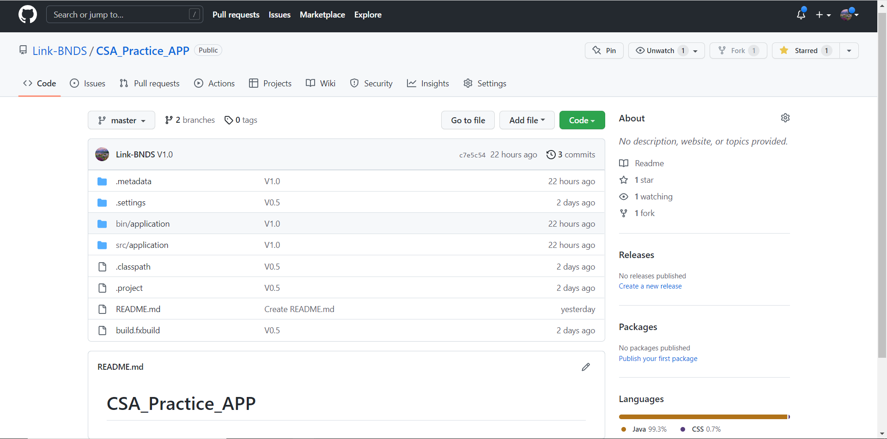
Our GITHUB PAGE
https://github.com/Link-BNDS/CSA_Practice_APP

Slide 5
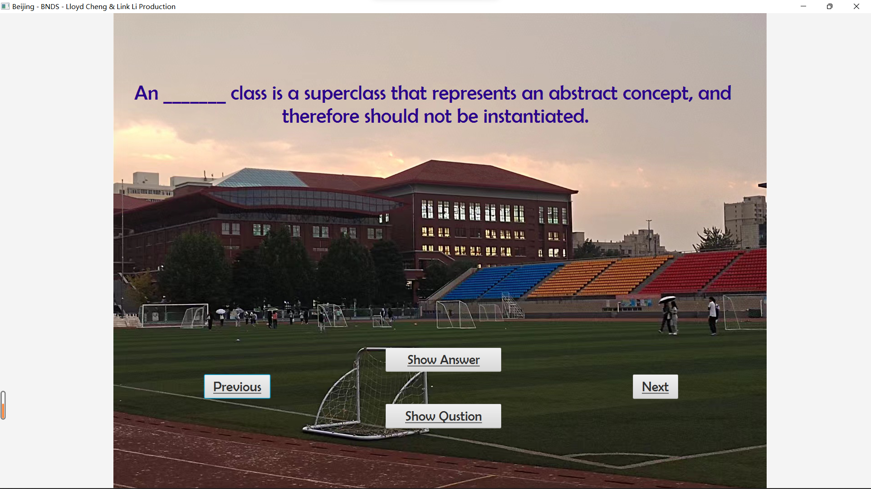
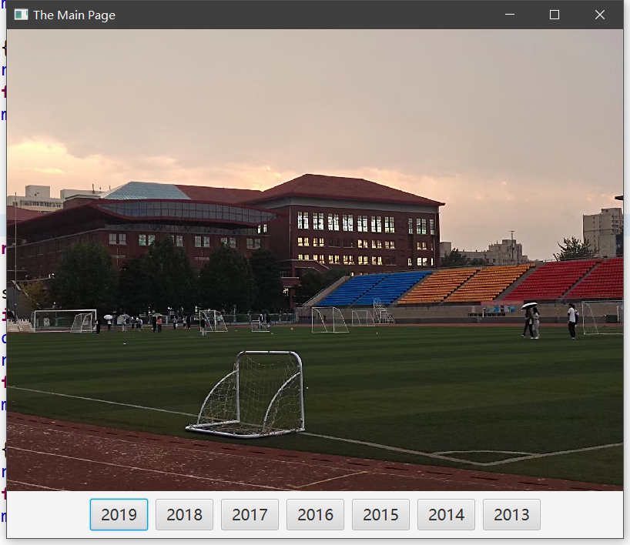
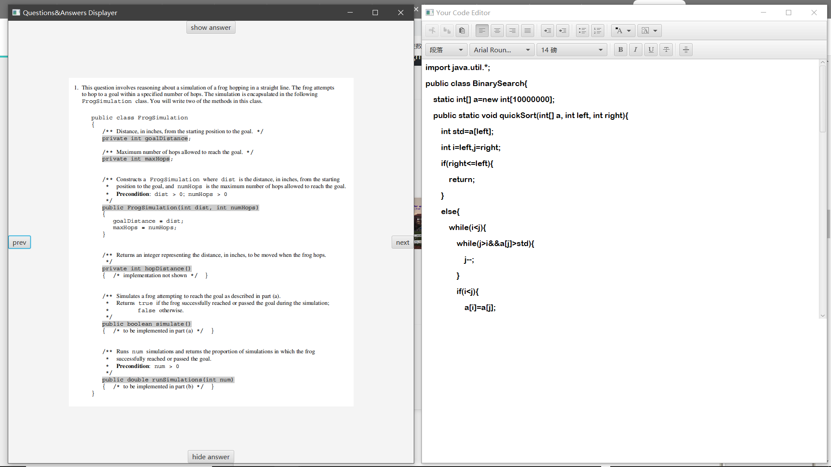
demonstration
Two Main Sections:
Definition Review Tool
FRQ Practice Tool

Slide 6
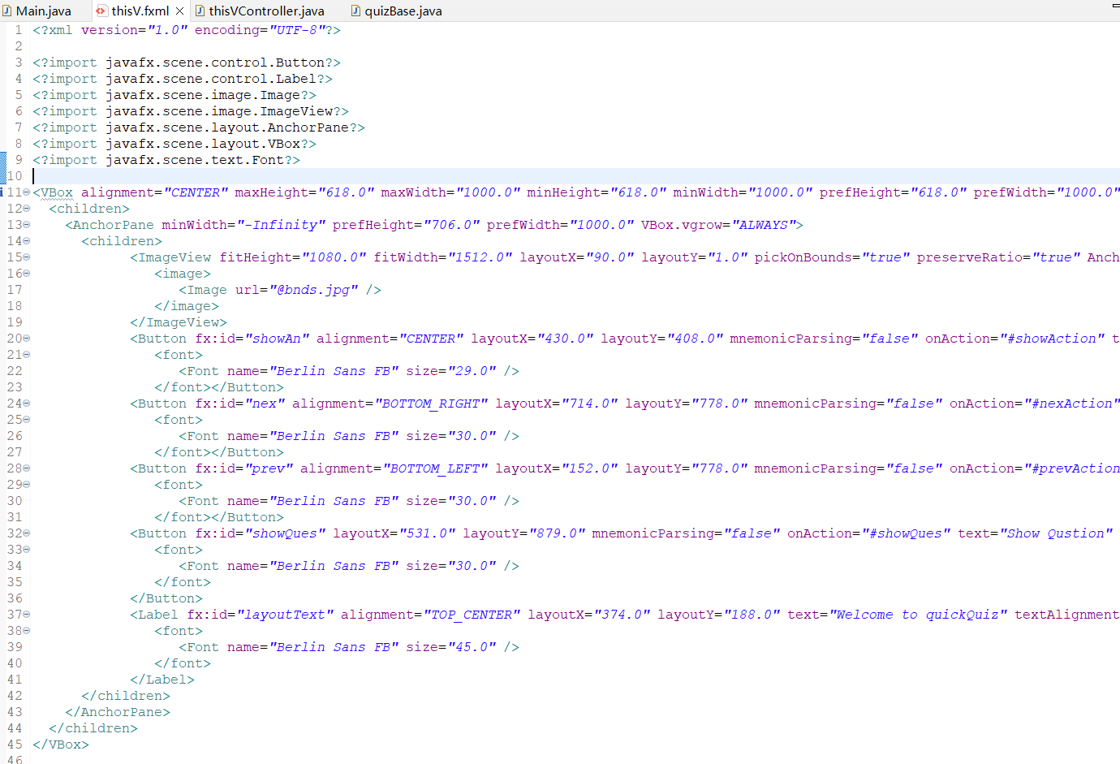
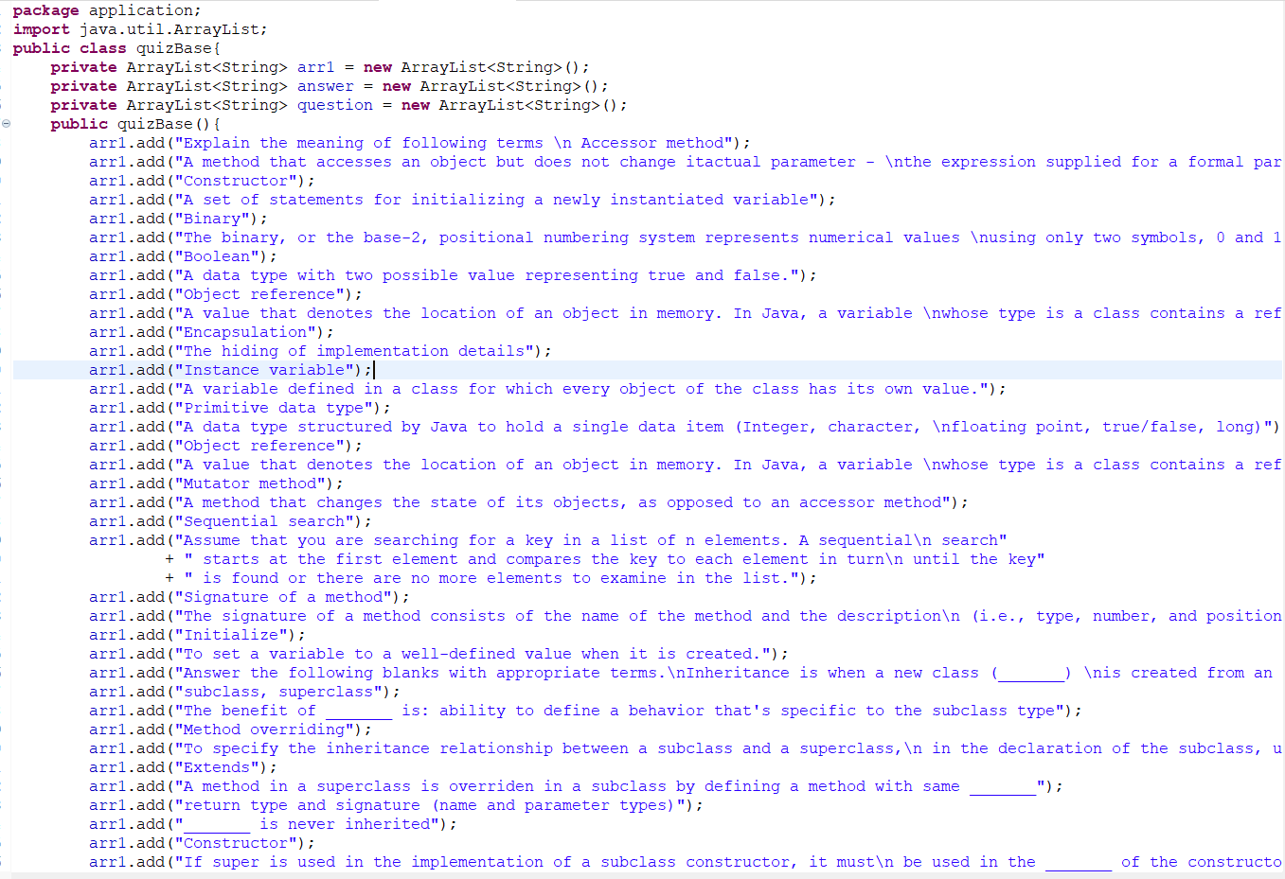
Fxml scene File
Quiz Base

Slide 7
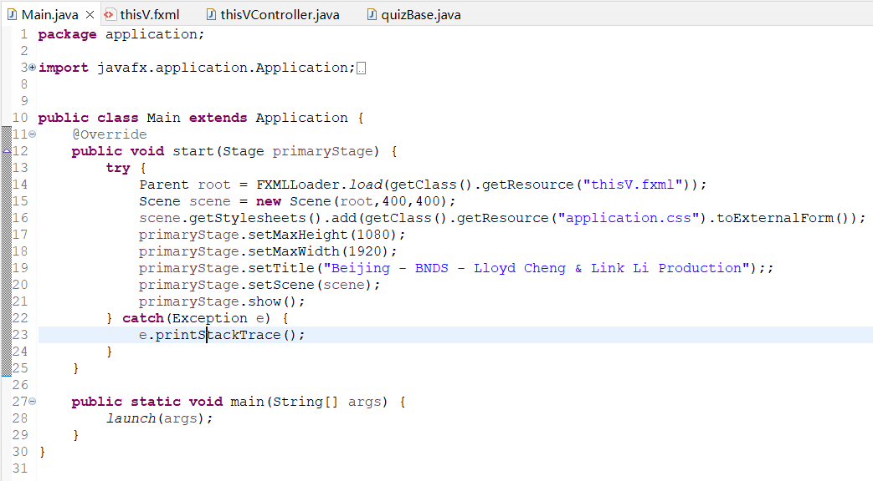
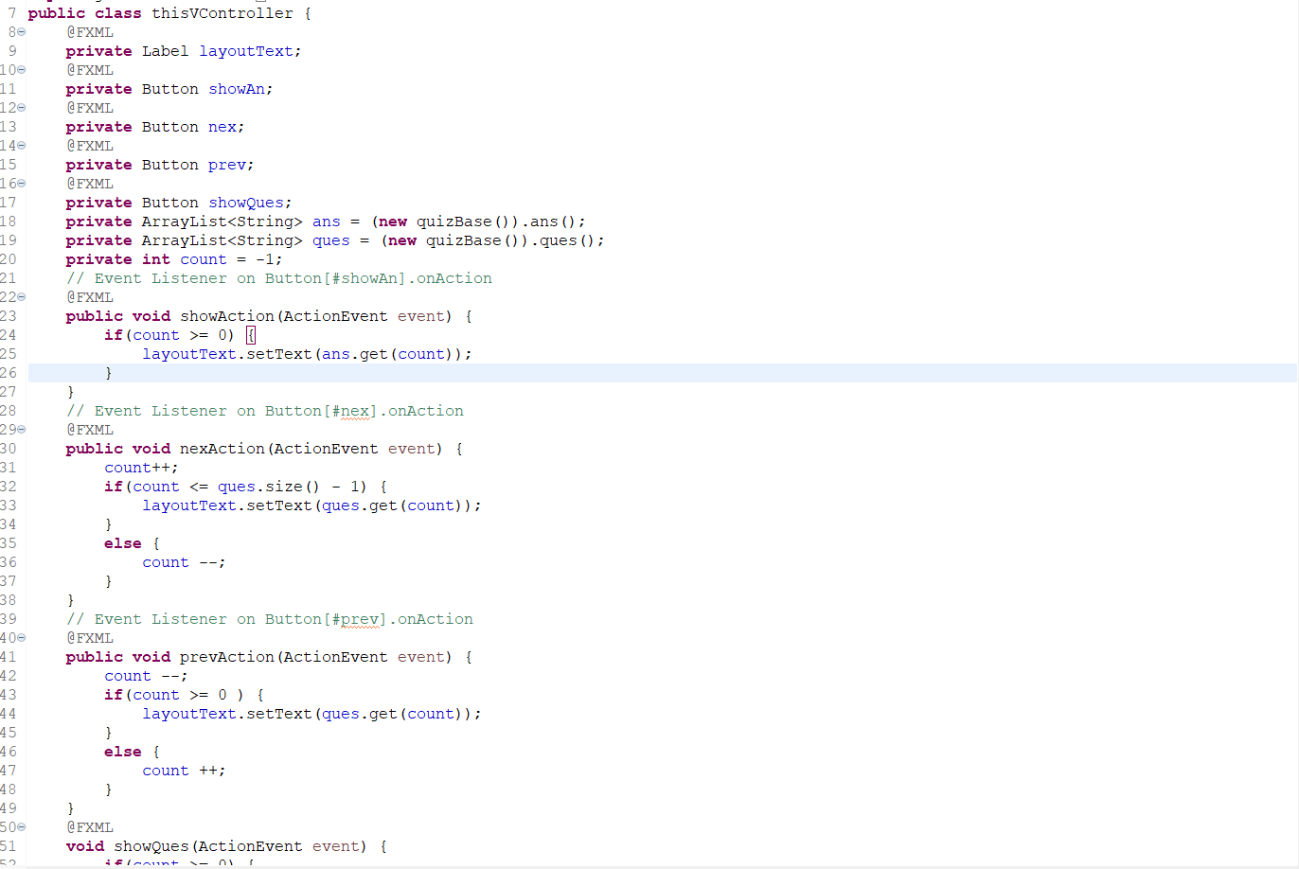
Stage Settings
Buttons Instantiation

Slide 8
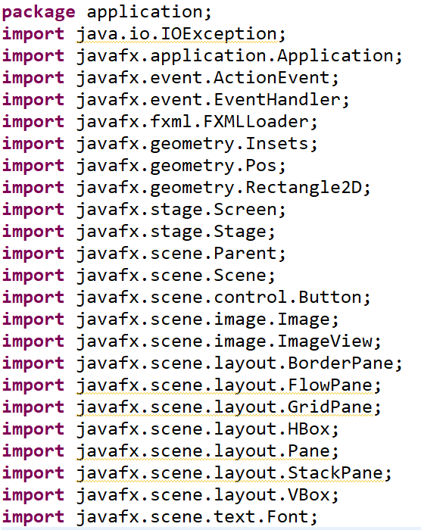
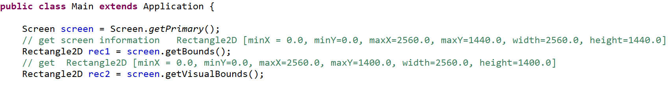
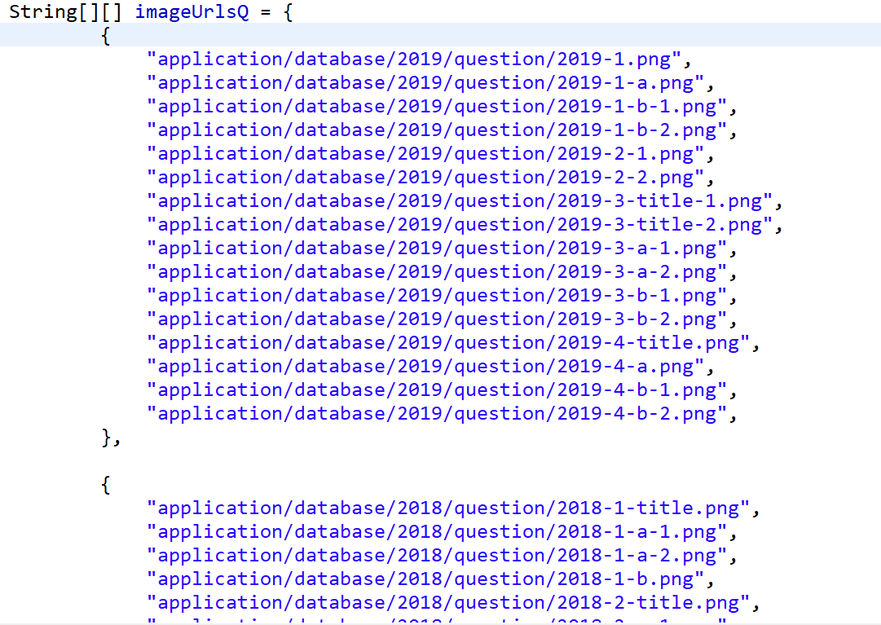
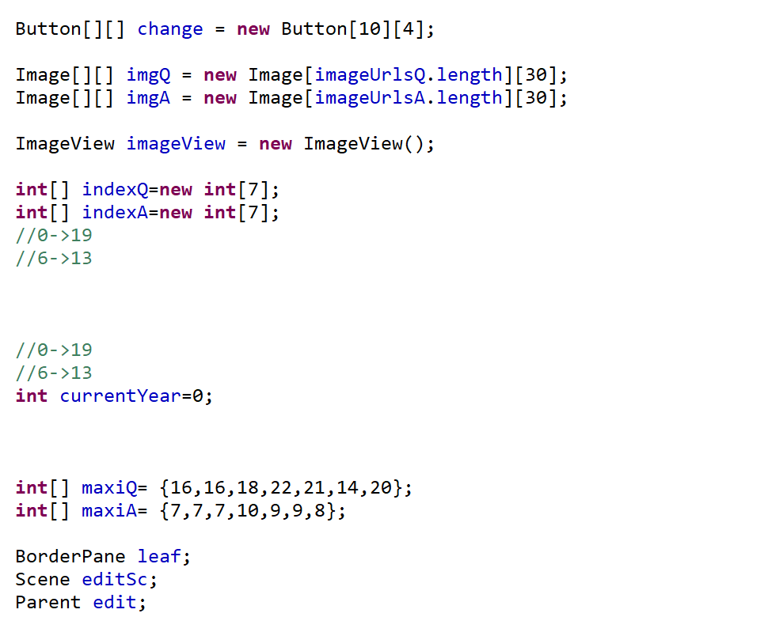
Import APIs
Get Screen Parameters
Import Pictures Files
Instantiation & Initiation

Slide 9
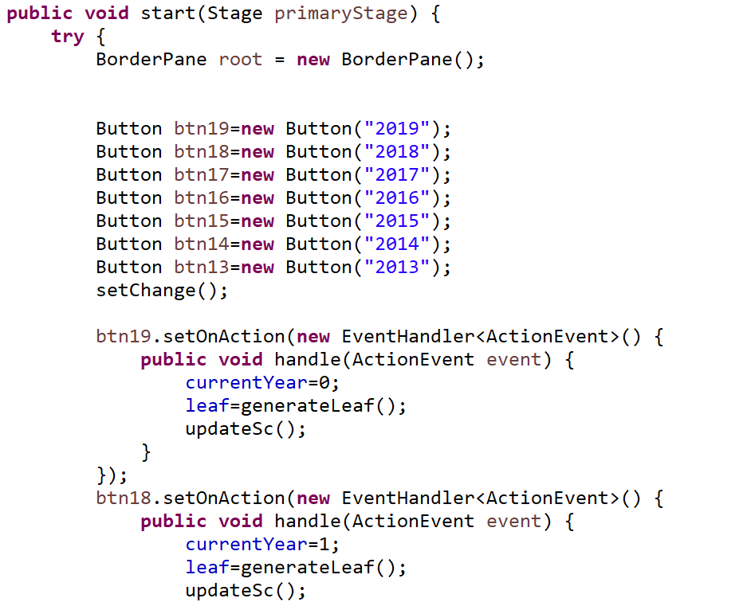
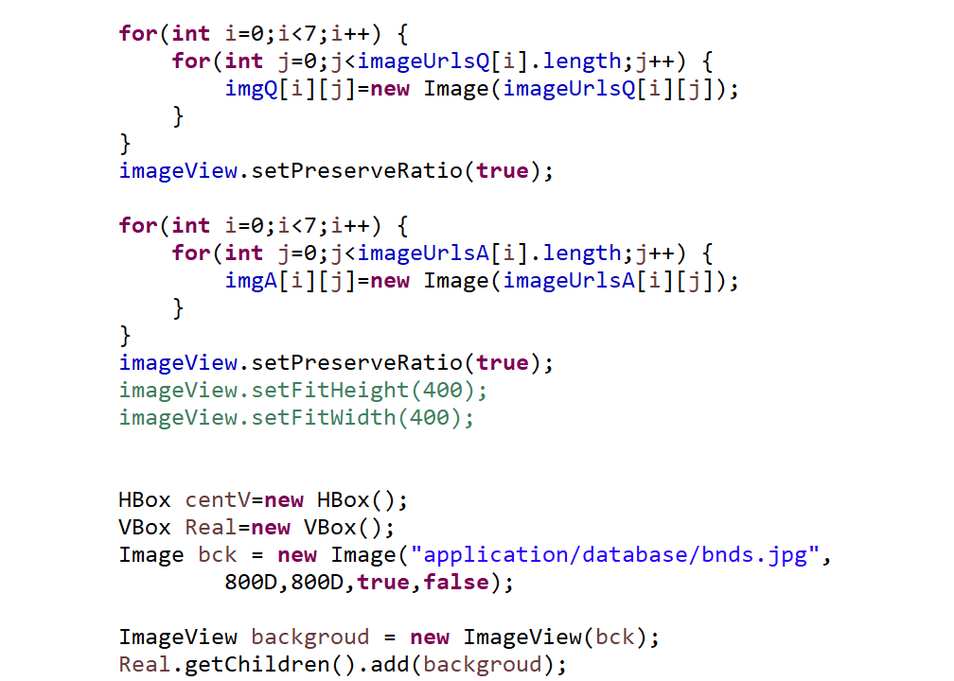
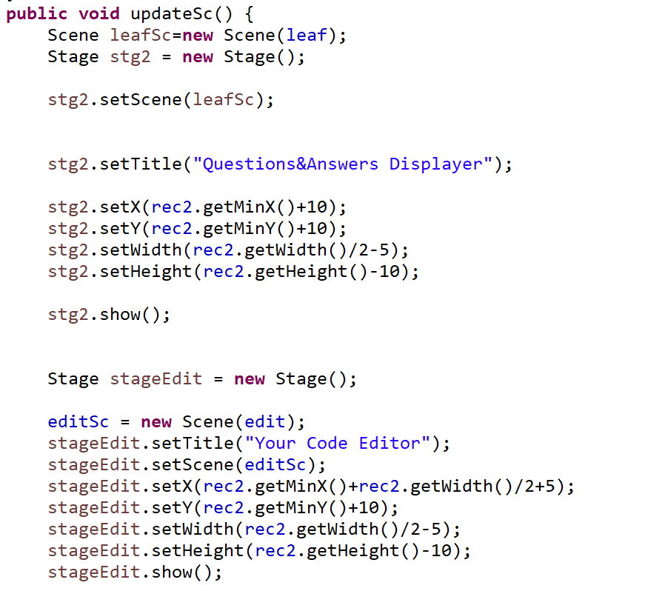
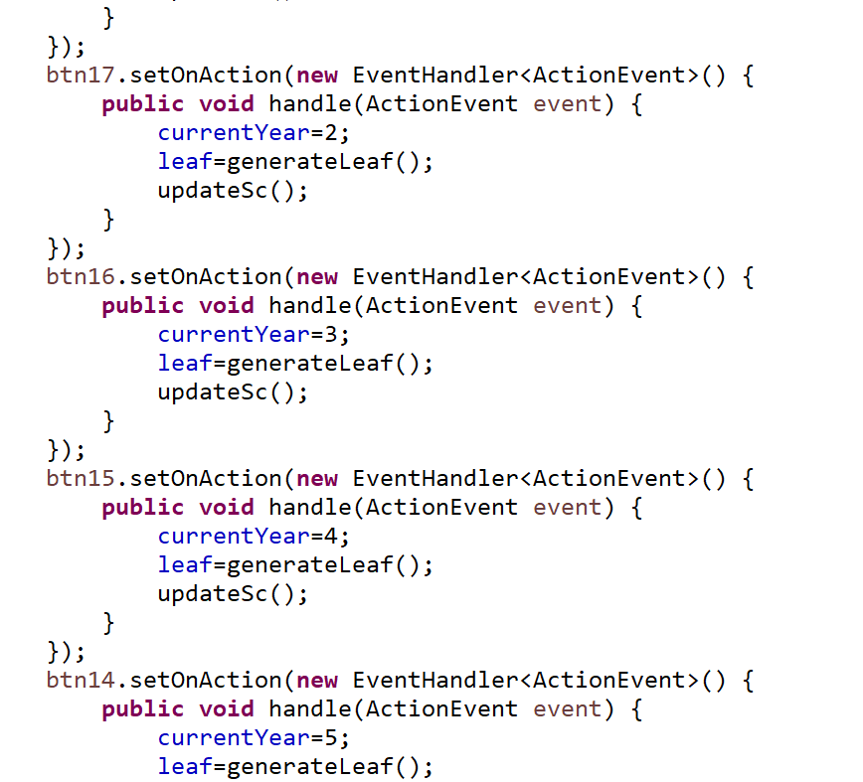
Load Pictures
Scene Setting
Button Instantiation

Slide 10
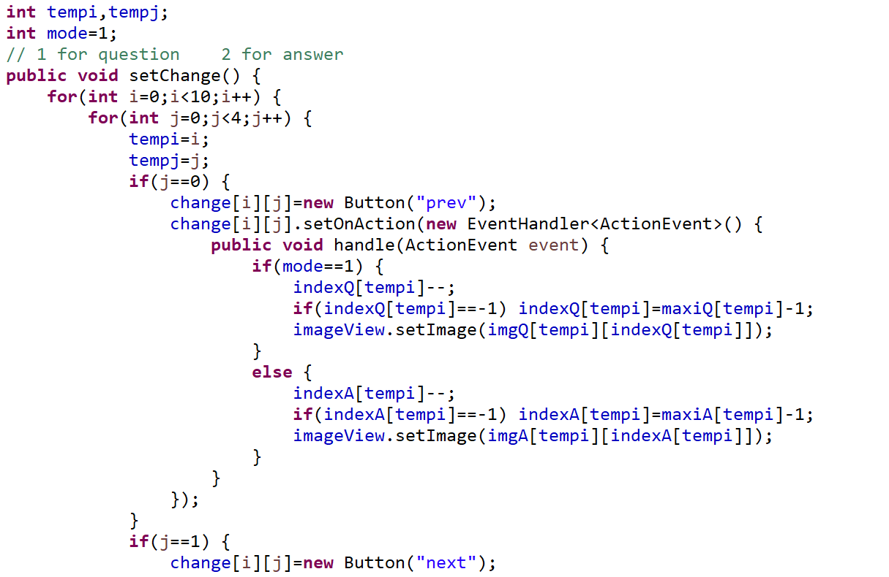
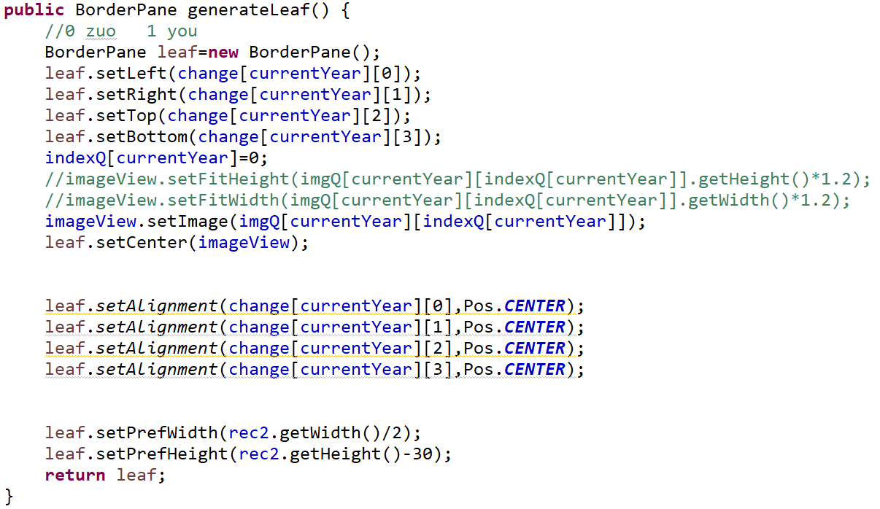
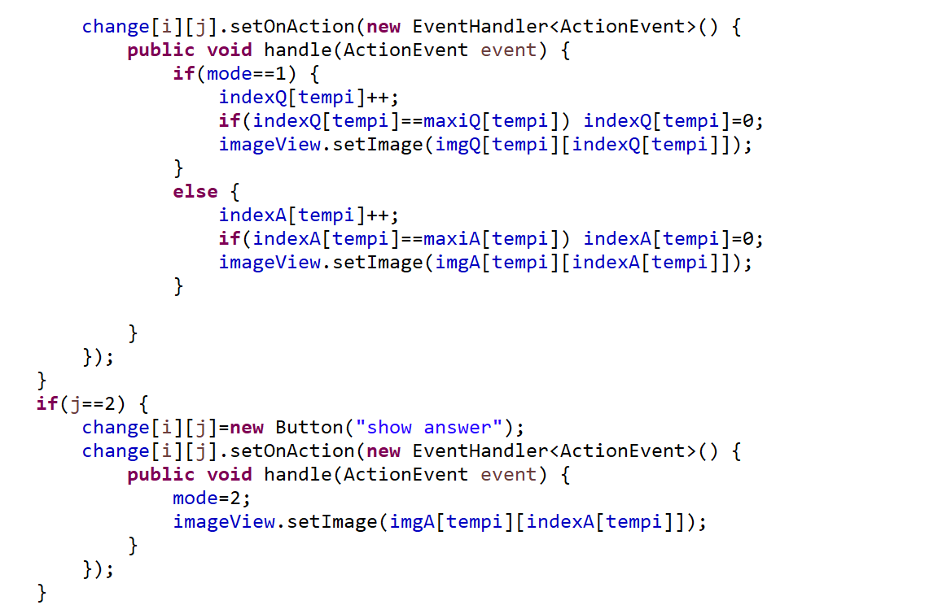
Pane Assembly
Change Buttons Setting

Slide 11
questions
What were the challenges you faced at various stages in your software development?
Complexity of JavaFX API and the learning use the new IDE
How much time it took you for design, implement, and test your project?
Learning JavaFX takes a few weeks; Designing takes 4 days; Implementing takes half weeks; Debugging takes half weeks
How will you further modify your program to make it better or what other functionalities you will add in your program at the later date?
1. More questions in FRQ and Definitions
2. Add more practice that related to APCSA
3. Make an online version of this practice application

Slide 12
Thanks a lot this year
See you in ADVANCED CS

