Slide 1
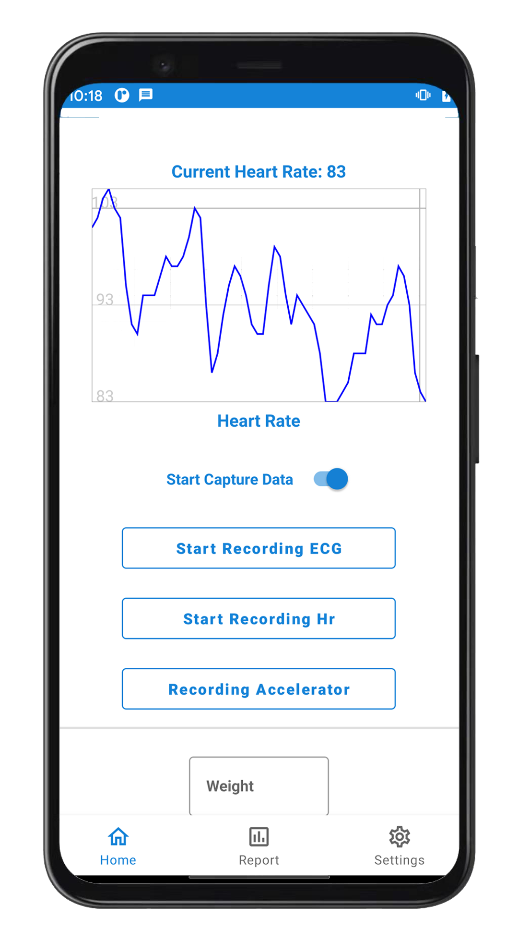
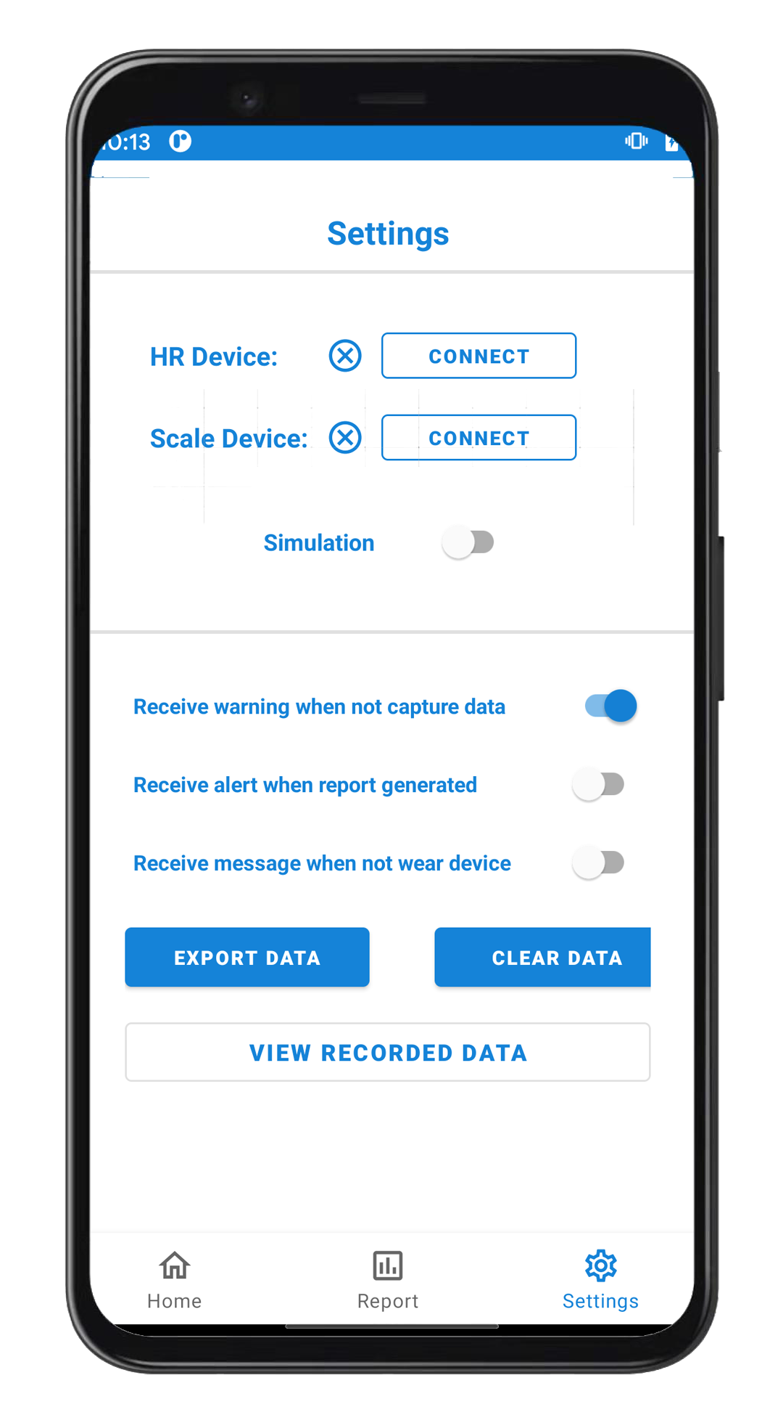
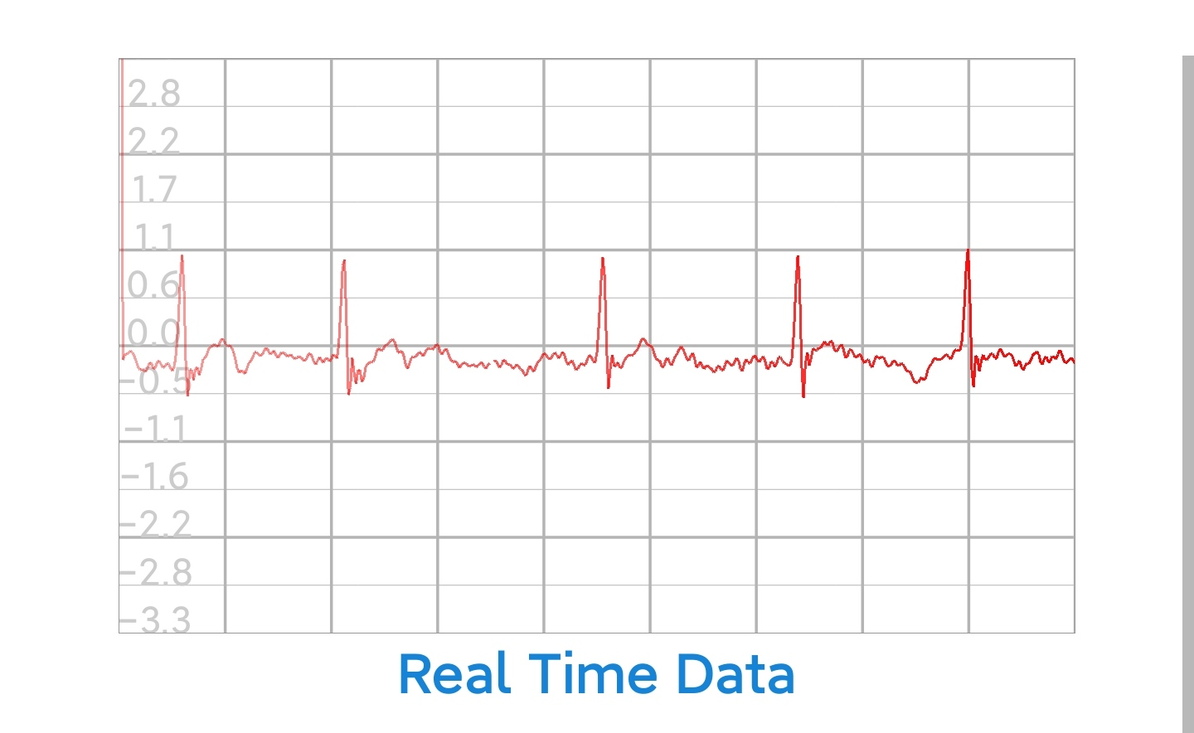


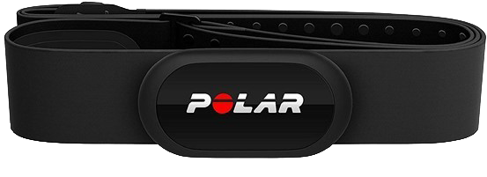
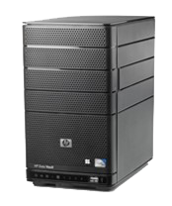
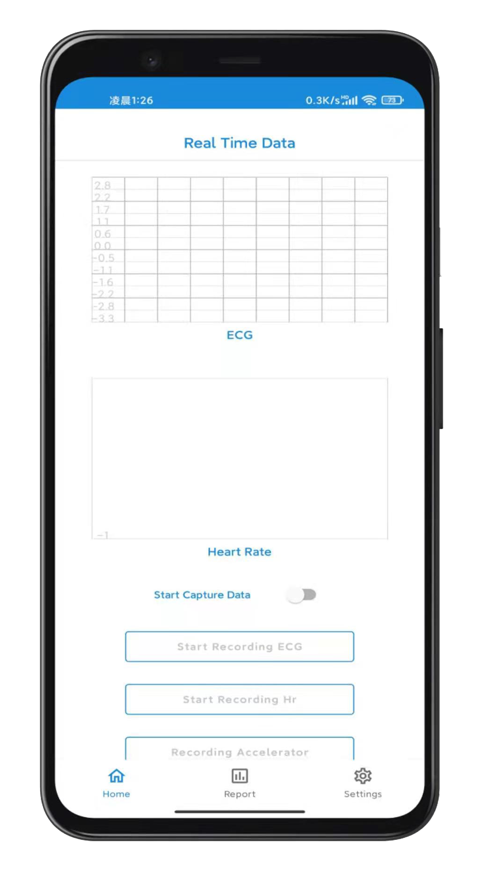
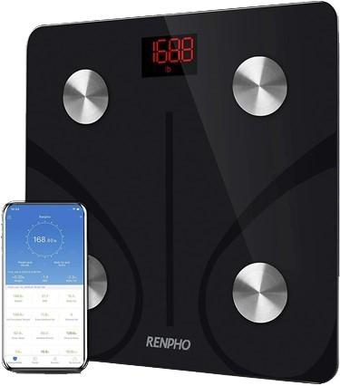

Group 19
Mobile System
for Monitoring Vital Signs
Haonan CHEN
Rongjiang YANG
Yiyang LI
Hudie LIU
Xiaotian XIA
Vital signs like ECG, heart rate, body weight and so on reflect the health conditions of people. Mobile applications for health monitoring are already on the market but the functionalities are limited.
Our project enable to connect with multiple vital sign devices, satisfy simultaneously the requirements of accuracy of capturing data, safe data transfer and storage, and advanced analyses with medical-grade algorithms.
This system is a prototype that enables connectivity of four devices and represents a basis for future Internet of Things (IoT) enabled uses.
IoT System
User
Data Exchange
Center
Real-time view
&Alert
Encrypted Data
Capture Data
Polar H10
Export Data
Send Results
Advanced
Analysis
Capture Data
Local Server
(long-term storage)
Process Data
(Clean, standardize)
Yunmai Scale
Our Android Application (temporary storage)
Professional medical analysis

