Slide 1

Control Structures
Decisive making in C++
Lecture 3

Slide 2
Description
In this chapter we will learn the conditional statement such as if statement and switch case which is used to control different action for different decision.

Slide 3
Control Structures
Sequential execution
Statements executed in order
Transfer of control
Next statement executed not next one in sequence
3 control structures (Bohm and Jacopini)
Sequence structure
Programs executed sequentially by default
Selection structures
if, if/else, switch
Repetition structures
while, do/while, for

Slide 4
Control Structures
C++ keywords
Cannot be used as identifiers or variable names

Slide 5
Control Structures
Flowchart
Graphical representation of an algorithm
Special-purpose symbols connected by arrows (flowlines)
Rectangle symbol (action symbol)
Any type of action
Oval symbol
Beginning or end of a program, or a section of code (circles)

Slide 6
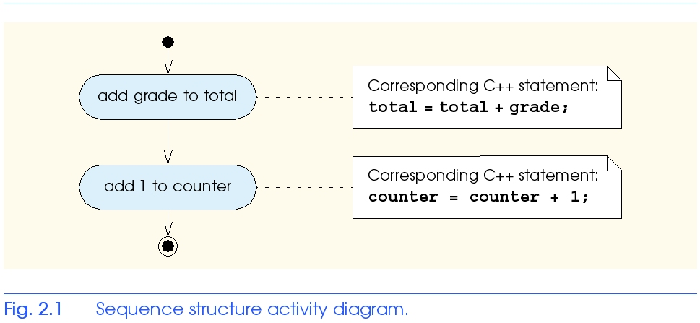
Control Structures

Slide 7
if Selection Structure
Selection structure
Choose among alternative courses of action
Pseudocode example:
If student’s grade is greater than or equal to 60
Print “Passed”
If the condition is true
Print statement executed, program continues to next statement
If the condition is false
Print statement ignored, program continues
Indenting makes programs easier to read
C++ ignores whitespace characters (tabs, spaces, etc.)

Slide 8
if Selection Structure
Translation into C++
If student’s grade is greater than or equal to 60
Print “Passed”
if ( grade >= 60 ) cout << "Passed";
Diamond symbol (decision symbol)
Indicates decision is to be made
Contains an expression that can be true or false
Test condition, follow path
if structure
Single-entry/single-exit

Slide 9
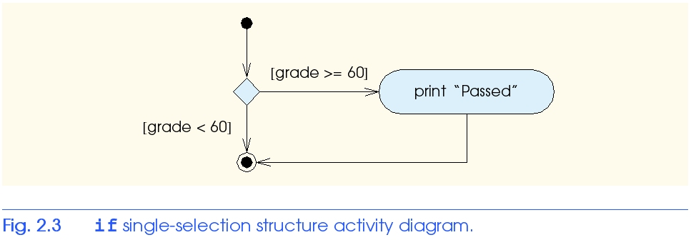
if Selection Structure
Flowchart of pseudocode statement
A decision can be made on any expression.
zero - false
nonzero - true
Example:
3 - 4 is true

Slide 10
if/else Selection Structure
if
Performs action if condition true
if/else
Different actions if conditions true or false
Pseudocode
if student’s grade is greater than or equal to 60 print “Passed”
else
print “Failed”
C++ code
if ( grade >= 60 ) cout << "Passed"; else cout << "Failed";

Slide 11
if/else Selection Structure
Ternary conditional operator (?:)
Three arguments (condition, value if true, value if false)
Code could be written:
cout << ( grade >= 60 ? “Passed” : “Failed” );
Condition
Value if true
Value if false

Slide 12
if/else Selection Structure
Nested if/else structures
One inside another, test for multiple cases
Once condition met, other statements skipped
if student’s grade is greater than or equal to 90 Print “A”
else if student’s grade is greater than or equal to 80 Print “B” else if student’s grade is greater than or equal to 70 Print “C” else if student’s grade is greater than or equal to 60 Print “D” else
Print “F”

Slide 13
if/else if Selection Structure
Example
if ( grade >= 90 ) // 90 and above cout << "A"; else if ( grade >= 80 ) // 80-89 cout << "B"; else if ( grade >= 70 ) // 70-79 cout << "C"; else if ( grade >= 60 ) // 60-69 cout << "D"; else // less than 60 cout << "F";

Slide 14
if/else Selection Structure
Compound statement
Set of statements within a pair of braces
if ( grade >= 60 ) cout << "Passed.\n"; else { cout << "Failed.\n"; cout << "You must take this course again.\n"; }
Without braces,
cout << "You must take this course again.\n";
always executed
Block
Set of statements within braces

Slide 15
switch Multiple-Selection Structure
Test variable for multiple values
Series of case labels and optional default case
switch ( variable ) { case value1: // taken if variable == value1
statements
break; // necessary to exit switch
case value2:
case value3: // taken if variable == value2 or == value3
statements
break;
default: // taken if variable matches no other cases
statements break;
}

Slide 16
The following rules apply to a switch statement −
The variable used in a switch statement can only be integers, convertable integers (byte, short, char), strings and enums.
You can have any number of case statements within a switch. Each case is followed by the value to be compared to and a colon.
The value for a case must be the same data type as the variable in the switch and it must be a constant or a literal.
When the variable being switched on is equal to a case, the statements following that case will execute until a break statement is reached.

Slide 17
When a break statement is reached, the switch terminates, and the flow of control jumps to the next line following the switch statement.
Not every case needs to contain a break. If no break appears, the flow of control will fall through to subsequent cases until a break is reached.
A switch statement can have an optional default case, which must appear at the end of the switch. The default case can be used for performing a task when none of the cases is true. No break is needed in the default case.

Slide 18
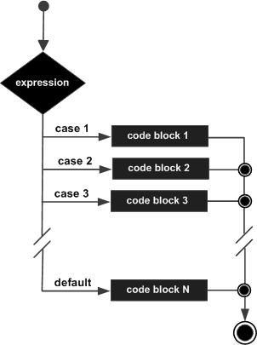
Flow Chart

Slide 19
public class Test {
public static void main(String args[]) {
// char grade = args[0].charAt(0);
char grade = 'C';
switch(grade) {
case 'A' :
System.out.println("Excellent!");
break;
case 'B' :
case 'C' :
System.out.println("Well done");

Slide 20
break;
case 'D' :
System.out.println("You passed");
case 'F' :
System.out.println("Better try again");
break;
default :
System.out.println("Invalid grade");
}
System.out.println("Your grade is " + grade);
}
}

Slide 21
Summary
If condition statement
Flow chart for if condition statement
Compound statement
If-else statement
If-else if statement
Switch statement and its flow chart

Slide 22
Thank You

