Slide 1
Computer Programming-1
CSC 111
Chapter 1 : Introduction

Slide 2
Chapter Outline
What a computer is
What a computer program is
The Programmer’s Algorithm
How a program that you write in Java is changed into a form that your computer can understand
Characteristics of Java
Page <number>
Dr. S. GANNOUNI & Dr. A. TOUIR
Introduction to OOP

Slide 3
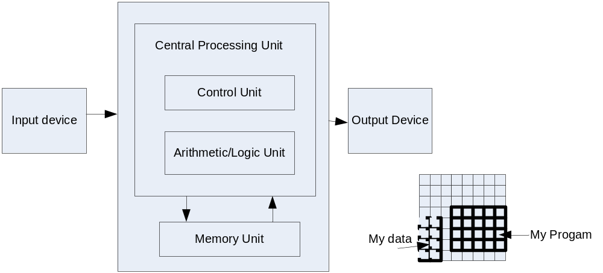
What Is a Computer?
Computer
  Executes statements (computations/logical decisions)
Hardware :Physical devices of computer system
Software: Programs that run on computers
Page <number>
Dr. S. GANNOUNI & Dr. A. TOUIR
Introduction to OOP

Slide 4
Computer Organization
Six logical units of computer system
  Input unit (Mouse, keyboard)
  Output unit (Printer, monitor, audio speakers)
  Memory unit (Retains input and processed information)
  Central processing unit (CPU) which consists of:
    Control unit (Supervises operation of other devices)
    Arithmetic and logic unit (ALU) (Performs calculations)
  Secondary storage unit (Hard drives, floppy drives)
Page <number>
Dr. S. GANNOUNI & Dr. A. TOUIR
Introduction to OOP

Slide 5
What a computer program is?
For a computer to be able to perform specific tasks (i.e. print what grade a student got on an exam), it must be given instructions to do the task.
The set of instructions that tells the computer to perform specific tasks is known as a computer program
Page <number>
Dr. S. GANNOUNI & Dr. A. TOUIR
Introduction to OOP

Slide 6
Levels of Abstraction
Human thought
Pseudo-Natural Language (English, Arabic)
High Level Programming Language (C, C++, Java, …)
Machine Code
Page <number>
Dr. S. GANNOUNI & Dr. A. TOUIR
Introduction to OOP

Slide 7
The Programmer’s Algorithm
An algorithm is a finite sequence of instructions that produces a solution to a problem.
The programmer’s algorithm:
  Define the problem.
  Plan the problem solution.
  Code the program.
  Compile the program.
  Run the program.
  Test and debug the program.
Page <number>
Dr. S. GANNOUNI & Dr. A. TOUIR
Introduction to OOP

Slide 8
Defining the Problem
The problem must be defined in terms of:
  Input: Data to be processed.
  Output: The expected result.
    Look for nouns in the problem statement that suggest output and input.
  and processing: The statements to achieve.
    Look for verbs to suggest processing steps.
input data
output data
Keyboard
Processing
Screen
Page <number>
Dr. S. GANNOUNI & Dr. A. TOUIR
Introduction to OOP

Slide 9
Input and Output
Inputs
  Can come from many sources, such as users, files, and other programs
  Can take on many forms, such as text, graphics, and sound
Outputs
  Can also take on many forms, such as numbers, text, graphics, sounds, or commands to other programs
Page <number>
Dr. S. GANNOUNI & Dr. A. TOUIR
Introduction to OOP

Slide 10
Example 1
Area and Perimeter of a rectangle
Input
  Length
  width
Processing
  Area = length*width
  Perimeter = 2*( length + width)
Output
  Area
  Perimeter
Page <number>
Dr. S. GANNOUNI & Dr. A. TOUIR
Introduction to OOP

Slide 11
Example 2
Sum and Average of 5 numbers
Input
  five number x1, x2, x3, x4, x5
Processing
  Sum = x1+x2+x3+x4+x5
  Average = Sum/5
Output
  Sum
  Average
Page <number>
Dr. S. GANNOUNI & Dr. A. TOUIR
Introduction to OOP

Slide 12
Example 3
Area and Perimeter of a circle
Input
  Radius
  PI
Processing
  Area = PI * Radius * Radius
  Perimeter = 2 * PI * Radius
Output
  Area
  Perimeter
Page <number>
Dr. S. GANNOUNI & Dr. A. TOUIR
Introduction to OOP

Slide 13
Planning the Solution
When planning, algorithms are used to outline the solution steps using Englishlike statements, called pseudocode.
Page <number>
Dr. S. GANNOUNI & Dr. A. TOUIR
Introduction to OOP

Slide 14
Coding the Program
Coding is writing the program in a formal language called Programming Language.
    Programming Language : A set of rules, symbols and special words used to write statements.
The program is written by translating the algorithm steps into a programming language statements.
The written program is called Source code and it is saved in a file with “.java” extension.
Algorithm
Pseudocode
Coding
Translating
Program
Source Code
(The “.java”)
Page <number>
Dr. S. GANNOUNI & Dr. A. TOUIR
Introduction to OOP

Slide 15
Why Coding in Programming Languages
We write computer programs (i.e. a set of instructions) in programming languages such as C, C++, and Java.
We use these programming languages because they are easily understood by humans
But then how does the computer understand the instructions that we write?
Page <number>
Dr. S. GANNOUNI & Dr. A. TOUIR
Introduction to OOP

Slide 16
Compiling Computer Programs
Computers do not understand programs written in programming languages such as C++ and Java
Programs must first be converted into machine code that the computer can run
A Software that translates a programming language statements into machine code is called a compiler
Program
Source code
Compiling
Translating
Machine code
Machine Code
Page <number>
Dr. S. GANNOUNI & Dr. A. TOUIR
Introduction to OOP

Slide 17
Programming Language Compiler
A compiler is a software that:
  Checks the correctness of the source code according to the language rules.
    Syntax errors are raised if some rules were violated.
  Translates the source code into a machine code if no errors were found.
Page <number>
Dr. S. GANNOUNI & Dr. A. TOUIR
Introduction to OOP

Slide 18
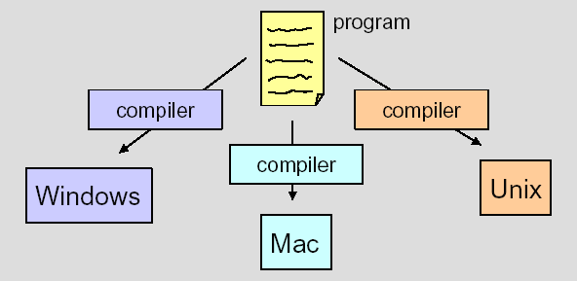
Platform dependent Compiling
Because different platforms, or hardware architectures along with the operating systems (Windows, Macs, Unix), require different machine code, you must compile most programs separately for each platform.
Page <number>
Dr. S. GANNOUNI & Dr. A. TOUIR
Introduction to OOP

Slide 19

Compiling Java Programs
The Java compiler produces bytecode (a “.class” file) not machine code from the source code (the “.java” file).
Bytecode is converted into machine code using a Java Interpreter
Source Code
Bytecode
Page <number>
Dr. S. GANNOUNI & Dr. A. TOUIR
Introduction to OOP

Slide 20
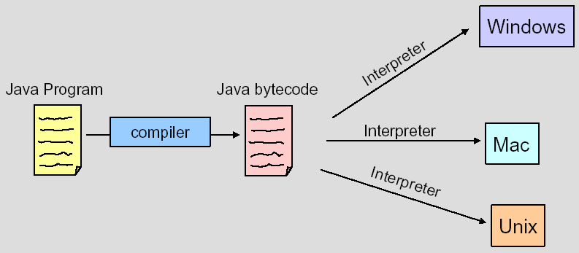
Platform Independent
Java Programs Compiling
You can run bytecode on an computer that has a Java Interpreter installed
“Hello.java”
“Hello.class”
Page <number>
Dr. S. GANNOUNI & Dr. A. TOUIR
Introduction to OOP

Slide 21
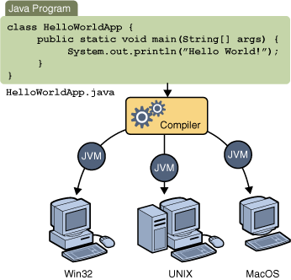
Multipurpose Java Compiling
Page <number>
Dr. S. GANNOUNI & Dr. A. TOUIR
Introduction to OOP

Slide 22
Running The Program
Class
Loader
Running
Bytecode
Verifier
The Bytecode
(the “.class” file)
Bytecode
Interpreter
JVM
Operating System
Hardware
Page <number>
Dr. S. GANNOUNI & Dr. A. TOUIR
Introduction to OOP

Slide 23
The Java Virtual Machine Components
The Class Loader
    stores bytecodes in memory
Bytecode Verifier
    ensures bytecodes do not violate security requirements
Bytecode Interpreter
    translates bytecodes into machine language
Page <number>
Dr. S. GANNOUNI & Dr. A. TOUIR
Introduction to OOP

Slide 24
The Java Virtual Machine
The class Loader, the Bytecode Verifier and Interpreter constitute the Java Virtual Machine (JVM).
JVM is platform specific.
The interpreter translates the bytecodes into specific machine commands.
Page <number>
Dr. S. GANNOUNI & Dr. A. TOUIR
Introduction to OOP

Slide 25
Testing and Debugging the Program
Testing
  Be sure that the output of the program conforms with the input.
  There are two types of errors:
    Logical Errors: The program run but provides wrong output.
    Runtime errors: The program stop running suddenly when asking the OS executing a non accepted statement (divide by zero, etc).
Debugging
  Find, Understand and correct the error
Page <number>
Dr. S. GANNOUNI & Dr. A. TOUIR
Introduction to OOP

Slide 26
Editor
Program is created in an editor and stored on disk in a file ending with .java.
Phase 1
Disk
Phase 2
Compiler
Disk
Compiler creates bytecodes and stores them on disk in a file ending with .class.
Primary
Memory
Phase 3
Class Loader
Class loader reads .class files containing bytecodes from disk and puts those bytecodes in memory.
Disk
.
.
.
.
.
.
Primary
Memory
Phase 4
Bytecode Verifier
Bytecode verifier confirms that all bytecodes are valid and do not violate Java’s security restrictions.
.
.
.
.
.
.
Primary
Memory
Phase 5
Interpreter
Interpreter reads bytecodes and translates them into a language that the computer can understand, possibly storing data values as the program executes.
.
.
.
.
.
.
Page <number>
Dr. S. GANNOUNI & Dr. A. TOUIR
Introduction to OOP

Slide 27
Some Characteristics of Java
Object-Oriented
  Combines data and behavior into one unit➔ objects
  Provides Data abstraction and encapsulation
  Decompose program into objects.
  Programs are collections of interacting and cooperating objects.
Platform-independent
  Portable
  Architecture neutral
  ”Write-once, run-anywhere”
Secure
  The bytecode verifier of the JVM :
    checks untrusted bytecode
    controls the permissions for high level actions.
Page <number>
Dr. S. GANNOUNI & Dr. A. TOUIR
Introduction to OOP

