Slide 1
Chapter 2: Java Fundamentals
Variables, Constants and Built-in Data Types

Slide 2
Objectives
Discovering what is a variable
Discovering what is a data type
Learning about the basic data types
Constants and variables identifiers
Get acquainted with how to select proper types for numerical data.
Write arithmetic expressions in Java.

Slide 3
Programs and Data
input data
output data
Keyboard
Processing
Screen
Most programs require the temporary storage of data. The data to be processed is stored in a temporary storage in the computer's memory: space memory.
A space memory has three characteristics
    Identifier
    Data Type
    State

Slide 4
State of the Space Memory
The state of the space memory is the current value (data) stored in the space memory.
The state of the space memory:
    May be changed.
      In this case the space memory is called variable.
    Cannot be changed.
      In this case the space memory is called constant.

Slide 5
Space Memory Identifier
Identifier is a sequence of characters that denotes the name of the space memory to be used.
    This name is unique within a program.
Identifier Rules
  It cannot begin with a digit (0 – 9).
  It may contain the letters a to z, A to Z, the digits 0 to 9, and the underscore symbol, _.
  No spaces or punctuation, except the underscore symbol, _, are allowed.

Slide 6
Identifier Conventions in Java
Constants:
    All uppercase, separating words within a multiword identifier with the underscore symbol, _.
Variables
  All lowercase.
  Capitalizing the first letter of each word in a multiword identifier, except for the first word.

Slide 7
Identifiers are Case-Sensitive
Identifiers in Java are case-sensitive. Thus, the identifiers myNumber and mynumber, are seen as two different identifiers by the compiler.

Slide 8
Data Type
The data type defines what kinds of values a space memory is allowed to store.
All values stored in the same space memory should be of the same data type.
All constants and variables used in a Java program must be defined prior to their use in the program.

Slide 9
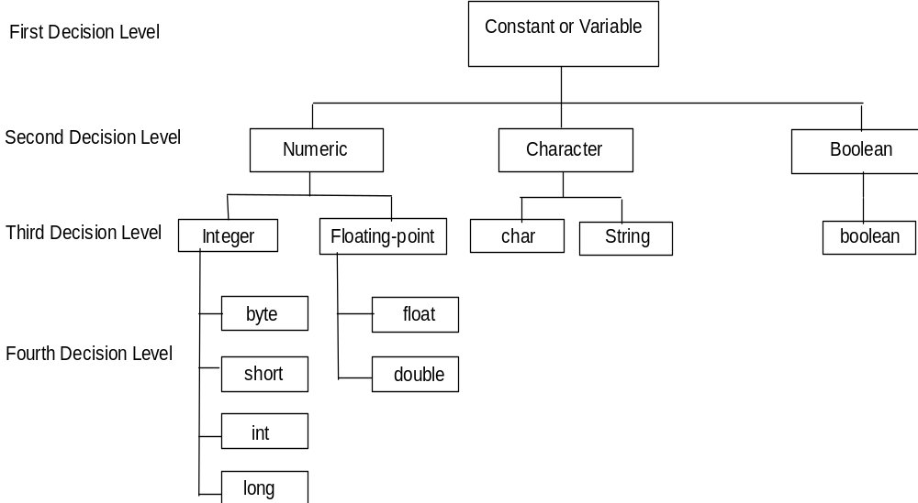
Java built-in Data Types

Slide 10
Primitive Data Types
Type | Size (bits) | Range | Description
boolean |  | true, false | Stores a value that is either true or false.
char | 16 |  | Stores a single 16-bit Unicode character.
byte | 8 | -128 to +127 | Stores an integer.
short | 16 | -32768 to +32767 | Stores an integer.
int | 32 bits | -2,147,483,648 to +2,147,483,647 | Stores an integer.
long | 64 bits | -9,223,372,036,854,775,808 to +9,223,372,036,854,775,807 | Stores an integer.
float | 32 bits | accurate to 8 significant digits | Stores a single-precision floating point number.
double | 64 bits | accurate to 16 significant digits | Stores a double-precision floating point number.

Slide 11
Variable/Constant Declaration
When the declaration is made, memory space is allocated to store the values of the declared variable or constant.
The declaration of a variable means allocating a space memory which state (value) may change.
The declaration of a constant means allocating a space memory which state (value) cannot change.

Slide 12
Constant Declaration
final dataType constIdentifier = literal | expression;
final double PI = 3.14159;
final int MONTH_IN_YEAR = 12;
final short FARADAY_CONSTANT = 23060;
final int MAX = 1024;
final int MIN = 128;
final int AVG = (MAX + MIN) / 2;
The reserved word final is used to declare constants.
These are constants, also called named constant.
These are called literals.
This is called expression.

Slide 13
Variable Declaration
A variable may be declared:
  With initial value.
  Without initial value.
Variable declaration with initial value;
  dataType variableIdentifier = literal | expression;
  double avg = 0.0;
  int i = 1;
  int x =5, y = 7, z = (x+y)*3;
Variable declaration without initial value;
dataType variableIdentifier;
  double avg;
  int i;

