Slide 1
Chapter 2: Java Fundamentals
Input and Output statements

Slide 2
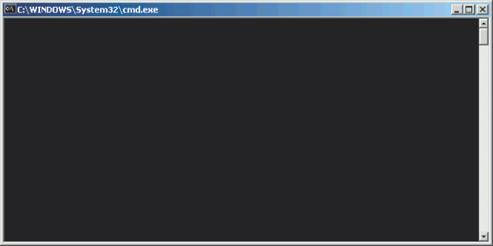
Standard Output Window
Using System.out, we can output multiple lines of text to the standard output window.
The exact style of standard output window depends on the Java tool you use.

Slide 3
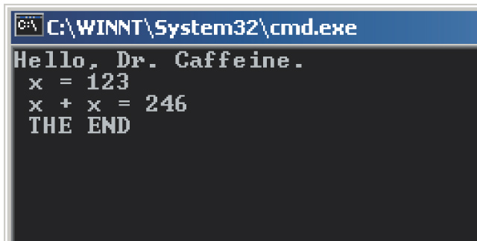
The println Method
We use println instead of print to skip a line.
    int x = 123, y = x + x;
    System.out.println( "Hello, Dr. Caffeine.“ );
    System.out.print( " x = “ );
    System.out.println( x );
    System.out.print( " x + x = “ );
    System.out.println( y );
    System.out.println( " THE END“ );

Slide 4
Standard Input
To input primitive data values, we use the Scanner class.
4 steps are needed to be able to use input primitive:
  Step 1: import the Scanner class:
    import Java.util.Scanner;
  Step 2 : declaring a reference variable of a Scanner
    Scanner read ; //we named the object read
  Step 3: creating an instance of the Scanner
    read = new Scanner (System.in);
  Step 4: use specific methods to enter data
    int x = read.nextInt();

Slide 5
Example
    1 import Java.util.Scanner;
    2 Scanner input ; // declaring the reference variable of a Scanner
    3 int area ,length, width; // declaring variables to store entries
    4 input = new Scanner (System.in); // creating an instance
    5 length = input.nextInt(); //reading the length from the keyboard
    6 width = input.nextInt(); //reading the width from the keyboard
    7 area = length * width ; // computing the area
    // displaying the result
    8 System.out.println(“the legnth is ”+ lenght);
    9 System.out.println(“the width is ”+ width);
    10 System.out.println(“the area is ”+ area);

Slide 6
Common Scanner Methods
Method Example
Scanner input = new Scanner (System.in);
nextByte( ) byte b = input.nextByte( );
nextDouble( ) double d = input.nextDouble( );
nextFloat( ) float f = input.nextFloat( );
nextInt( ) int i = input.nextInt( );
nextLong( ) long l = input.nextLong( );
nextShort( ) short s = input.nextShort( );
next() String str = input.next();

