Slide 1
Chapter3: Introduction to Classes and Objects
Classes and Objects: Definitions

Slide 2
Objectives
What is an object
What is a class
UML representation of a class
Objects and Instance variables
Primitive types and reference type
Practical Organization

Slide 3
Let’s consider the following
Let’s consider two doors D1 and D2.
We aim to develop an application monitoring these doors.
What actions may be applied on these doors:
    Open and close.

Slide 4
Procedural Programming
In Procedural programming:
    The doors are considered as passive entities of the real world with no interaction with their environments.
    Two robots (procedures) with specific roles are created: one for Opening doors, the other for closing.
         Open(doorId)  Close(doorId)
    In order to open or to close a given door, the user should:
      Order the appropriate robot to perform the required action on the specified door.
        Open(d); or
        Close(d); where d is either D1 or D2

Slide 5
Object Oriented Programming
In Object-Oriented programming:
    The doors are considered as active entities of the real world capable of interacting with their environments.
    Each one of them offers two services open and close.
         Open()  Close()
    In order to open or to close a door, the user should:
      Order the appropriate door to perform the required action.
        d.Open(); or
        d.Close(); where d is either D1 or D2

Slide 6
Objects
Objects are key-concept to understand object-oriented technology.
Objects are entities of the real-world that may interact with their environments by performing services on demand.
Examples of real-world objects: your Car, your Cell-phone, the coffee slot-machine.
Each Nokia-N71 cell-phone is an object and may execute some services.

Slide 7
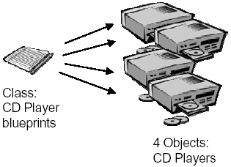
Classes
Objects of the real world may be classified into types: Cars, Cell-Phones, CD Players, etc.
Objects of the same type have the same characteristics and are manufactured using the same blueprint.
A class is a blueprint or prototype from which objects of the same type are created.
A class describes a set of objects having the same characteristics and offering the same services.

Slide 8
Object Oriented Basic Principles
Abstraction
Encapsulation
Information Hiding
Message Passing
Overloading
Inheritance
Overriding
Polymorphism
Dynamic Binding
Information hiding, Message passing and Overloading are covered by chapter 5 of this course.
Inheritance, Polymorphism, Overriding and Dynamic binding are discussed in CSC 113.

Slide 9
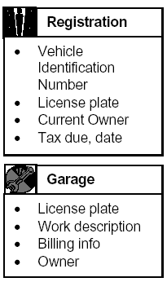
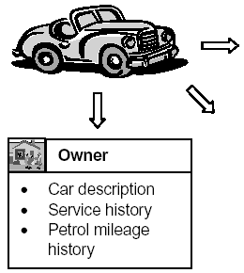
Abstraction Principle
Data Abstraction
  In order to process something from the real world we have to extract the essential characteristics of that object.
  Data abstraction is the process of:
    Refining away the unimportant details of an object,
    Keeping only the useful characteristics that define the object.
  For example, depending on how a car is viewed (e.g. in terms of something to be registered, or alternatively something to be repaired, etc.) different sets of characteristics will emerge as being important.
Functionality Abstraction
  Modeling functionality suffers from
    unnecessary functionality may be extracted,
    or alternatively, an important piece of functionality may be omitted.
  Functionality abstraction is the process of determining which functionality is important.
view
view
view

Slide 10
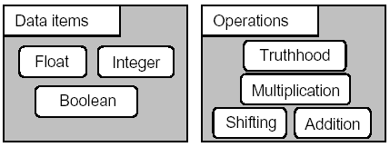
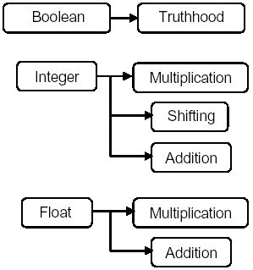
Encapsulation Principle
Abstraction involves reducing a real world entity to its abstraction essential defining characteristics.
Encapsulation extends this idea by also modeling and linking each data of an entity to the appropriate functionality of that entity.

Slide 11
Encapsulation Gives Classes
OOP makes use of encapsulation to ensure that data is used in an appropriate manner.
  by preventing from accessing data in a non-intended manner (e.g. asking if an Integer is true or false, etc.).
Through encapsulation, only a predetermined appropriate group of operations may be applied (have access) to the data.
Place data and the operations that act on that data in the same class.
Encapsulation is the OO principle that allows objects to contain the appropriate operations that could be applied on the data they store.
  My Nokia-N71 cell-phone stores:
    My contacts,
    Missed calls
    … etc.
  My Nokia-N71 may perform the following operations on the data it contains:
    Edit/Update/Delete an existing contact
    Add a new contact
    Display my missed calls.
    …etc.

Slide 12
UML Representation of a Class
UML represents a class with a rectangle having 3 compartments stacked vertically.
    The top compartment shows the class's name.
    The middle compartment lists the attributes.
    The bottom compartment lists the operations: methods or services.
ClassName
att₁: dataType₁
…
att_{i}: dataType_{i}
Attributes
+ m₁(…): dataType₁
+ ...
+ m_{j}(…): dataType_{j}
Methods (Services)

Slide 13
Attribute
An attribute is an abstraction of a single characteristic possessed by all objects of the same class.
An attribute has a name unique within the class.
There are two types of attributes:
    Class attributes
        Independent of any object and their values are shared by all objects of the class.
    Instance attributes
        Dependent to the objects and their values are associated with and accessed through objects.

Slide 14
Declaring a Class with Java
ClassName
att₁: dataType₁
…
att_{i}: dataType_{i}
Attributes
+ m₁(…): dataType₁
+ ...
+ m_{j}(…): dataType_{j}
Methods (Services)
public class ClassName {
// Attributes
// Methods (services)
}

Slide 15
Declaring Attributes With Java
  <modifiers> <data type> <attribute name> ;
Modifiers
Data Type
Name
  public String studentName ;

Slide 16
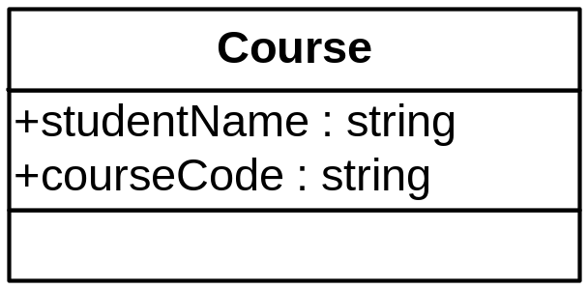
Example of a Class Declaration with Java
public class Course {
// Attributes
public String studentName;
public String courseCode ;
// No method Members
}

